Slide 1

SWEATSHOP REGULATION AND WORKER CHOICES
who was it?
Idris (11304617)
when was it?

Slide 2
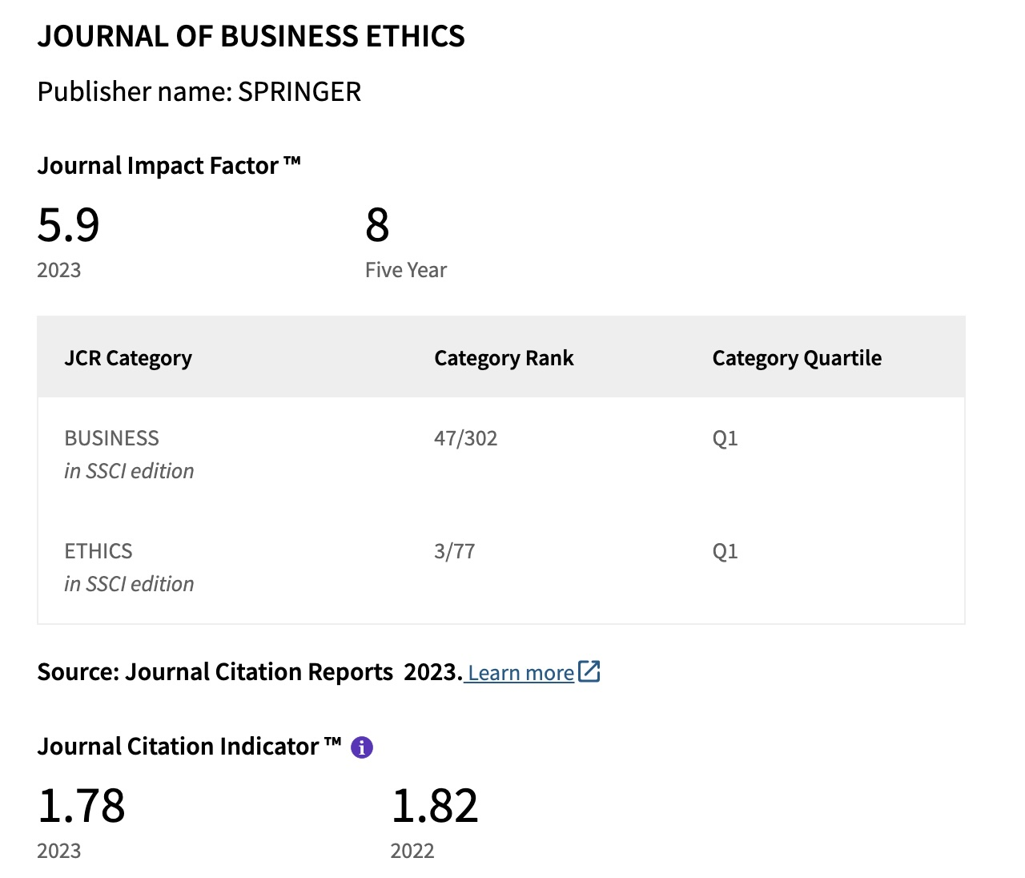
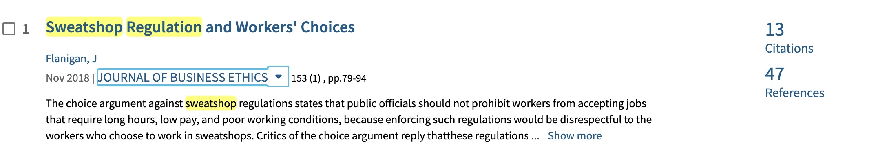
JOURNAL INFORMATION

Slide 3
REASONING
The reason why choosing this article:
The chosen paper fits the requirements.
The paper is interesting and crucial ethical practice for stakeholders, companies, and employees in term of sweatshop regulation and free choice for worker
The paper emphasizes that workers voluntarily choose sweatshop labor because it's better than their alternatives .
The paper Introduces the argument that while regulation might improve conditions, it could also harm the very workers it intends to help by reducing employment opportunities or shifting jobs elsewhere .
wordart

Slide 4
PAPER STRENGTH
Defense Autonomy
officials should not interfere with workers' ability to choose to work in sweatshops, as doing so would be a violation of their autonomy. This respect for autonomy provides a compelling ethical foundation
Empirical and Moral Uncertainty
Who?
How?
The risks associated with regulating sweatshops in the face of empirical and moral uncertainty
Critique of Paternalism
Risk of Economic Harm
The regulations, which are meant to improve workers' conditions by limiting choices, can be paternalistic and morally risky
When?
Where?
The paper brings attention to the potential economic harms of regulation, such as unemployment and the relocation of businesses to less regulated areas
Why?
Clue?
Coordination Problems
Pluralistic Foundation
The paper addresses the criticism that sweatshop workers face coordination problems that prevent them from collectively demanding better conditions
The paper accommodates different moral perspectives, including libertarian views that stress non-interference with permissible choices and liberal views that value workers’ autonomy highly

Slide 5
WHAT CAN I LEARN?
What I can learn from the paper is that the author provides a strong argument in the introduction, such as setting up the central debate of the regulation and the dilemma between respecting workers' choices to work in sweatshops.
The paper is a conventional review and inspires me to make other ethical issue by using the same method but in a systematic literature review

Slide 6
FUTURE WRITING
TOPIC: Sweetshop and poor working condition in tourism Industry
RESEARCH QUESTION (RQ):
  What is the most ethical issue related to the tourism industry studied in the last decade?
  How do stakeholders overcome Sweetshop and poor working condition issue in tourism Industry in the last decade?
METHOD: Systematic literature review
  PRISMA (Preferred Reporting Items for Systematic Reviews and Meta-Analyses)
  Database: Scopus and WoS
  Data analysis: Bibliometric and content analysis

Slide 7


