Slide 1
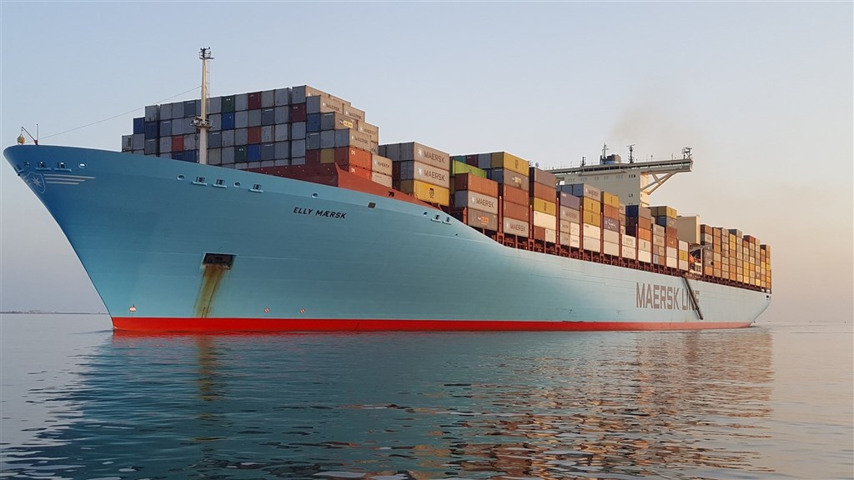
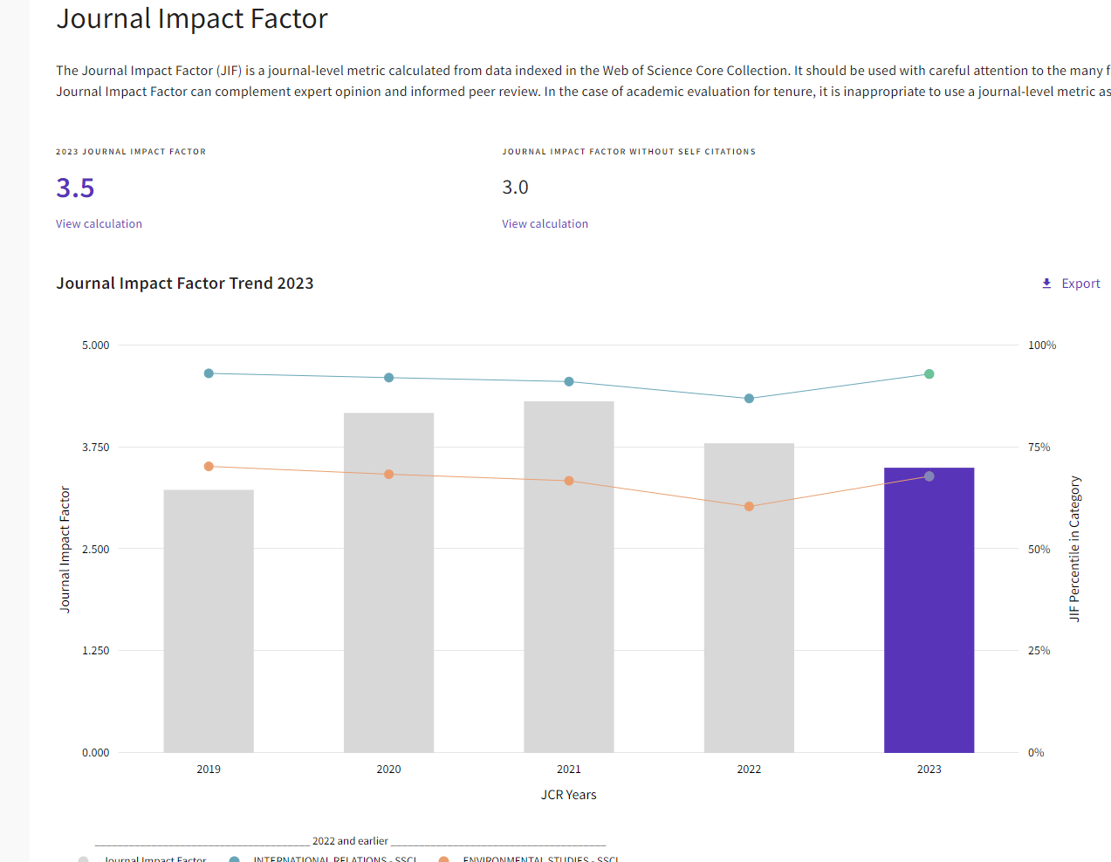
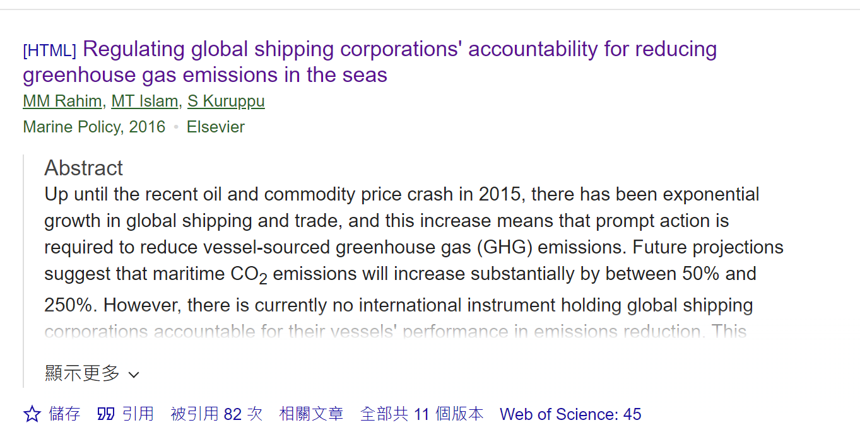
About this paper
Regulating global shipping corporations' accountability for reducing greenhouse gas emissions in the seas
Notes:
The Impact Factor of this article is 3point5. Regarding the number of citations, I used [Google Scholar] to query, and the number of citations was 82. In addition, this article was published in 2016.

Slide 2

Global Warming
Shipping corporations' accountability regulation
Advantages of this article
Notes:
Over the past century, large-scale burning of fossil fuels, such as coal and oil, has increased the concentration of carbon dioxide in the atmosphere. This, coupled with the large-scale reclamation of forest land, expansion of agricultural and industrial development, has led to increasingly high concentrations of greenhouse gases. Over a century of accumulation, excess greenhouse gases in the atmosphere have caused global warming. This article takes shipping companies as an example and analyzes that the greenhouse gases produced by ships account for approximately 3% of total global greenhouse gas (GHG) emissions. This number is large and growing rapidly. Some believe that if no action is taken, this number will increase to 18% by 2050.
The current regulatory framework designed to help shipping companies address issues related to the impact of greenhouse gas emissions from their ships on global climate change is considered woefully inadequate. Within the global greenhouse gas reduction framework, all regulatory models are country-centric. Unfortunately, the different countries were not cohesive; they failed to develop any comprehensive mechanism for shipping companies to be effectively integrated into the framework. The topic of my future thesis will be [the impact on the company after the company reduces carbon]. I am currently working in a consulting company to assist companies in calculating carbon emissions and reducing carbon emissions. Moreover, all countries are expected to be carbon neutral by 2050, and reducing carbon emissions will be the future trend.

