Slide 1

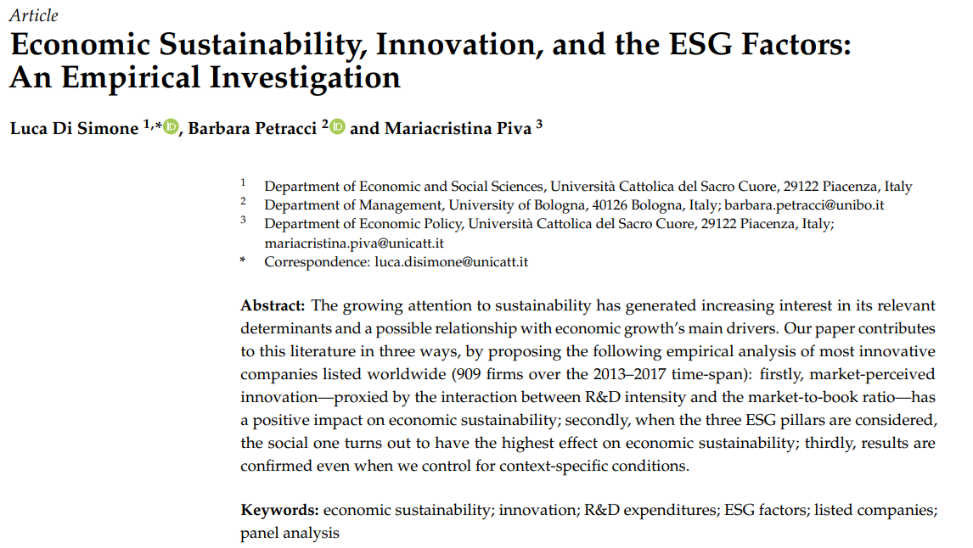
PROFESSOR：GLORIA CHENG
YANG CHONG CHENG(DOUBLE)
CHUNG YUAN CHRISTIAN UNIVERSITY

Slide 2
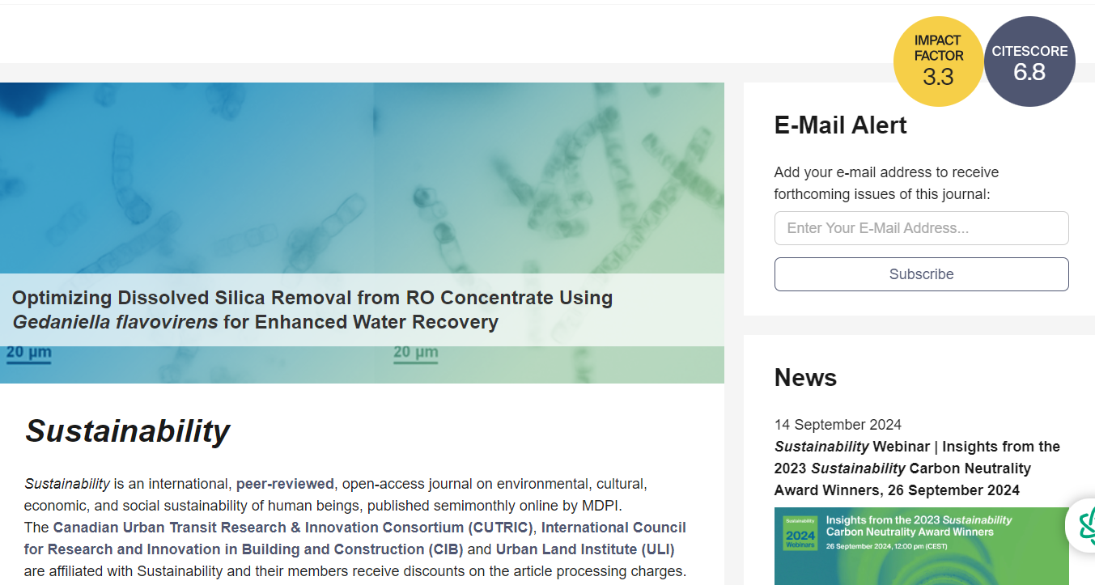

Slide 3
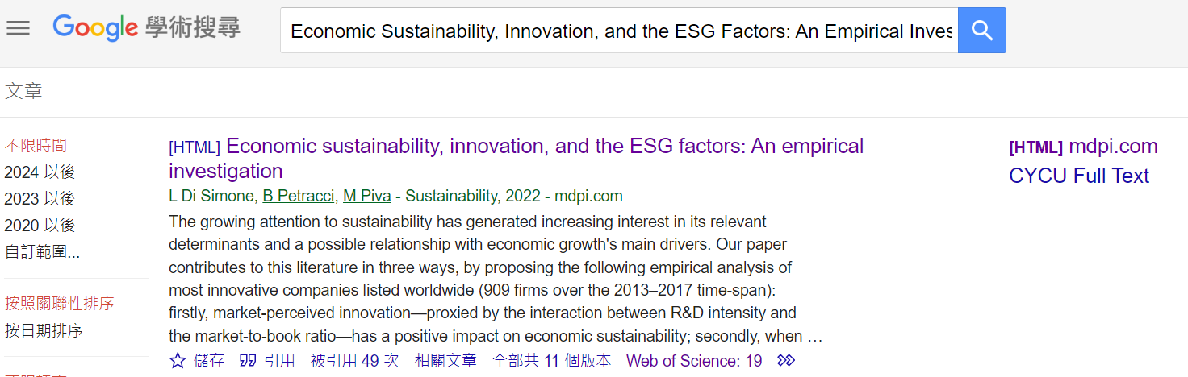

Slide 4
WHY？
Research Interest: I am focused on exploring the social aspect of ESG (Environmental, Social, and Governance), particularly the contributions of corporations to health and well-being.
Core Topic: This paper discusses the sustainability of innovative companies and evaluates the impact of the three ESG pillars on economic sustainability.
Key Findings: The study reveals that the "Social" pillar of ESG has the most significant impact on economic sustainability, which aligns with my research interest.

Slide 5
Application to my research
Focus on Health and Well-being in Corporate Behavior: The findings of this paper provide a solid theoretical foundation for exploring how companies can enhance employee health and well-being through the “Social” dimension of ESG.
Reference Value for Empirical Research: I can use the paper’s empirical methods and data analysis as a reference, especially in assessing the social impact of companies through corporate data.
Future Research Direction: My future research will explore how companies can improve community health through social responsibility and how these impacts can be quantified in terms of economic and social benefits.

