Slide 1
Political connections and corporate social responsibility:
Political incentives in China
Business Ethics by professor gloria
Presented by Avi Sunani (11304609)
24 October 2024

Slide 2
RESEARCH BACKGROUND
As a special form of business–government relationship, political connections are an important means of government intervention in firms.
Concurrently, political connections are an important channel for Chinese firms to access government protection and valuable resources, such as lower taxation, privileged access to debt financing from government-controlled banks and relaxed government oversight (Claessens, Feijen, & Laeven, 2008; Wu, Wu, Zhou, & Wu, 2012).

Slide 3
RESEARCH BACKGROUND
The Chinese government has an absolute power advantage in the business–government relationship.
Enterprises will potentially be required to undertake certain CSR in exchange for trust and resources; otherwise, the government has the power to prevent them from acquiring what they want.
Thus, catering to the government to compete for political resources could be an important factor that induces Chinese firms to assume social responsibility.

Slide 4
RESEARCH BACKGROUND
This paper further integrates the RDT and social exchange theory (SET) into the literature on political CSR (Shirodkar et al., 2018).
This research attempts to investigate the role of the government in driving CSR activities from multiple perspectives by answering two questions:
(1) What is the impact of political connections on CSR performance in China?
(2) Are the effects likely to be different depending on the level of dependence on the government for legitimacy and acquisition of resources?

Slide 5
Political connection
According to Faccio (2006), corporate political connection is defined as “…at least one of its large shareholders (anyone controlling at least 10 percent of voting shares) or one of its top officers (CEO, president, vice-president, chairman, or secretary) is a member of parliament, a minister, or is closely related to a top politician or political party.”

Slide 6
Instances of Political connection
The Chinese government has sought to incorporate corporate elites (particularly successful entrepreneurs from privately controlled enterprises) into the political system by appointing them as delegates to the National People's Congress (NPC) or the Chinese People's Political Consultative Conference (CPPCC).
It has also appointed people who used to be officials as chairs of state-owned enterprises (SOEs).

Slide 7
Csr in china
CSR in China has two important attributes:
First, unlike the voluntary premise of Western CSR, most of the socially responsible behaviors of Chinese firms show characteristics of government orientation.
Second, CSR is a term that combines the harmony principles of Confucianism. Its core notion is building a harmonious society by ‘respecting nature and loving people’ (Wang & Juslin, 2009).

Slide 8
Political connection and Csr
Unlike the West, where enterprises can intervene in politics through political donation, China is a one-party dictatorship in which the central officials are elected by the party and local officials are all appointed by the superior government (Fan et al., 2007).
The Chinese government has an absolute power advantage in the business–government relationship.
Thus, enterprises will potentially be required to undertake certain social responsibilities in exchange for maintaining political ties; otherwise, the government will terminate the provision of subsidies.

Slide 9
Political connection and Csr
Politically connected firms are more likely to receive social and government attention than their nonconnected peers, resulting in added pressure to undertake CSR (Chiu & Sharfman, 2011).
Hypothesis 1 Politically connected companies demonstrate a higher level of CSR than their nonconnected peers.

Slide 10
market level development and Csr
In places where market institutions are less developed, the leading role of the government in the economy is stronger and the resources that can be brought to enterprises are scarcer and more important.
Thus, the government is more likely to become the key stakeholder affecting the companies’ survival and success, making it more common to seek the fulfilment of interests through political connections (Zhang et al., 2016).
Hypothesis 2a The pulling effect of political connections on CSR is stronger for firms in less market-oriented regions.

Slide 11
OWNERSHIP STRUCTURE and Csr
Due to the lack of common values between NSOEs and the government, the trust between them is not substantial. To maintain their hard-won political connections, NSOEs will have a stronger incentive to exchange CSR for government trust.
Political resources, such as bank loans, lower tax rates, protection of property rights, and relaxed government oversight, are particularly precious to NSOEs, causing them to place greater value on the opportunity to obtain such resources through political connections (Chen, Li, Su, & Sun, 2011).
Therefore, politically connected NSOEs will be more likely to be forced to assist the government in accepting social responsibility for the exchange of such resources.
Hypothesis 2b The pulling effect of political connections on CSR is stronger for NSOEs

Slide 12
FIRM SIZE AND CSR
Because of the larger power gap between SMEs and the government, they would be more answerable to the government and are required to respond to the governments’ needs quickly in exchange for more development opportunities.
CSR could be the outcome of the relational accumulating process through which SMEs build their social capital.
Hypothesis 2c The pulling effect of political connections on CSR is stronger for SMEs.

Slide 13
SAMPLE SELECTION
Sample consists of firms with A-shares listed on either the Shenzhen or Shanghai Stock Exchange from the 2008 to 2013 period.
Eliminate financial firms, as they operate under different regulations and have different equity financing activities than industrial firms.
This procedure yields a final sample of 911 observations for the period of 2008–2013. Table 1 shows the sample composition by industry group (as defined by the National Bureau of Statistics of China).
The manufacturing, transportation, and real estate sectors dominate the sample.

Slide 14
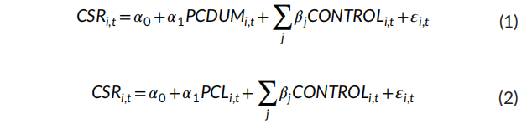
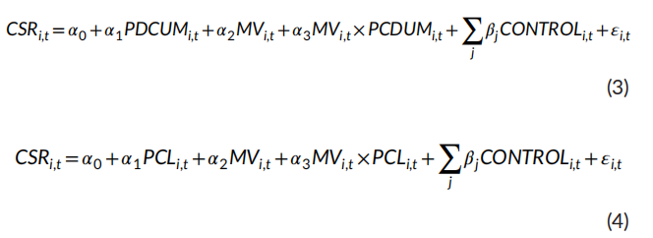
Regression variable
To test our hypothesis 1, we use ordinary least squares regression to examine the relationship between political connections and CSR from two aspects- whether there are political connections and the level of the connections.
To further test hypothesis 2a, hypothesis 2b and hypothesis 2c, we separately add the interaction between PCDUM (PCL) and SIZE (PROP or MARKET) to Model (1) and Model (2).

Slide 15
Variable definition
This paper further defines political connections in two ways: (a) the existing relationship, measured by whether one of the top officers (CEO, president, vice-president, chairman, or secretary) is an NPC delegate or CPPCC delegate; and (b) the former relationship, measured by whether one of the top officers has served as a government or military official.
We construct three dummy variables, RCDUM, GOVDUM, and PCDUM, as proxies for whether the firm is politically connected.
RCDUM (or GOVDUM) equals 1 if one of the top officers is an NPC or CPPCC delegate (or was formerly a government or military official) and zero otherwise, while PCDUM stands for the integrated political connections, and it equals 1 when the top officers include one type of connection regardless of an existing or a former relationship and zero otherwise.

Slide 16
Variable definition
They combine the harmony principles from Confucianism (Wang & Juslin, 2009) to identify CSR dimensions on the basis of Chinese institutional and cultural backgrounds. An indicial method based on a firm's CSR disclosure is used to specify our proxy for CSR.
They construct a set of CSR index systems. An index that assesses CSR with regard to six stakeholder groups, including investors, employees, customers, community, suppliers, and the environment, is developed after examining the issues addressed by various global standards such as the KLD database, GRI guidelines, and relevant ISO standards.

Slide 17
Variable definition
They initially construct a CSR index system including 47 items.
The 47 items are then shown to 60 respondents (including experts working in the area of CSR and the managers of firms), who are asked to judge the importance of the items in terms of assessing the CSR of Chinese companies by questionnaire, in which each item is assigned a score on a five point scale ranging from “it is not important at all” (=1) to “it is very important” (=5).
They then test the reliability of the questionnaire, finding that the inter-item alpha reliability of all 40 items is high (Cronbach's alpha = 0.856). The final CSR index contains 40 items as shown in Table 2.

Slide 18
Control and moderating variable
With regard to control variables, they include profitability (return on assets (ROA)), leverage (total debt/total assets (LEV)), growth (capital expenditures/total assets (GROWTH)), the controlling shareholder's power (the percentage of shares held by the largest shareholder (TOP1)), cash flow from operations (cash flow from operations divided by total assets (CASH)), and the level of market competition (Herfindahl–Hirschman Index (HHI)).
They also control for three moderating variables to examine Hypothesis 2, including firm size (the natural logarithm of total assets (SIZE)), a dummy variable (PROP) representing whether the firm is an SOE, and the level of marketization of the province where the company is located, measured by the marketization index (MARKET) based on Fan et al. (2011), indicating less political interference as the index increases.
To control for possible variability across industries and time, we also include industry and year dummies. The region is, moreover, included as a regional fixed effect to control for the cluster of listed firms and various degrees of public governance.

Slide 19
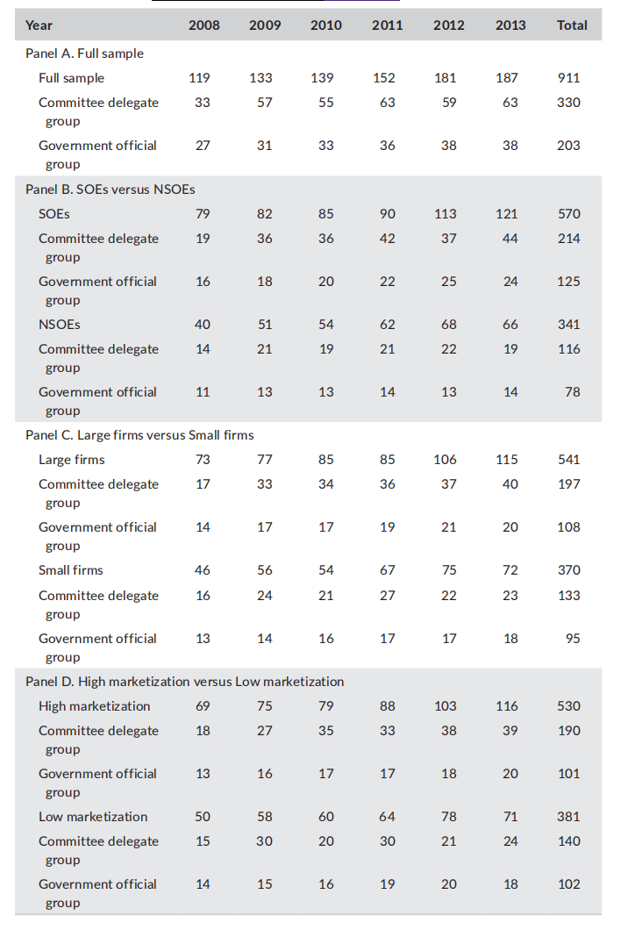
Descriptive statistics

Slide 20
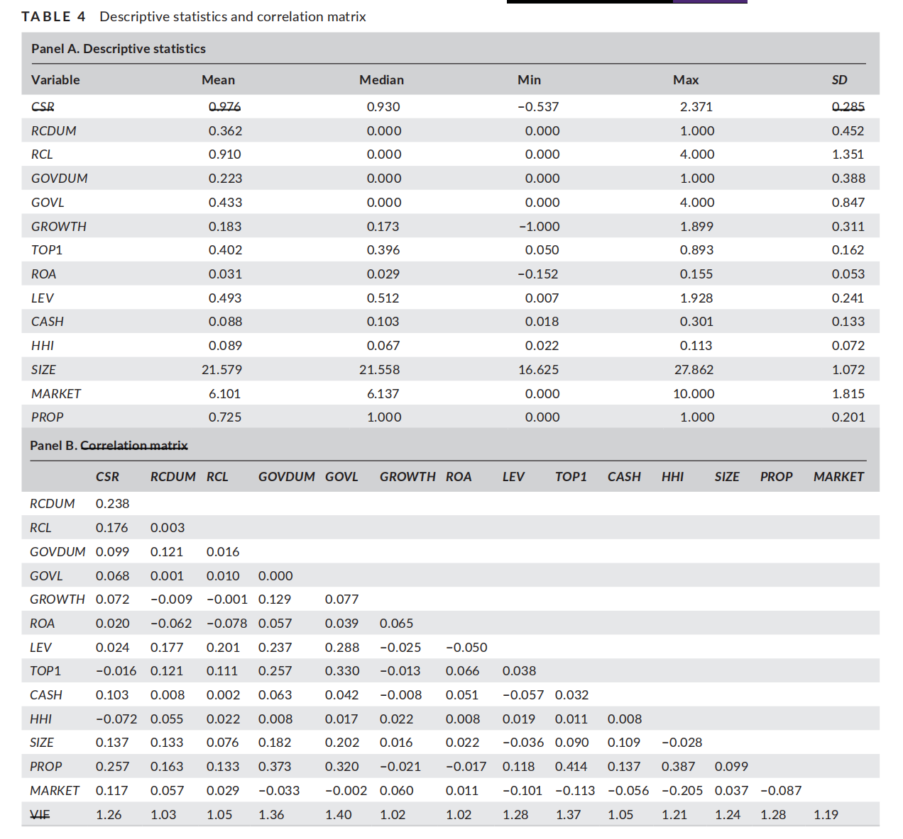

Slide 21
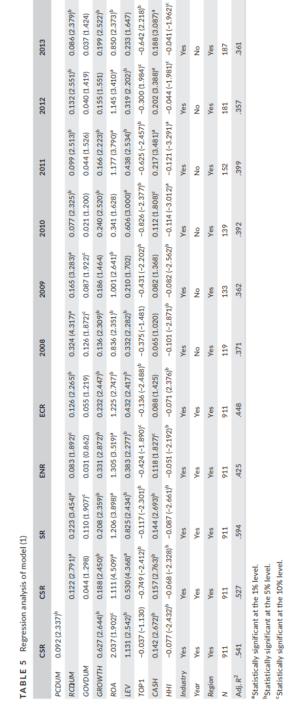

Slide 22
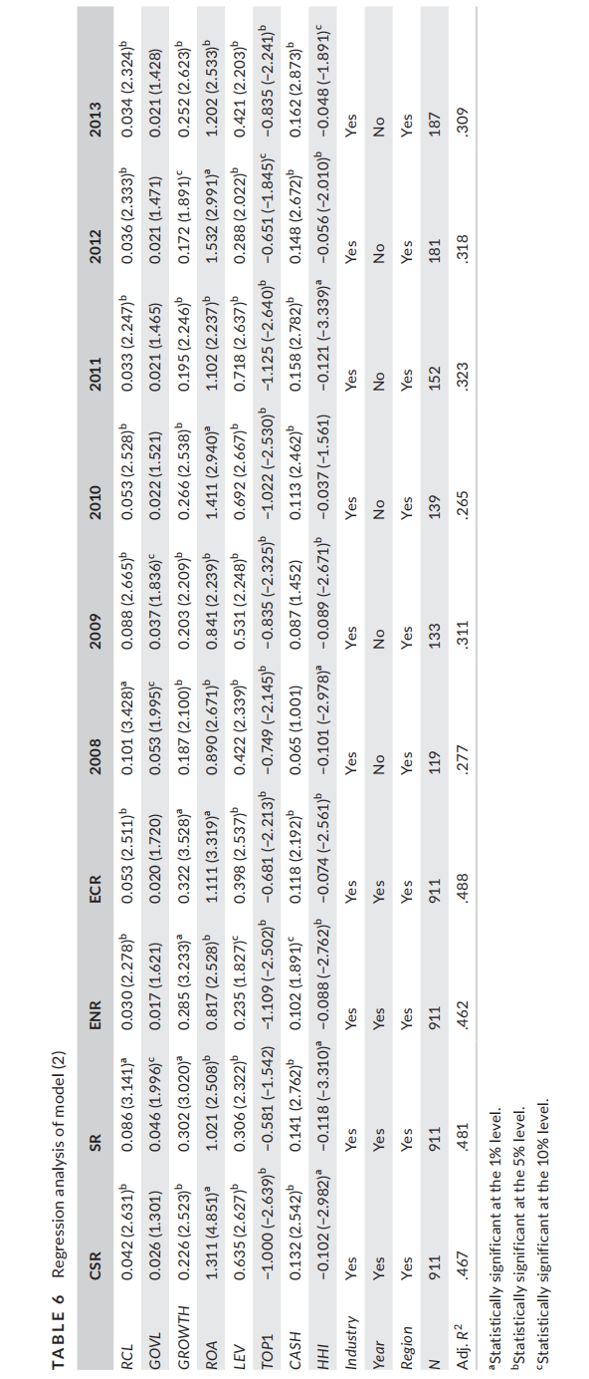

Slide 23
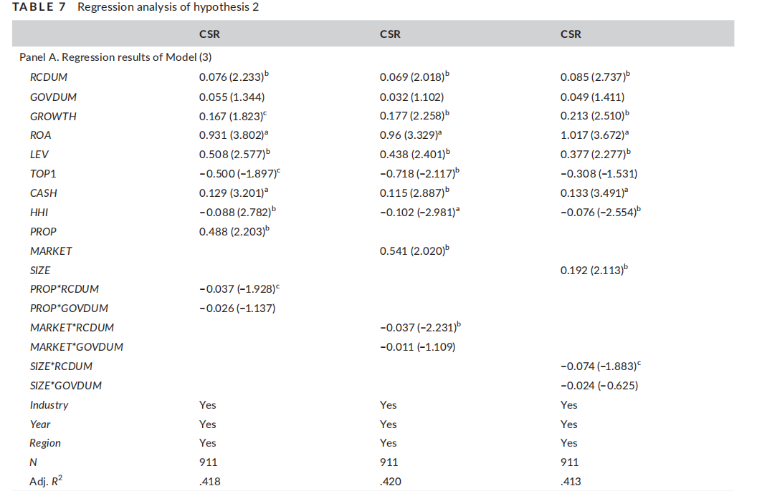

Slide 24
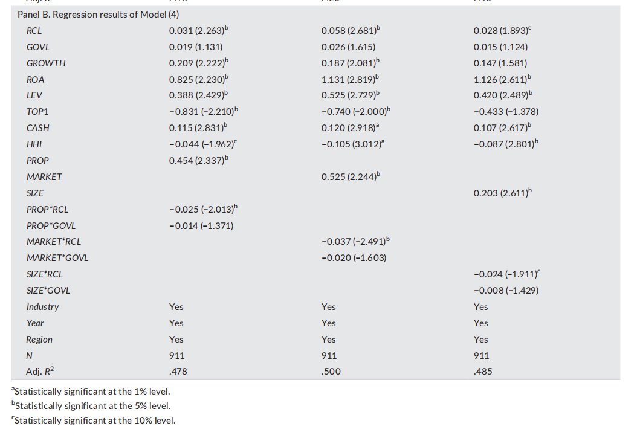

Slide 25
Robustness test
According to the results shown in Table 12, we also find that the coefficients of TURNOVER and the interaction variables are all positive and significant at least at the 10% level, providing evidence that supports the politically motivated CSR strategies in China.
Similarly, based on the results of the grouping test reported in Table 14, we also find that the coefficients of all types of political connections (RCDUM, RCL, GOVDUM, or GOVL) of NSOEs (small firms or firms in less market-oriented regions) are all positive and greater than those of SOEs (large firms or firms in more market-oriented regions), suggesting that the pulling effect of political connections on CSR is more prominent in firms for which political connections are more valuable.
Therefore, the results presented in Tables 8–14 reinforce the evidence presented in Tables 5–7, further confirming H1 and H2.

Slide 26
GENERAL DISCUSSION
The findings related to the first hypothesis indicate that politically connected firms demonstrate better CSR than nonconnected firms.
As the Chinese government, the key external stakeholder, controls the critical resources needed by companies for survival and success and has the arduous task of maintaining the harmonious development of economy, society, and the environment, CSR has become an exchange for enterprises to maintain political connections to obtain political resources.
Political incentives are indeed a very important factor driving Chinese firms to undertake CSR.

Slide 27
GENERAL DISCUSSION
From the perspective of RDT and SET, the driving force that comprises political factors introduces not only external institutional pressure, but also internal interest exchange.
Dividing political connections into two types, we find that the effect is stronger for firms with top officers including an NPC or a CPPCC delegate than for firms in which one of the top officers has formerly worked in the government, suggesting that existing connections can provide a considerably stronger motivation for implementing CSR activities.
Results illustrate that the effect is more prominent in firms for which political connections are more valuable, specifically NSOEs, SMEs, and firms operating in cities with lower levels of marketization.

Slide 28
GENERAL DISCUSSION
Furthermore, dividing CSR activities into three categories for comparative purposes, the obtained results also show that the relationship between top officers’ political connections and CSR activities is more significant for social-based activities.
Social issues, such as employment, housing, and poverty, which are related to social stability and the vital interests of all people, are the core thrusts of the Chinese government in developing the economy in the ‘new normal’ period.

Slide 29
RESEARCH LIMITATION
First, cross-country studies can be very useful. Whether there are political motivations underpinning CSR activities in developed countries or in other developing countries would be interesting to address.
Second, it would be interesting to use a sample of unlisted firms with very different requirements and standards in terms of CSR and financing means from those of listed firms.
Third, constrained by the conditions, we use an indicial method to measure CSR according to the measurement process of the KLD database and other previous literature.

Slide 30
THANK YOU

