Slide 1
The effect of business model innovation on Sme’s international performance: the contingent roles of foreign institutional voids and entrepreneurial orientation
Ruey-Jer Bryan Jean, Deakwan Kim, Rudolf R. Sinkovics, Erin Cavusgil
Supervisor : Professor LEE, CHENG-WEN
Student : Ignatius Reyner G
Student id : 11205610
Date of Presentation : 09 April 2024

Slide 2
Outline of contain
Business model innovation & boundary conditions
Business model innovation as a signaling strategy
Chapter 1
The effect of BM innovation on international performance
Survey development & sample
Introduction and Motivation
Measurement
The boundary conditions of institutional capabilities on international performance
Chapter 2
Theory and hypotheses
Control variables
Chapter 3
Addressing endogeneity
Method
Analysis & results
Chapter 4
Discussion
The effect of BMs on international performance
Chapter 5
Boundary conditions of BM innovation
Limitation & future research directions
Managerial implications

Slide 3
Chapter I
Introduction & motivation

Slide 4
Introduction
Innovation & internationalization can hold the key to survival and growth among SMEs
International markets, characterized by uncertain formal and informal institutional environments, are driving SMEs to continuously advance their products, services, and business morels (BMs) to satisfy the requirements of foreign markets (Miller et al., 2021)
Advanced technologies such as digital platforms, industry 4.0, and artificial intelligence have triggered the emergence of new BMs which can potentially alter firms’ value creation and capture mechanisms (Solus et al., 2021)
In this paper, the researchers seek to understand how SMEs can effectively leverage advanced technologies for BM innovation and turn these advancements into competitive advantages in international markets.
This research is to connect BM innovation & international performance by drawing on signaling theory.
This study provides a theory-grounded framework for investigating the link between BM innovation & performance in the international context, which responds to the recent call for more research examining the relationship between BM innovation and international performance
The empirical setting of this study is Chinese SME exporters which take part in Alibaba’s e-business platform

Slide 5
This research is also examine internal and external moderating effects on the relationship between BM innovation and international performance
This study advances the research on BM innovation and international performance by focusing on emerging market firms. Previous empirical evidence on the effectof BM innovation on international performance has mainly been based on firms from developed countries (Asemokha et al., 2019)
This study addresses this gap by offering theoretically grounded empirical evidence based on Chinese exporters.
Motivation
Respond to the paucity of work relating to the international dimension of the BM innovation and performance link, by explicitly considering the international element.
To respond to literature which suggests that boundary and contingency perspectives of the BM innovation-performance link require further consideration
The researcher address this through two contingencies which are relevant for international SME context, namely entrepreneurial orientation as an internal, firm-level dimension and foreign institutional voids as an external dimension

Slide 6

Alibaba.com
Alibaba is the world’s largest Internet B2B platform, providing cross border exchanges between SME exporters and foreign buyers
Alibaba offers a wide range of innovation BMs for Chinese SME exporters, extending from online mini sites to certificate service
Chinese SME exporters which use Alibaba provide an excellent setting in which to investigate emerging market SMEs’ BM innovation enabled by digital technologies

Slide 7
Chapter II
Theory and hypotheses

Slide 8
Business model (BM) innovation & boundary conditions
Basic concept, effect of BM innovation, international performance
BM in this research refers to ‘the content, structure, and governance of transactions design to create value through the exploitation of opportunities. (Amit & Zott, 2001)
As a BM ‘explains how an organization is linked to external stakeholders, and how it engages in economic exchanges with them to create value for all exchange partners’ (Zott & Amit, 2007, p. 181), it should be reinvented to capitalize on emerging opportunities (Amit & Zott, 2001).
Explains how an organization is linked to external stakeholders, & how it engages in economic exchanges with them to create value for all exchange partners’.
BM innovation requires a firm to build a boundary-spanning business network with its external stakeholders to effectively seek and exploit opportunities and capture value (Zot & Amit, 2013)
This research develops and empirically tests a conceptual model which examines the effect of BM innovation on international performance. The model of this research identifies the contingent roles of foreign institutional voids and entrepreneurial orientation as internal and external moderators in the link between BM innovation and SMEs’ international performance.

Slide 9
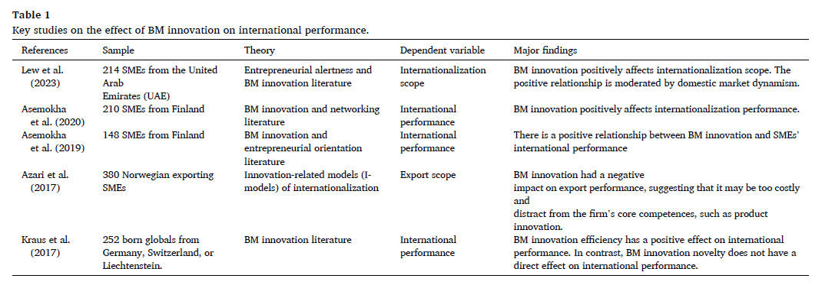

Slide 10
Business model innovation as a signaling strategy
Signaling theory focuses on how firms or individuals convey unobservable qualities or prospects through observable signals.
Credible signals must fulfill the following criteria:
  A signal must be observable to the exchange partners
  Signal cost must be costly and thus higher for bad sellers than good sellers
Digital platforms seen through the lens of signaling theory reduce information asymmetry in transactions with foreign buyers.
Based on this logic, the researchers conceptualize SMEs’ use of digital platforms as BM innovation and a signaling strategy that involves new ways of conducting economic exchange among transaction participants.
In this context, digital platforms like Alibaba.com offer new ways of exchange and a governance mechanism between SME exporters and their foreign customers.

Slide 11
The effect of BM innovation on international performance
Innovative to offers a third party certification service by Alibaba.com as a digital platform help increase the firm’s credibility to foreign buyers.
The credibility signals generated by the use of Alibaba.com as a digital platform can help buyers differentiate the quality of sellers on the platform.
Credibility signals generated by the use of Alibaba.com as a digital platform can help buyers differentiate the quality of sellers on the platform.
The use of the Alibaba.com platform as a BM innovation helps SMEs enhance their export performance, thus the researchers predict:
H1: BM innovation is positively related to international performance for Chinese SMEs

Slide 12
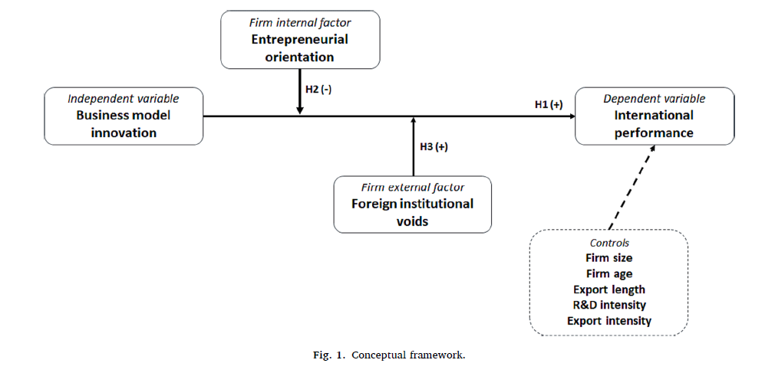
H2: Entrepreneurial orientation negatively moderates the relationship between digital BM innovation and Chinese SME’s international performance
H1: BM innovation is positively related to international performance for Chinese SMEs
H3: Foreign institutional voids positively moderate the relationship between digital BM innovation and Chinese SMEs’ international performance

Slide 13
the boundary conditions of institutional capabilities on international performance
Entrepreneurial orientation
H2: Entrepreneurial orientation negatively moderates the relationship between digital BM innovation and Chinese SME’s international performance
Boundary conditions of institutional capabilities on international performance
Foreign institutional voids
H3: Foreign institutional voids positively moderate the relationship between digital BM innovation and Chinese SME’s international performance

Slide 14
Entrepreneurial orientation
Entrepreneurial orientation is a central construct in SME internationalization research (Cavugil & knight, 2015; Felzensztein et al., 2015; Zhou & Wu, 2014).
Previous work has argues that entrepreneurial orientation may affect the international performance of SMEs.
Recent work further indicates that entrepreneurial orientation can serve as an alternative signaling strategy which signals firm capacities and behavioral intentions (Moss et al., 2015)
Based on this logic, the researcher argue that, in this research context, the entrepreneurial orientation of SMEs can be seen as an alternative signal, which helps reduce information asymmetry between SMEs and their foreign customers.

Slide 15
Foreign institutional voids
Foreign institutional voids represent institutional conditions that can make it difficult for buyers and sellers to interact successful in markets (Doh et al., 2017).
Institutional voids increase the transaction costs of market activity (Wang & Cuervo-Cazurra, 2017)
The researchers purpose that the positive relationship between BM innovation and international performance is more salient for Chinese SMEs in host countries characterized by greater institutional voids because :
(1) Foreign institutional voids create market information asymmetries in foreign buyers’ global purchases and sourcing (Peeters et al., 2015; Stancyzk et al., 2017)
(2) Foreign institutional voids strengthen legitimacy pressures that Chinese SMEs face to secure acceptance in host markets (Marano et als., 2017)

Slide 16
Chapter iii
Methods

Slide 17
Survey development and sample
The researcher conduct a series of in-depth interviews with export managers for Chinese exporters and platform managers for Alibaba.
Designed an open-ended and semi-structured discussion guide that advanced across key constructs in the proposed model
Proposed model: BM innovation, entrepreneurial orientation, & international performance.
The researchers develop an English version of the questionnaire (related with major Alibaba activities that exporters rely on) → convert to Chinese and evaluated by 2 Chinese bilingual scholars
Conducted a pre-test with 30 export manufacturers and 3 Alibaba platform managers to elicit their comments on the questionnaire

Slide 18
Formal survey, using the simple random sampling method to select 1,500 exporters in China who used Alibaba
Area: Most Developed (Beijing and Guangdong) & Relatively developed (Jiangsu, Shandong, Tianjing and Zhejiang)
Received 350 questionnaires
Performed t-tests on demographic variables such as
  firm size = (t: 0,508 ; p: 0,612)
  Firm age = (t: 0,263 ; p: 0,793)
  Entrepreneurial orientation = (t: 1,281 ; p: 0,201)
  Foreign institutional voids = (t: 0,689 ; p: 0,491)
  Export sales performance = (t: 1,640 ; p: 0,102)
  As all the t-tests were nonsignificant, nonresponse bias was not a concern in this study
Questionnaire include 3 items that assessed the informant’s
  Involvement in the exporters’ business and e Platform decisions
  Knowledge about the questions
  Confidence in completing the questionnaire
The average score for informant competence was 5,56 on a 7-point scale, indicating that they were reasonably qualified informants.

Slide 19
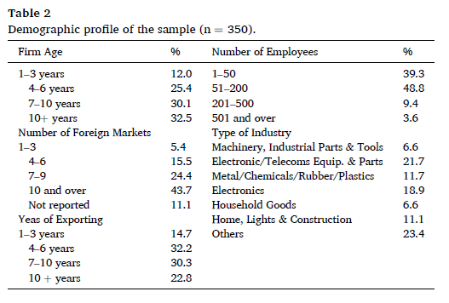

Slide 20
3.2 Measurement
To measure an exporter’s BM innovation, the independent variable of this study focuses on an exporter’s stress on the adoption and utilization of Alibaba as a new BM by adapting the scale from Solus et al. (2021)
For international performance, the focus on a firm’s export sales volume, market share, export profitability, export sales growth, and export market share growth.
For entrepreneurial orientation, the researcher will adapted a scale from Zhou et al. (2010), emphasizing the opportunity-seeking efforts and risk-taking behaviors of each exporter in the market
For a firm’s perceived foreign institutional barriers in its foreign market, adapting a scale from Tan and Mayer (2011)

Slide 21
3.3 Control Variables
Number | Name of the controlled | reason
1 | Size | Firm size is common determinant of a firm’s export activities and performance through the scale of resources (Gao et al., 2010).
2 | Firm Age | An exporter’s business experience indicates its competence in handling online transaction (Sturman, 2003)
3 | Export experience | Helps a firm accumulate the foreign market knowledge and skills necessary to handle intercultural situations (Choquette,2019). It also include the years a firm had been in the export business
4 | Export intensity | Indicates a firm’s emphasis on exporting activities and is critical to export performance. Thus in this research include: ratio of export revenue to total revenue
5 | Ratio of R&D Expenditure to a firm’s total revenue

Slide 22
3.4 Addressing endogeneity
Addressing Endogeneity
Assessed common method variance through the marker variable approach
Showed that common method variance would not be of concern in the study
BM innovation, the independent variable in the model, likely to be endogenous
Omission bias is a source of endogeneity then the researchers used multiple control variable to minimize this in the study

Slide 23
Analysis & results
Using SmartPLS 3.0 ; using a bootstrapping specification of 500 as the number of resamples
Measurement model indicates a good level of validity and reliability of the study constructs
All the shared variances were less than the respective AVEs, with the largest shared variance of 0.21 between export performance and entrepreneurial orientation
The smallest AVE in the study being 0.598, shown table 3 and 4; revealing a good level of discriminant validity between the study constructs.

Slide 24
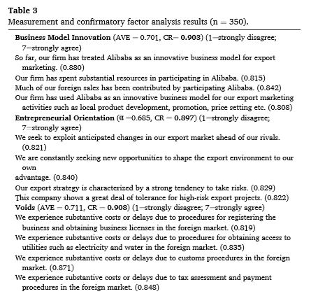
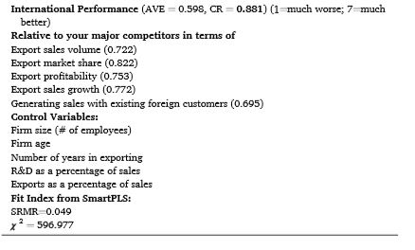

Slide 25
Hypothesis 1, proposes that BM innovation improves a firm’s export performance. Figure 2, shows a firm’s BM innovation increases its export performance. Thus, hypothesis 1 is supported
Hypothesis 2, claims that an exporter’s foreign institutional voids strengthen the relationship between BM iinovation and export performance. As Figure 2, reveals a firm’s foreign institutional voids improve the impact of BM innovation on its export performance. Thus, hypothesis 2 is supported
Hypothesis 3, states that an exporter’s entrepreneurial orientation weakens the impact of BM innovation on its export performance. As the results in figure 2. indicate, entrepreneurial orientation decreases the impact of BM innovation on export performance. Thus, hypothesis 3 is supported

Slide 26
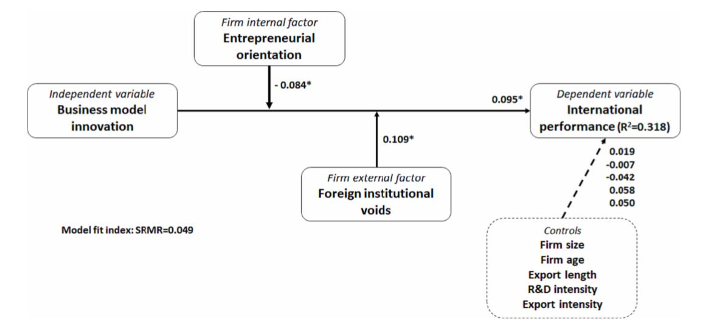
Figure 2

Slide 27
Robustness checks
The researcher also conducted several robustness tests for assess the stability of the PLS model estimation (two additional estimations using 200 and 1000 resamples in the bootstrapping process)
Used an alternative single measure of our dependent variable that captures the extent to which a firm’s global competitiveness has improved, estimating the model with this alternative measure.
Used multi-item scale that measures the extent to which an exporter uses Alibaba to identify foreign customers

Slide 28
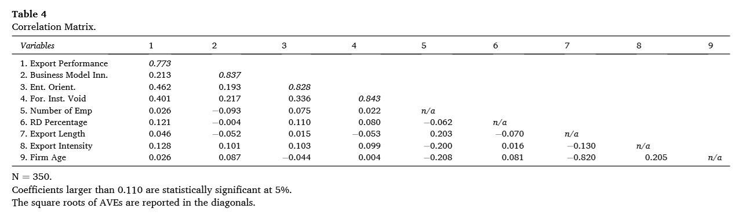

Slide 29
Chapter IV
Discussion

Slide 30
Mind Mapping for Chapter IV
The effect of BMs on international performance
Discussion
Boundary conditions of BM innovation
Managerial implications

Slide 31
The research findings indicate that business model innovation has a positive and significant impact on SMEs' international performance. This positive effect is attributed to the ability of innovative business models to reduce information asymmetry and signal the capabilities and intentions of SMEs to foreign buyers, ultimately enhancing their international performance
This study emphasizes the critical importance of innovative business models for the success of emerging market firms in international markets. The digitally enabled business model innovation, particularly through participation in digital platforms, is seen as a mechanism that can make internationalization efforts less costly and more effective.
Significant Impact
Cost Consideration

Slide 32
Boundary Conditions
This study identifies foreign institutional voids and entrepreneurial orientation as important boundary conditions that moderate the relationship between business model innovation and international performance. In the presence of institutional voids, innovative business models play a crucial role in alleviating information asymmetry and reducing transaction costs, thereby enhancing international performance. Additionally, the level of entrepreneurial orientation within SMEs influences the value created by innovative business models in foreign markets. For SMEs with lower entrepreneurial orientation, adopting innovative business models that leverage digital platforms for exporting can lead to higher returns in international markets
Cost Consideration
The study provides valuable insights for SME managers, suggesting that accumulating resources and capabilities for engaging in business model innovation can significantly benefit internationalization efforts. Managers are advised to consider the contingent effects of business model innovation on international performance, especially in the context of institutional environments and entrepreneurial orientation. Understanding the overlapping nature of business model innovation and entrepreneurial orientation is crucial for success in international markets. Additionally, managers should be aware of the costs and limitations associated with developing and utilizing entrepreneurial orientation and business model innovation, and consider internal and external factors that may impact the effectiveness of business model innovation on international performance

Slide 33
Chapter V
Limitation and future directions

Slide 34
Current position | Future recommendation
This research only focus on a specific type of BM innovation ex: SME’s adoption of digital platforms | Future research may examine other types of BM innovation (adopting: AI, Industrial 4.0, etc)
 | Investigate other contingent factor such as technological uncertainty or market dynamism (which may also shape the relationship between BM innovation and international performance)
Limitation: cross-sectional design | Using longitudinal data collection, even over relatively short periods
Empirical context of this study is provided by China. The result may not apply to other emerging markets. | Future research may extend and replicate the results in other emerging markets

Slide 35
Thank you

