Slide 1


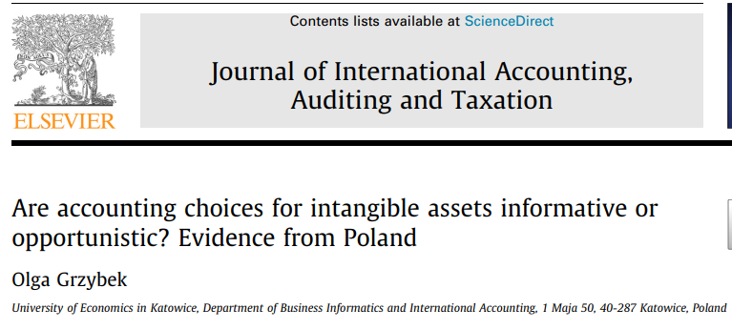
SEMINAR IN INTERNATIONAL OPERATIONS MANAGEMENT AND TRADE
INSTRUCTOR: PROFESSOR CHENG-WEN LEE
STUDENT: MAKAIREH DAMPHA(11004610)

Slide 2
PRESENTATION OUTLINE
1. INTRODUCTION
2. HYPOTHESIS DEVELOPMENT
3. RESEARCH DESIGN
4. RESULT AND DISCUSSION
5. CONCLUSION

Slide 3
INTRODUCTION
Intangibles are key to developing a business and creating sustainable value. However, information on intangible resources is under-reported in financial statements subject to International Financial Reporting Standards (IFRS). because International Accounting Standard 38, ‘‘Intangible Assets” (IAS 38), constrains the recognition of intangible assets, also allows some degree of accounting flexibility, which managers use to achieve different goals.
On the one hand, managers may use their discretion in financial reporting to provide investors with reliable information on key value drivers; on the other hand, managers may behave opportunistically and distort financial information (Pham et al., 2019)
Goodacre & McGrath, 1997; Lev & Ohlson, 1982). It is unclear whether investors are misled by managers’ accounting choices as previous research is mixed, with findings supporting both the rationality hypothesis and the earnings fixation hypothesis.
(Ballas et al., 2012) Even if investors are indifferent to accounting choices, accounting choices might still be important to managers for reasons related to the underlying economics of a company or to opportunistic managerial incentives
PAT (Watts & Zimmerman, 1986) emphasizes agency conflicts among different groups of stakeholders, each attempting to maximize its wealth.

Slide 4
INTRODUCTION
The Political cost hypothesis of PAT assumes that managers choose income-decreasing accounting methods to reduce potential wealth transfers to other stakeholders. However, managers have an incentive to choose income-increasing accounting methods to avoid breaching debt covenants (debt hypothesis) and to increase their compensation linked to accounting performance (bonus plan hypothesis)
Finally, an income-increasing strategy may reflect high expected future benefits from intangible assets. According to this view, accounting methods reveal managers’ expectations about the firm’s future cash flows (Holthausen, 1990), which is called an informative accounting choice
This study investigates whether the relationships between the income strategy adopted by an entity and firm size, leverage, profitability, and managerial compensation are driven by opportunistic incentives or reflect the underlying economics of the company
First, under-reported intangible resources are a crucial area of information asymmetry between managers and investors (Ferdaous & Rahman, 2019; Labidi & Gajewski, 2019),
which gives managers room for discretion. Managers may exercise this discretion in opportunistic ways to mislead stakeholders or in non-opportunistic ways to enhance information quality (Bowen et al., 2008).

Slide 5
INTRODUCTION
Second, results for Poland may be of interest for other developed markets, while the Polish capital market is more suitable for verifying opportunistic incentives
Finally, the audit environment in Poland exhibits very different characteristics from most other countries included in the study by Gunn et al. (2019). According to their findings, Poland has the lowest audit fees, with Big 4 auditors servicing less than half of the audit market. These features suggest that managerial incentives to behave opportunistically may be especially strong in Poland
The study contributes to the existing literature in several ways.
Primarily, it contributes to the literature on accounting choices by investigating the determinants of the income strategy chosen by managers.
The study also adds to the literature on intangible assets being crucial but under-reported value drivers. New research methods are needed because previous research on intangible assets and accounting choices provided inconclusive findings
Finally, the study emphasizes the need for deeper insight into the decision-making process as traditionally considered determinants and research methods do not seem sufficient to explain accounting choices

Slide 6
HYPOTHESES DEVELOPMENT
(Holthausen, 1990) Generally accepted accounting principles give managers some discretion about reporting financial information. Managers can use this discretion to report conservatively, which leads to lower reported earnings in the current period (income decreasing strategy), or aggressively, which leads to relatively higher reported earnings (income increasing strategy). Three alternative, not mutually exclusive, perspectives on accounting method choice are efficient contracting, opportunistic behavior, and information perspective
(Watts & Zimmerman, 1986), The first two perspectives are the core of PAT which seeks to explain and predict managers’ choices of accounting methods.
(Deegan, 2014, p. 323). PAT considers firms as a nexus of contracts between various self-interested individuals within and outside the firm and explains how financial accounting can be used to minimize the cost implications associated with each contracting party operating in their own self-interest
(Holthausen, 1990). In contrast, the information perspective suggests that the accounting choices provide information about the firm’s future cash flows
(Fields et al., 2001). In this perspective, accounting provides an avenue through which better-informed managers disseminate privately held information to less-well-informed investors

Slide 7
HYPOTHESES DEVELOPMENT
However, the actions of managers in a growth firm are more difficult for shareholders to supervise and monitor. Previous research confirms that growth firms are more likely to use incentive compensation schemes that tie management compensation to measures of firm performance (Smith & Watts, 1986),
Despite many contradictory findings, opportunistic incentives are still the starting point for much research on accounting choice and earnings management. Three key hypotheses developed in the PAT literature are the
political cost hypothesis, the debt hypothesis, and the bonus plan hypothesis.
firms are under scrutiny by various groups, such as governments, employees, consumers, and environmental lobby groups. These groups may promote the view that a company, particularly a large one, is generating excessive profits and not paying its ‘‘fair share” to other stakeholders (Deegan, 2014, p. 308).
To mitigate this type of problem, this study investigates accounting policies only for intangible assets and links them to the market-to-book ratio, which indicates the intangible nature of a company.
In line with the PAT political cost hypothesis that large firms prefer a less aggressive income strategy, the first hypothesis is formulated as follows:
H1: Managers of larger firms prefer a less aggressive income strategy regarding intangible assets

Slide 8
HYPOTHESES DEVELOPMENT
Financing business activities with debt produces a conflict of interest between the firm’s stockholders and bondholders.
Smith and Warner (1979) describe primary sources of this conflict as dividend payment, claim dilution, asset substitution, and underinvestment.
In regard to intangible assets, Aboody and Lev (1998) provide evidence that more leveraged US firms tend to capitalize software costs more aggressively
A similar relationship was found with a German sample (Dinh et al., 2016). These findings are not confirmed in the case of R&D in France, where no significant difference in leverage between firms with aggressive accounting policy (capitalizers) and those with conservative accounting policy (expensers) was found (Cazavan-Jeny et al., 2011)
However, one must notice that leverage is a proxy measure for the closeness to breaching debt covenants, which is often unknown to outsiders. Although there is some evidence that leverage is a good surrogate for proximity to accounting constraints (Press & Weintrop, 1990), results may be sensitive to the measure of leverage used and vary between different types of covenants.
Assuming opportunistic behavior of the managers, the second hypothesis is as follows:
H2: Managers of highly leveraged firms prefer a more aggressive income strategy regarding intangible assets

Slide 9
HYPOTHESES DEVELOPMENT
PAT predicts that if managers’ compensation is related to accounting numbers, there are strong incentives for self-interested managers to choose income-increasing accounting policy. In this setting, managers act opportunistically when maximizing their own wealth at the expense of the stockholders
Researchers must often use proxy measures for management compensation plans when testing the bonus plan hypothesis because, in many countries, companies do not disclose sufficient information in their annual reports.
They assess compensation level in comparison to various performance measures, such as sales, assets, or earnings. Higher compensation, especially compared to a particular performance measure, increases the need for its justification, which creates stronger incentives to inflate earnings. Based on the above arguments, the following hypothesis is formulated:
H3: Managers with a high compensation-to-sales ratio prefer a more aggressive income strategy regarding intangible assets.

Slide 10
HYPOTHESES DEVELOPMENT
in this study, the market-to-book value is used as an indicator of the intangible component of a company
The market-to-book value reflects investors’ perceptions of the company’s opportunities for growth (Chen & Zhao, 2006) and is used as a proxy for investment opportunity set relative to the assets in place (Kallapur & Trombley, 2001). The market to-book value is also widely used as a symptom of intangibles (Marzo, 2013)
Moreover, in the finance literature Park (2019) investigates the change in the book-to-market effect related to the value investing strategy, which involves building a zero-investment portfolio that buys high book-to-market ratio stocks and shorts low book-to-market ratio stocks

Slide 11
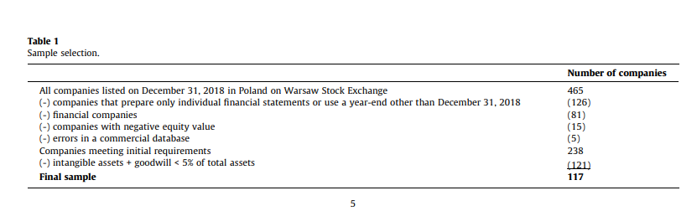
RESEARCH DESIGN
Sample selection
The sample comprises companies listed on the Warsaw Stock Exchange (Poland). The data are drawn from consolidated financial statements with accounting year-end on December 31, 2018, because it is the last annual period not affected by the COVID-19 pandemic

Slide 12
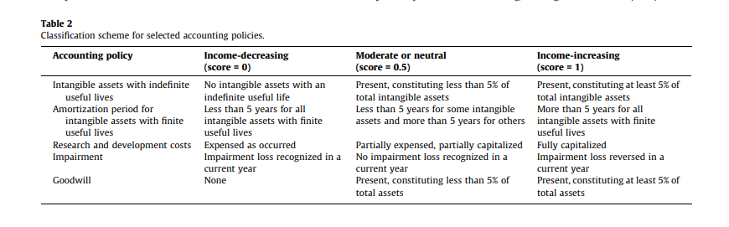
RESEARCH DESIGN
Classification scheme for the income-strategy measurement
To measure income strategy regarding intangible assets, five accounting procedures that are vulnerable to managerial discretion and may impact income reporting are considered (see Table 2).

Slide 13
RESEARCH DESIGN
Variables definitions
For each hypothesis tested, at least two different measures of the underlying concept are used. The variables are defined in Table 3. Following Cazavan-Jeny et al. (2011), variables used in this study are adjusted for the impact of accounting choices in regard to intangible assets.
Assets are calculated as total assets as if the entity had chosen an aggressive accounting policy without charging earnings with any amortization, impairment loss/reversal, or R&D expenses, and earnings are adjusted for amortization, impairment loss/reversal, and R&D expenses. Raw data is also presented for clarity and to give a complete view of the surveyed companies
To capture political cost incentives, firm size proxied by the natural logarithm of net sales (SALES) and by the natural logarithm of total assets (ASSETS) is used.
Three additional proxies are used to capture compensation incentives: return on assets (ROA); compensation to net sales (COMP_SALES), because sales are unaffected by accounting policy choices for intangible assets; and compensation to assets adjusted for accounting policy choices for intangible assets (COMP_ASSETS).
Finally, the market-to-book ratio indicates the intangible nature of a company and is used to distinguish economic-intangible from book-only-intangible firms.

Slide 14
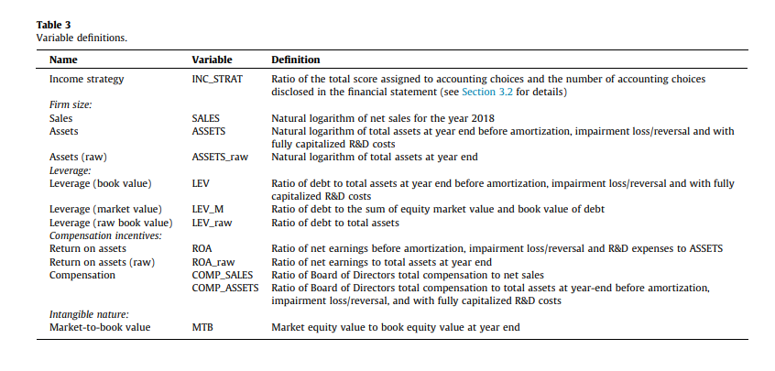
RESEARCH DESIGN

Slide 15
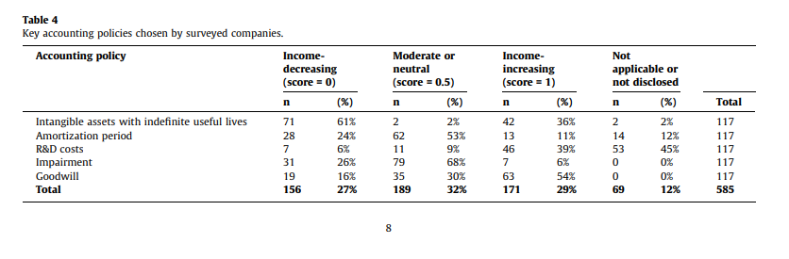
RESULTS AND DISCUSSION
Accounting policies chosen by sample firms
Results in Table 4 show that many individual accounting choices made by Polish-listed companies have a moderate impact on income (32%), followed by income-increasing accounting choices (29%). Only 27% of individual accounting choices have an income-decreasing effect
Most companies do not assess the useful life as indefinite (61%) and instead select a moderately long amortization period (53%) for their assets with a definite life.

Slide 16
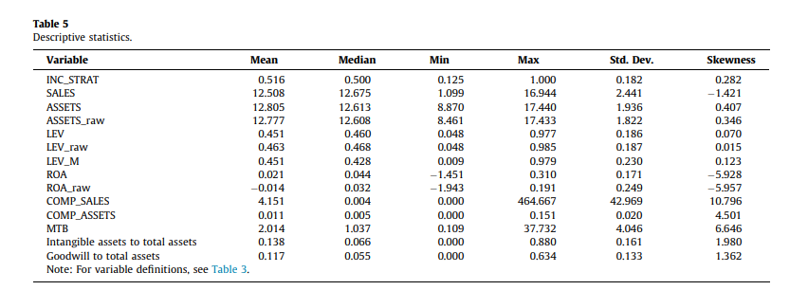
RESULTS AND DISCUSSION
SAMPLE CHARACTERISTICS
No single entity chooses an extremely conservative (INC_STRAT = 0) accounting policy in regard to intangible assets. The average of the INC_STRAT is 0.516, which is consistent with previous studies that suggest more income increasing accounting methods are chosen (Ali & Ahmed, 2017; Astami & Tower, 2006; Kullab & Yan, 2018; Waweru et al., 2011)

Slide 17
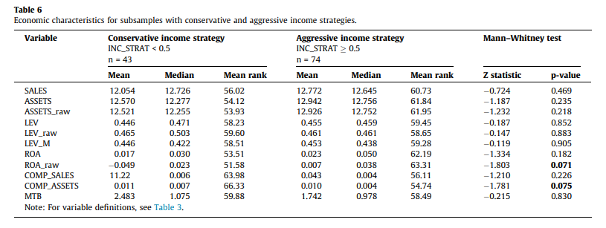
RESULTS AND DISCUSSION
UNIVARIATE TESTS
In the first step of the analysis, the entire sample is divided into two groups according to median INC_STRAT of 0.50
Table 6 shows that entities that choose an aggressive income strategy do not differ significantly from entities that choose a conservative income strategy

Slide 18
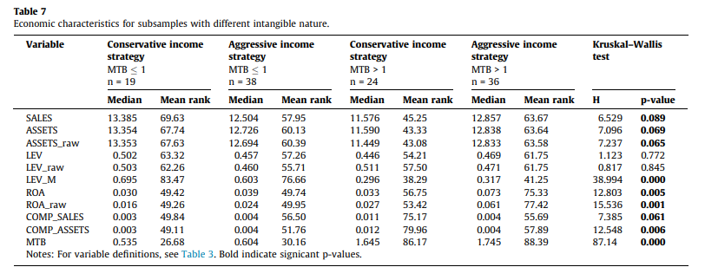
RESULTS AND DISCUSSION
The results in Table 7 suggest significant differences in firm size between subsamples regardless of the proxy measure used (at significance level a = 0.1)
Large firms with unrecognized intangible assets choose an aggressive income strategy, whereas large firms with a low market-to-book ratio choose conservative income strategies.
This finding confirms the political cost hypothesis (H1) only for companies whose value does not depend on intangible resources
In contrast, large firms with unrecognized intangible assets account for identified intangible assets rather aggressively, emphasizing their investments in intangibles

Slide 19
RESULTS AND DISCUSSION
All groups are similar with regard to the leverage measured at the book-value level. Significant differences in LEV_M reflect only the split of the sample into subsamples according to MTB with no differences within these subsamples
Hence, the debt covenants hypothesis (H2) is not supported. According to univariate tests, a firm’s leverage ratio does not determine income strategy for intangible assets. This result is in line with some previous findings (Cazavan-Jeny et al., 2011; Waweru et al., 2011
Post hoc Dunn’s tests show significant differences between low- and high-MTB conservative firms regarding all size proxies, LEV_M, COMP_SALES, and COMP_ASSETS. There are also significant differences between low- and high-MTB aggressive firms in regard to LEV_M, ROA, and ROA_raw

Slide 20
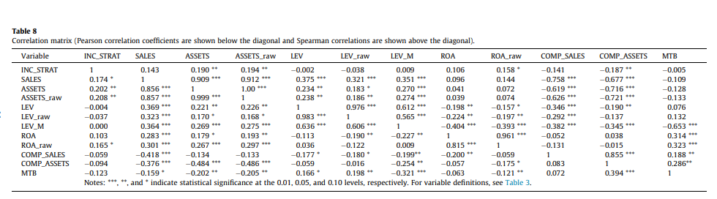
RESULTS AND DISCUSSION
Table 8 shows the correlation matrix for the variables used to identify associations between managerial incentives and the income strategy for intangible assets. All measures of firm size are positively correlated with leverage measures, which means that larger firms are also more indebted. Spearman correlations between measures of leverage and profitability are significant and negative, suggesting that more-leveraged firms are less profitable

Slide 21
RESULTS AND DISCUSSION
FRACTIONAL REGRESSION ANALYSIS
Given the bounded nature of the dependent variable INC_STRAT, the data treatment methodology used in this study utilizes regression analysis of fractional response with robust standard errors, as suggested by Ramalho (2019). To calculate the model, R software with the ‘‘frm” package is used, which applies the general linear model to perform the estimations and easily allows estimation of several alternative regression link functions.
The main regression model is as follows:

Slide 22
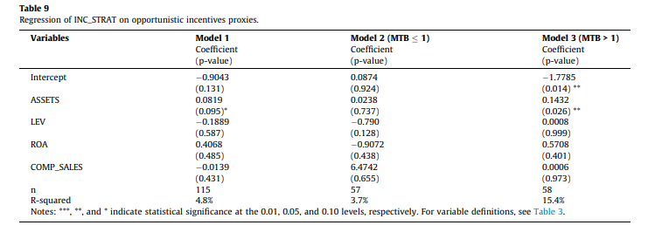
RESULTS AND DISCUSSION
These observations are outliers according to Cook’s distance and would bias regression results. Because univariate tests show that incentives to choose particular accounting policies vary between economic-intangible (MTB greater than 1) and book-only-intangible firms (MTB 1), models for the whole sample and separate models for subsamples of firms with different intangible nature are constructed. The results are shown in Table 9

Slide 23
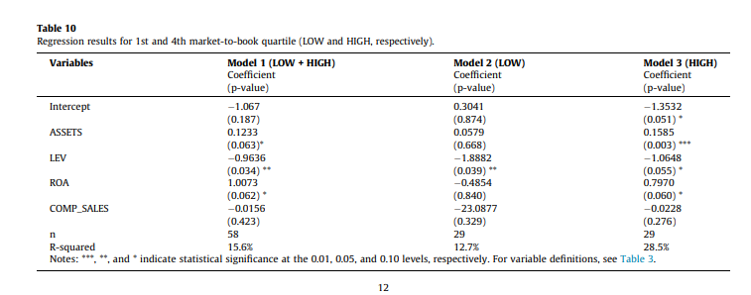
RESULTS AND DISCUSSION
Managerial accounting choices in firms with high-MTB value do not seem self-serving. All relationships except for COMP_SALES are significant but in the opposite direction than posited by PAT hypotheses assuming opportunistic managerial behaviors

Slide 24
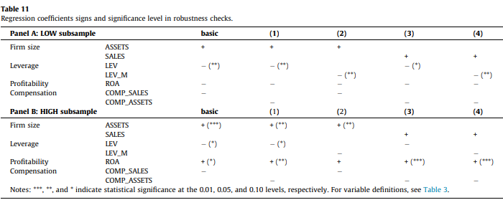
RESULTS AND DISCUSSION
Panel A of Table 11 summarizes the signs and significance of regression coefficients obtained in robustness checks for the LOW subsample.
Panel B of Table 11 summarizes the signs and significance of regression coefficients obtained in robustness checks for the HIGH subsample
All regressions are carried out with both logit and probit link functions, as logit and probit differ in the assumption made about the distribution of the error term. Probit models assume a standard normal distribution while logit models assume a standard logistic distribution. The results for the probit models are consistent with the results for the logit models with respect to both the signs and significance of the regression coefficients.

Slide 25
Armstrong et al. (2016) test managerial incentives for accrual earnings management of newly public companies. Abnormally high accruals in the year of the initial public offering are well-documented in the accounting and finance literature which interprets these results as opportunistic misreporting
However, much of that evidence is based exclusively on the magnitude of abnormal accruals, without distinguishing between misreporting and economic activity explanations.
Armstrong et al. (2016) test for both misreporting and economic activity explanations and find no evidence of opportunistic behavior.
Findings of the present study are in line with Windisch (2021), who finds that discretionary accruals are informative about firms’ future economic prospects, especially in a low enforcement environment
Despite many concerns about managerial self-interest, Dinh et al. (2019) find that managerial discretion is not used opportunistically, even for real activities, which is much more difficult to detect than accounting choices

Slide 26
CONCLUSION
This study examines the determinants of accounting choices for intangible assets within the framework of PAT. A set of five accounting choices is used to determine the character of income strategy adopted by managers
Overall, the results indicate firms use more income-increasing policies, emphasize varying incentives in the selection of accounting methods and suggest that accounting choices are rather informative than opportunistic
The study contributes to the mainly by accounting choice literature identifying that managerial incentives in selecting accounting methods differ depending on a firm’s intangible nature expressed in the market-to-book ratio. It contributes to the broad discussion on managerial discretion in accounting, suggesting the informative use of accounting flexibility
Most recent studies use accruals measures to capture the income strategy and earnings management concepts. My study represents another point of view and further supports the findings of studies based on accruals
However, this research has some limitations. The identification strategy used is very simple and necessarily assumes that a company’s intangible component is reflected in its market-to-book value.
The results of the study may be sensitive to market imperfections and other factors captured by the market-to-book value.

Slide 27


