Slide 1
Chung Yuan Christian University Business College
Seminar on International Operations Management and Trade
Journal Presentation
Instructor : Prof. LEE, CHENG-WEN
Student : Patrick A. Mendy
Date: Feb 27, 2024.

Slide 2
Outline
1. Introduction
2. Human resource outsourcing (HRO)
3. Method
4. Analysis and observations
5. Insights of HRO
6. Implications for academia and practitioners
7. Conclusion

Slide 3
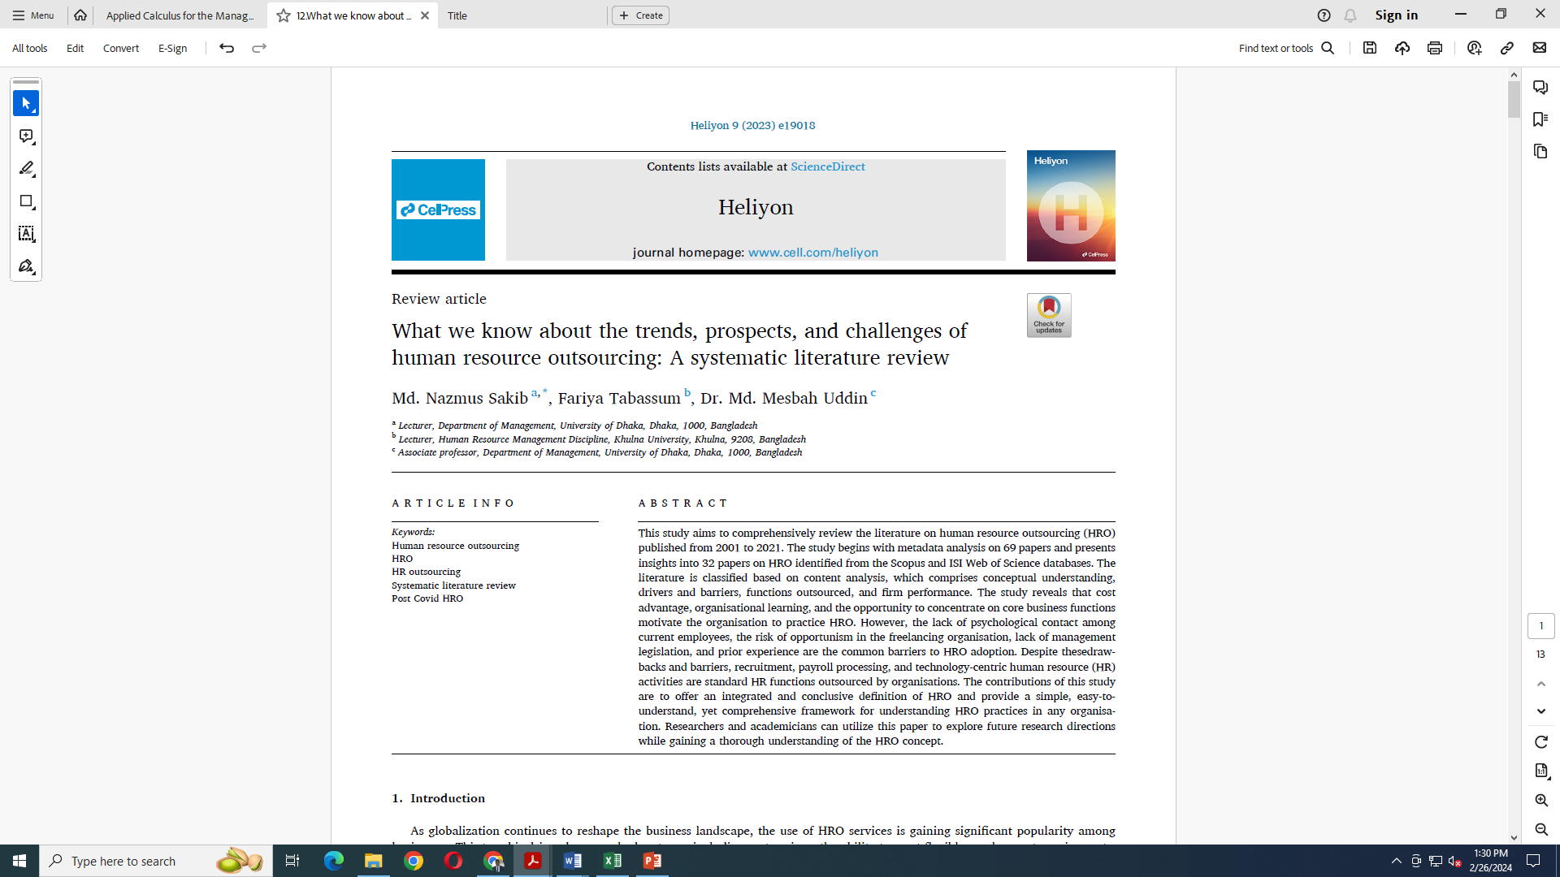

Slide 4
Introduction
The use of HRO services is gaining significant popularity among businesses as globalization continues to reshape the business landscape. This trend is driven by several advantages, including cost savings, the ability to meet flexible employment requirements, risk reduction, and access to top-notch talent pools. By leveraging HRO services, businesses can optimize their operations while tapping into high-quality labor resources.
There is a growing debate among policymakers about whether HRO is an opportunity or risk for an organization. Earlier research argues both positive and negative aspects of HRO. A great deal of previous studies argues that in the age of globalization, firms in developing countries can be immensely benefitted from outsourcing HR functions from the viewpoint of their strategic aspects.
A study by Coggburn argues in favor of cost efficiency that when the external vendor provides the same service at a lower cost than the in-house service maker, it is called cost-effectiveness. On the contrary, earlier studies have identified opposing arguments against organizations' decisions to outsource HR, highlighting potential drawbacks and limitations.

Slide 5
Introduction
The authors argue that HRO leads to a reduction of employees and impels to recruit seasonal employees. Therefore, there would be a gap in organizational and interpersonal relationships, encouraging a lack of psychological contact and destroying pre-existing networks and organizational memory.
In the long run, the client company becomes inefficient, loses its organizational values, fails to develop essential knowledge, and lacks unique competencies. Despite having positive and negative arguments, there has been a modest growth rate rather than overwhelmingly fleet since the 1990s, and the practice of HRO is anticipated to have future upliftment.
A study by Yan proposes a conceptual framework for examining the effectiveness of practicing HRO in ‘make or buy’ decisions, where metadata analysis is completely ignored. A study by Shen highlights the significance of supporting the development of HRO practices by focusing on how to effectively implement HRM functions, the reasons for adopting this approach, and practical advice for managers in the field.
The first paper emphasizes the resource-based theory, while the second one acknowledges the significance of both resource-based theory and institutional theory in decision-making pertaining to the HRO concept. Furthermore, existing research also emphasizes the strong connection between successful HR outsourcing and the quality of partnerships.

Slide 6
Introduction
Considering only all the empirical studies of HRO, a study by Sim employing a grounded code technique, provides valuable insights into the field of HRO.
None of the review articles contributes to a metadata analysis that establishes the criteria for selecting articles, nor do they develop a theoretical framework for further research approaches. In contrast, most of the reviews contribute to the analysis of the evidence on HRO.
Earlier studies collect and analyze papers based on a subjective approach, potentially leading to bias. Therefore, there is a need to collect papers based on an objective approach. Hence, this paper has adopted an objective approach for data collection from the Scopus database, which objectively collects data based on search strings.
Further, due to the increased use of and considerable debacles on HRO, there is a growing demand to review the concept thoroughly with its trends, challenges & limitations, along with the benefits that might be brought with the hand of HRO. Thus, the limited number of previous review papers justifies the need for the present study to encompass recent developments and provide key insights, which would contribute to the existing body of knowledge on HRO

Slide 7
Introduction
The study addresses the following research questions:
Who are the influential actors in HRO?
What are the present trends in the HRO arena?
What are the influential journals of HRO?
What are the key contributing countries, institutions, affiliations, & subject areas of HRO?
What are the key themes that would help classify and arrange the existing literature on HRO & finally illustrate a simple framework to understand the concept of HRO?
Hence, the main aim of this paper is to review the hitherto extant literature in the domain of HRO to acquire knowledge on the current trends and developments of HRO while identifying/discovering future research avenues.
The data for this paper has been collected from the Scopus and ISI Web of Science databases from 2001 to August 2021. Earlier studies have utilized these two databases as credible sources for conducting a systematic literature review paper.

Slide 8
Human resource outsourcing
Human resource outsourcing (HRO) is a strategic business practice where an organization delegates certain HR functions or processes to external service providers. Instead of handling all HR tasks internally, companies choose to outsource specific HR functions to third-party vendors who specialize in HR services.
Here's a breakdown of human resource outsourcing:
Payroll processing
Employee benefits administration
Recruitment and staffing
Training and development
Performance management
Compliance with labor laws and regulations
Organizations can choose to outsource all HR functions (total outsourcing) or select specific HR processes (partial outsourcing) based on their needs and strategic objectives.
Total outsourcing involves transferring the entire HR department to an external provider, while partial outsourcing entails outsourcing individual HR functions while retaining others in-house.

Slide 9
Human resource outsourcing
Academics and practitioners echo the same while considering the value of HRO practices to drag down the costs by adopting flexible employment demands, improving customer services, and maintaining global standardization. Although it appeared as a concept more than two decades ago, scholarly contributions in this domain gained momentum in 2010, and since then, it has maintained an erratic growth trend. However, the idea maintained a steady growth till 2016.
Traditionally, outsourcing is considered a nonstrategic element where resources are left for significant strategic contribution. In the past, outsourcing HR activities was based on a contractual agreement and trust between the vendor company and service receiver company, whereas today it is pursued as a means to gain a competitive advantage, with HRO influencing an organization’s financial circumstances while also serving as a tool to drive innovation and enhance stakeholder performance.
Earlier scholars defined HRO that primarily focused on these key advantages. For instance, Butler defines HRO and argues that HRO is what an organization shares its human resource functions and transfers internal work responsibility to an outside supplier for getting HR related services. Whereas Zhao takes a utilitarian perspective in defining HRO, emphasizing that it involves outsourcing HR centric tasks to external organizations.

Slide 10
Method
The research methodology involves a systematic literature search and selection process of relevant academic articles, reports, and other publications related to HRO. The selected literature is then thoroughly analyzed using qualitative techniques such as thematic and content analyses to identify common themes, patterns, and key insights related to the domain of HRO.
This study employs a meta-synthesis, which involves synthesizing the findings of multiple studies to generate overarching themes and theoretical frameworks. The rigorous scientific approach ensures that the review is comprehensive, objective, and grounded in the existing body of knowledge on HRO, providing valuable insights for practitioners, policymakers, and researchers in the field of HRO.
According to the researchers, when conducting a systematic literature review, it is required to assess the different types of sources, for example, journal articles, books, and web-based resources. However, an integrative literature review generates new ideas and directions for the specific field, laying a foundation for future research or theory.

Slide 11
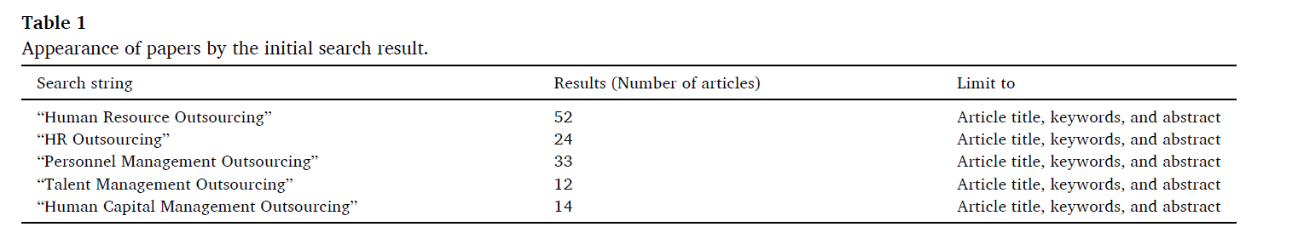
The PRISMA model four stages of screening data based on Content Analysis.
Identification of the data:
The Scopus integrated database served as the foundation for collecting data in this study, encompassing all key publishers, including Taylor and Francis, Emerald, Springer, Nature, Wiley, and Elsevier. The academician’s contributions to HRO and related fields began in 2001. Consequently, a search was conducted to identify papers covering the period from 2001 to August 2021.
The search string included terms such as “Human Resource Outsourcing,” “HR outsourcing,” “Personnel Management Outsourcing,” “Talent Management Outsourcing,” and “Human Capital Management Outsourcing,” limited to the article title, keywords, and abstract.
Initially, a total of 135 results was shown, as displayed in Table 1:

Slide 12
Screening of initial data , Eligibility determination & Data inclusion
During the initial data identification stage, a total of 135 items comprising articles, book chapters, conference papers, and reviews were selected. The selection process followed the recommendations outlined in previous literature. Subsequently, non-article items were excluded, narrowing down the selection. After removing 66 duplicated papers, a final set of 69 papers remained for metadata analysis.
Following the suggestions of previous literature by Islam and Tseng, this study objectively determined 32 eligible papers by performing a keyword search in the ISI Web of Science database using the keywords “human resource outsourcing,” “personnel outsourcing,” and “HR outsourcing.” Papers appearing in both the ISI Web of Science and Scopus databases were selected as eligible for the next step.
The study ensures that the data is sourced from an enriched and standard database while maintaining unbiasedness. The paper collects data exclusively from the ISI Web of Science database through a keyword search. In addition, it is worth noting that the papers found in ISI Web of Science may also be found in the Scopus database.

Slide 13
Analysis and observations
Metadata analysis
This section presents descriptive statistics that uncover the metadata analysis of 69 papers which includes the names of journals, years, authors, funding institutions, citations, countries, subject areas, and affiliated institutions. There is a possibility of counting a single paper multiple times in the metadata analysis; for example, if a paper is counted based on its authors, it is also counted in terms of its year and area. In some instances, this study does not present the statistics in an exhaustive list but instead uses a reduced format to enhance readability.
The exploration of HRO in academic papers began in early 2001, with two notable publications in this field. However, academic contributions pertaining to HRO were relatively scarce until the year 2010. In 2010, the maximum number of papers was published, totaling 16. Both in 2011 and 2015, seven papers were found, indicating significant progress. In 2014 and 2016, the number of articles stood at 6 for each year, respectively.
Although the literature on HRO is found in diversified journals, three papers each are sourced from both the Journal of Business Research and the International Journal of Human Resource Management. Additionally, six papers are obtained from Advanced Science Letters, Human Resource Management, and Human Resource Management International Journal, with two papers from each journal. The meta-analysis reveals that the top authors who have made contributions to HRO-related papers are ranked based on Scopus indexed journals.

Slide 14
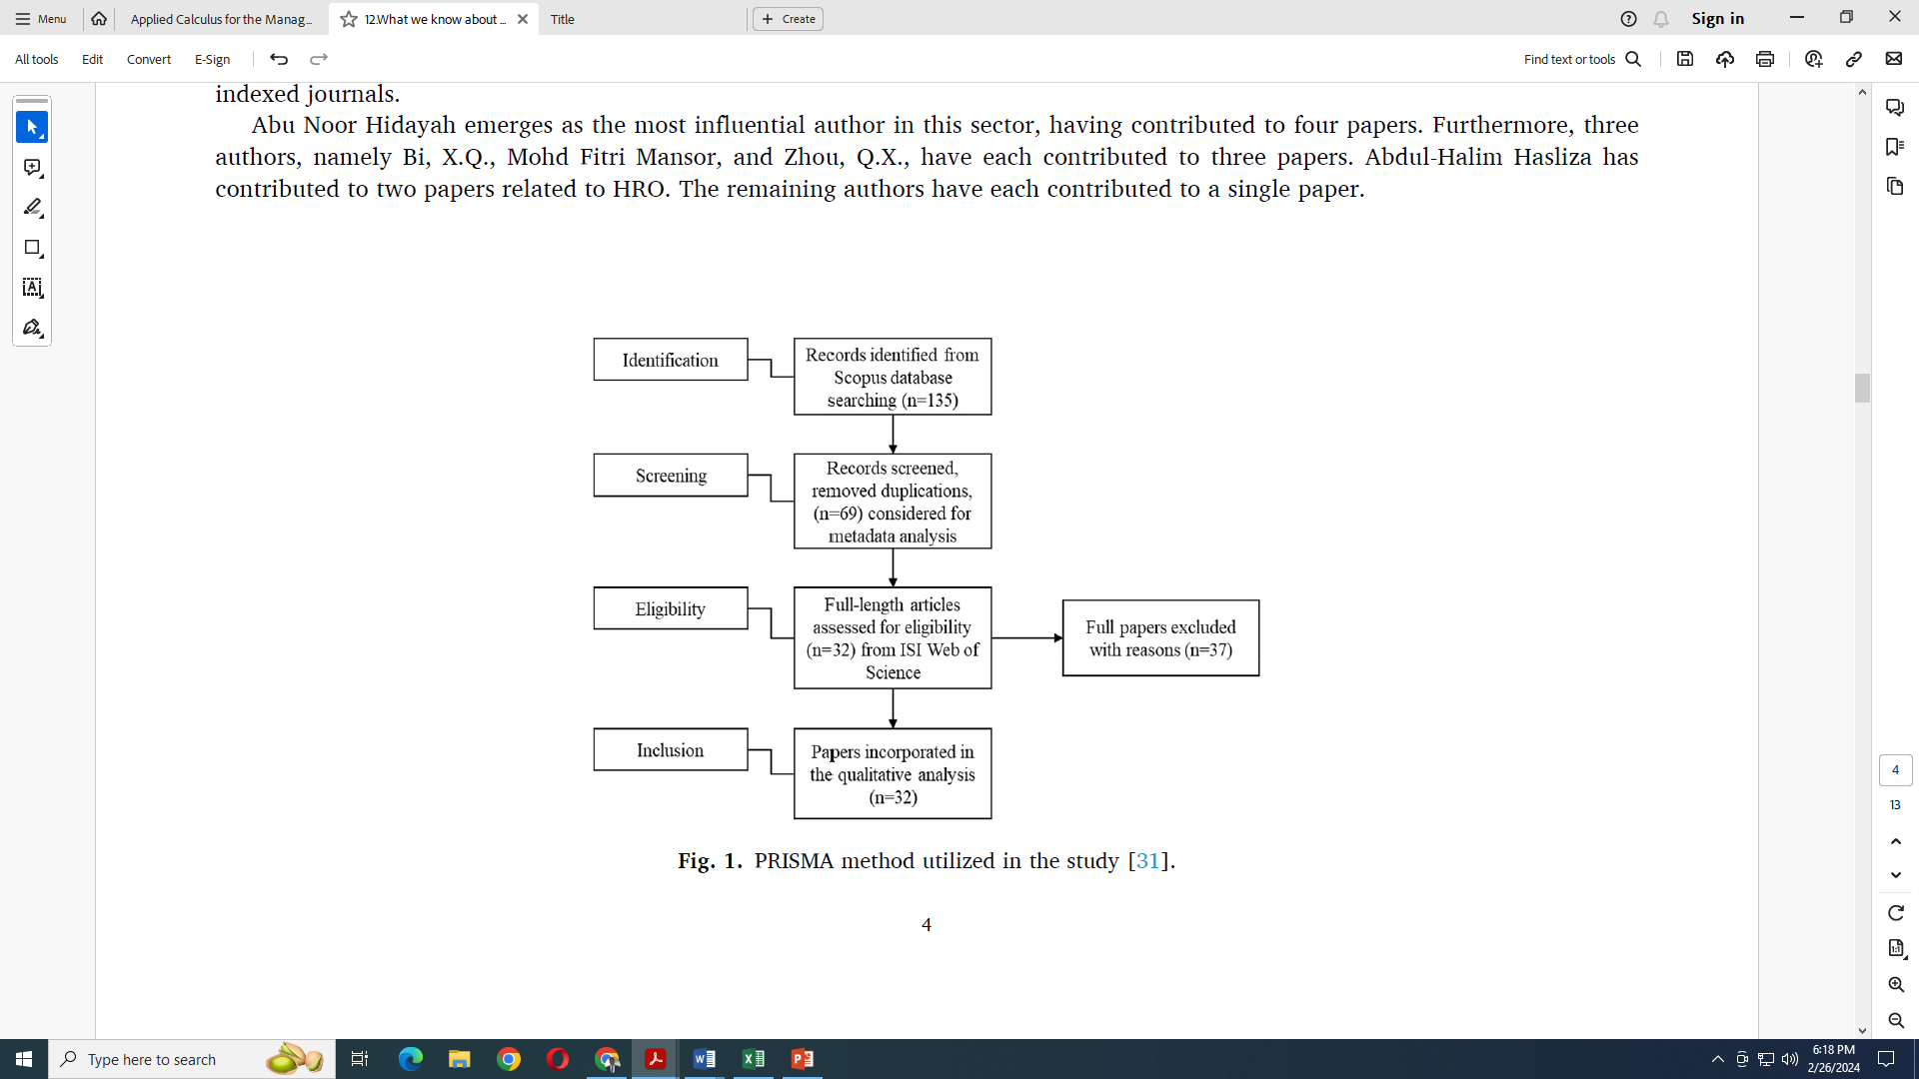
Publication by journals
Abu Noor Hidayah emerges as the most influential author in this sector, having contributed to four papers. Furthermore, three authors, namely Bi, X.Q., Mohd Fitri Mansor, and Zhou, Q.X., have each contributed to three papers. Abdul-Halim Hasliza has contributed to two papers related to HRO. The remaining authors have each contributed to a single paper.

Slide 15
Publications by country/territory
China dominates the production of papers related to HRO, accounting for 35% of the total. However, Malaysia and the United States both share the same percentage, contributing 16% of the total papers each. Similarly, Taiwan and the United Kingdom have each contributed 7% of the papers. Furthermore, two Asian countries (India and Hong Kong) and North America (Canada) have produced 12% of the total HRO-related papers, with each country contributing 4%. On the other hand, Australia has the lowest number of HRO related papers, while Vietnam is the second-to-last contributing country, producing 3% of the total.
Publication by document type
HRO is not commonly discussed in academia, reflecting a limited number of book chapters and review papers, a large portion of 58% is found in article, accounting more than half of the total output. Conference papers cover 34% of the total contribution, while book chapters and reviews contribute 3% and 5%, respectively.

Slide 16
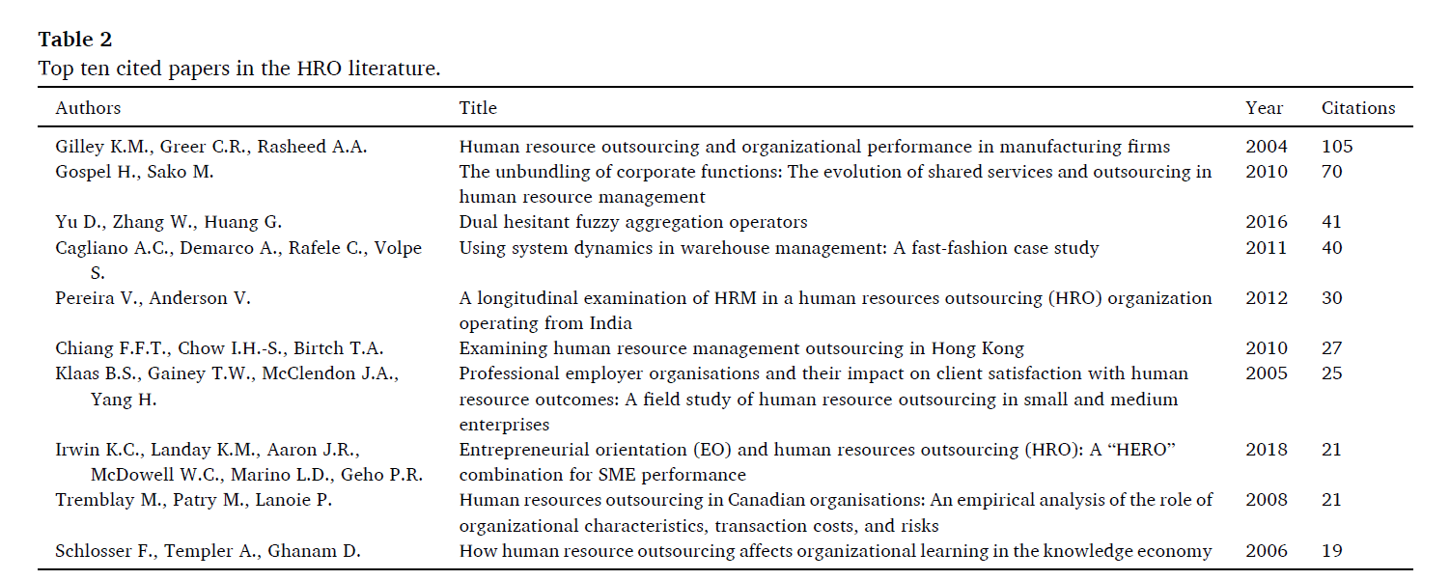
Publications by citations
The data presented in Table 2 highlights that the paper by Gilley et al. (2004) has received the highest number of citations in the HRO field, followed by Gospel and Sako with 70 citations. Additionally, Yu et al. (2016) and Cagliano et al. (2011) have received around 40 citations.

Slide 17
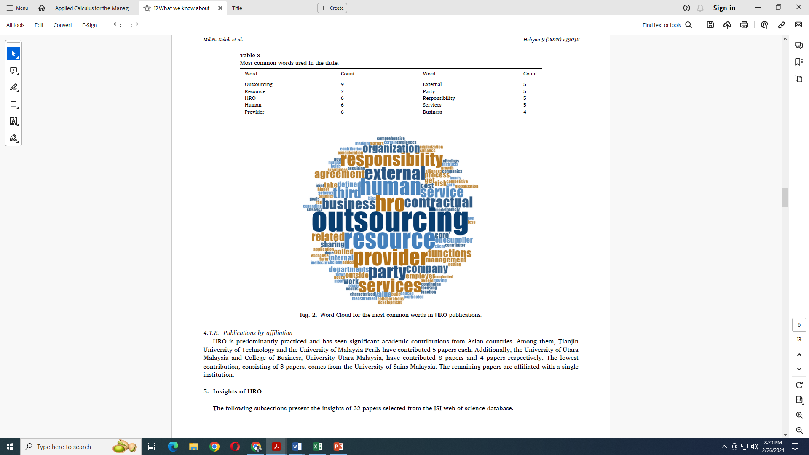
Most common words appeared in the title
To identify the most common words appearing in the titles of HRO publications, the word cloud feature of NVivo 12 (latest version) software was utilized. Table 3 presents the most frequent words found in HRO titles, including ‘outsourcing’, ‘resource’, ‘HRO’, and ‘human’.
Fig. 2, generated from NVivo 12, visually presents these common words with more comprehensive and bold fonts, while relatively less frequent words are displayed in smaller fonts. Previous studies have argued the effectiveness of word clouds in exploring prevalent words in complex environments, commonly used in literature to identify prominent terms, keywords, and common themes in publications.

Slide 18
Publications by subject area
HRO is a branch of human resource management practice, it is practiced and accepted in several sectors and contributed to academic areas. As a result, the maximum contribution of 54% is made on business, management, and accounting, and it is more than half of the total. Further, the second-largest performance is seen in computer science, and it is 26%.
HRO practices are seen at 23%, 14%, and 12% in Engineering, Social Sciences, and Decision Sciences, consecutively. Additionally, Economics, Econometrics, and Finance cover 10% of the papers, while Mathematics accounts for 7%. Materials Science and Psychology both contribute 6% each, and the lowest percentage comes from Chemistry, representing 4% of the total.
Publications by affiliation
HRO is predominantly practiced and has seen significant academic contributions from Asian countries. Among them, Tianjin University of Technology and the University of Malaysia Perils have contributed 5 papers each. Additionally, the University of Utara Malaysia and College of Business, University Utara Malaysia, have contributed 8 papers and 4 papers respectively. The lowest contribution, consisting of 3 papers, comes from the University of Sains Malaysia. The remaining papers are affiliated with a single institution.

Slide 19
Insights of HRO
Fig. 3 displays the ‘word tree’ associated with the past definitions, illustrating how the word ‘outsourcing’ is positioned within the sentence structure while defining HRO. For example, the phrases ‘responsibility of HR function,’ ‘with outside service provider,’ and ‘moving towards comprehensive outsourcing’ emerge as the most common contexts derived from prior definitions.
Fig. 3. The placement of the word “outsourcing” in the definition

Slide 20
Conceptual and theory development
Shared responsibility, understanding the client’s expectations, and the organization’s capability, benefits, and risks are essential elements of the HRO process and crucial for successful outsourcing. However, top management’s role in pursuing HRO success is often not strongly emphasized, and the responsibility for HRO implementation is commonly delegated to other employees.
The presence of trust and close supervision is a core issue, as the absence of trust can disrupt information flow, create coordination problems, and lead to conflicts between organizations Again, provider quality and knowledge sharing are crucial factors that can be evaluated based on the recommendation from in-house personnel of the receiving company.
HR Outsourcing involves the service receiver company delegating both core and non-core HR functions to an outsourcing company, aiming to achieve organizational and economic advantages by reallocating significant time and resources from employee management programs. The provided definition encompasses the involvement of HRO partners, such as vendor companies and inter-organizational employees, with an emphasis on trustworthiness and reliability.
In the evaluation of the HRO concept, previous studies have highlighted how it has emerged as a trusted partner for businesses. The service receiver company is not merely seeking the right provider, but also a longstanding and reliable partner reliable partner. As a result, the evolution of HRO literature has embraced the contributions of numerous researchers, leading to a wide range of studies focused on the conceptual development of HRO.

Slide 21
Drivers and drawbacks of HRO
Cost reduction and several other factors are often determine whether a company will engage an external vendor. Internal operational needs, resource limitations, urgency, and internal capabilities are taken into consideration. Traditional companies typically retain their HR department while attempting to save costs through economies of scale, lower technology-investment costs, efficient HR processes, and reduced headcount.
Earlier studies by Pandey and Quartey reveal that HRO impacts organizational learning both positively and negatively. However, beyond formal organizational boundaries, it provides a new learning network and offers specialized practice for a function, which is then obtained by the client company. Furthermore, firms that engage in innovative products and aim to exploit the market are more likely to buy routine HR functions, while those that maintain a pace strategy are less likely to outsource non-core HR activities.
Along with the aforementioned factors, firms are influenced to buy HR functions because it provides access to new technology, minimizes risk, and eliminates internal biases within the organization. Following the employee retention concept, specialized training opportunities and succession planning foster social capital, which is firm-specific and encourages employees to stay with the organization.
A study by Butler found that outsourcing transactional HR functions can increase market share value, leading to positive cash flows, especially in service firms. However, in the long run, the return on investment may decline if firms fail to optimize HRO participation.

Slide 22
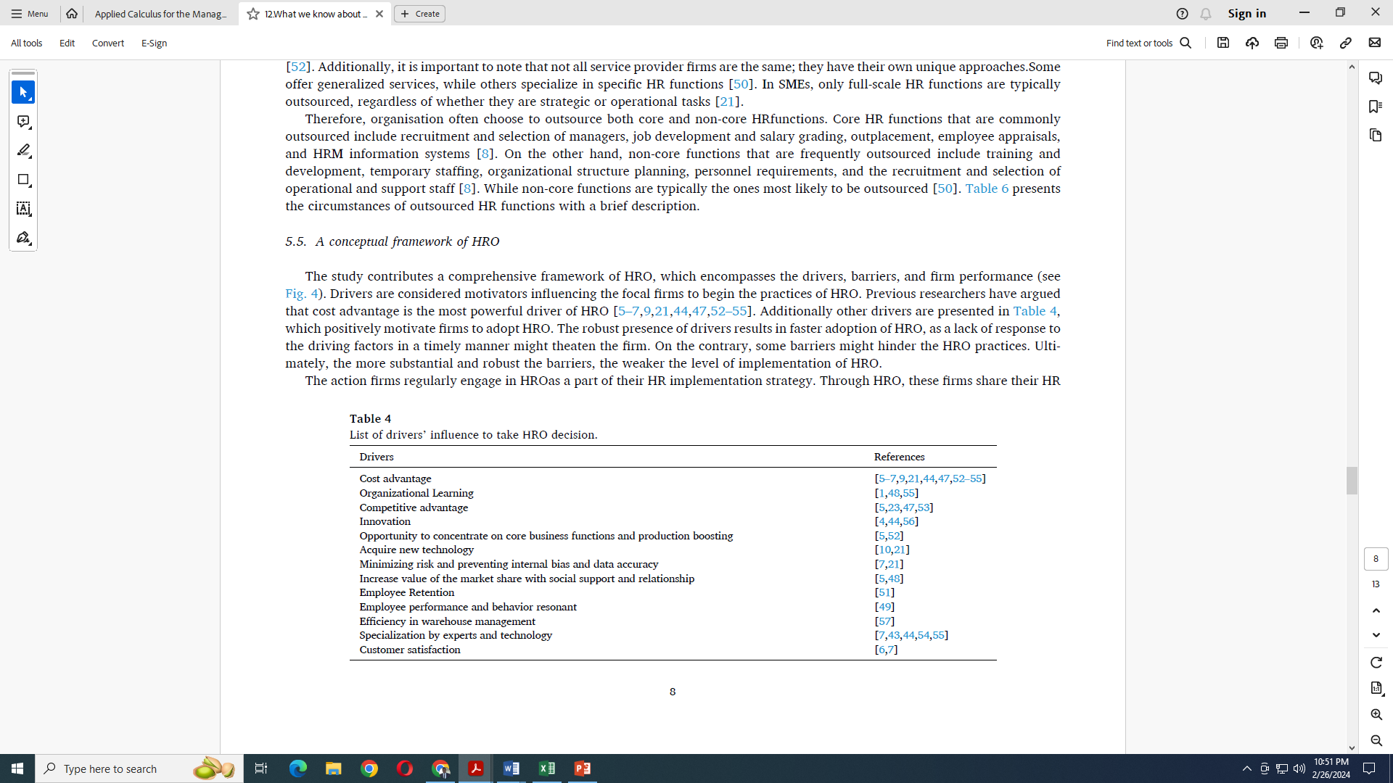
Drivers and drawbacks of HRO
Labor-intensive sectors that prioritize pragmatic and problem-solving tasks while maintaining service quality are increasingly practicing outsourcing HR functions to influence and regulate employee performance and behavioral resonance. Decentralized firms find it effective to outsource their HR activities for standardizing their system and processes, rather than relying on a centralized firm.
Table 4 presents the drivers related to HRO decision-making.

Slide 23
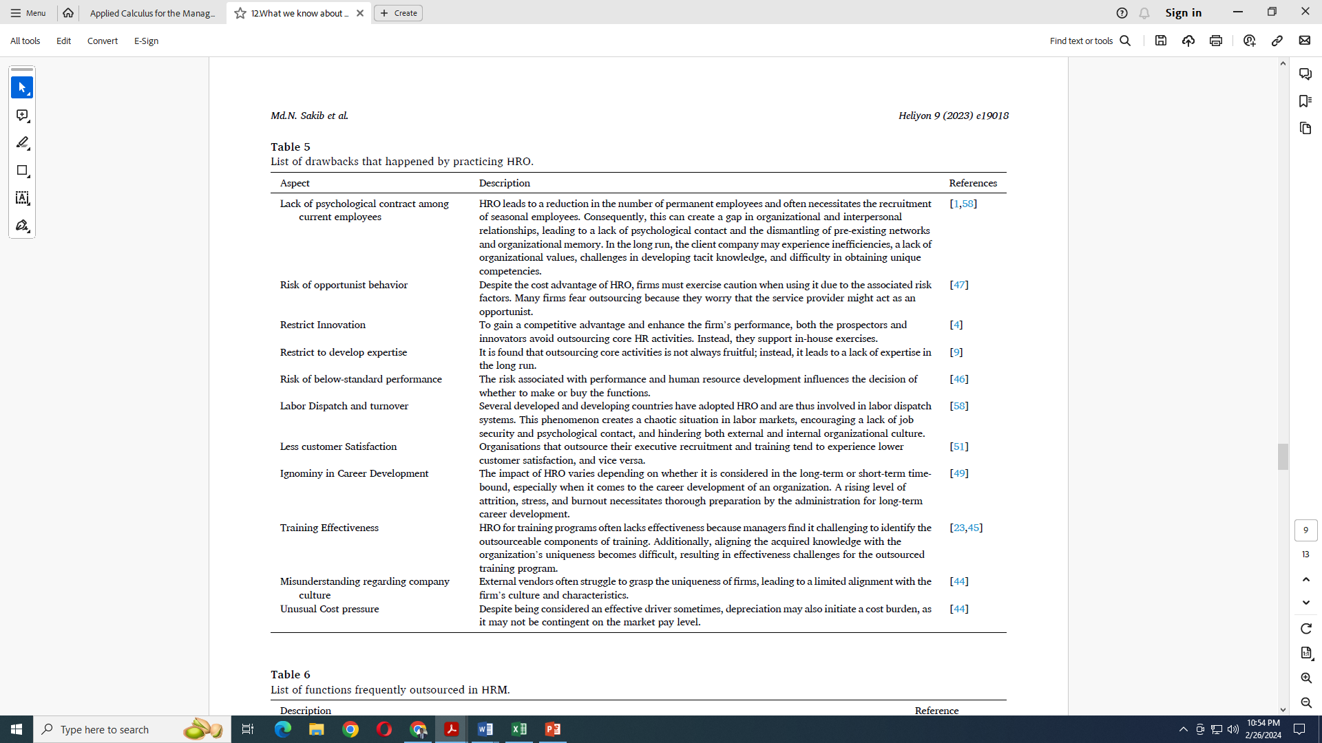

Slide 24
Barriers to choose HRO practices
Outsourcing can be highly beneficial for an organization, encompassing both core and non-core HR functions. However, the absence of an established guiding framework for the decision to outsource often leads to the discouragement of outsourcing core HR functions. This discouragement stems from various factors such as the organization's strategy, structural choices, size, management style, as well as organizational fit and potential impact.
Following the trends, the large organization intends to outsource HR related operational tasks and retains strategic responsibilities of HR activities. Similarly, several other studies also highlight the potential loss of control in the implementation of HRO.
HRO faces numerous challenges, such as the absence of proper management regulations and prior experience, difficulties in finding trustworthy suppliers, uncertainties regarding cost-effectiveness, and potential consequences in case of outsourcing failures. Perceived risk associated with HR outsourcing is also a common barrier to HRO adoption. Moreover, HRO policies may face government regulation due to fears of labor dispatch. Finally, it should be noted that the absence of a HR manager’s commitment make sit unlikely for existing HRO practices to continue.

Slide 25
Functions outsourced
Despite the study of Chiang suggesting the importance of maximizing internal resource utilization, organizations that have outsourced HR functions are likely to achieve a competitive advantage by considering HRO as a strategic practice. However, not all outsourced functions have an equal impact, as they can affect the organization's performance directly, indirectly, or simultaneously.
It is important to note that not all service provider firms are the same; they have their own unique approaches. Some offer generalized services, while others specialize in specific HR functions. In SMEs, only full-scale HR functions are typically outsourced, regardless of whether they are strategic or operational tasks.
Organization often choose to outsource both core and non-core HR functions. Core HR functions that are commonly outsourced include recruitment and selection of managers, job development and salary grading, outplacement, employee appraisals, and HRM information systems.

Slide 26
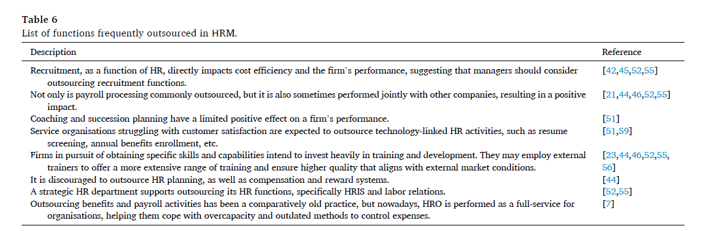
Functions outsourced
On the other hand, non-core functions that are frequently outsourced include training and development, temporary staffing, organizational structure planning, personnel requirements, and the recruitment and selection of operational and support staff. While non-core functions are typically the ones most likely to be outsourced.
Table 6 presents the circumstances of outsourced HR functions with a brief description:

Slide 27
A conceptual framework of HRO
The study contributes a comprehensive framework of HRO, which encompasses the drivers, barriers, and firm performance. Drivers are considered motivators influencing the focal firms to begin the practices of HRO. Previous researchers have argued that cost advantage is the most powerful driver of HRO.
The robust presence of drivers results in faster adoption of HRO, as a lack of response to the driving factors in a timely manner might threaten the firm. On the contrary, some barriers might hinder the HRO practices. Ultimately, the more substantial and robust the barriers, the weaker the level of implementation of HRO.
The action firms regularly engage in HRO as a part of their HR implementation strategy. Through HRO, these firms share their HR functions on a contractual basis, effectively transferring HR responsibilities to external suppliers. In other words, the focal firms delegate their HR tasks to outside suppliers. Therefore, HRO provides opportunities for fostering collaborative relationships with external firms.

Slide 28
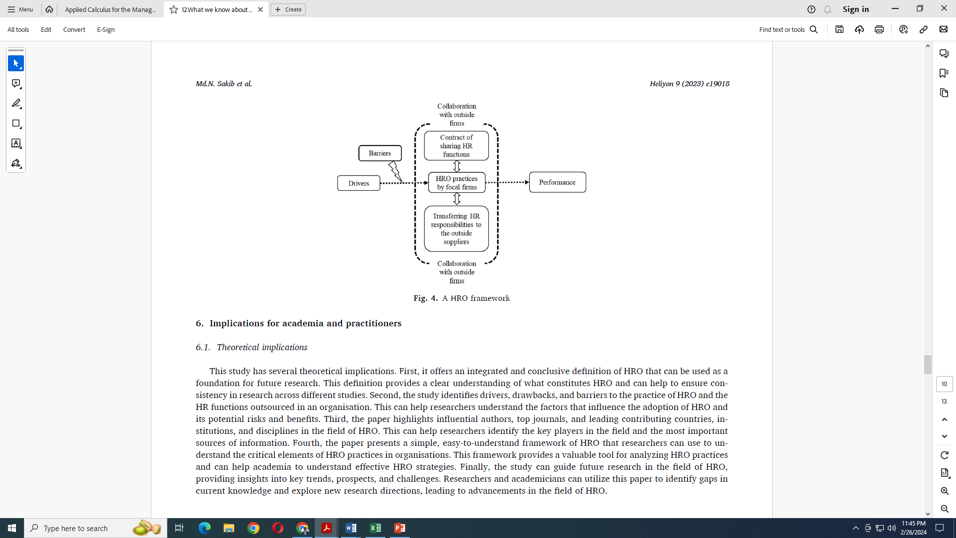
A conceptual framework of HRO
Fig. 4 illustrates the drivers motivating the focal firms to adopt HRO practices. The arrow from drivers to HRO practices indicates a positive relationship between them. Additionally, successful adoption of HRO practices can lead to improved performance, represented by the right-side arrow from performance box. The barrier box with the arrow curving in the opposite direction represents hindrances caused by barriers to adopting HRO.

Slide 29
Implications for academia and practitioners
Theoretical implications
It offers an integrated and conclusive definition of HRO that can be used as a foundation for future research. This definition provides a clear understanding of what constitutes HRO and can help to ensure consistency in research across different studies.
Second, the study identifies drivers, drawbacks, and barriers to the practice of HRO and the HR functions outsourced in an organization. This can help researchers understand the factors that influence the adoption of HRO and its potential risks and benefits.
Third, the paper highlights influential authors, top journals, and leading contributing countries, institutions, and disciplines in the field of HRO. This can help researchers identify the key players in the field and the most important sources of information.
Fourth, the paper presents a simple, easy-to-understand framework of HRO that researchers can use to understand the critical elements of HRO practices in organizations. This framework provides a valuable tool for analyzing HRO practices and can help academia to understand effective HRO strategies.
Finally, the study can guide future research in the field of HRO, providing insights into key trends, prospects, and challenges. Researchers and academicians can utilize this paper to identify gaps in current knowledge and explore new research directions, leading to advancements in the field of HRO.

Slide 30
Practical implications
The practical implications of this paper can benefit both organizations and practitioners involved in HRO. First, the study offers insights into the drivers and barriers to HRO adoption, which can help organizations make informed decisions when considering outsourcing HR functions.
The study suggests that organizations can benefit from cost advantages and the ability to focus on core business functions, but they need to be aware of potential drawbacks, such as the risk of opportunism and the loss of psychological contact among current employees. Second, the study identifies recruitment, payroll processing, and technology-centric HR activities as the standard HR functions outsourced by organizations.
This can help organizations decide which HR functions they can outsource to maximize the benefits of HRO. Additionally, the study presents a simple and comprehensive framework of HRO that can help practitioners understand the concept of HRO and apply it to their organizational context.

Slide 31
Conclusion
Due to changes in the world’s working ambiance and the way of working, there is an increased need to accomplish the tasks without physical presence. The pandemic situation and the mandate to limit social interactions have boosted the practice of HRO, encouraging both vendors and service receiver companies to keep their functions in top shape. Thus, HRO deserves more attention than a typical HR department. It is a new concept in which an organization delegates core and non-core HR tasks as much as employee management requires. While the idea of HRO isn’t new, the practice has gained popularity since the 21st century.
This paper identifies the reasons behind the rapid growth of HRO in connection with this idea. At the beginning of the study, we presented the concept of HRO by following a methodology that involves reviewing extant literature. In addition, the study systematically reviews and provides descriptive analysis based on metadata analysis and offers insights based on content analysis. We utilized a reliable database for data collection.
Metadata analysis includes influential authors, funding and grant institutions, popular journals, publications by year, top contributing countries, institutions, document types, top-cited papers, and subject areas. According to the number of contributed papers, Abu Noor Hidayah was identified as the most influential author in this study. The International Journal of Human Resource Management and the Journal of Business Research are two of the most popular journals in this field. Furthermore, China emerged as the dominant country in terms of the number of published papers and their impact

Slide 32
Conclusion
Business, management, and accounting retain a significant share of the literature in HRO. To gain insight into the study, we considered the shortlisted papers from SCOPUS and Web of Science. Content analysis formed the basis of our insights, and we categorized the content into four sections: conceptual and theory development, drivers and drawbacks, barriers to choosing HRO practice, and outsourced functions. The content analysis suggests that the author is still working on describing HRO in several dimensions, and as more reasons for the practice of HRO emerge, there are also many considerations to be taken into account.
The contribution of this paper is to offer an integrated and conclusive definition of HRO. It presents key insights and trends in HRO, which significantly differ from earlier studies. The paper provides a simple, easy-to-understand, yet comprehensive framework of HRO. Ultimately, researchers and academicians can utilize this paper to explore future research directions while gaining a thorough understanding of the HRO concept.

Slide 33



