Slide 1
Chapter 06
Mining Frequent Patterns, Association and Correlations
Dr. Chin-Hui Lai
Department of Information Management, CYCU
Email: chlai@cycu.edu.tw

Slide 2
Outline
Basic Concepts
Frequent Itemset Mining Methods
  Apriori algorithm
  FP-growth algorithm
Which Patterns Are Interesting?—Pattern Evaluation Methods
Summary

Slide 3
What Is Frequent Pattern Analysis?
Frequent pattern: a pattern (a set of items, subsequences, substructures, etc.) that occurs frequently in a data set
First proposed by Agrawal, Imielinski, and Swami [AIS93] in the context of frequent itemsets and association rule mining
Motivation: Finding inherent regularities in data
  What products were often purchased together?— Beer and diapers?!
  What are the subsequent purchases after buying a PC?
  What kinds of DNA are sensitive to this new drug?
  Can we automatically classify web documents?
Applications
  Basket data analysis, cross-marketing, catalog design, sale campaign analysis, Web log (click stream) analysis, and DNA sequence analysis.

Slide 4
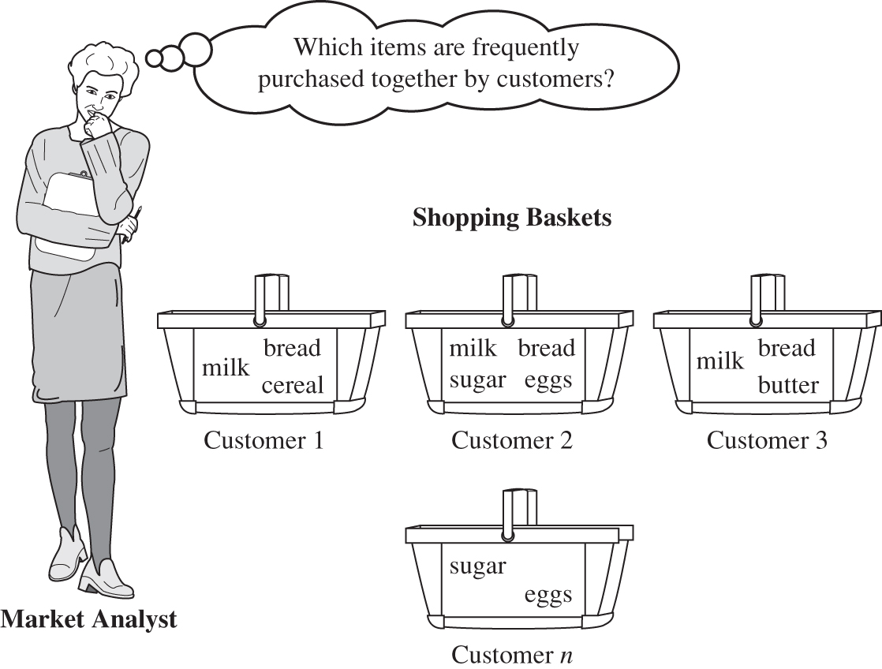
Example: Market Basket Analysis
Figure 6.1 Market basket analysis.

Slide 5
Why Is Freq. Pattern Mining Important?
Freq. pattern: An intrinsic and important property of datasets
Foundation for many essential data mining tasks
  Association, correlation, and causality analysis
  Sequential, structural (e.g., sub-graph) patterns
  Pattern analysis in spatiotemporal, multimedia, time-series, and stream data
  Classification: discriminative, frequent pattern analysis
  Cluster analysis: frequent pattern-based clustering
  Data warehousing: iceberg cube and cube-gradient
  Semantic data compression: fascicles
  Broad applications

Slide 6
Basic Concepts: Frequent Patterns
TID | Items bought
10 | Beer, Nuts, Diaper
20 | Beer, Coffee, Diaper
30 | Beer, Diaper, Eggs
40 | Nuts, Eggs, Milk
50 | Nuts, Coffee, Diaper, Eggs, Milk
itemset: A set of one or more items
k-itemset X = {x₁, …, x_{k}}
(absolute) support, or, support count of X: Frequency or occurrence of an itemset X
(relative) support, s, is the fraction of transactions that contains X (i.e., the probability that a transaction contains X)
An itemset X is frequent if X’s support is no less than a minsup threshold
Customer
buys both
Customer
buys diaper
Customer
buys beer

Slide 7

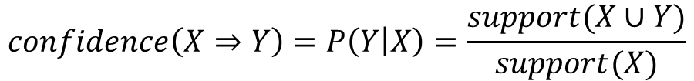
Basic Concepts: Association Rules (1/2)
TID
Items bought
Find all the rules X → Y with minimum support and confidence
  support, s, probability that a transaction contains X ∪ Y
  confidence, c, conditional probability that a transaction having X also contains Y
10
Beer, Nuts, Diaper
20
Beer, Coffee, Diaper
30
Beer, Diaper, Eggs
40
Nuts, Eggs, Milk
50
Nuts, Coffee, Diaper, Eggs, Milk
Customer
buys both
$$support\left(X⇒Y\right)=P(X∪Y)$$
Customer
buys diaper
Customer
buys beer
$$confidence\left(X⇒Y\right)=P\left(Y | X\right)=\frac{support(X∪Y)}{support(X)}$$

Slide 8
Basic Concepts: Association Rules (2/2)
Let minsup = 50%, minconf = 50%
Freq. Pat.: Beer:3, Nuts:3, Diaper:4, Eggs:3, {Beer, Diaper}:3
Association rules: (many more!)
  Beer → Diaper (60%, 100%)
  Diaper → Beer (60%, 75%)

Slide 9

Closed Patterns and Max-Patterns
A long pattern contains a combinatorial number of sub-patterns, e.g., {a₁, …, a₁₀₀} contains 2¹⁰⁰ – 1 = 1.27*10³⁰ sub-patterns!
Solution: Mine closed patterns and max-patterns instead
An itemset X is closed if X is frequent and there exists no super-pattern Y כ X, with the same support as X (proposed by Pasquier, et al. @ ICDT’99)
An itemset X is a max-pattern if X is frequent and there exists no frequent super-pattern Y כ X (proposed by Bayardo @ SIGMOD’98)
Closed pattern is a lossless compression of freq. patterns
  Reducing the # of patterns and rules

Slide 10
Closed Patterns and Max-Patterns
Exercise. DB = {<a₁, …, a₁₀₀>, < a₁, …, a₅₀>}
  Min_sup = 1.
What is the set of closed itemset?
  <a₁, …, a₁₀₀>: 1
  < a₁, …, a₅₀>: 2
What is the set of max-pattern?
  <a₁, …, a₁₀₀>: 1
What is the set of all patterns?
  !!

Slide 11
The Downward Closure Property and Scalable Mining Methods
The downward closure property of frequent patterns
  Any subset of a frequent itemset must be frequent
  If {beer, diaper, nuts} is frequent, so is {beer, diaper}
  i.e., every transaction having {beer, diaper, nuts} also contains {beer, diaper}
Scalable mining methods: Three major approaches
  Apriori (Agrawal & Srikant@VLDB’94)
  Freq. pattern growth (FPgrowth—Han, Pei & Yin @SIGMOD’00)
  Vertical data format approach (Charm—Zaki & Hsiao @SDM’02)
Notes:
Downward closure property 向下封閉性

Slide 12
Apriori Algorithm

Slide 13
Apriori: A Candidate Generation & Test Approach
Apriori pruning principle: If there is any itemset which is infrequent, its superset should not be generated/tested! (Agrawal & Srikant @VLDB’94, Mannila, et al. @ KDD’ 94)
Method:
  Initially, scan DB once to get frequent 1-itemset
  Generate length (k+1) candidate itemsets from length k frequent itemsets
  Test the candidates against DB
  Terminate when no frequent or candidate set can be generated

Slide 14
The Apriori Algorithm—An Example
Database TDB
Itemset | sup
{A} | 2
{B} | 3
{C} | 3
{D} | 1
{E} | 3
Itemset | sup
{A} | 2
{B} | 3
{C} | 3
{E} | 3
Tid | Items
10 | A, C, D
20 | B, C, E
30 | A, B, C, E
40 | B, E
C₁
L₁
1st scan
Sup_{min} = 2
Itemset | sup
{A, B} | 1
{A, C} | 2
{A, E} | 1
{B, C} | 2
{B, E} | 3
{C, E} | 2
Itemset
{A, B}
{A, C}
{A, E}
{B, C}
{B, E}
{C, E}
Itemset | sup
{A, C} | 2
{B, C} | 2
{B, E} | 3
{C, E} | 2
C₂
C₂
L₂
2nd scan
C₃
Itemset
{B, C, E}
3rd scan
L₃
Itemset | sup
{B, C, E} | 2

Slide 15
The Apriori Algorithm (Pseudo-Code)
C_{k}: Candidate itemset of size k
L_{k} : frequent itemset of size k
L₁ = {frequent items};
for (k = 1; L_{k} !=∅; k++) do begin
C_{k+1} = candidates generated from L_{k};
for each transaction t in database do
  increment the count of all candidates in C_{k+1} that are contained in t
L_{k+1} = candidates in C_{k+1} with min_support
end
return ∪_{k} L_{k};

Slide 16
Implementation of Apriori
How to generate candidates?
  Step 1: self-joining L_{k}
  Step 2: pruning
Example of Candidate-generation
  L₃={abc, abd, acd, ace, bcd}
  Self-joining: L₃*L₃
    abcd from abc and abd
    acde from acd and ace
  Pruning:
    acde is removed because ade is not in L₃
  C₄ = {abcd}

Slide 17
How to Count Supports of Candidates?
Why counting supports of candidates a problem?
  The total number of candidates can be very huge
  One transaction may contain many candidates
Method:
  Candidate itemsets are stored in a hash-tree
  Leaf node of hash-tree contains a list of itemsets and counts
  Interior node contains a hash table
  Subset function: finds all the candidates contained in a transaction

Slide 18
Counting Supports of Candidates Using Hash Tree
Subset function
Transaction: 1 2 3 5 6
3,6,9
1,4,7
2,5,8
1 + 2 3 5 6
1 3 + 5 6
2 3 4
5 6 7
1 4 5
3 4 5
3 5 6
3 5 7
6 8 9
3 6 7
3 6 8
1 3 6
1 2 + 3 5 6
1 2 4
4 5 7
1 2 5
4 5 8
1 5 9
https://stanthecoder.me/apriori-bi-ji-2/

Slide 19
Further Improvement of the Apriori Method
Major computational challenges
  Multiple scans of transaction database
  Huge number of candidates
  Tedious workload of support counting for candidates
Improving Apriori: general ideas
  Reduce passes of transaction database scans
  Shrink number of candidates
  Facilitate support counting of candidates

Slide 20
Partition: Scan Database Only Twice
Any itemset that is potentially frequent in DB must be frequent in at least one of the partitions of DB
  Scan 1: partition database and find local frequent patterns
  Scan 2: consolidate global frequent patterns
(A. Savasere, E. Omiecinski and S. Navathe, VLDB’95)
DB₁
+
DB₂
+
+
DB_{k}
= DB
sup₁(i) < σDB₁
sup₂(i) < σDB₂
sup_{k}(i) < σDB_{k}
sup(i) < σDB

Slide 21
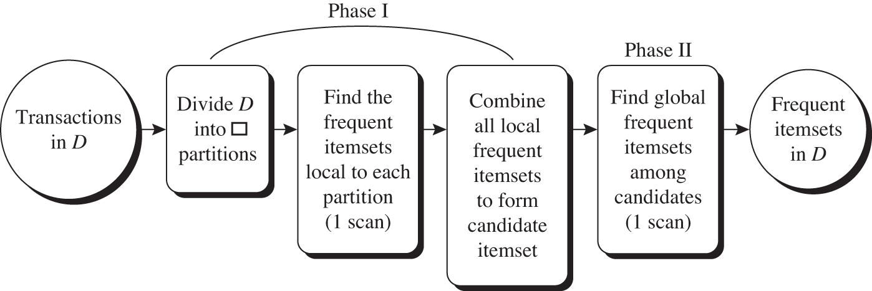
Mining by partitioning the data

Slide 22
DHP: Reduce the Number of Candidates
A k-itemset whose corresponding hashing bucket count is below the threshold cannot be frequent
  Candidates: a, b, c, d, e
  Hash entries
    {ab, ad, ae}
    {bd, be, de}
    …
  Frequent 1-itemset: a, b, d, e
  ab is not a candidate 2-itemset if the sum of count of {ab, ad, ae} is below support threshold
(J. Park, M. Chen, and P. Yu. An effective hash-based algorithm for mining association rules. SIGMOD’95)
count
itemsets
35
{ab, ad, ae}
88
{bd, be, de}
...
...
102
{yz, qs, wt}
Hash Table

Slide 23
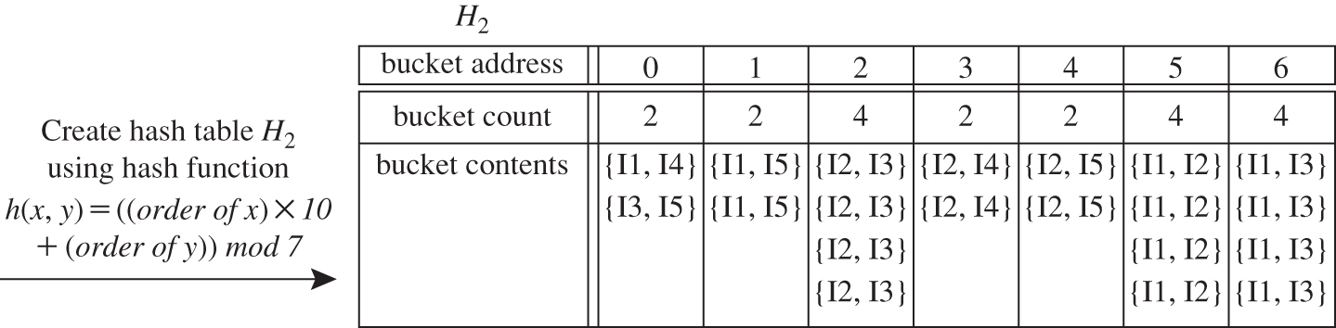
DHP: Reduce the Number of Candidates
Min support count =3
Figure 6.5 Hash table, H₂, for candidate 2-itemsets. This hash table was generated by scanning Table 6.1’s transactions while determining L₁. If the minimum support count is, say, 3, then the itemsets in buckets 0, 1, 3, and 4 cannot be frequent and so they should not be included in C₂.
Notes:
The modulo (or "modulus" or "mod") is the remainder after dividing one number by another.
Example: 100 mod 9 equals 1
Because 100/9 = 11 with a remainder of 1

Slide 24
Sampling for Frequent Patterns
Select a sample of original database, mine frequent patterns within sample using Apriori
Scan database once to verify frequent itemsets found in sample, only borders of closure of frequent patterns are checked
  Example: check abcd instead of ab, ac, …, etc.
Scan database again to find missed frequent patterns
H. Toivonen. Sampling large databases for association rules. In VLDB’96

Slide 25
DIC: Reduce Number of Scans
ABCD
Once both A and D are determined frequent, the counting of AD begins
Once all length-2 subsets of BCD are determined frequent, the counting of BCD begins
ABC
ABD
ACD
BCD
AB
AC
BC
AD
BD
CD
Transactions
1-itemsets
A
B
C
D
Apriori
2-itemsets
…
{}
Itemset lattice
1-itemsets
2-items
S. Brin R. Motwani, J. Ullman, and S. Tsur. Dynamic itemset counting and implication rules for market basket data. SIGMOD’97
DIC
3-items

Slide 26
Exercise 1
Transactional database, D, for an AllElectronics Branch
Please use the Apriori algorithm for finding the frequent itemsets in D. (The min support count =2)

Slide 27
Exercise 2
Based on the transactional database D for AllElectronics, the resulting association rules are as shown below.
Please calculate the confidence for each rule.
If the minimum confidence threshold is 70%, which are strong rules?

Slide 28
FP-Growth Approach

Slide 29
Pattern-Growth Approach: Mining Frequent Patterns Without Candidate Generation
Bottlenecks of the Apriori approach
  Breadth-first (i.e., level-wise) search
  Candidate generation and test
    Often generates a huge number of candidates
The FPGrowth Approach (J. Han, J. Pei, and Y. Yin, SIGMOD’ 00)
  Depth-first search
  Avoid explicit candidate generation
Major philosophy: Grow long patterns from short ones using local frequent items only
  “abc” is a frequent pattern
  Get all transactions having “abc”, i.e., project DB on abc: DB|abc
  “d” is a local frequent item in DB|abc → abcd is a frequent pattern

Slide 30
FP-Tree and FP-Growth Algorithm
FP-Tree: Frequent Pattern Tree
  Compact presentation of the DB without information loss.
  Easy to traverse, can quickly find out patterns associated with a certain item.
  Well-ordered by item frequency
FP-Growth Algorithm
  Start mining from length-1 patterns
  Recursively do the following
    Constructs its conditional FP-tree
    Concatenate patterns from conditional FP-tree with suffix
  Divide-and-Conquer mining technique
Ref: https://www.softwaretestinghelp.com/fp-growth-algorithm-data-mining/
Notes:
https://www.geeksforgeeks.org/ml-frequent-pattern-growth-algorithm/
https://blog.csdn.net/bryant_meng/article/details/80864910
https://www.softwaretestinghelp.com/fp-growth-algorithm-data-mining/

Slide 31
FP-Tree Definition (1/2)
Three components:
  One root: labeled as “null”
  A set of item prefix subtrees
  A frequent-item header table
root
f : 4
c : 1
c : 3
b : 1
b : 1
Header Table
a : 3
p : 1
item
head of node-links
f
m : 2
b : 1
c
a
b
p : 2
m : 1
m
p

Slide 32
FP-Tree Definition (2/2)
Each node in the item prefix subtree consists of three fields:
  item-name
  node-link
  count
Each entry in the frequent-item header table consists of two fields:
  item-name
  head of node-link

Slide 33
Construct FP-tree from a Transaction Database
TID Items bought (ordered) frequent items
100 {f, a, c, d, g, i, m, p} {f, c, a, m, p}
200 {a, b, c, f, l, m, o} {f, c, a, b, m}
300 {b, f, h, j, o, w} {f, b}
400 {b, c, k, s, p} {c, b, p}
500 {a, f, c, e, l, p, m, n} {f, c, a, m, p}
min_support = 3
{}
Scan DB once, find frequent 1-itemset (single item pattern)
Sort frequent items in frequency descending order, f-list
Scan DB again, construct FP-tree
Header Table
Item frequency head
f 4
c 4
a 3
b 3
m 3
p 3
f:4
c:1
c:3
b:1
b:1
a:3
p:1
m:2
b:1
F-list = f-c-a-b-m-p
p:2
m:1

Slide 34
Example 1: FP-Tree Construction
The transaction database used:
minimum support threshold ξ= 3
TID | Items Bought
100 | f,a,c,d,g,i,m,p
200 | a,b,c,f,l,m,o
300 | b,f,h,j,o
400 | b,c,k,s,p
500 | a,f,c,e,l,p,m,n

Slide 35
Example 1 (cont.)
First Scan: //count and sort
  count the frequencies of each item
  collect length-1 frequent items, then sort them in support descending order into L, frequent item list.
  L = {(f:4), (c:4), (a:3), (b:3), (m:3), (p:3)}
Item frequency
f 4
c 4
a 3
b 3
m 3
p 3
TID | Items Bought | (Ordered) Frequent Items
100 | f,a,c,d,g,i,m,p | f,c,a,m,p
200 | a,b,c,f,l,m,o | f,c,a,b,m
300 | b,f,h,j,o | f,b
400 | b,c,k,s,p | c,b,p
500 | a,f,c,e,l,p,m,n | f,c,a,m,p

Slide 36
Example 1 (cont.)
Second Scan://create the tree and header table
  create the root, label it as “null”
  for each transaction Trans, do
    select and sort the frequent items in Trans
    increase nodes count or create new nodes
    If prefix nodes already exist, increase their counts by 1;
    If no prefix nodes, create it and set count to 1.
  build the item header table
    nodes with the same item-name are linked in sequence via node-links

Slide 37
Example 1 (cont.)
The building process of the tree
root
root
root
root
f : 1
f : 2
f : 3
c : 1
c : 2
c : 2
b : 1
a : 1
a : 2
a : 2
m : 1
m : 1
b : 1
m : 1
b : 1
p : 1
p : 1
m : 1
p : 1
m : 1
Create root
After trans 1 (f,c,a,m,p)
After trans 2 (f,c,a,b,m)
After trans 3 (f,b)

Slide 38
Example 1 (cont.)
The building process of the tree (cont.)
root
root
f : 3
c : 1
f : 4
c : 1
c : 2
b : 1
b : 1
c : 3
b : 1
b : 1
a : 2
p : 1
a : 3
p : 1
m : 1
b : 1
m : 2
b : 1
p : 1
m : 1
p : 2
m : 1
After trans 4 (c,b,p)
After trans 5 (f,c,a,m,p)

Slide 39
Example 1 (cont.)
Build the item header table
root
f : 4
c : 1
c : 3
b : 1
b : 1
Header Table
a : 3
p : 1
item
head of node-links
f
m : 2
b : 1
c
a
b
p : 2
m : 1
m
p

Slide 40
FP-Growth Algorithm
Functionality:
  Mining frequent patterns using FP-Tree generated before
Input:
  FP-tree constructed earlier
  minimum support threshold ξ
Output:
  The complete set of frequent patterns
Main algorithm:
  Call FP-growth(FP-tree, null)

Slide 41
Partition Patterns and Databases
Frequent patterns can be partitioned into subsets according to f-list
  F-list = f-c-a-b-m-p
  Patterns containing p
  Patterns having m but no p
  …
  Patterns having c but no a nor b, m, p
  Pattern f
Completeness and non-redundency

Slide 42
Find Patterns Having P From P-conditional Database
Starting at the frequent item header table in the FP-tree
Traverse the FP-tree by following the link of each frequent item p
Accumulate all of transformed prefix paths of item p to form p’s conditional pattern base
{}
Conditional pattern bases
item cond. pattern base
c f:3
a fc:3
b fca:1, f:1, c:1
m fca:2, fcab:1
p fcam:2, cb:1
Header Table
Item frequency head
f 4
c 4
a 3
b 3
m 3
p 3
f:4
c:1
c:3
b:1
b:1
a:3
p:1
m:2
b:1
p:2
m:1

Slide 43
Example 2: Mining Frequent Patterns using FP-Tree
Start from the bottom of the header table: node p
Two paths
p’s conditional pattern base
  {(f:2, c:2, a:2, m:2), (c:1, b:1)}
p’s conditional FP-tree
  Only one branch (c:3)
➔pattern (cp:3)
Patterns:
  (p:3)
  (cp:3)
transformed prefix path
root
f : 4
c : 1
c : 3
b : 1
b : 1
Header Table
a : 3
p : 1
item
head of node-links
f
m : 2
b : 1
c
a
b
p : 2
m : 1
m
p

Slide 44
Example 2 (cont.)
Continue with node m
Two paths
m’s conditional pattern base
  {(f:2, c:2, a:2), (f:1,c:1, a:1, b:1)}
m’s conditional FP-tree:
  (f:3, c:3, a:3)
Call mine(<f:3, c:3, a:3>| m)
Patterns:
  (m:3)
  see next slide
root
f : 4
c : 1
c : 3
b : 1
b : 1
Header Table
a : 3
p : 1
item
head of node-links
f
m : 2
b : 1
c
a
b
p : 2
m : 1
m
p

Slide 45
mine(<(f:3, c:3, a:3>| m)
root
node a:
  (am:3)
  call mine(<f:3, c:3>|am)
    (cam:3)
    call(<f:3)|cam)
      (fcam:3)
    (fam:3)
node c:
  (cm:3)
  call mine(<f:3>|cm)
    (fcm:3)
node f:
  (fm:3)
All the patterns: (m:3, am:3, cm:3, fm:3, cam:3, fam:3, fcm:3, fcam:3)
Conclusion: A single path FP-Tree can be mined by outputting all the combination of the items in the path.
Header Table
item
head of node-links
f : 3
f
c
a
c : 3
a : 3
conditional FP-tree of “m”

Slide 46
Example 2 (cont.)
Continue with node b
Three paths
b’s conditional pattern base
  {(f:1, c:1, a:1), (f:1), (c:1)}
b’s conditional FP-tree
  Φ
Patterns:
  (b:3)
root
f : 4
c : 1
c : 3
b : 1
b : 1
Header Table
a : 3
p : 1
item
head of node-links
f
m : 2
b : 1
c
a
b
p : 2
m : 1
m
p

Slide 47
Example 2 (cont.)
Continue with node a
One path
a’s conditional pattern base
  {(f:3, c:3)}
a’s conditional FP-tree
  {(f:3, c:3)}
Patterns:
  (a:3)
  (ca:3)
  (fa:3)
  (fca:3)
root
f : 4
c : 1
c : 3
b : 1
b : 1
Header Table
a : 3
p : 1
item
head of node-links
f
m : 2
b : 1
c
a
b
p : 2
m : 1
m
p

Slide 48
Example 2 (cont.)
Continue with node c
Two paths
c’s conditional pattern base
  {(f:3)}
c’s conditional FP-tree
  {(f:3)}
Patterns:
  (c:4)
  (fc:3)
root
f : 4
c : 1
c : 3
b : 1
b : 1
Header Table
a : 3
p : 1
item
head of node-links
f
m : 2
b : 1
c
a
b
p : 2
m : 1
m
p

Slide 49
Example 2 (cont.)
Continue with node f
One path
f’s conditional pattern base
  Φ
f’s conditional FP-tree
  Φ
Patterns:
  (f:4)
root
f : 4
c : 1
c : 3
b : 1
b : 1
Header Table
a : 3
p : 1
item
head of node-links
f
m : 2
b : 1
c
a
b
p : 2
m : 1
m
p

Slide 50
Example 2 (cont.)
Final results:
item | conditional pattern base | conditional FP-tree | frequent patterns
p | {(f:2, c:2, a:2, m:2), (c:1, b:1)} | {(c:3)}| p | {cp:3}
m | {(f:2, c:2, a:2), (f:1,c:1, a:1, b:1)} | {(f:3, c:3, a:3)}| m | {am:3}, {cm:3}, {fm:3}, {cam:3}, {fam:3}, {fcm:3}, {fcam:3}
b | {(f:1, c:1, a:1), (f:1), (c:1)} | Φ
a | {(f;3, c:3)} | {(f:3, c:3}| a | {ca:3},{fa:3},{fca:3}
c | {(f:3)} | {(f:3)}| c | {fc:3}
f | Φ | Φ

Slide 51
A Special Case: Single Prefix Path in FP-tree
Suppose a (conditional) FP-tree T has a shared single prefix-path P
Mining can be decomposed into two parts
  Reduction of the single prefix path into one node
  Concatenation of the mining results of the two parts
{}
a₁:n₁
a₂:n₂
a₃:n₃
{}
r₁
b₁:m₁
C₁:k₁
a₁:n₁
+

r₁
=
b₁:m₁
C₁:k₁
a₂:n₂
C₂:k₂
C₃:k₃
a₃:n₃
C₂:k₂
C₃:k₃

Slide 52
Benefits of the FP-tree Structure
Completeness
  Preserve complete information for frequent pattern mining
  Never break a long pattern of any transaction
Compactness
  Reduce irrelevant info—infrequent items are gone
  Items in frequency descending order: the more frequently occurring, the more likely to be shared
  Never be larger than the original database (not count node-links and the count field)

Slide 53
The Frequent Pattern Growth Mining Method
Idea: Frequent pattern growth
  Recursively grow frequent patterns by pattern and database partition
Method
  For each frequent item, construct its conditional pattern-base, and then its conditional FP-tree
  Repeat the process on each newly created conditional FP-tree
  Until the resulting FP-tree is empty, or it contains only one path—single path will generate all the combinations of its sub-paths, each of which is a frequent pattern

Slide 54
Scaling FP-growth by Database Projection
What about if FP-tree cannot fit in memory?
  DB projection
First partition a database into a set of projected DBs
Then construct and mine FP-tree for each projected DB
Parallel projection vs. partition projection techniques
  Parallel projection
    Project the DB in parallel for each frequent item
    Parallel projection is space costly
    All the partitions can be processed in parallel
  Partition projection
    Partition the DB based on the ordered frequent items
    Passing the unprocessed parts to the subsequent partitions

Slide 55
Partition-Based Projection
Parallel projection needs a lot of disk space
Partition projection saves it
Tran. DB
fcamp
fcabm
fb
cbp
fcamp
p-proj DB
fcam
cb
fcam
m-proj DB
fcab
fca
fca
b-proj DB
f
cb
…
a-proj DB
fc
…
c-proj DB
f
…
f-proj DB
…
am-proj DB
fc
fc
fc
cm-proj DB
f
f
f
…

Slide 56
Performance of FP-growth in Large Datasets
Data set T25I20D10K
Data set T25I20D100K
FP-Growth vs. Apriori
FP-Growth vs. Tree-Projection

Slide 57
Advantages of the Pattern Growth Approach
Divide-and-conquer:
  Decompose both the mining task and DB according to the frequent patterns obtained so far
  Lead to focused search of smaller databases
Other factors
  No candidate generation, no candidate test
  Compressed database: FP-tree structure
  No repeated scan of entire database
  Basic ops: counting local freq items and building sub FP-tree, no pattern search and matching
A good open-source implementation and refinement of FPGrowth
  FPGrowth+ (Grahne and J. Zhu, FIMI'03)

Slide 58
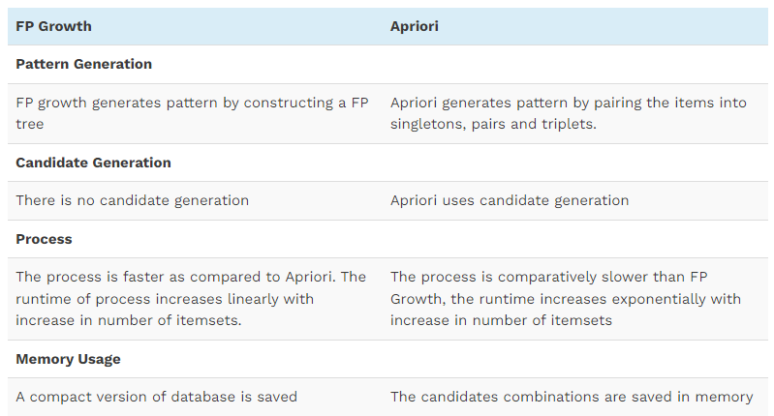
FP-growth v.s. Apriori
https://www.softwaretestinghelp.com/fp-growth-algorithm-data-mining/

Slide 59
Further Improvements of Mining Methods
AFOPT (Liu, et al. @ KDD’03)
  A “push-right” method for mining condensed frequent pattern (CFP) tree
Carpenter (Pan, et al. @ KDD’03)
  Mine data sets with small rows but numerous columns
  Construct a row-enumeration tree for efficient mining
FPgrowth+ (Grahne and Zhu, FIMI’03)
  Efficiently Using Prefix-Trees in Mining Frequent Itemsets, Proc. ICDM'03 Int. Workshop on Frequent Itemset Mining Implementations (FIMI'03), Melbourne, FL, Nov. 2003
TD-Close (Liu, et al, SDM’06)

Slide 60
Extension of Pattern Growth Mining Methodology
Mining closed frequent itemsets and max-patterns
  CLOSET (DMKD’00), FPclose, and FPMax (Grahne & Zhu, Fimi’03)
Mining sequential patterns
  PrefixSpan (ICDE’01), CloSpan (SDM’03), BIDE (ICDE’04)
Mining graph patterns
  gSpan (ICDM’02), CloseGraph (KDD’03)
Constraint-based mining of frequent patterns
  Convertible constraints (ICDE’01), gPrune (PAKDD’03)
Computing iceberg data cubes with complex measures
  H-tree, H-cubing, and Star-cubing (SIGMOD’01, VLDB’03)
Pattern-growth-based Clustering
  MaPle (Pei, et al., ICDM’03)
Pattern-Growth-Based Classification
  Mining frequent and discriminative patterns (Cheng, et al, ICDE’07)

Slide 61
Scalable Frequent Itemset Mining Methods
Apriori: A Candidate Generation-and-Test Approach
Improving the Efficiency of Apriori
FPGrowth: A Frequent Pattern-Growth Approach
ECLAT: Frequent Pattern Mining with Vertical Data Format
Mining Close Frequent Patterns and Maxpatterns

Slide 62
ECLAT: Mining by Exploring Vertical Data Format
Vertical format: t(AB) = {T₁₁, T₂₅, …}
  tid-list: list of trans.-ids containing an itemset
Deriving frequent patterns based on vertical intersections
  t(X) = t(Y): X and Y always happen together
  t(X) ⊂ t(Y): transaction having X always has Y
Using diffset to accelerate mining
  Only keep track of differences of tids
  t(X) = {T₁, T₂, T₃}, t(XY) = {T₁, T₃}
  Diffset (XY, X) = {T₂}
Eclat (Zaki et al. @KDD’97)
Mining Closed patterns using vertical format: CHARM (Zaki & Hsiao@SDM’02)

Slide 63
Mining Frequent Closed Patterns: CLOSET
Flist: list of all frequent items in support ascending order
  Flist: d-a-f-e-c
Divide search space
  Patterns having d
  Patterns having d but no a, etc.
Find frequent closed pattern recursively
  Every transaction having d also has cfa → cfad is a frequent closed pattern
J. Pei, J. Han & R. Mao. “CLOSET: An Efficient Algorithm for Mining Frequent Closed Itemsets", DMKD'00.
Min_sup=2
TID | Items
10 | a, c, d, e, f
20 | a, b, e
30 | c, e, f
40 | a, c, d, f
50 | c, e, f

Slide 64
CLOSET+: Mining Closed Itemsets by Pattern-Growth
Itemset merging: if Y appears in every occurrence of X, then Y is merged with X
Sub-itemset pruning: if Y כ X, and sup(X) = sup(Y), X and all of X’s descendants in the set enumeration tree can be pruned
Hybrid tree projection
  Bottom-up physical tree-projection
  Top-down pseudo tree-projection
Item skipping: if a local frequent item has the same support in several header tables at different levels, one can prune it from the header table at higher levels
Efficient subset checking

Slide 65
MaxMiner: Mining Max-Patterns
1st scan: find frequent items
  A, B, C, D, E
2nd scan: find support for
  AB, AC, AD, AE, ABCDE
  BC, BD, BE, BCDE
  CD, CE, CDE, DE
Since BCDE is a max-pattern, no need to check BCD, BDE, CDE in later scan
R. Bayardo. Efficiently mining long patterns from databases. SIGMOD’98
Tid | Items
10 | A, B, C, D, E
20 | B, C, D, E,
30 | A, C, D, F
Potential max-patterns

Slide 66
CHARM: Mining by Exploring Vertical Data Format
Vertical format: t(AB) = {T₁₁, T₂₅, …}
  tid-list: list of trans.-ids containing an itemset
Deriving closed patterns based on vertical intersections
  t(X) = t(Y): X and Y always happen together
  t(X) ⊂ t(Y): transaction having X always has Y
Using diffset to accelerate mining
  Only keep track of differences of tids
  t(X) = {T₁, T₂, T₃}, t(XY) = {T₁, T₃}
  Diffset (XY, X) = {T₂}
Eclat/MaxEclat (Zaki et al. @KDD’97), VIPER(P. Shenoy et al.@SIGMOD’00), CHARM (Zaki & Hsiao@SDM’02)

Slide 67
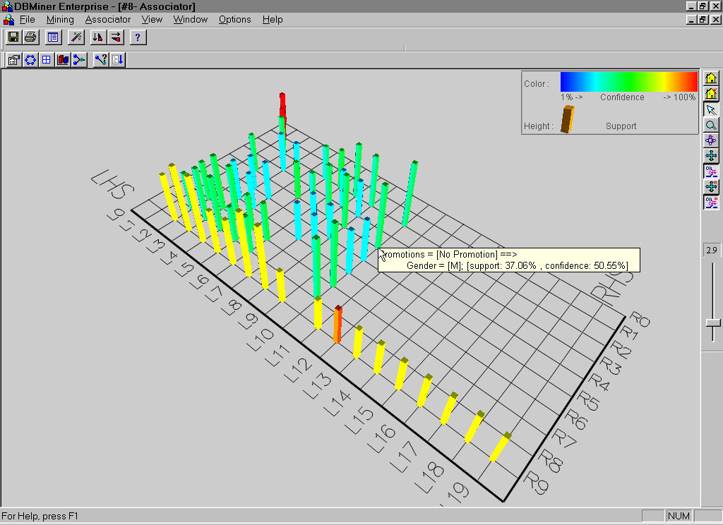
Visualization of Association Rules: Plane Graph

Slide 68
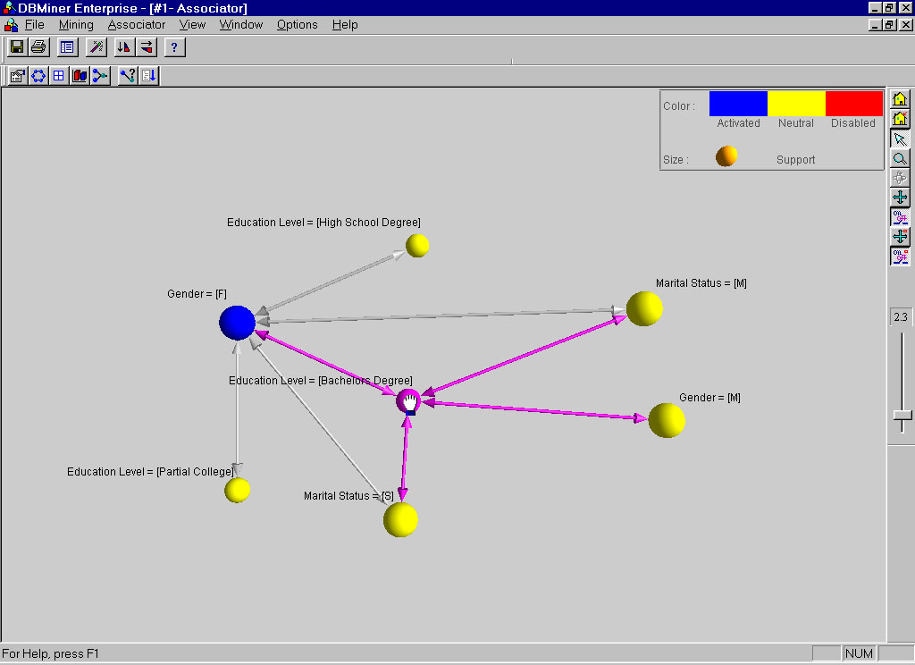
Visualization of Association Rules: Rule Graph

Slide 69
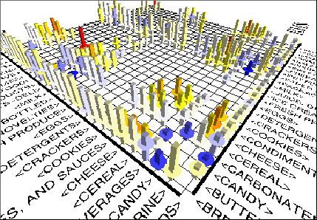
Visualization of Association Rules
(SGI/MineSet 3.0)

Slide 70
Pattern Evaluation Methods

Slide 71
Interestingness Measure: Correlations (Lift)
play basketball ⇒ eat cereal [40%, 66.7%] is misleading
  The overall % of students eating cereal is 75% > 66.7%.
play basketball ⇒ not eat cereal [20%, 33.3%] is more accurate, although with lower support and confidence
Measure of dependent/correlated events: lift
(Min support=30%, Min Conf.=60%)
 | Basketball | Not basketball | Sum (row)
Cereal | 2000 | 1750 | 3750
Not cereal | 1000 | 250 | 1250
Sum(col.) | 3000 | 2000 | 5000
lift <1 : negatively correlated
Lift =1: independent
Lift >1: positively correlated

Slide 72
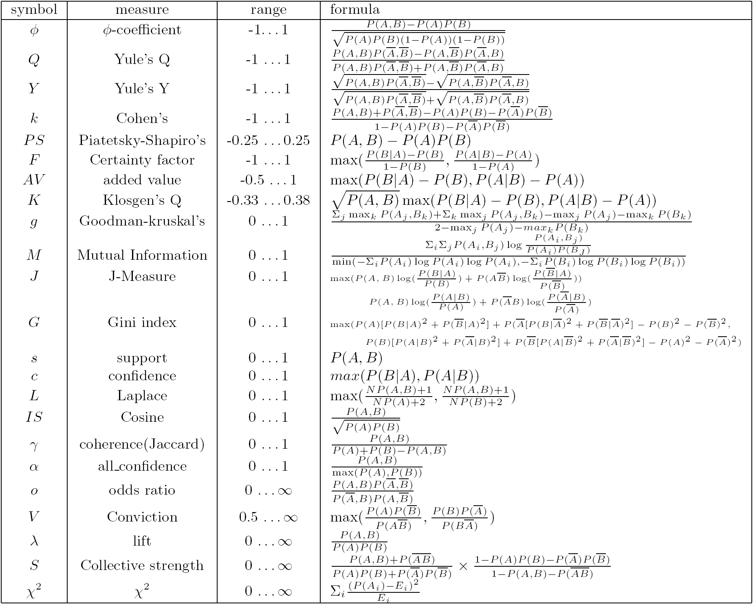
Are They Good Measures of Correlation?
“Buy walnuts ⇒ buy milk [1%, 80%]” is misleading if 85% of customers buy milk
Support and confidence are not good to indicate correlations
Over 20 interestingness measures have been proposed (see Tan, Kumar, Sritastava @KDD’02)
Which are good ones?

Slide 73
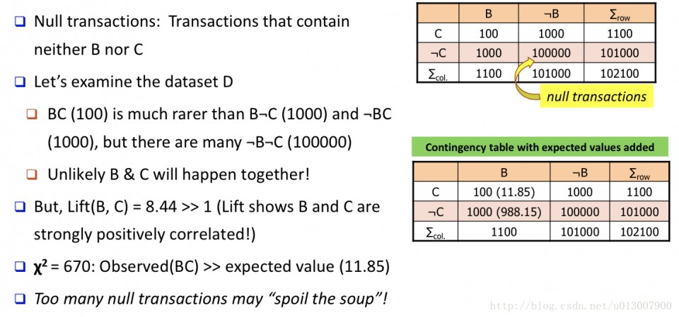
Lift and χ²: Are They Always Good Measures?

Slide 74
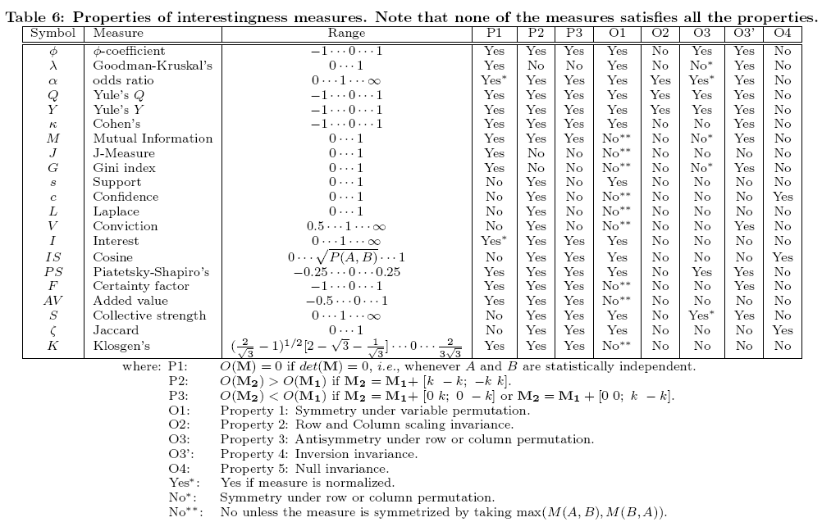
Null-Invariant Measures

Slide 75
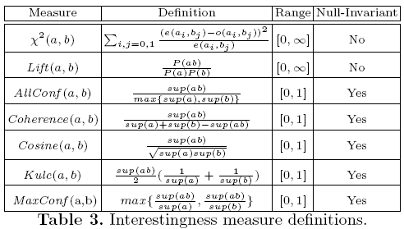
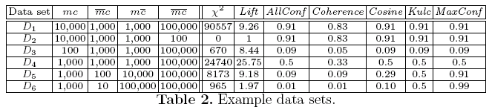
Comparison of Interestingness Measures
Null-(transaction) invariance is crucial for correlation analysis
Null invariance: value does not change with the # of null transactions
Lift and χ² are not null-invariant
5 null-invariant measures
 | Milk | No Milk | Sum (row)
Coffee | m, c | ~m, c | c
No Coffee | m, ~c | ~m, ~c | ~c
Sum(col.) | m | ~m | Σ
Null-transactions w.r.t. m and c
Kulczynski measure (1927)
Null-invariant
Subtle: They disagree

Slide 76
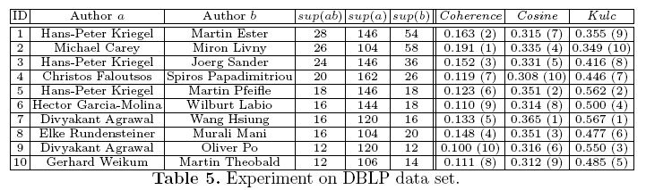
Analysis of DBLP Coauthor Relationships
Recent DB conferences, removing balanced associations, low sup, etc.
Advisor-advisee relation: Kulc: high, coherence: low, cosine: middle
Tianyi Wu, Yuguo Chen and Jiawei Han, “Association Mining in Large Databases: A Re-Examination of Its Measures”, Proc. 2007 Int. Conf. Principles and Practice of Knowledge Discovery in Databases (PKDD'07), Sept. 2007

Slide 77
Which Null-Invariant Measure Is Better?
IR (Imbalance Ratio): measure the imbalance of two itemsets A and B in rule implications
Kulczynski and Imbalance Ratio (IR) together present a clear picture for all the three datasets D₄ through D₆
  D₄ is balanced & neutral
  D₅ is imbalanced & neutral
  D₆ is very imbalanced & neutral

Slide 78
Exercise 3
Please use the frequent pattern growth algorithm for finding the frequent patterns in transactional database D. (The minimum support threshold = 50%)
  Building the FP-tree
  Mining the FP-tree and list the frequent patterns
Transaction | List of items
T1 | I1,I2,I3
T2 | I2,I3,I4
T3 | I4,I5
T4 | I1,I2,I4
T5 | I1,I2,I3,I5
T6 | I1,I2,I3,I4

Slide 79
Summary
Basic concepts: association rules, support-confident framework, closed and max-patterns
Scalable frequent pattern mining methods
  Apriori (Candidate generation & test)
  Projection-based (FPgrowth, CLOSET+, ...)
  Vertical format approach (ECLAT, CHARM, ...)
Which patterns are interesting?
  Pattern evaluation methods

