Slide 1
Chapter 03
Data Preprocessing
Dr. Chin-Hui Lai
Department of Information Management, CYCU
Email: chlai@cycu.edu.tw

Slide 2
Outline
Data Preprocessing: An Overview
  Data Quality
  Major Tasks in Data Preprocessing
Data Cleaning
Data Integration
Data Reduction
Data Transformation and Data Discretization
Summary
2

Slide 3
Data Quality: Why Preprocess the Data?
Measures for data quality: A multidimensional view
  Accuracy: correct or wrong, accurate or not
  Completeness: not recorded, unavailable, …
  Consistency: some modified but some not, dangling, …
  Timeliness: timely update?
  Believability: how trustable the data are correct?
  Interpretability: how easily the data can be understood?

Slide 4
Major Tasks in Data Preprocessing
Data cleaning
  Fill in missing values, smooth noisy data, identify or remove outliers, and resolve inconsistencies
Data integration
  Integration of multiple databases, data cubes, or files
Data reduction
  Dimensionality reduction
  Numerosity reduction
  Data compression
Data transformation and data discretization
  Normalization
  Concept hierarchy generation

Slide 5
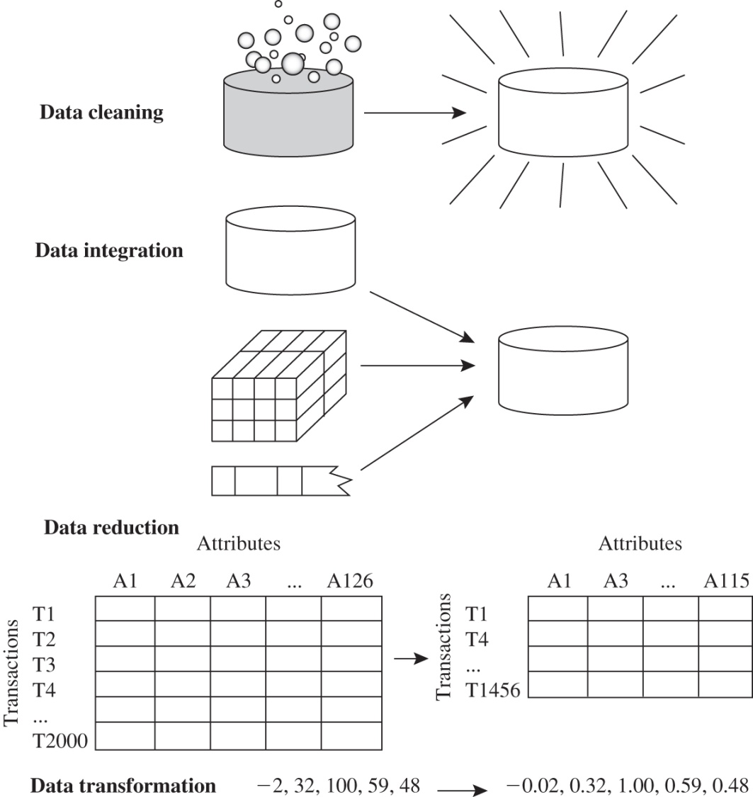
Major Tasks in Data Preprocessing

Slide 6
Data Cleaning
Data in the Real World Is Dirty: Lots of potentially incorrect data, e.g., instrument faulty, human or computer error, transmission error
  incomplete: lacking attribute values, lacking certain attributes of interest, or containing only aggregate data
    e.g., Occupation=“ ” (missing data)
  noisy: containing noise, errors, or outliers
    e.g., Salary=“−10” (an error)
  inconsistent: containing discrepancies in codes or names, e.g.,
    Age=“42”, Birthday=“03/07/2010”
    Was rating “1, 2, 3”, now rating “A, B, C”
    discrepancy between duplicate records
  Intentional (e.g., disguised missing data)
    Jan. 1 as everyone’s birthday?

Slide 7
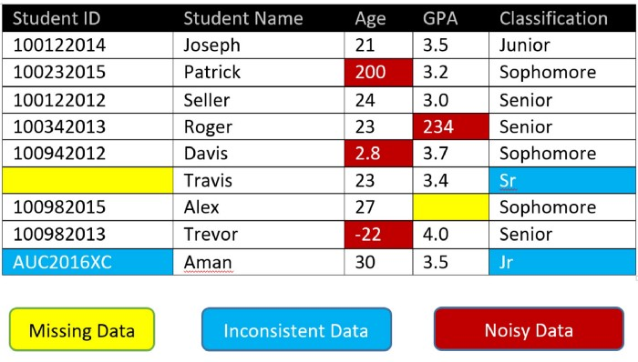
Example of Dirty Data
Ref: https://medium.com/@casternxavier/get-rid-of-the-dirt-from-your-data-data-cleaning-techniques-743253b1c3e5

Slide 8
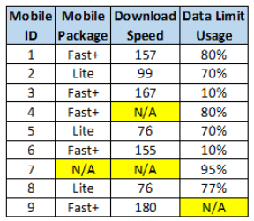
Incomplete (Missing) Data
Data is not always available
  E.g., many tuples have no recorded value
  for several attributes
Missing data may be due to
  equipment malfunction
  inconsistent with other recorded data and thus deleted
  data not entered due to misunderstanding
  certain data may not be considered important at the time of entry
  not register history or changes of the data
Missing data may need to be inferred
Ref: https://towardsdatascience.com/all-about-missing-data-handling-b94b8b5d2184

Slide 9
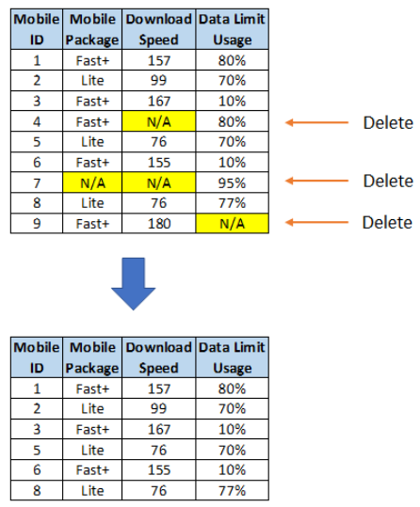
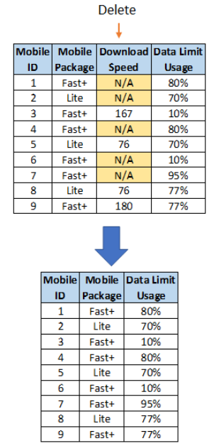
How to Handle Missing Data? (1/4)
Ignore the tuple: usually done when class label is missing (when doing classification)—not effective when the % of missing values per attribute varies considerably

Slide 10
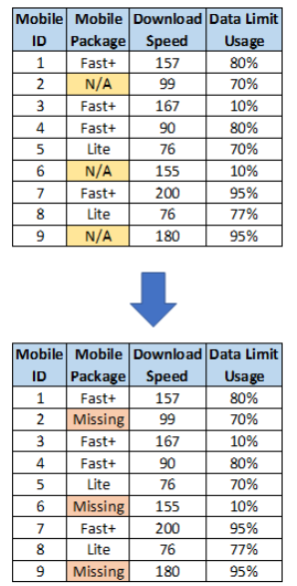
How to Handle Missing Data? (2/4)
Fill in the missing value manually: tedious + infeasible?
Fill in it automatically with
  a global constant : e.g., “unknown”, a new class?!

Slide 11
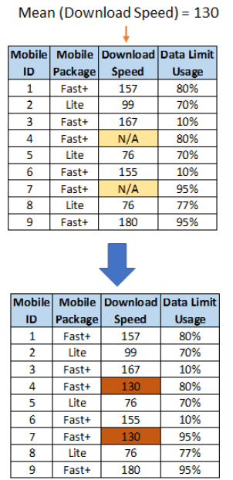
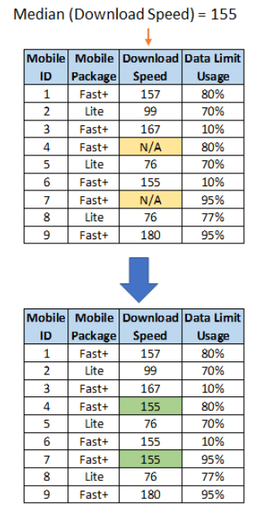
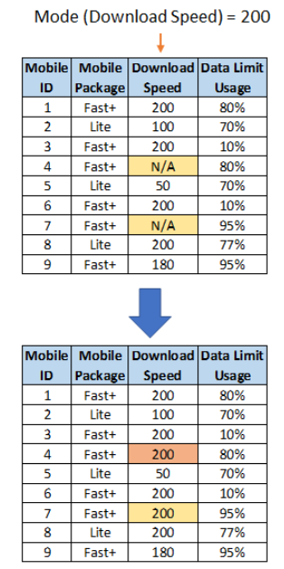
How to Handle Missing Data? (3/4)
  the attribute mean or median or mode
    Median: when the variable has a skewed distribution

Slide 12
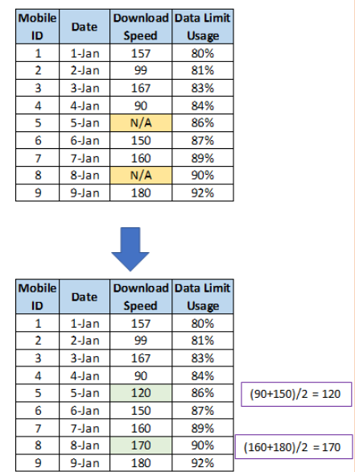
How to Handle Missing Data? (4/4)
  the attribute mean for all samples belonging to the same class: smarter
  the most probable value: inference-based such as regression, Bayesian formula or decision tree
Linear Interpolation

Slide 13
Noisy Data
Noise: random error or variance in a measured variable
Incorrect attribute values may be due to
  faulty data collection instruments
  data entry problems
  data transmission problems
  technology limitation
  inconsistency in naming convention
Other data problems which require data cleaning
  duplicate records
  incomplete data
  inconsistent data
13
Notes:
13

Slide 14
How to Handle Noisy Data?
Binning
  first sort data and partition into (equal-frequency) bins
  then one can smooth by bin means, smooth by bin median, smooth by bin boundaries, etc.
Regression
  smooth by fitting the data into regression functions
Clustering
  detect and remove outliers
Combined computer and human inspection
  detect suspicious values and check by human (e.g., deal with possible outliers)

Slide 15
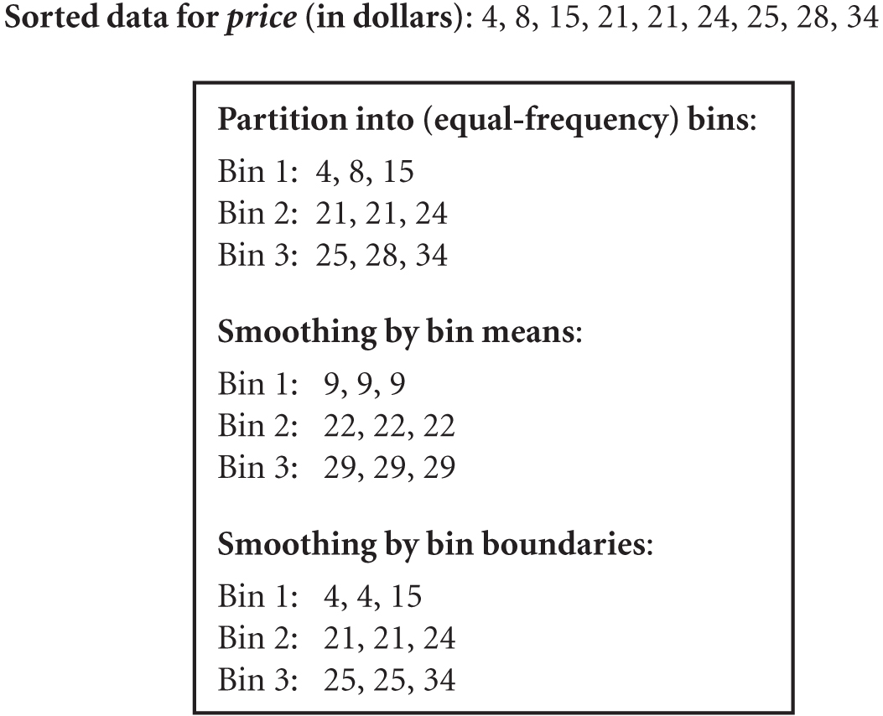
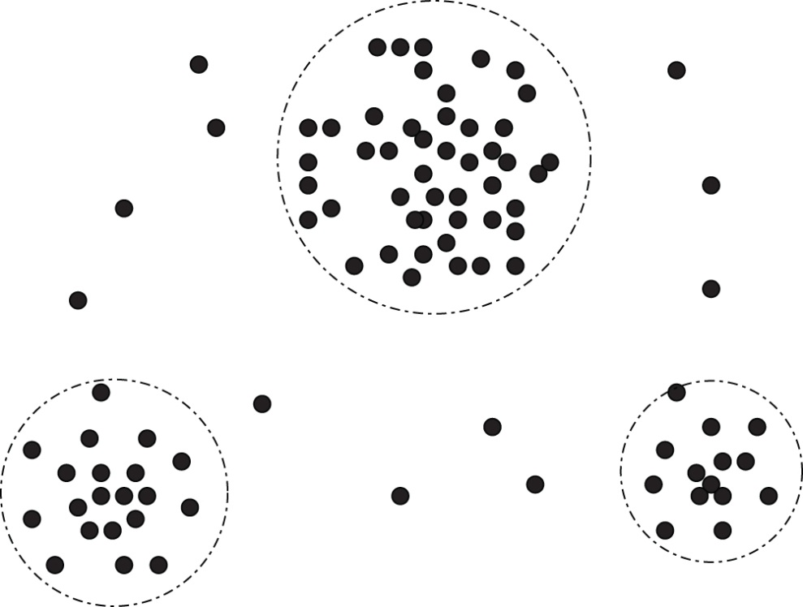
How to Handle Noisy Data? (Example)
A 2-D customer data plot with respect to customer locations in a city, showing three data clusters. Outliers may be detected as values that fall outside of the cluster sets.

Slide 16
Data Cleaning as a Process
Data discrepancy detection
  Use metadata (e.g., domain, range, dependency, distribution)
  Check field overloading
  Check uniqueness rule, consecutive rule and null rule
  Use commercial tools
    Data scrubbing: use simple domain knowledge (e.g., postal code, spell-check) to detect errors and make corrections
    Data auditing: by analyzing data to discover rules and relationship to detect violators (e.g., correlation and clustering to find outliers)
Data migration and integration
  Data migration tools: allow transformations to be specified
  ETL (Extraction/Transformation/Loading) tools: allow users to specify transformations through a graphical user interface
Integration of the two processes
  Iterative and interactive (e.g., Potter’s Wheels)

Slide 17
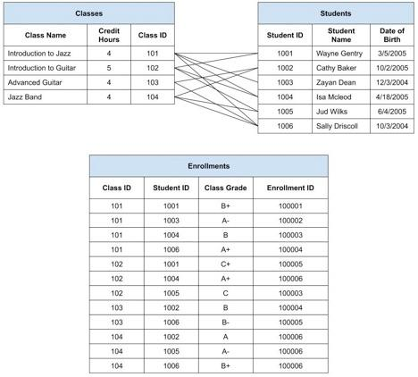
Data Integration (1/2)
Combines data from multiple sources into a coherent store
Schema integration:
  e.g., classes.classID ≡ Enrollments.ClassID, students.studentID≡ Enrollments.studentID
Integrate metadata
from different sources
17

Slide 18
Data Integration (2/2)
Entity identification problem:
  Identify real world entities from multiple data sources, e.g., Bill Clinton = William Clinton,
Detecting and resolving data value conflicts
  For the same real world entity, attribute values from different sources are different
  Possible reasons: different representations, different scales, e.g., metric vs. British units

Slide 19
Handling Redundancy in Data Integration
Redundant data occur often when integration of multiple databases
  Object identification: The same attribute or object may have different names in different databases
  Derivable data: One attribute may be a “derived” attribute in another table, e.g., annual revenue
Redundant attributes may be able to be detected by correlation analysis and covariance analysis
Careful integration of the data from multiple sources may help reduce/avoid redundancies and inconsistencies and improve mining speed and quality
19

Slide 20
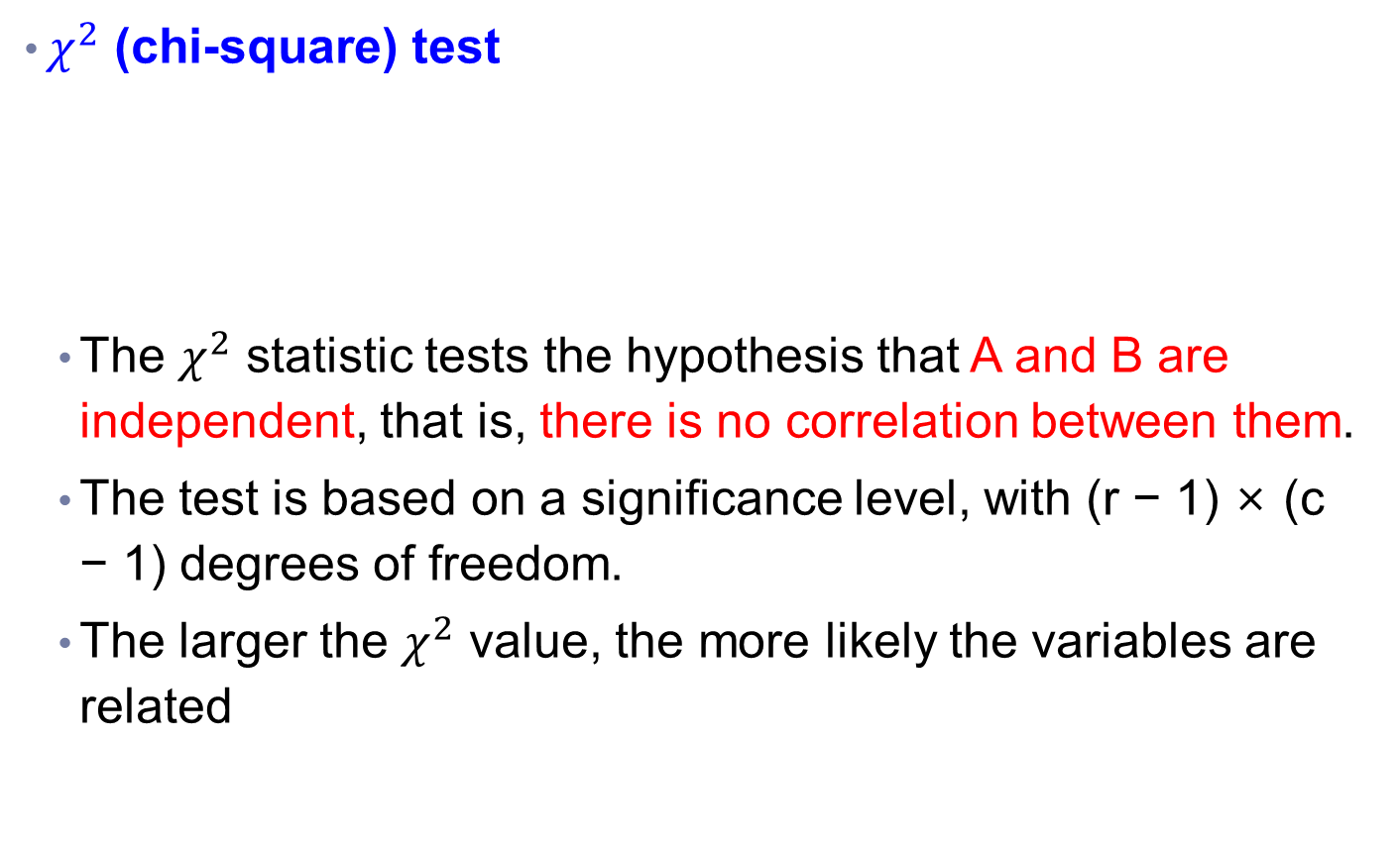
Correlation Analysis (Nominal Data)
$χ^{2}$ (chi-square) test
  The $χ^{2}$ statistic tests the hypothesis that A and B are independent, that is, there is no correlation between them.
  The test is based on a significance level, with (r − 1) × (c − 1) degrees of freedom.
  The larger the $χ^{2}$ value, the more likely the variables are related

Slide 21
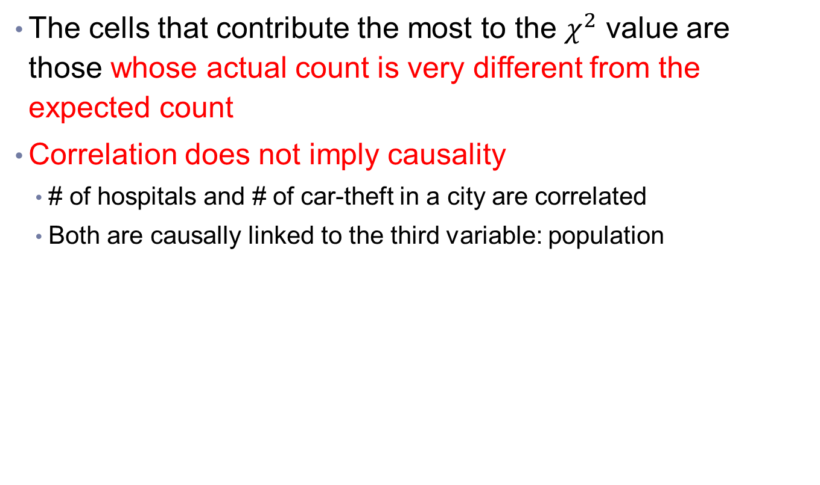
Correlation Analysis (Nominal Data)
The cells that contribute the most to the $χ^{2}$ value are those whose actual count is very different from the expected count
Correlation does not imply causality
  # of hospitals and # of car-theft in a city are correlated
  Both are causally linked to the third variable: population

Slide 22

Chi-Square Calculation: An Example
$χ^{2}$(chi-square) calculation (numbers in parenthesis are expected counts calculated based on the data distribution in the two categories)
It shows that like_science_fiction and play_chess are correlated in the group
 | Play chess | Not play chess | Sum (row)
Like science fiction | 250(90) | 200(360) | 450
Not like science fiction | 50(210) | 1000(840) | 1050
Sum(col.) | 300 | 1200 | 1500
Notes:
For this 2 × 2 table, the degrees of freedom are (2 − 1)(2 − 1) = 1.
For 1 degree of freedom, the χ 2 value needed to reject the hypothesis at the 0.001 significance level is 10.828
(taken from the table of upper percentage points of the χ 2 distribution, typically available from any textbook on statistics)

Slide 23

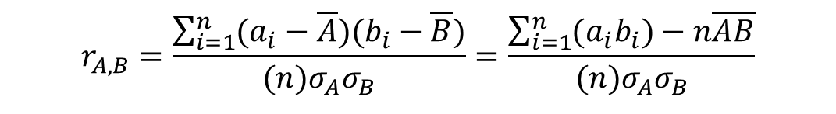
Correlation Analysis (Numeric Data)
Correlation coefficient (also called Pearson’s product moment coefficient)
  where n is the number of tuples, and are the respective means of A and B, σ_{A} and σ_{B} are the respective standard deviation of A and B, and Σ(a_{i}b_{i}) is the sum of the AB cross-product.
  If r_{A,B} > 0, A and B are positively correlated (A’s values increase as B’s). The higher, the stronger correlation.
  r_{A,B} = 0: independent;
  r_{AB} < 0: negatively correlated
$$r_{A,B}=\frac{\sum_{i=1}^{n}{(a_{i}−\overline{A})(b_{i}−\overline{B})}}{(n)σ_{A}σ_{B}}=\frac{\sum_{i=1}^{n}{(a_{i}b_{i})−n\overline{A}\overline{B}}}{(n)σ_{A}σ_{B}}$$
$$−1≤r_{A,B}≤1$$
Ref: https://www.statisticshowto.com/probability-and-statistics/correlation-coefficient-formula/#hand

Slide 24
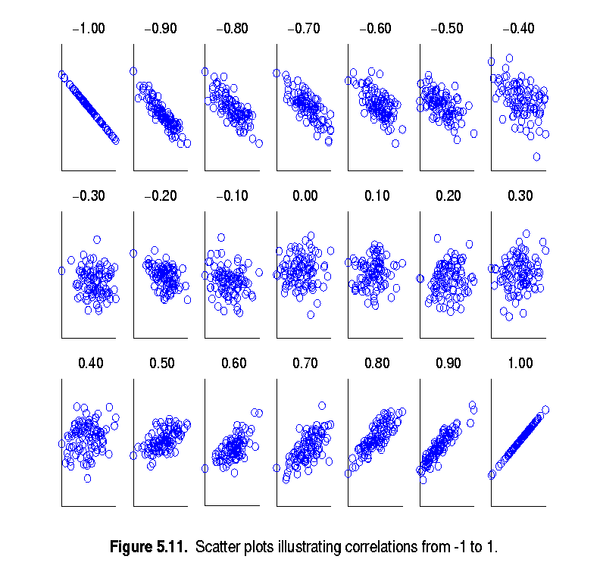
Visually Evaluating Correlation
Scatter plots showing the similarity from –1 to 1.

Slide 25
Correlation (viewed as linear relationship)
Correlation measures the linear relationship between objects
To compute correlation, we standardize data objects, A and B, and then take their dot product

Slide 26
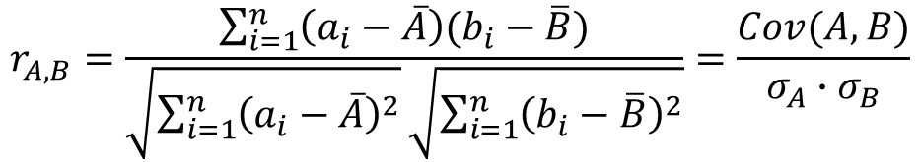


Covariance (Numeric Data)
Covariance is similar to correlation
Correlation coefficient
  n is the number of tuples
  and are the respective mean or expected values of A and B
  σ_{A} and σ_{B} are the respective standard deviation of A and B.
$$r_{A,B}=\frac{\sum_{i=1}^{n}{\left(a_{i}−\overline{A}\right)(b_{i}−\overline{B})}}{\sqrt{\sum_{i=1}^{n}{{\left(a_{i}−\overline{A}\right)}^{2}}}\sqrt{\sum_{i=1}^{n}{{\left(b_{i}−\overline{B}\right)}^{2}}}}=\frac{Cov(A,B)}{σ_{A}∙σ_{B}}$$
Standardized
$$\overline{A}$$
$$\overline{B}$$
Ref: https://www.statisticshowto.com/probability-and-statistics/statistics-definitions/covariance/
Notes:
共變異數: 兩個變數一同變大/變小的程度

Slide 27
Covariance (Numeric Data)
Positive covariance: If Cov_{A,B} > 0, then A and B both tend to be larger than their expected values.
Negative covariance: If Cov_{A,B} < 0 then if A is larger than its expected value, B is likely to be smaller than its expected value.
Independence: Cov_{A,B} = 0 but the converse is not true:
  Some pairs of random variables may have a covariance of 0 but are not independent. Only under some additional assumptions (e.g., the data follow multivariate normal distributions) does a covariance of 0 imply independence

Slide 28
Covariance v.s. Correlation
Covariance
  illustrates the degree to which two variables vary with respect to each other (how the two variables differ)
Correlation
  Determines the strength and direction of two variables (how the two variables are related)
  A special case of covariance which can be achieved when the data is in standardized form
Correlation is preferred over covariance because it does not get affected by the change in scale.
Ref: https://careerfoundry.com/en/blog/data-analytics/covariance-vs-correlation/
https://www.simplilearn.com/covariance-vs-correlation-article
https://www.mygreatlearning.com/blog/covariance-vs-correlation/#differences-between-covariance-and-correlation

Slide 29

Co-Variance: An Example
It can be simplified in computation as
Suppose two stocks A and B have the following values in one week: (2, 5), (3, 8), (5, 10), (4, 11), (6, 14).
Question: If the stocks are affected by the same industry trends, will their prices rise or fall together?
  E(A) = (2 + 3 + 5 + 4 + 6)/ 5 = 20/5 = 4
  E(B) = (5 + 8 + 10 + 11 + 14) /5 = 48/5 = 9.6
  Cov(A,B) = (2×5+3×8+5×10+4×11+6×14)/5 − 4 × 9.6 = 4
Thus, A and B rise together since Cov(A, B) > 0.

Slide 30
Co-Variance: An Exercise
Stock prices for AllElectronics and HighTech
Time Point | AllElectronics | HighTech
T1 | 6 | 20
T2 | 5 | 10
T3 | 4 | 14
T4 | 3 | 5
T5 | 2 | 5
1. If the stocks are affected by the same industry trends, will their prices rise or fall together?
2. Pearson correlation = ?

Slide 31
What is Data Reduction
Data reduction
  Obtain a reduced representation of the data set that is much smaller in volume but yet produces the same (or almost the same) analytical results
Why data reduction?
  A database/data warehouse may store terabytes of data.
  Complex data analysis may take a very long time to run on the complete data set.

Slide 32
Data Reduction Strategies
Dimensionality reduction, e.g., remove unimportant attributes
  Wavelet transforms
  Principal Components Analysis (PCA)
  Feature subset selection
Numerosity reduction (some simply call it: Data Reduction)
  Regression and Log-Linear Models
  Histograms, clustering, sampling
  Data cube aggregation
Data compression

Slide 33
Data Reduction 1: Dimensionality Reduction
Curse of dimensionality
  When dimensionality increases, data becomes increasingly sparse
  Density and distance between points, which is critical to clustering, outlier analysis, becomes less meaningful
Dimensionality reduction
  Avoid the curse of dimensionality
  Help eliminate irrelevant features and reduce noise
  Reduce time and space required in data mining
  Allow easier visualization
Dimensionality reduction techniques
  Wavelet transforms
  Principal Component Analysis
  Supervised and nonlinear techniques (e.g., feature selection)
Notes:
33
Wavelet transforms : 小波轉換

Slide 34
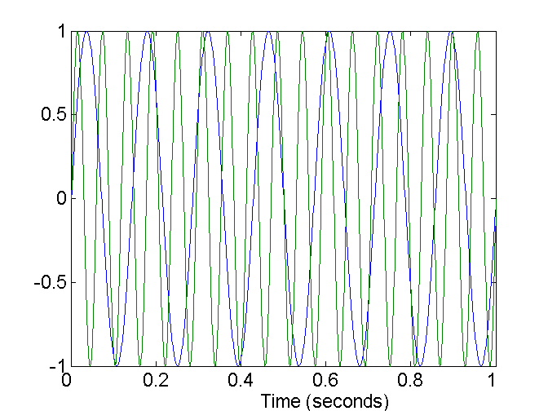
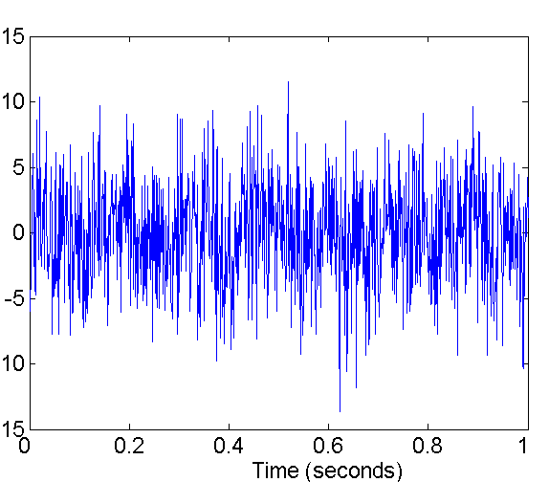
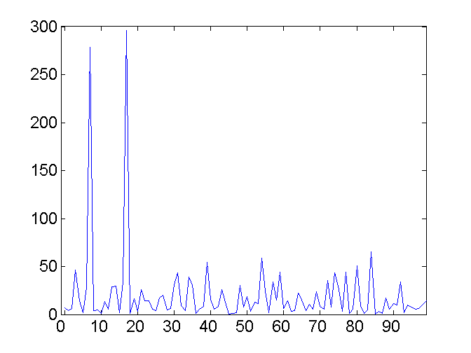
Mapping Data to a New Space
Fourier transform
Wavelet transform
Two Sine Waves
Two Sine Waves + Noise
Frequency
Notes:
34

Slide 35
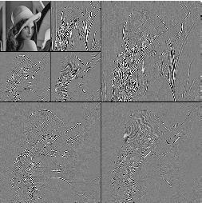
What Is Wavelet Transform?
Decomposes a signal into different frequency subbands
  Applicable to n-dimensional signals
Data are transformed to preserve relative distance between objects at different levels of resolution
Allow natural clusters to become more distinguishable
Used for image compression
Notes:
35

Slide 36
Wavelet Transformation
Haar2
Daubechie4
Discrete wavelet transform (DWT) for linear signal processing, multi-resolution analysis
Compressed approximation: store only a small fraction of the strongest of the wavelet coefficients
Similar to discrete Fourier transform (DFT), but better lossy compression, localized in space
Method:
  Length, L, must be an integer power of 2 (padding with 0’s, when necessary)
  Each transform has 2 functions: smoothing, difference
  Applies to pairs of data, resulting in two set of data of length L/2
  Applies two functions recursively, until reaches the desired length
Notes:
36

Slide 37
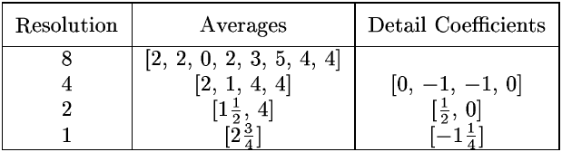
Wavelet Decomposition
Wavelets: A math tool for space-efficient hierarchical decomposition of functions
S = [2, 2, 0, 2, 3, 5, 4, 4] can be transformed to S^ = [2³/₄, -1¹/₄, ¹/₂, 0, 0, -1, -1, 0]
Compression: many small detail coefficients can be replaced by 0’s, and only the significant coefficients are retained
Notes:
37

Slide 38
Haar Wavelet Coefficients
Coefficient “Supports”
₊
Hierarchical decomposition structure (a.k.a. “error tree”)
2.75
₋
2.75
₊
+
-1.25
₋
+
-1.25
-
₊
0.5
₋
0.5
0
₊
+
-
+
-
0
₋
0
-1
-1
0
₊
0
₋
+
-
+
-
+
-
+
-
₊
₋
-1
2 2 0 2 3 5 4 4
₊
-1
₋
₊
Original frequency distribution
0
Notes:
38

Slide 39
Why Wavelet Transform?
Use hat-shape filters
  Emphasize region where points cluster
  Suppress weaker information in their boundaries
Effective removal of outliers
  Insensitive to noise, insensitive to input order
Multi-resolution
  Detect arbitrary shaped clusters at different scales
Efficient
  Complexity O(N)
Only applicable to low dimensional data
Notes:
39

Slide 40
Principal Component Analysis (PCA)
Find a projection that captures the largest amount of variation in data
The original data are projected onto a much smaller space, resulting in dimensionality reduction. We find the eigenvectors of the covariance matrix, and these eigenvectors define the new space
x₂
e
x₁
Notes:
http://arbu00.blogspot.tw/2017/02/6-principal-component-analysispca.html
https://molecular-service-science.com/2013/06/15/principal-component-analysis-and-factor-analysis/

Slide 41
Principal Component Analysis (Steps)
Given N data vectors from n-dimensions, find k ≤ n orthogonal vectors (principal components) that can be best used to represent data
  Normalize input data: Each attribute falls within the same range
  Compute k orthonormal (unit) vectors, i.e., principal components
  Each input data (vector) is a linear combination of the k principal component vectors
  The principal components are sorted in order of decreasing “significance” or strength
  Since the components are sorted, the size of the data can be reduced by eliminating the weak components, i.e., those with low variance (i.e., using the strongest principal components, it is possible to reconstruct a good approximation of the original data)
Works for numeric data only

Slide 42
Attribute Subset Selection (1/2)
Another way to reduce dimensionality of data
Redundant attributes
  if it can be derived from any other attribute or set of attributes
    E.g., purchase price of a product and the amount of sales tax paid
  Inconsistencies in attribute or dimension naming can also lead to the redundancies in data set
  Can be detected by correlation analysis
    correlation coefficient (for numerical attributes)
    Χ² (chi-square) test (for categorical attributes)

Slide 43
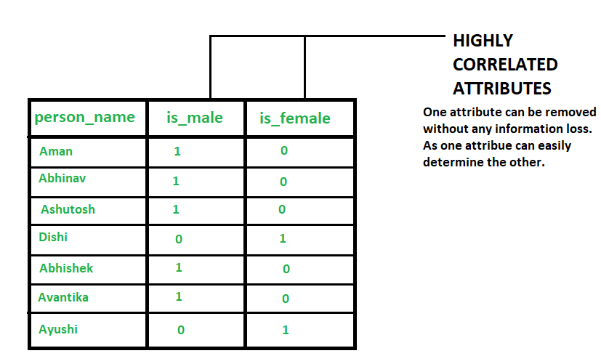
Example of redundant attributes
is_male is 1 if the corresponding person is a male else it is 0 .
is_female is 1 if the corresponding person is a female else it is 0.
https://www.geeksforgeeks.org/redundancy-and-correlation-in-data-mining/

Slide 44
Attribute Subset Selection (2/2)
Irrelevant attributes
  Contain no information that is useful for the data mining task at hand
  E.g., students' ID is often irrelevant to the task of predicting students' GPA

Slide 45
Heuristic Search in Attribute Selection
There are 2^{d} possible attribute combinations of d attributes
Typical heuristic attribute selection methods:
  Best single attribute under the attribute independence assumption: choose by significance tests
  Step-wise forward selection:
    The best single-attribute is picked first
    Then next best attribute condition to the first, ...
  Step-wise backward elimination:
    Repeatedly eliminate the worst attribute
  Decision tree induction
    Algorithm: ID3, C4.5, CART
    Choose the best attribute to partition the data into individual classes

Slide 46
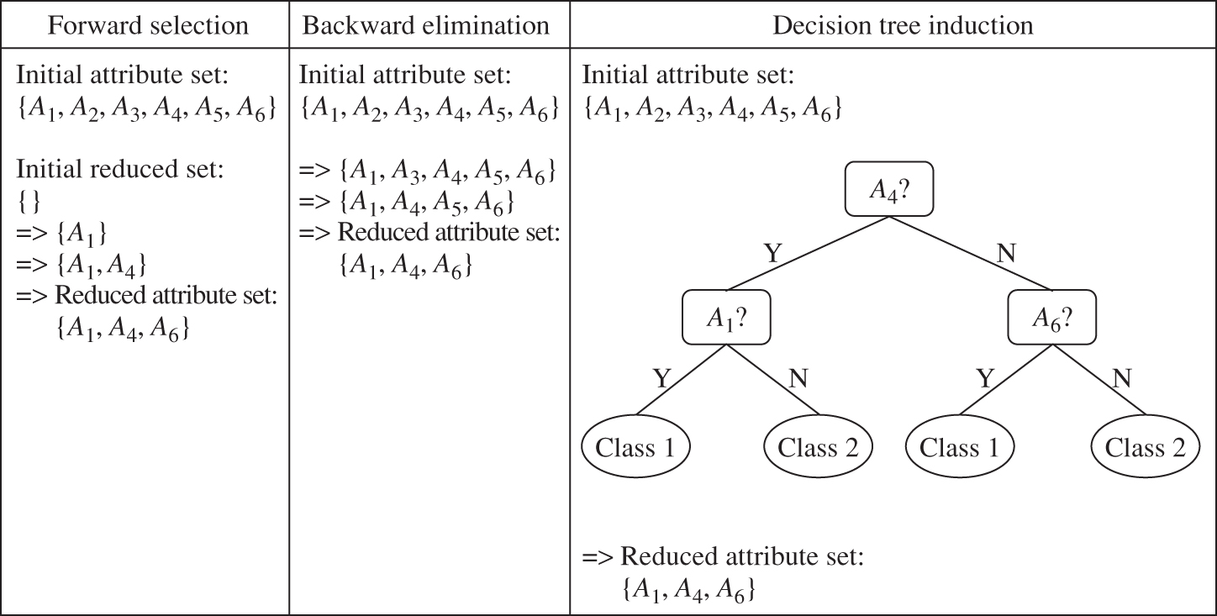
Heuristic Search in Attribute Selection (Example)
Figure 3.6 Greedy (heuristic) methods for attribute subset selection.

Slide 47
Attribute Creation (Feature Generation)
47
Create new attributes (features) that can capture the important information in a data set more effectively than the original ones
Three general methodologies
  Attribute extraction
    Domain-specific
  Mapping data to new space (see: data reduction)
    E.g., Fourier transformation, wavelet transformation, manifold approaches (not covered)
  Attribute construction
    Combining features (see: discriminative frequent patterns in Chapter 7)
    Data discretization
Notes:
47

Slide 48
Data Reduction 2: Numerosity Reduction
Reduce data volume by choosing alternative, smaller forms of data representation
Parametric methods (e.g., regression)
  Assume the data fits some model, estimate model parameters, store only the parameters, and discard the data (except possible outliers)
  Ex.: Log-linear models—obtain value at a point in m-D space as the product on appropriate marginal subspaces
Non-parametric methods
  Do not assume models
  Major families: histograms, clustering, sampling, …
Notes:
Parametric method 有母數分析方法
Non-parametric method 無母數分析方法

Slide 49
Parametric Data Reduction: Regression and Log-Linear Models
Linear regression
  Data modeled to fit a straight line
  Often uses the least-square method to fit the line
Multiple regression
  An extension of simple linear regression
  Allows a response variable Y to be modeled as a linear function of multidimensional feature vector
  Models the linear relationship between a single dependent continuous variable and more than one independent variable
  it takes more than one predictor variable to predict the response variable Y

Slide 50
Parametric Data Reduction: Regression and Log-Linear Models (2/2)
Log-linear model
  Approximates discrete multidimensional probability distributions

Slide 51
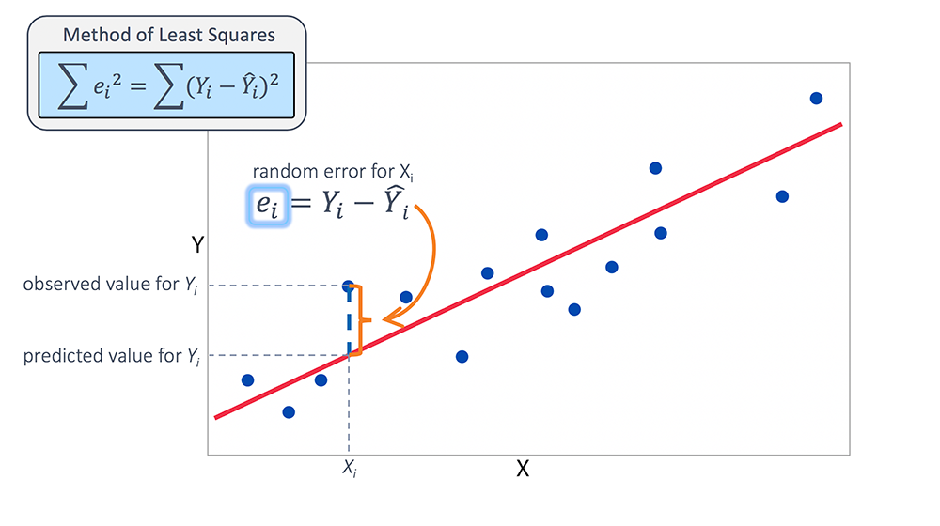


Regression Analysis (1/2)
Regression analysis: A collective name for techniques for the modeling and analysis of numerical data consisting of values of a dependent variable (also called response variable or measurement) and of one or more independent variables (aka. explanatory variables or predictors)
$$\hat{Y_{i}}=β_{0}+β_{1}X_{i}+ε_{i}$$
$$slope=β_{1}$$
Ref: https://www.jmp.com/en_hk/statistics-knowledge-portal/what-is-multiple-regression/fitting-multiple-regression-model.html

Slide 52
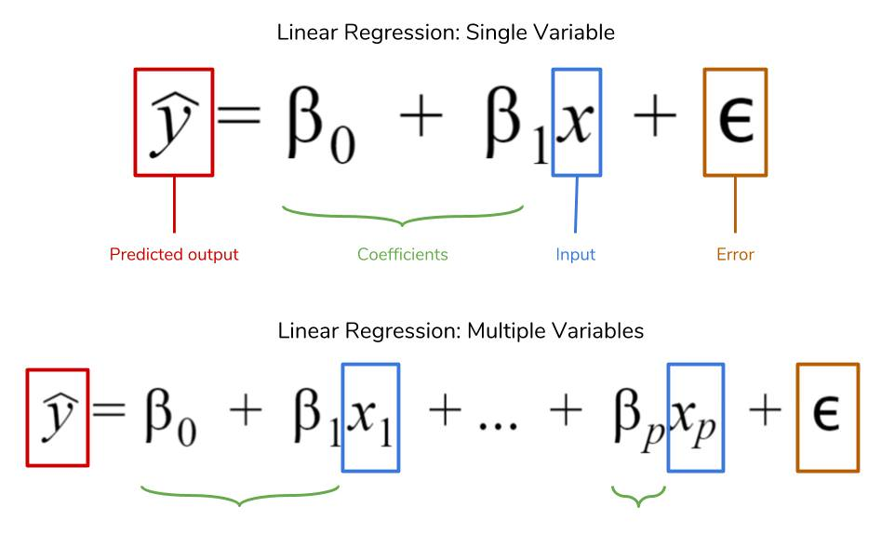
Regression Analysis (2/2)
The parameters are estimated so as to give a "best fit" of the data
Most commonly the best fit is evaluated by using the least squares method, but other criteria have also been used
Used for prediction (including forecasting of time-series data), inference, hypothesis testing, and modeling of causal relationships

Slide 53
Regression Analysis
Linear regression: Y = w X + b
  Two regression coefficients, w and b, specify the line and are to be estimated by using the data at hand
  Using the least squares criterion to the known values of Y₁, Y₂, …, X₁, X₂, ….
Multiple regression: Y = b₀ + b₁ X₁ + b₂ X₂
  Many nonlinear functions can be transformed into the above
Log-linear models:
  Approximate discrete multidimensional probability distributions
  Estimate the probability of each point (tuple) in a multi-dimensional space for a set of discretized attributes, based on a smaller subset of dimensional combinations
  Useful for dimensionality reduction and data smoothing

Slide 54
Histogram Analysis
Using binning to approximate data distributions
  Divide data into buckets and store average (sum) for each bucket
Partitioning rules:
  Equal-width: equal bucket range
  Equal-frequency (or equal-depth)

Slide 55
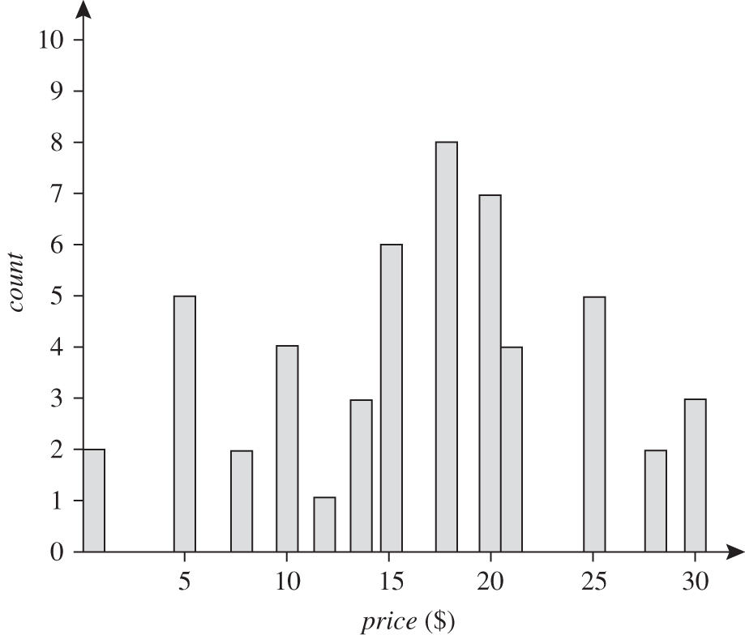
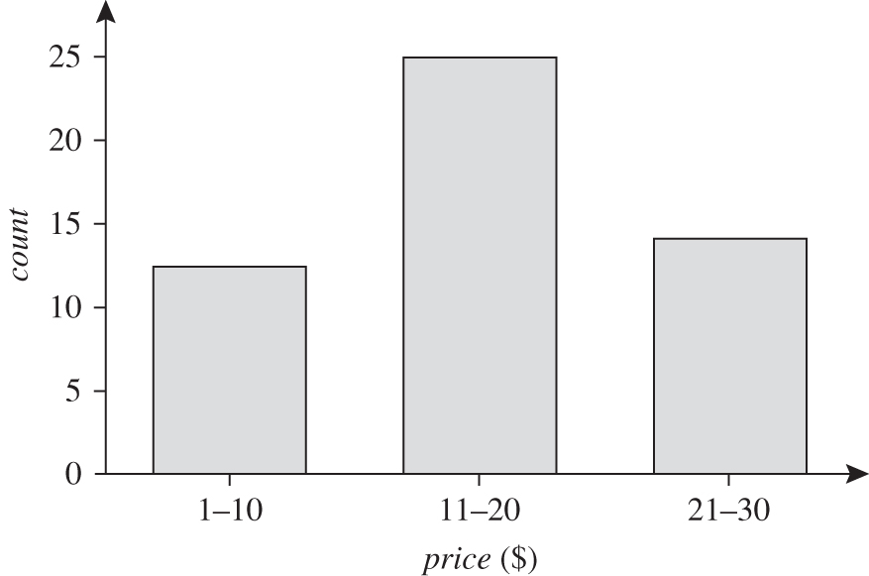
Histogram Analysis - Example
The following data are a list of AllElectronics prices for commonly sold items (rounded to the nearest dollar).
The numbers have been sorted: 1, 1, 5, 5, 5, 5, 5, 8, 8, 10, 10, 10, 10, 12, 14, 14, 14, 15, 15, 15, 15, 15, 15, 18, 18, 18, 18, 18, 18, 18, 18, 20, 20, 20, 20, 20, 20, 20, 21, 21, 21, 21, 25, 25, 25, 25, 25, 28, 28, 30, 30, 30.
Figure 3.7 A histogram for price using singleton buckets—each bucket represents one price–value/frequency pair.
Figure 3.8 An equal-width histogram for price, where values are aggregated so that each bucket has a uniform width of $10.

Slide 56
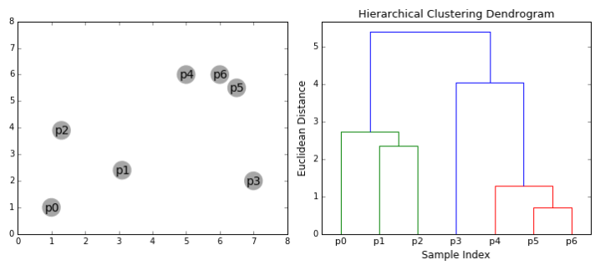
Clustering
Partition data set into clusters based on similarity, and store cluster representation (e.g., centroid and diameter) only
Can have hierarchical clustering and be stored in multi-dimensional index tree structures
There are many choices of clustering definitions and clustering algorithms
Cluster analysis will be studied in depth in Chapter 10

Slide 57
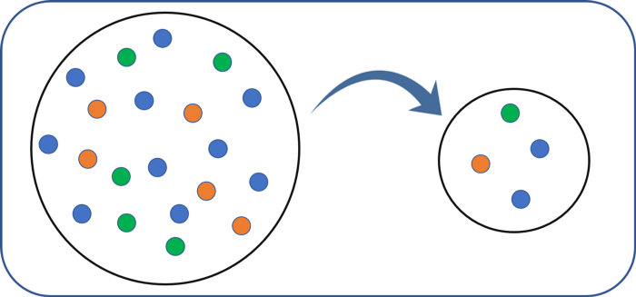
Sampling
Sampling: obtaining a small sample s to represent the whole data set N
Allows a large data set to be represented by a much smaller random data sample (subset)
Key principle: Choose a representative subset of the data
  Develop adaptive sampling methods, e.g., stratified sampling

Slide 58
Types of Sampling
Simple random sampling
  There is an equal probability of selecting any particular item
  Have very poor performance in the presence of skew
Sampling without replacement
  Once an object is selected, it is removed from the population
Sampling with replacement
  A selected object is not removed from the population
Stratified sampling:
  Partition the data set, and draw samples from each partition (proportionally, i.e., approximately the same percentage of the data)
  Used in conjunction with skewed data
Notes:
不放回抽樣
放回抽樣

Slide 59
Sampling: With or without Replacement
SRSWOR
(simple random
sampling without
replacement)
SRSWR
Raw Data

Slide 60
Sampling: Cluster or Stratified Sampling
Raw Data
Cluster/Stratified Sample

Slide 61
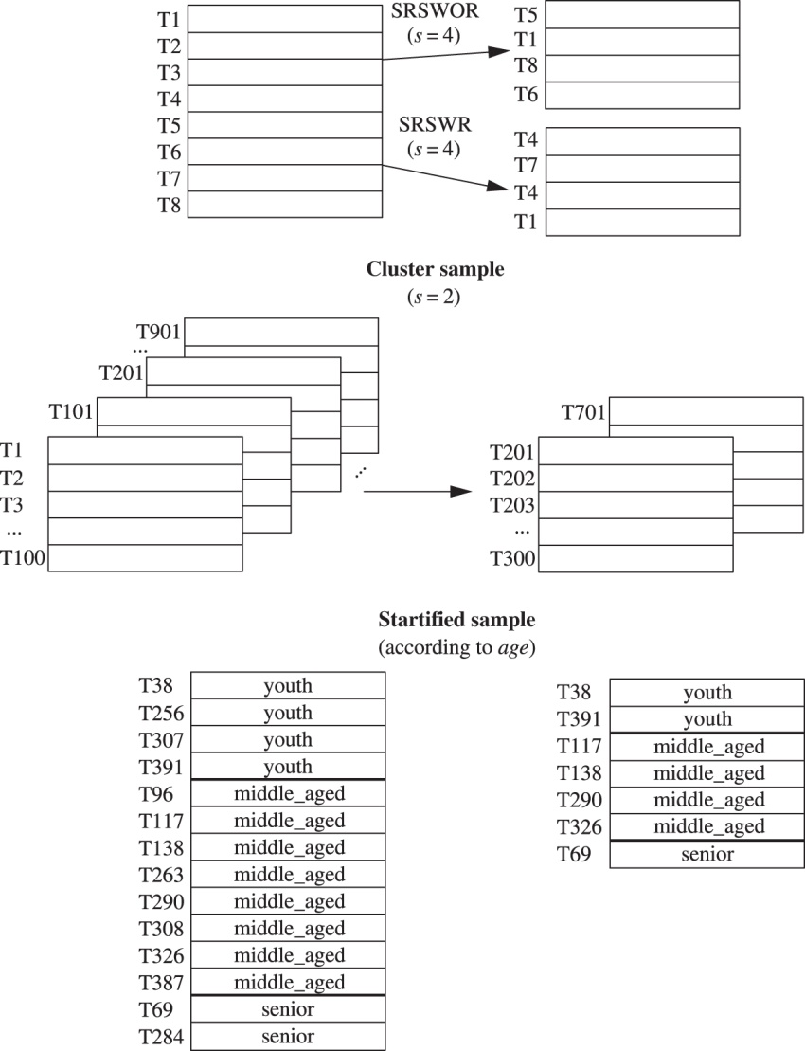
Sampling for data reduction
SRSWOR: simple random sample without replacement
SRSWR: simple random sample with replacement

Slide 62
Data Cube Aggregation
The lowest level of a data cube (base cuboid)
  The aggregated data for an individual entity of interest
  E.g., a customer in a phone calling data warehouse
Multiple levels of aggregation in data cubes
  Further reduce the size of data to deal with
Reference appropriate levels
  Use the smallest representation which is enough to solve the task
Queries regarding aggregated information should be answered using data cube, when possible
Notes:
62

Slide 63
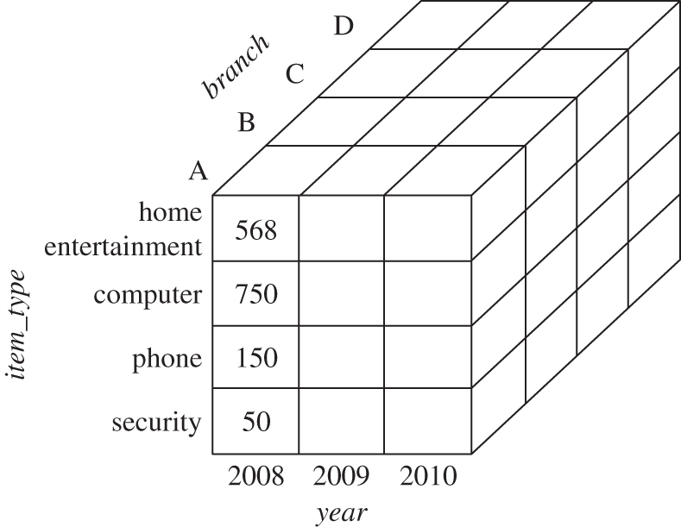
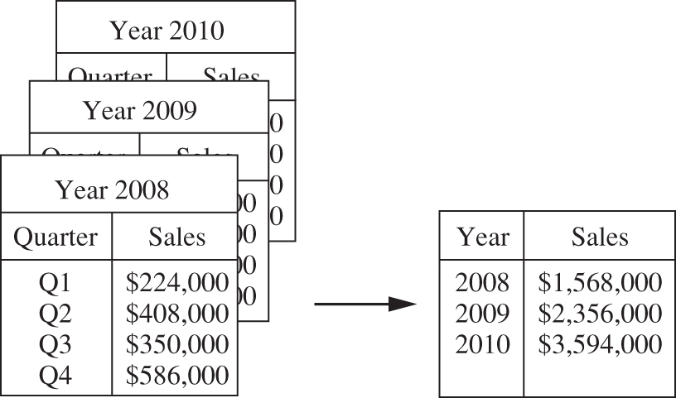
Data Cube Aggregation - Example
Figure 3.10 Sales data for a given branch of AllElectronics for the years 2008 through 2010. On the left, the sales are shown per quarter. On the right, the data are aggregated to provide the annual sales.
Figure 3.11 A data cube for sales at AllElectronics.

Slide 64
Data Reduction 3: Data Compression
String compression
  There are extensive theories and well-tuned algorithms
  Typically lossless
  Only limited manipulation is possible without expansion
Audio/video compression
  Typically lossy compression, with progressive refinement
  Sometimes small fragments of signal can be reconstructed without reconstructing the whole
Dimensionality and numerosity reduction may also be considered as forms of data compression
Notes:
64

Slide 65
Data Compression
Original Data
Compressed
Data
lossless
Original Data
Approximated
lossy
Notes:
65

Slide 66
Data Transformation
A function that maps the entire set of values of a given attribute to a new set of replacement values s.t. each old value can be identified with one of the new values
Methods
  Smoothing: Remove noise from data (e.g. binning, regression, clustering)
  Attribute/feature construction
    New attributes constructed from the given ones
  Aggregation: Summarization, data cube construction
  Normalization: Scaled to fall within a smaller, specified range
    min-max normalization
    z-score normalization
    normalization by decimal scaling
  Discretization: Concept hierarchy climbing
Notes:
66

Slide 67
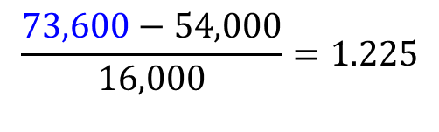
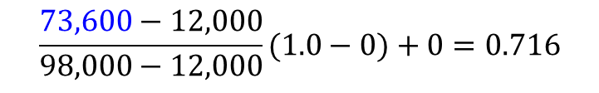
Normalization
Min-max normalization: to [new_min_{A}, new_max_{A}]
  Ex. Let income range $12,000 to $98,000 normalized to [0.0, 1.0]. Then $73,600 is mapped to
Z-score normalization (μ: mean, σ: standard deviation):
  Ex. Let μ = 54,000, σ = 16,000. Then
$$\frac{73,600−12,000}{98,000−12,000}(1.0−0)+0=0.716$$
$$\frac{73,600−54,000}{16,000}=1.225$$

Slide 68
Normalization
Normalization by decimal scaling
Where j is the smallest integer such that Max(|ν’|) < 1
Ex: the recorded value of A range from -986 to 917.
-986 normalizes to -0.986 and 917 normalizes to 0.917.

Slide 69
Discretization
Three types of attributes
  Nominal—values from an unordered set, e.g., color, profession
  Ordinal—values from an ordered set, e.g., military or academic rank
  Numeric—real numbers, e.g., integer or real numbers
Discretization: Divide the range of a continuous attribute into intervals
  Interval labels can then be used to replace actual data values
  Reduce data size by discretization
  Supervised vs. unsupervised
  Split (top-down) vs. merge (bottom-up)
  Discretization can be performed recursively on an attribute
  Prepare for further analysis, e.g., classification

Slide 70
Data Discretization Methods
Typical methods: All the methods can be applied recursively
  Binning
    Top-down split, unsupervised
  Histogram analysis
    Top-down split, unsupervised
  Clustering analysis (unsupervised, top-down split or bottom-up merge)
  Decision-tree analysis (supervised, top-down split)
  Correlation (e.g., χ²) analysis (unsupervised, bottom-up merge)
70
Notes:
70

Slide 71
Simple Discretization: Binning (1/2)
Equal-width (distance) partitioning
  Divides the range into N intervals of equal size: uniform grid
  if A and B are the lowest and highest values of the attribute, the width of intervals will be: W = (B –A)/N.
  The most straightforward, but outliers may dominate presentation
  Skewed data is not handled well
Equal-depth (frequency) partitioning
  Divides the range into N intervals, each containing approximately same number of samples
  Good data scaling
  Managing categorical attributes can be tricky

Slide 72
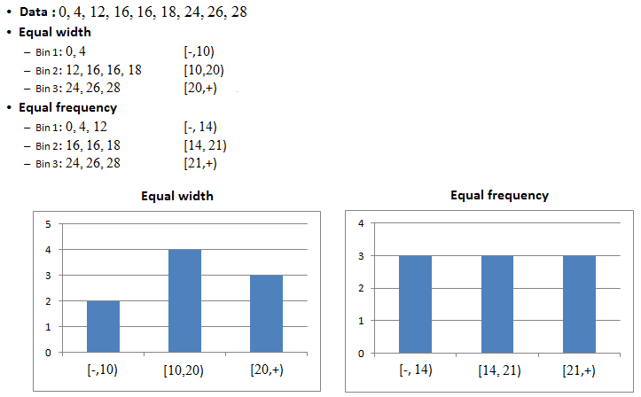
Simple Discretization: Binning (2/2)
https://www.saedsayad.com/unsupervised_binning.htm

Slide 73
Binning Methods for Data Smoothing
Sorted data for price (in dollars): 4, 8, 9, 15, 21, 21, 24, 25, 26, 28, 29, 34
* Partition into equal-frequency (equal-depth) bins:
- Bin 1: 4, 8, 9, 15
- Bin 2: 21, 21, 24, 25
- Bin 3: 26, 28, 29, 34
* Smoothing by bin means:
- Bin 1: 9, 9, 9, 9
- Bin 2: 23, 23, 23, 23
- Bin 3: 29, 29, 29, 29
* Smoothing by bin boundaries:
- Bin 1: 4, 4, 4, 15
- Bin 2: 21, 21, 25, 25
- Bin 3: 26, 26, 26, 34

Slide 74
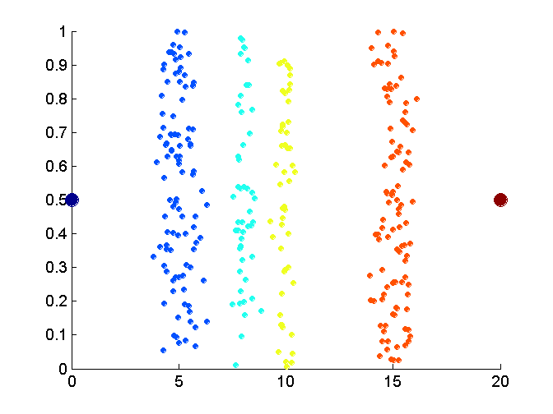
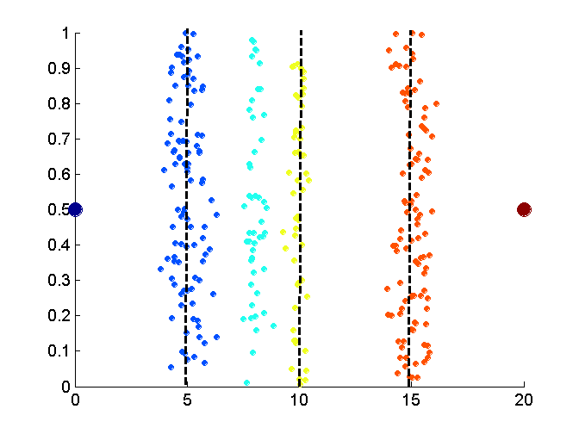
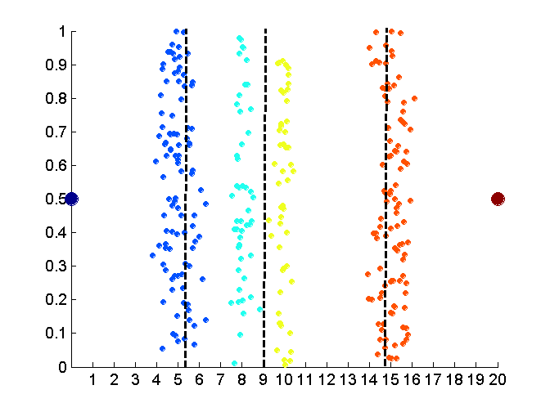
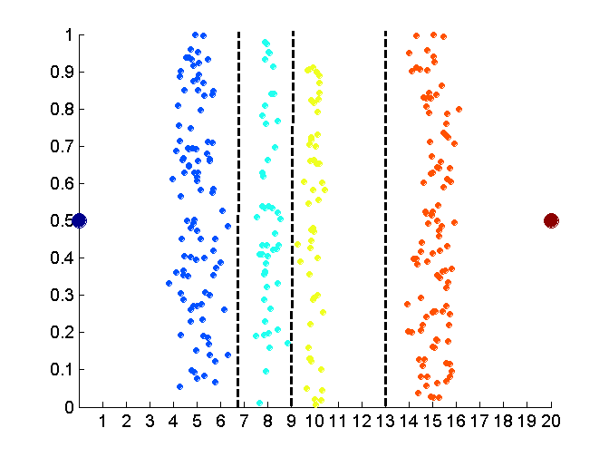
Discretization Without Using Class Labels
(Binning vs. Clustering)
Data
Equal interval width (binning)
Equal frequency (binning)
K-means clustering leads to better results
74
Notes:
74

Slide 75
Discretization by Classification & Correlation Analysis
Classification (e.g., decision tree analysis)
  Supervised: Given class labels, e.g., cancerous vs. benign
  Using entropy to determine split point (discretization point)
  Top-down, recursive split
  Details to be covered in Chapter 7
Correlation analysis (e.g., chi-merge: χ²-based discretization)
  Supervised: use class information
  Bottom-up merge: find the best neighboring intervals (those having similar distributions of classes, i.e., low χ² values) to merge
  Merge performed recursively, until a predefined stopping condition
75
Notes:
75

Slide 76
Concept Hierarchy Generation
Concept hierarchy organizes concepts (i.e., attribute values) hierarchically and is usually associated with each dimension in a data warehouse
Concept hierarchies facilitate drilling and rolling in data warehouses to view data in multiple granularity
Concept hierarchy formation: Recursively reduce the data by collecting and replacing low level concepts (such as numeric values for age) by higher level concepts (such as youth, adult, or senior)
Concept hierarchies can be explicitly specified by domain experts and/or data warehouse designers
Concept hierarchy can be automatically formed for both numeric and nominal data. For numeric data, use discretization methods shown.
Notes:
Drill-down 向下鑽取
Roll-up 往上彙整

Slide 77
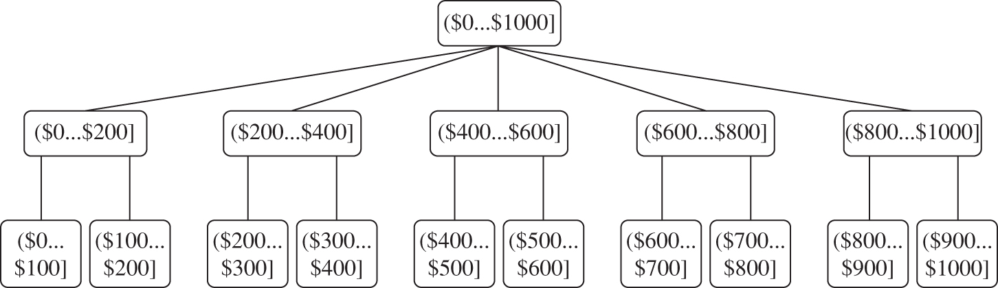
Concept Hierarchy Generation for Numeric Data
Figure 3.12 A concept hierarchy for the attribute price, where an interval ($X … $Y] denotes the range from $X (exclusive) to $Y (inclusive).

Slide 78
Concept Hierarchy Generation for Nominal Data
Specification of a partial/total ordering of attributes explicitly at the schema level by users or experts
  street < city < state < country
Specification of a hierarchy for a set of values by explicit data grouping
  {Urbana, Champaign, Chicago} < Illinois
Specification of only a partial set of attributes
  E.g., only street < city, not others
Automatic generation of hierarchies (or attribute levels) by the analysis of the number of distinct values
  E.g., for a set of attributes: {street, city, state, country}

Slide 79
Automatic Concept Hierarchy Generation
Some hierarchies can be automatically generated based on the analysis of the number of distinct values per attribute in the data set
  The attribute with the most distinct values is placed at the lowest level of the hierarchy
  Exceptions, e.g., weekday, month, quarter, year
country
15 distinct values
province_or_ state
365 distinct values
city
3567 distinct values
street
674,339 distinct values

Slide 80
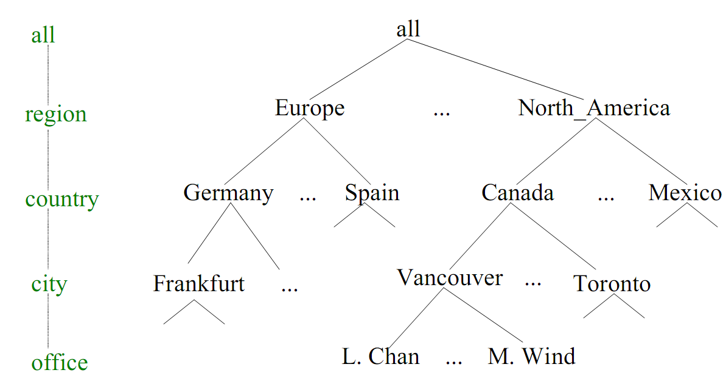
Concept Hierarchy Generation - An Example

Slide 81
Exercise
Suppose a group of 12 sales price records has been sorted as follows:
  5, 10, 11, 13, 15, 35, 50, 55, 72, 92, 204, 215.
  Partition them into three bins by each of the following methods.
  (a) equal-frequency (equal-depth) partitioning
  (b) equal-width partitioning
  (c) min-max normalization by setting min=0 and max=1

Slide 82
Summary
Data quality: accuracy, completeness, consistency, timeliness, believability, interpretability
Data cleaning: e.g. missing/noisy values, outliers
Data integration from multiple sources:
  Entity identification problem
  Remove redundancies
  Detect inconsistencies
Data reduction
  Dimensionality reduction
  Numerosity reduction
  Data compression
Data transformation and data discretization
  Normalization
  Concept hierarchy generation

