Slide 1
Chapter 02
Getting to Know your data
Dr. Chin-Hui Lai
Department of Information Management, CYCU
E-mail: chlai@cycu.edu.tw

Slide 2
Outline
Data Objects and Attribute Types
Basic Statistical Descriptions of Data
Data Visualization
Measuring Data Similarity and Dissimilarity
Summary

Slide 3
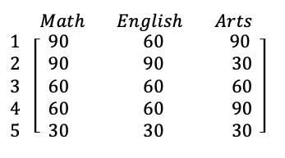
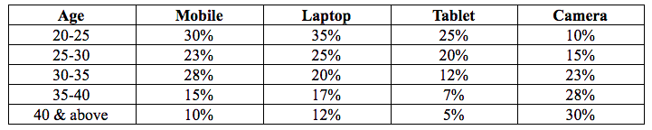
Types of Data Sets: Records (1/3)
Records
  Data matrix, e.g., numerical matrix, crosstabs
  Transaction data

Slide 4
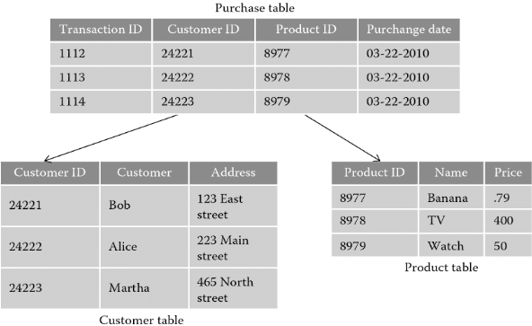
Types of Data Sets: Records (2/3)
  Relational records
In a relational database:

Slide 5
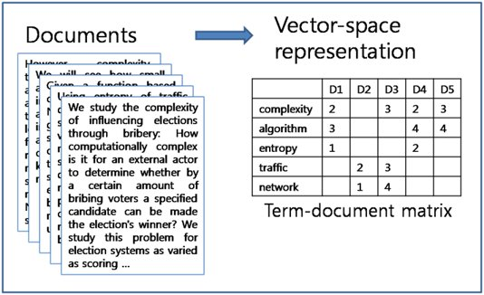
Types of Data Sets: Records (3/3)
  Document data / text documents ➔ term-document matrix
Word Vector
Term frequency
Document Vector

Slide 6
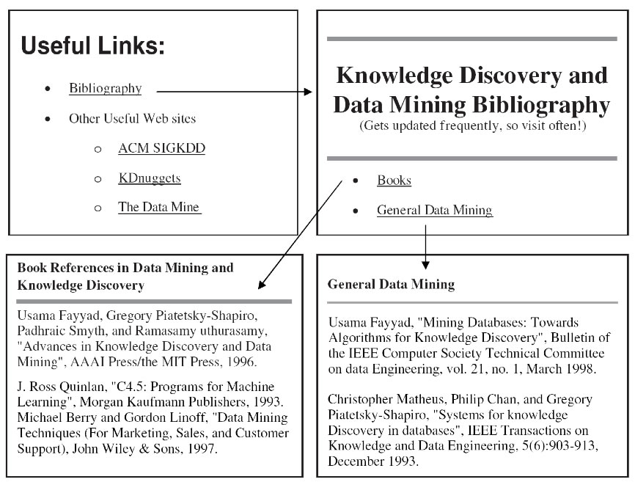
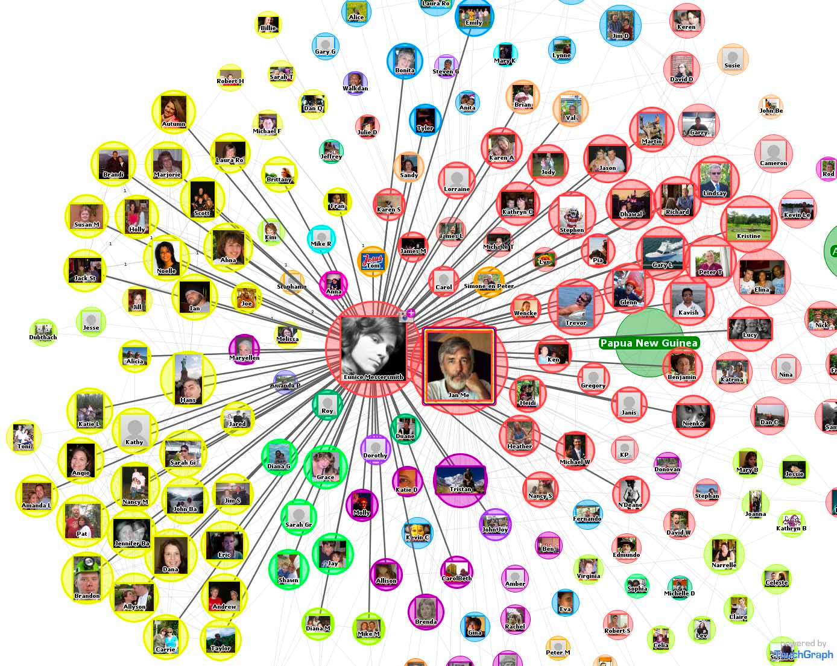
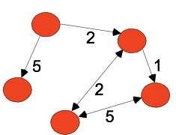
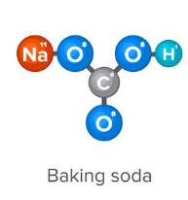
Types of Data Sets: Graph and Network
Graph and network
  World Wide Web
  Social or information networks
  Molecular Structures
node
edge

Slide 7
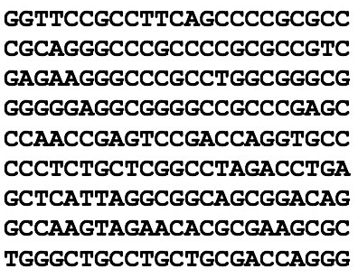
Types of Data Sets: Ordered Data (1/2)
Ordered
  Video data: sequence of images
  Sequential Data: transaction sequences
  Genetic sequence data
DNA Sequence

Slide 8
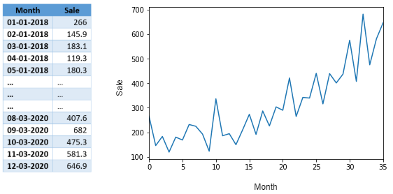
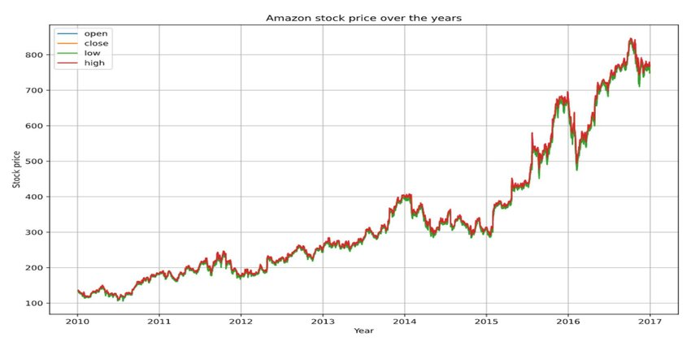
Types of Data Sets: Ordered Data (2/2)
  Temporal data: time-series

Slide 9
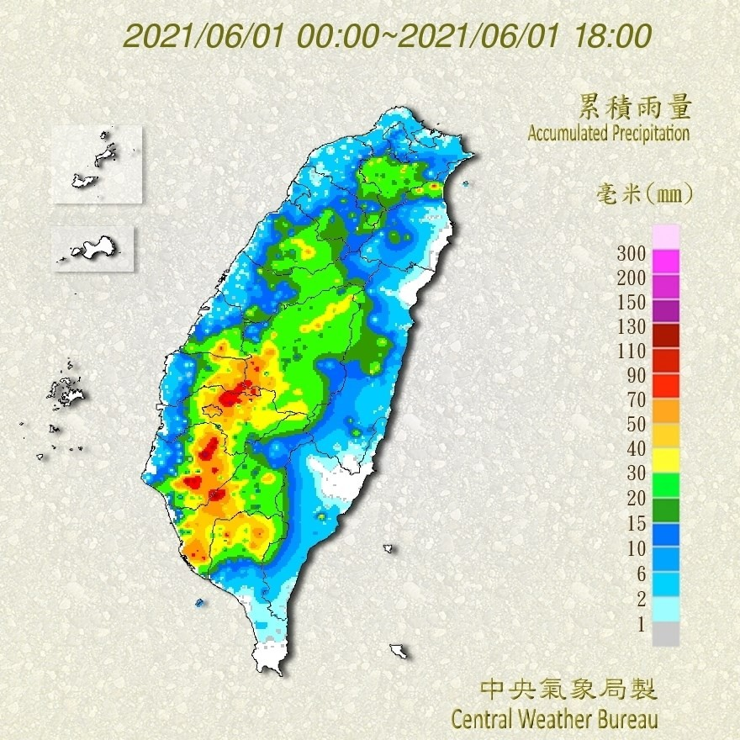
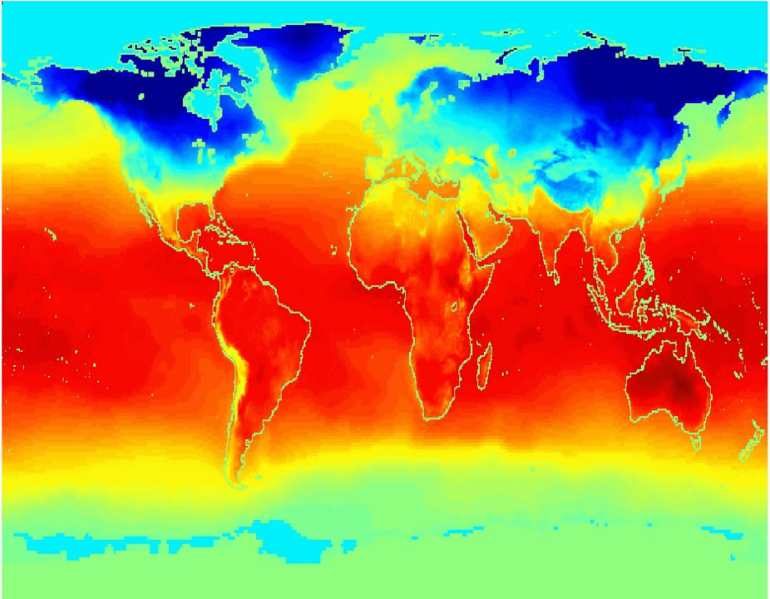
Types of Data Sets: Others (1/2)
Spatial, image and multimedia:
  Spatial data: maps
  Image data
  Video data
Average Monthly Temperature of land and ocean

Slide 10
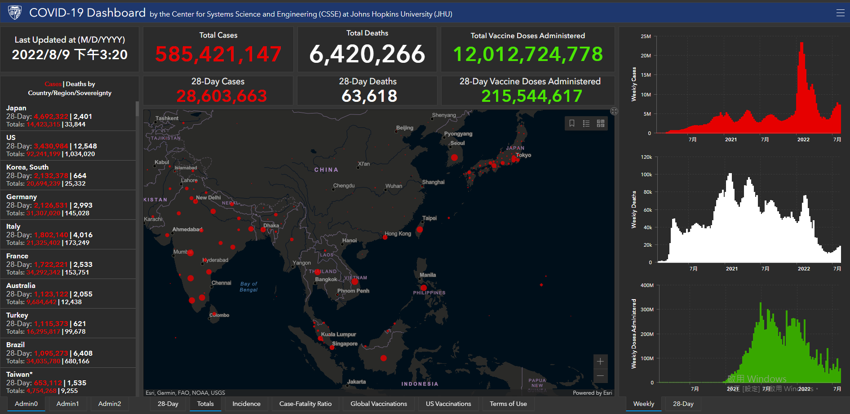
Types of Data Sets: Others (2/2)
Ref: https://www.arcgis.com/apps/dashboards/bda7594740fd40299423467b48e9ecf6

Slide 11
Important Characteristics of Structured Data
Dimensionality
  Curse of dimensionality
Sparsity
  Only presence counts
Resolution
  Patterns depend on the scale
Distribution
  Centrality and dispersion

Slide 12
Data Objects
Data sets are made up of data objects.
A data object represents an entity.
  Also called samples, examples, instances, data points, objects, tuples.
Data objects are described by attributes.
Database rows -> data objects; columns ->attributes
Examples:
  Sales database: customers, store items, sales
  Medical database: patients, treatments
  University database: students, professors, course

Slide 13
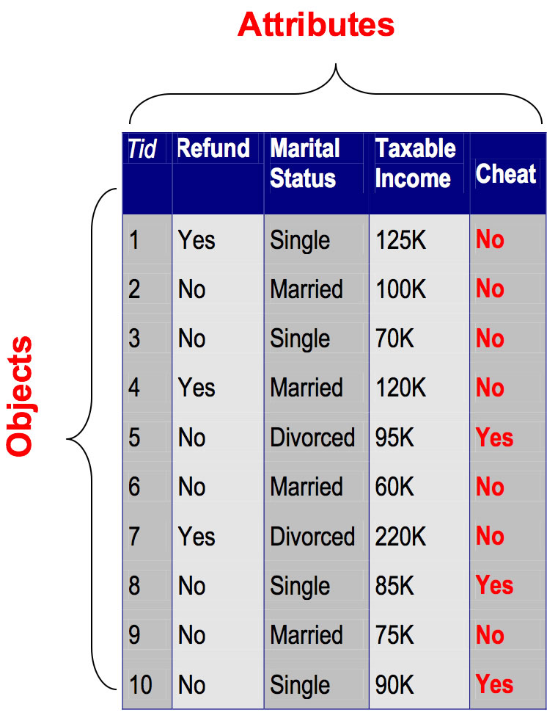
Attributes
Attribute (or dimensions, features, variables): a data field, representing a characteristic or feature of a data object.
Types:
  Nominal
  Binary
  Numeric: quantitative
    Interval-scaled
    Ratio-scaled

Slide 14
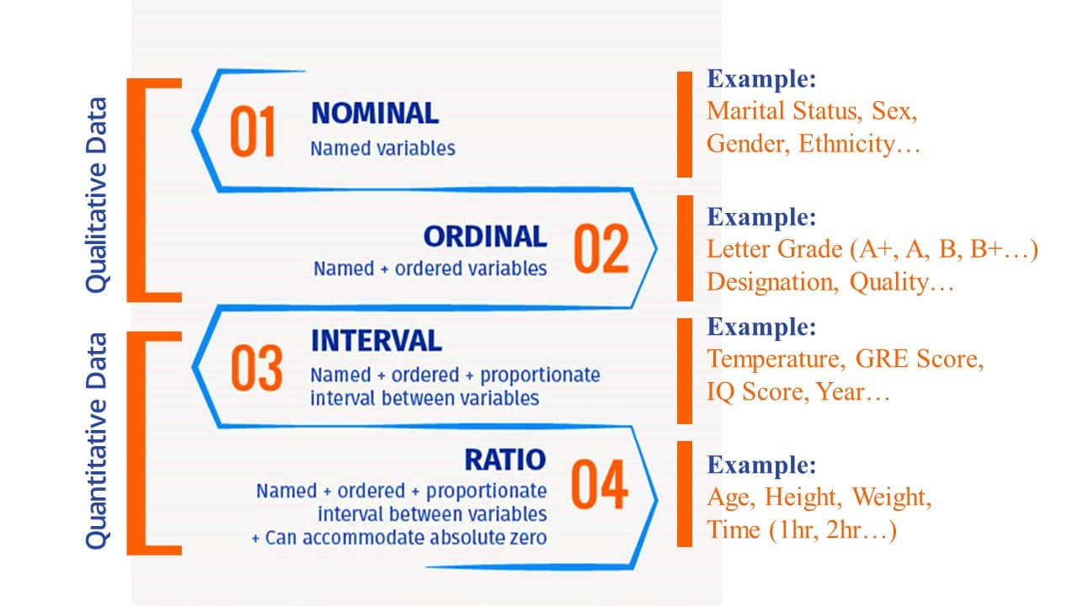
Attribute Types

Slide 15
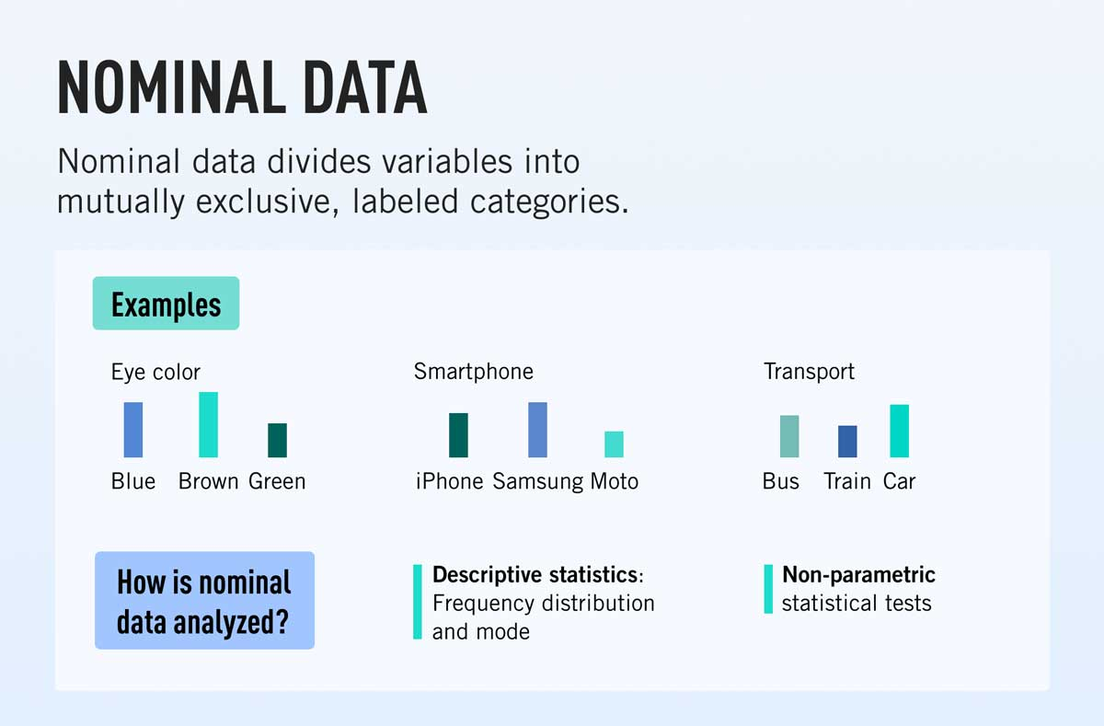
Attribute Types - Nominal Data
Nominal: categories, states, or “names of things”
  Hair_color = {auburn, black, blond, brown, grey, red, white}
https://careerfoundry.com/en/blog/data-analytics/what-is-nominal-data/
Notes:
marital status, occupation, ID numbers, zip codes

Slide 16
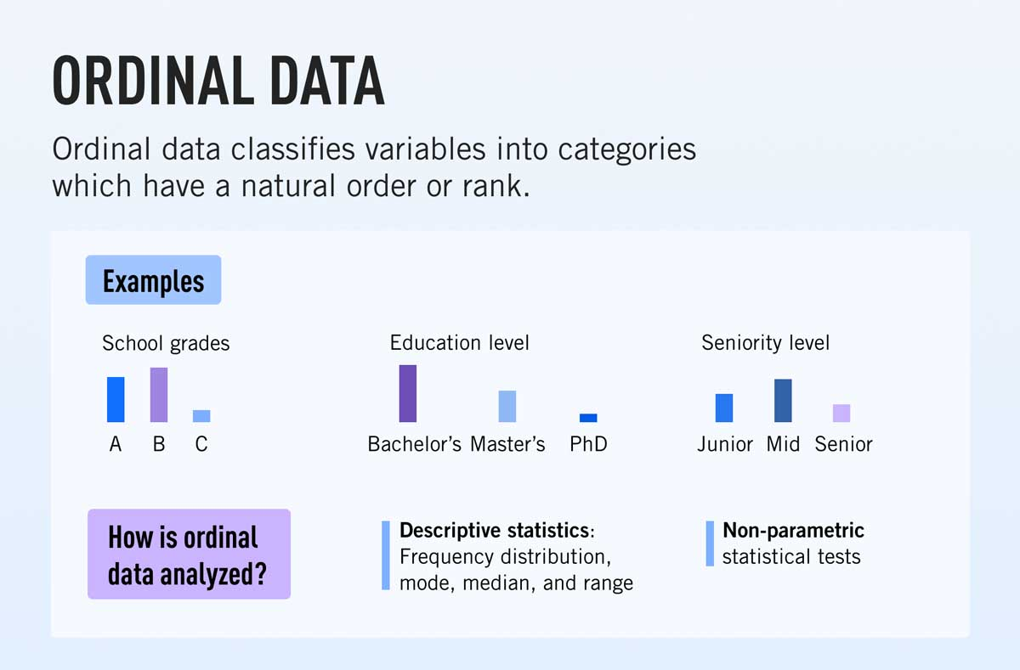
Attribute Types - Ordinal Data
Ordinal data: Values have a meaningful order (ranking) but magnitude between successive values is not known.
  Example: Size = {small, medium, large}, grades, army rankings
https://careerfoundry.com/en/blog/data-analytics/what-is-ordinal-data/

Slide 17
Attribute Types – Binary Data
Binary
  Nominal attribute with only 2 states (0 and 1)
  Symmetric binary: both outcomes equally important
    e.g., gender
  Asymmetric binary: outcomes not equally important.
    e.g., medical test (positive vs. negative)
    Convention: assign 1 to most important outcome (e.g., HIV positive)

Slide 18
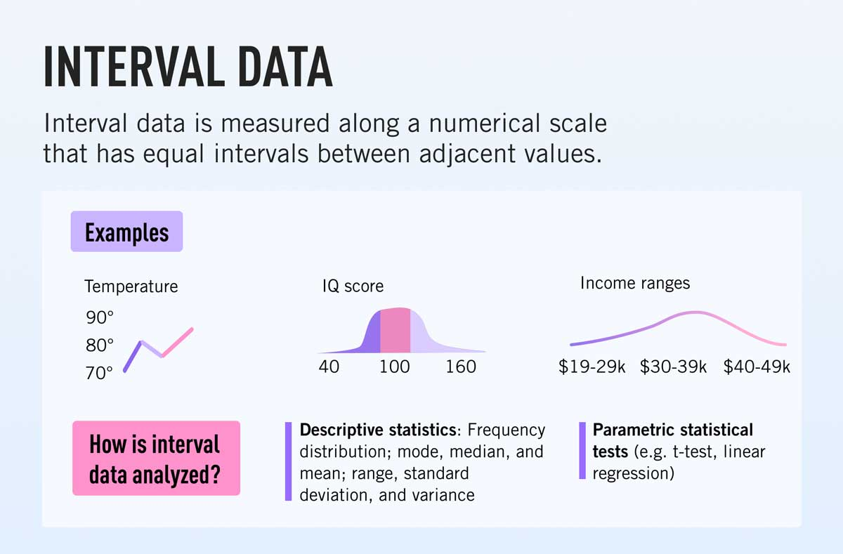
Numeric Attribute Types – Interval Data
Measured on a scale of equal-sized units
Values have order and can be positive, 0 or negative
No true zero-point
Can compute the measures of central tendency
https://careerfoundry.com/en/blog/data-analytics/what-is-interval-data/

Slide 19
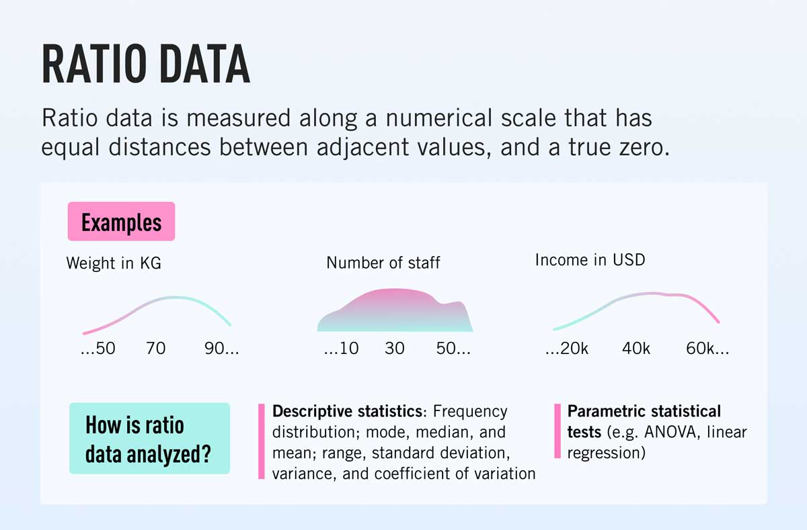
Numeric Attribute Types – Ratio Data
Inherent zero-point
Values are ordered and can compute the difference and central tendency
We can speak of values as being an order of magnitude larger than the unit of measurement (10 K˚ is twice as high as 5 K˚).
https://careerfoundry.com/en/blog/data-analytics/what-is-ratio-data/

Slide 20
Discrete vs. Continuous Attributes
Discrete Attribute
  Has only a finite or countably infinite set of values
    E.g., zip codes, profession, or the set of words in a collection of documents
  Sometimes, represented as integer variables
  Note: Binary attributes are a special case of discrete attributes
Continuous Attribute
  Has real numbers as attribute values
    E.g., temperature, height, or weight
  Practically, real values can only be measured and represented using a finite number of digits
  Continuous attributes are typically represented as floating-point variables

Slide 21
Basic Statistical Descriptions of Data
Motivation
  To better understand the data: central tendency, variation and spread
Data dispersion characteristics
  median, max, min, quantiles, outliers, variance, etc.
Numerical dimensions correspond to sorted intervals
  Data dispersion: analyzed with multiple granularities of precision
  Boxplot or quantile analysis on sorted intervals
Dispersion analysis on computed measures
  Folding measures into numerical dimensions
  Boxplot or quantile analysis on the transformed cube

Slide 22
Measuring the Central Tendency
Mean (algebraic measure) (sample vs. population):
  Note: n is sample size and N is population size.
  Weighted arithmetic mean:
  Trimmed mean: chopping extreme values
Median:
  Middle value if odd number of values, or average of the middle two values otherwise
  Estimated by interpolation (for grouped data):

Slide 23
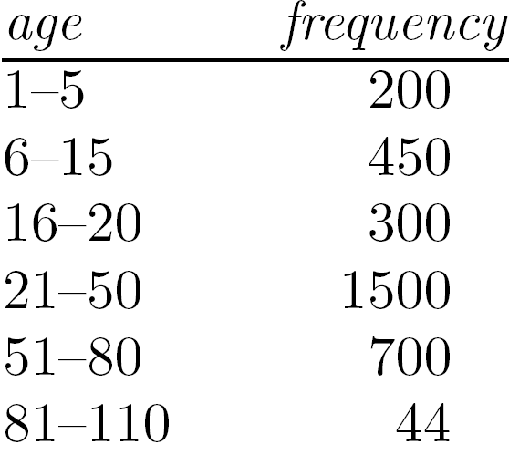
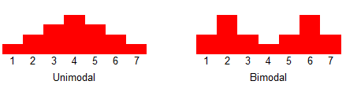
Measuring the Central Tendency
Mode
  Value that occurs most frequently in the data
  Unimodal, bimodal, trimodal

Slide 24
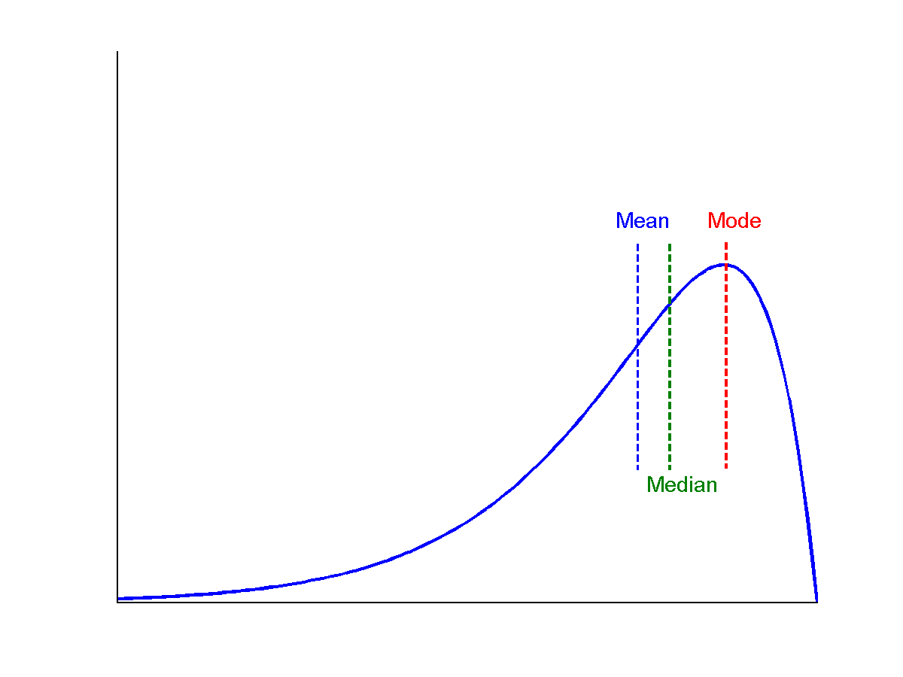
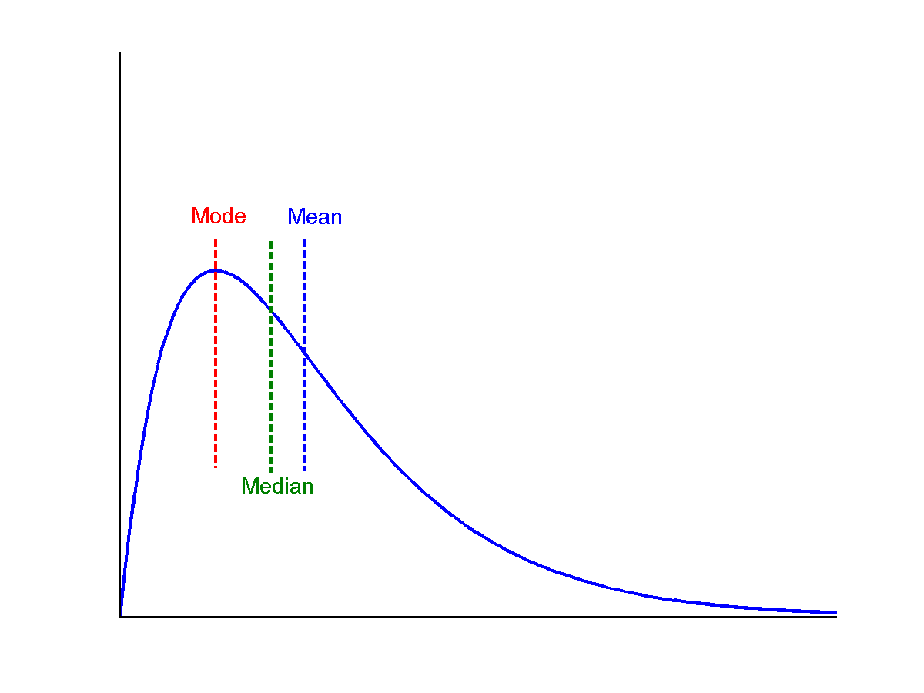
Symmetric vs. Skewed Data
Median, mean and mode of symmetric, positively and negatively skewed data
For unimodal numeric data that are moderately skewed (asymmetrical)
  Empirical formula:
symmetric
negatively skewed
positively skewed
**Mode>median
**Mode<median

Slide 25
Measuring the Central Tendency-Example
The values for salary (in thousands of dollars), shown in increasing order: 30, 36, 47, 50, 52, 52, 56, 60, 63, 70, 70, 110
  Mean salary= ?
  Median = ?
  Mode = ?

Slide 26
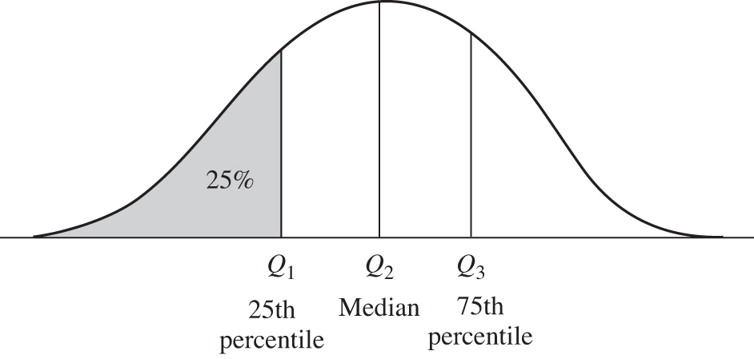
Measuring the Dispersion of Data
Quartiles, outliers and boxplots
  Quartiles: Q₁ (25th percentile), Q₃ (75th percentile)
  Inter-quartile range: IQR = Q₃ – Q₁
  Five number summary: min, Q₁, median, Q₃, max
  Boxplot: ends of the box are the quartiles; median is marked; add whiskers, and plot outliers individually
  Outlier: usually, a value higher/lower than 1.5 x IQR
Notes:
Inter-quartile range 四分位距
箱形圖（英文：Box plot），又稱為盒鬚圖、盒式圖、盒狀圖或箱線圖，是一種用作顯示一組數據分散情況資料的統計圖。

Slide 27
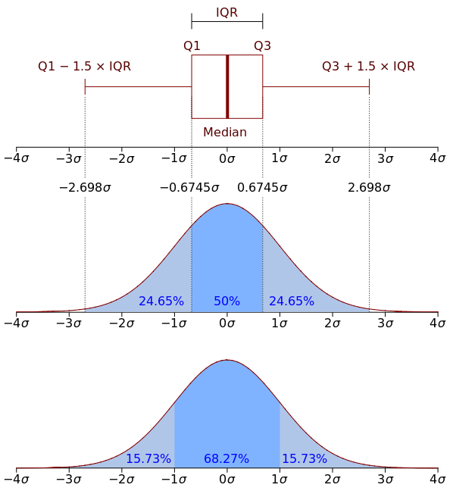
Measuring the Dispersion of Data
Variance and standard deviation (sample: s, population: σ)
  Variance: (algebraic, scalable computation)
  Standard deviation s (or σ) is the square root of variance s² ⁽or σ²⁾
https://en.wikipedia.org/wiki/Interquartile_range

Slide 28
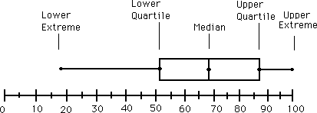
Boxplot Analysis (1/2)
Five-number summary of a distribution
  Minimum, Q1, Median, Q3, Maximum

Slide 29
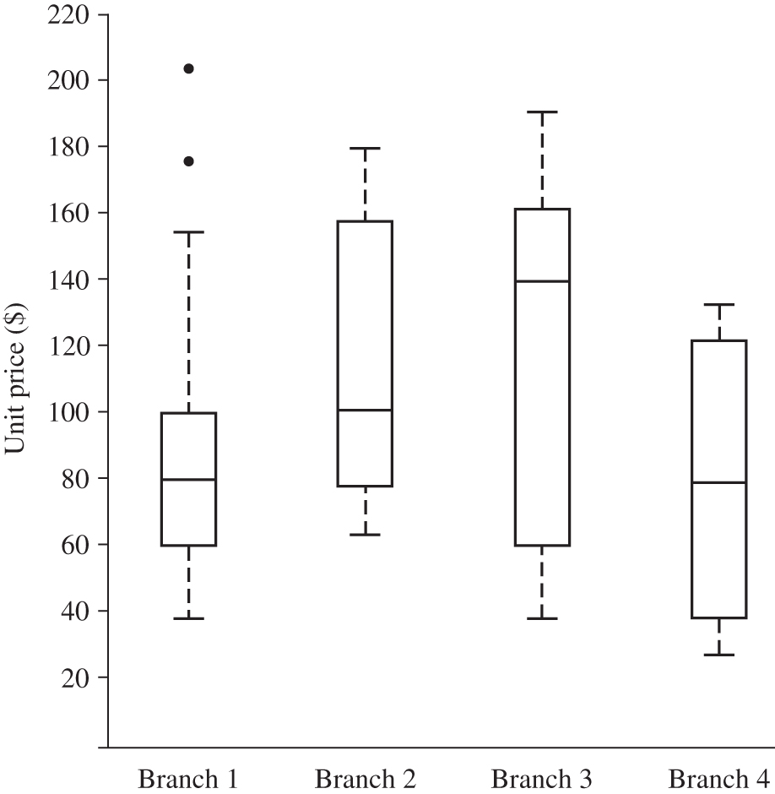
Boxplot Analysis (2/2)
Boxplot
  Data is represented with a box
  The ends of the box are at the first and third quartiles, i.e., the height of the box is IQR
  The median is marked by a line within the box
  Whiskers: two lines outside the box extended to Minimum and Maximum
  Outliers: points beyond a specified outlier threshold, plotted individually
Boxplot for the unit price data for items sold at four branches of AllElectronics during a given time period.

Slide 30
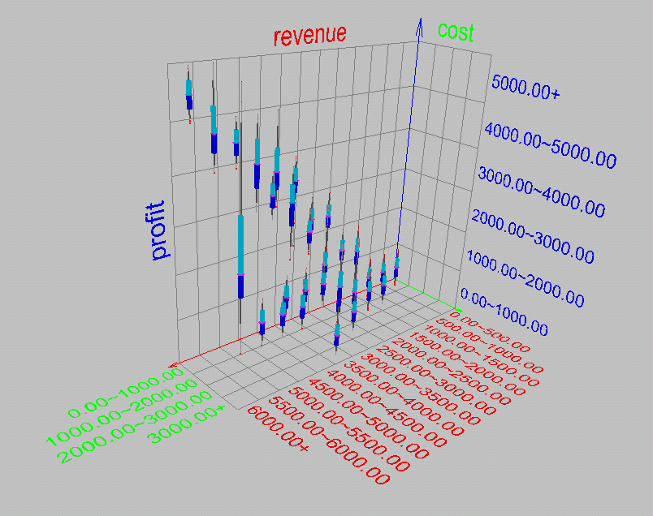
Visualization of Data Dispersion: 3-D Boxplots

Slide 31
Example of boxplot
The math scores of 12 students:
  59, 60, 64, 65, 67, 70, 72, 74, 75, 76, 78, 80
1) Please show the five number summary:
  Min= ?
  Q1=?
  Median=?
  Q3=?
  Max=?
  IQR=?
2) Draw a boxplot

Slide 32
Properties of Normal Distribution Curve
The normal (distribution) curve
  From μ–σ to μ+σ: contains about 68% of the measurements (μ: mean, σ: standard deviation)
  From μ–2σ to μ+2σ: contains about 95% of it
  From μ–3σ to μ+3σ: contains about 99.7% of it

Slide 33
Graphic Displays of Basic Statistical Descriptions
Boxplot: graphic display of five-number summary
Histogram: x-axis are values, y-axis repres. frequencies
Quantile plot: each value xi is paired with fi indicating that approximately 100 fi % of data are ≤ xi
Quantile-quantile (q-q) plot: graphs the quantiles of one univariant distribution against the corresponding quantiles of another
Scatter plot: each pair of values is a pair of coordinates and plotted as points in the plane

Slide 34
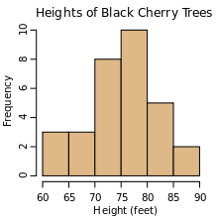
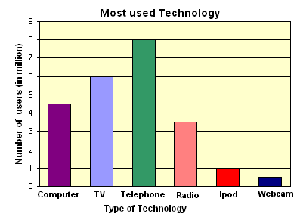
Histogram Analysis
Histogram: Graph display of tabulated frequencies, shown as bars
It shows what proportion of cases fall into each of several categories
Differs from a bar chart in that it is the area of the bar that denotes the value, not the height as in bar charts, a crucial distinction when the categories are not of uniform width
The categories are usually specified as non-overlapping intervals of some variable. The categories (bars) must be adjacent
Notes:
Histogram for numeric data
Bar chart for nominal data / discrete data

Slide 35
Histograms Often Tell More than Boxplots
The two histograms shown in the left may have the same boxplot representation
  The same values for: min, Q1, median, Q3, max
But they have rather different data distributions

Slide 36
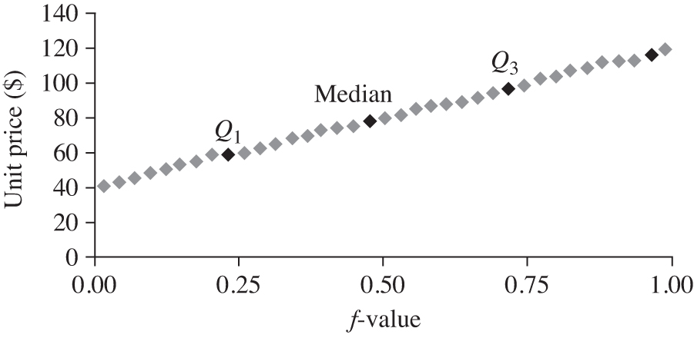
Quantile Plot
Displays all of the data (allowing the user to assess both the overall behavior and unusual occurrences)
Plots quantile information
  For a data x_{i} data sorted in increasing order, f_{i} indicates that approximately f_{i} *100% of the data are below or equal to the value x_{i}

Slide 37
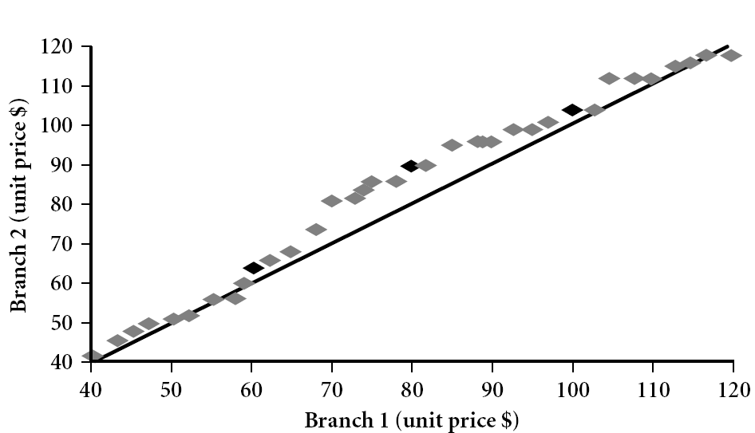
Quantile-Quantile (Q-Q) Plot
Graphs the quantiles of one univariate distribution against the corresponding quantiles of another
View: Is there a shift in going from one distribution to another?
Example shows unit price of items sold at Branch 1 vs. Branch 2 for each quantile. Unit prices of items sold at Branch 1 tend to be lower than those at Branch 2.
Notes:
Note: We need to label the dark plotted points as Q1, Median, Q3 – that would help in understanding this graph.
Tell audience: There is a shift in distribution of branch 1 WRT branch 2 in that the unit prices of items sold at branch 1 tend to be lower than those at branch 2.

Slide 38
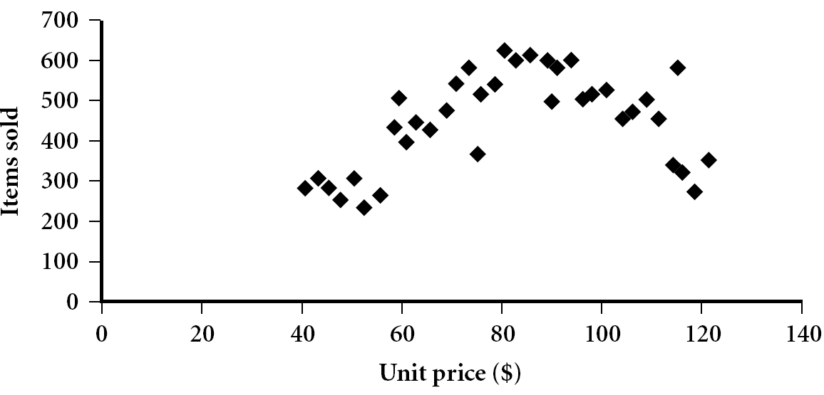
Scatter plot
Provides a first look at bivariate data to see clusters of points, outliers, etc
Each pair of values is treated as a pair of coordinates and plotted as points in the plane

Slide 39
Positively and Negatively Correlated Data
The left half fragment is positively correlated
The right half is negative correlated

Slide 40
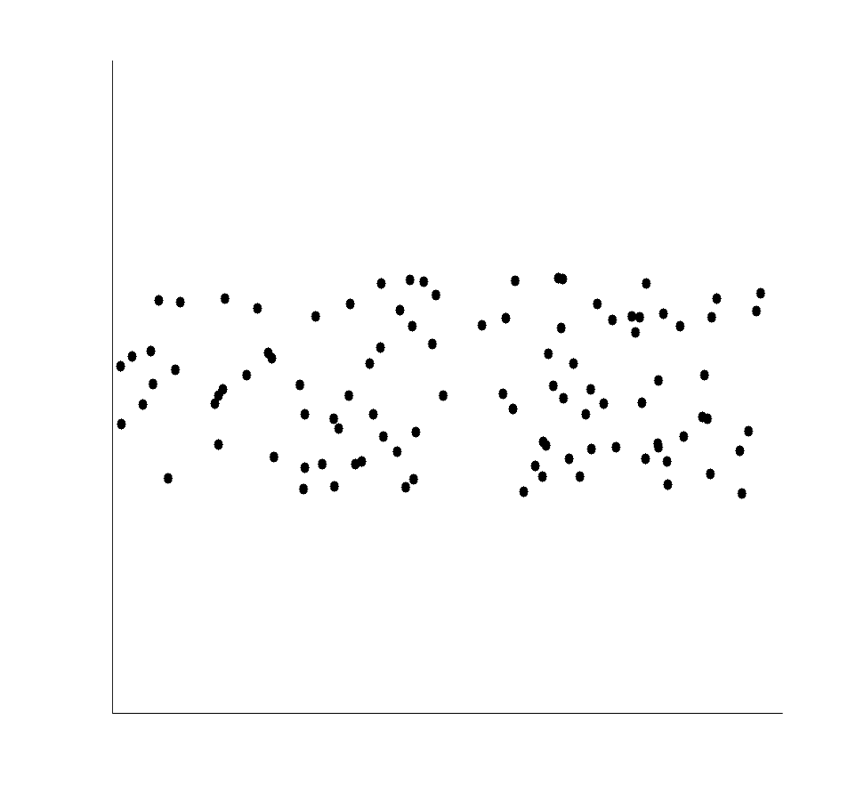
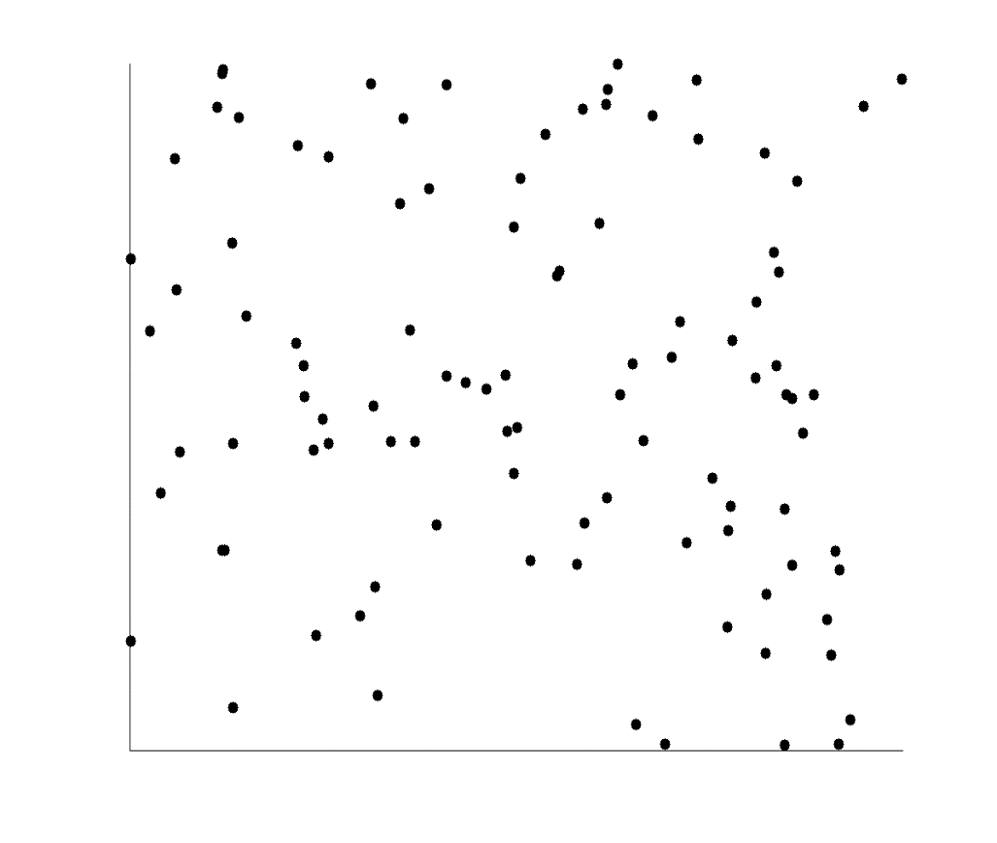
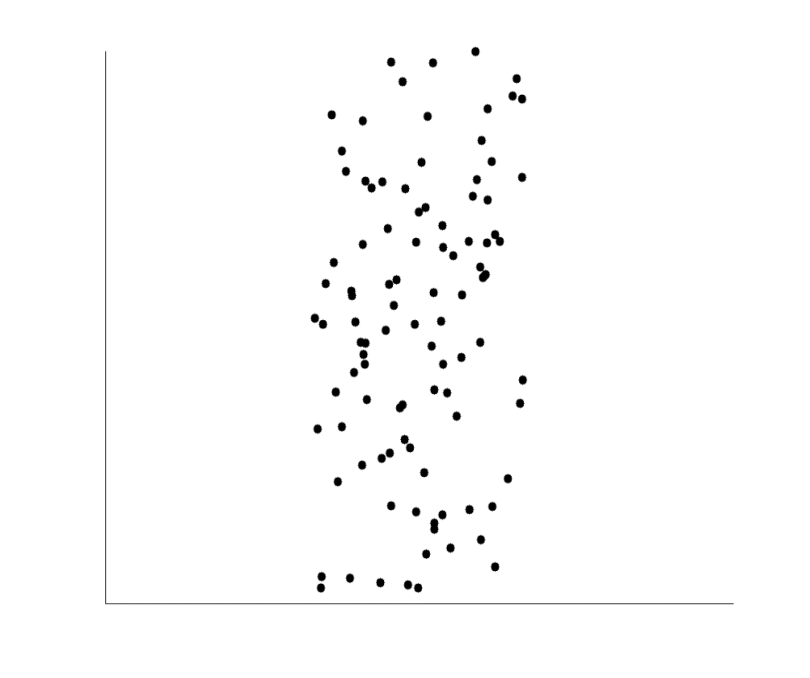
Uncorrelated Data

Slide 41
Data Visualization (1/2)
Why data visualization?
  Gain insight into an information space by mapping data onto graphical primitives
  Provide qualitative overview of large data sets
  Search for patterns, trends, structure, irregularities, relationships among data
  Help find interesting regions and suitable parameters for further quantitative analysis
  Provide a visual proof of computer representations derived

Slide 42
Data Visualization (2/2)
Categorization of visualization methods:
  Pixel-oriented visualization techniques
  Geometric projection visualization techniques
  Icon-based visualization techniques
  Hierarchical visualization techniques
  Visualizing complex data and relations

Slide 43
Pixel-Oriented Visualization Techniques
For a data set of m dimensions, create m windows on the screen, one for each dimension
The m dimension values of a record are mapped to m pixels at the corresponding positions in the windows
The colors of the pixels reflect the corresponding values
Income
(b) Credit Limit
(c) transaction volume
(d) age
43
Notes:
43

Slide 44
Laying Out Pixels in Circle Segments
To save space and show the connections among multiple dimensions, space filling is often done in a circle segment
Representing a data record in circle segment
(b) Laying out pixels in circle segment
44
Notes:
44

Slide 45
Geometric Projection Visualization Techniques
Visualization of geometric transformations and projections of the data
Methods
  Direct visualization
  Scatterplot and scatterplot matrices
  Landscapes
  Projection pursuit technique: Help users find meaningful projections of multidimensional data
  Prosection views
  Hyperslice
  Parallel coordinates

Slide 46
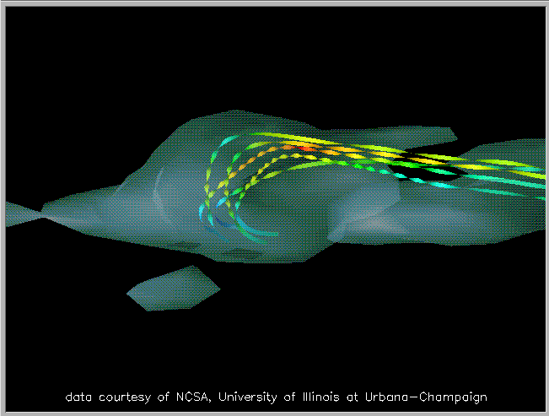
Direct Data Visualization
Ribbons with Twists Based on Vorticity
Notes:
http://books.elsevier.com/companions/1558606890/pictures/Chapter_01/fig1-6b.gif

Slide 47
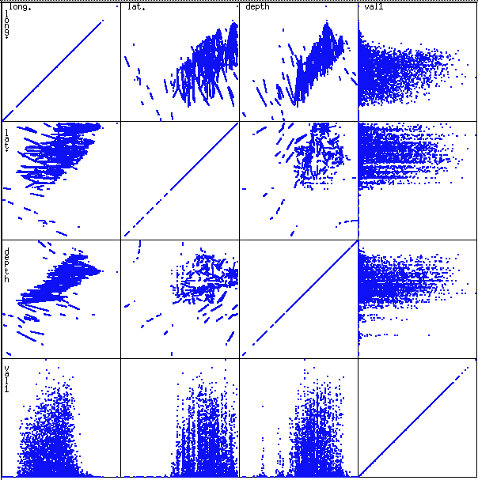
Scatterplot Matrices
Used by ermission of M. Ward, Worcester Polytechnic Institute
Matrix of scatterplots (x-y-diagrams) of the k-dim. data [total of (k2/2-k) scatterplots]

Slide 48
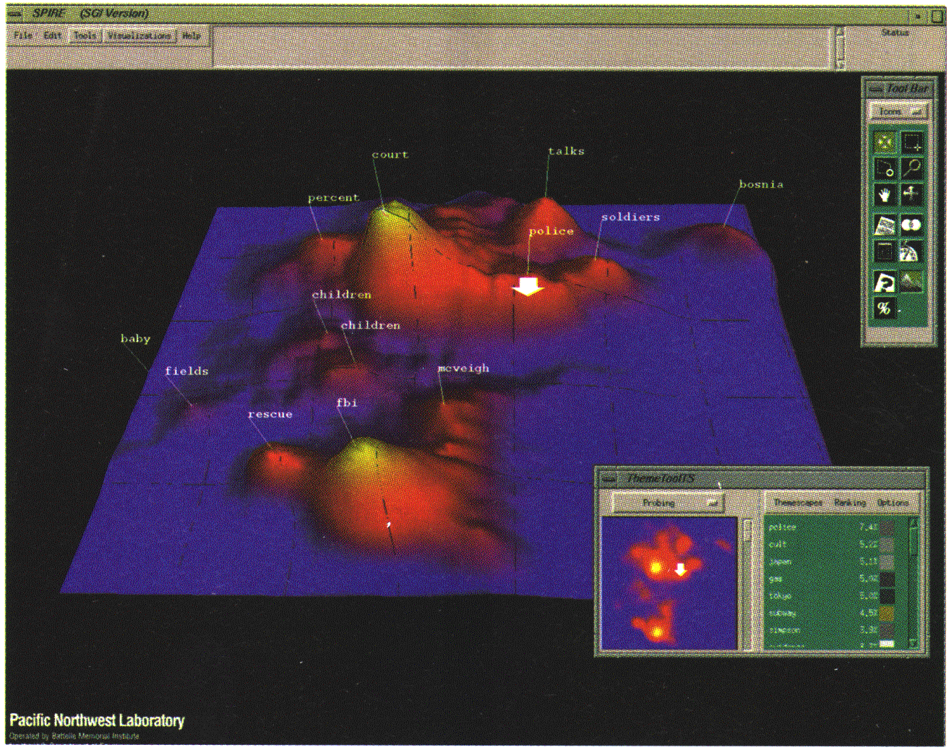
Landscapes
news articles
visualized as
a landscape
Used by permission of B. Wright, Visible Decisions Inc.
Visualization of the data as perspective landscape
The data needs to be transformed into a (possibly artificial) 2D spatial representation which preserves the characteristics of the data

Slide 49
Parallel Coordinates
n equidistant axes which are parallel to one of the screen axes and correspond to the attributes
The axes are scaled to the [minimum, maximum]: range of the corresponding attribute
Every data item corresponds to a polygonal line which intersects each of the axes at the point which corresponds to the value for the attribute

Slide 50
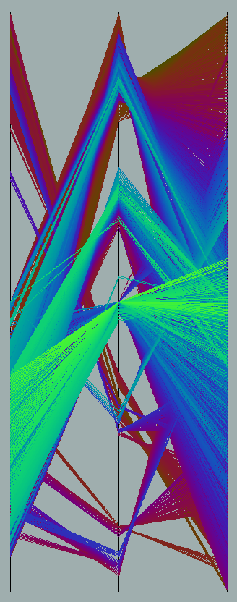
Parallel Coordinates of a Data Set

Slide 51
Icon-Based Visualization Techniques
Visualization of the data values as features of icons
Typical visualization methods
  Chernoff Faces
  Stick Figures
General techniques
  Shape coding: Use shape to represent certain information encoding
  Color icons: Use color icons to encode more information
  Tile bars: Use small icons to represent the relevant feature vectors in document retrieval

Slide 52
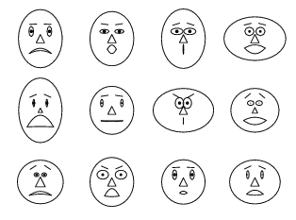
Chernoff Faces
A way to display variables on a two-dimensional surface, e.g., let x be eyebrow slant, y be eye size, z be nose length, etc.
The figure shows faces produced using 10 characteristics--head eccentricity, eye size, eye spacing, eye eccentricity, pupil size, eyebrow slant, nose size, mouth shape, mouth size, and mouth opening): Each assigned one of 10 possible values, generated using Mathematica (S. Dickson)
REFERENCE: Gonick, L. and Smith, W. The Cartoon Guide to Statistics. New York: Harper Perennial, p. 212, 1993
Weisstein, Eric W. "Chernoff Face." From MathWorld--A Wolfram Web Resource. mathworld.wolfram.com/ChernoffFace.html

Slide 53
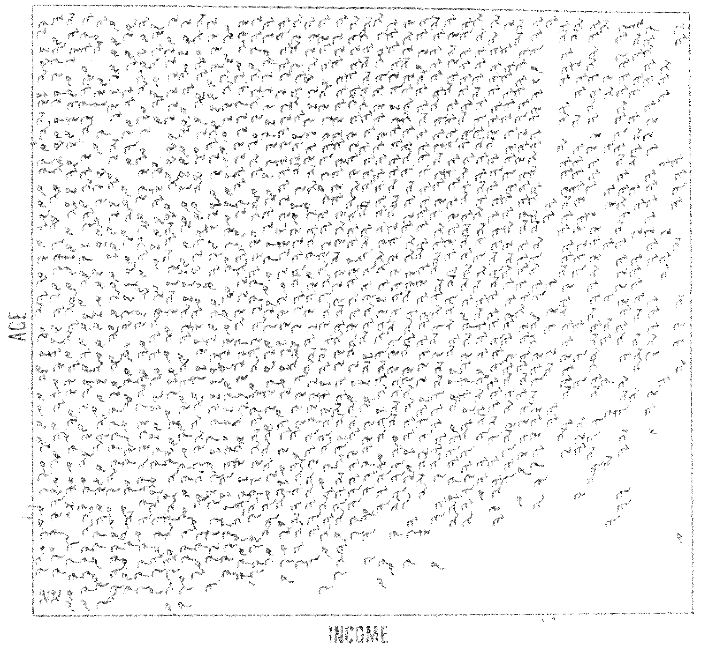
Stick Figure
A census data figure showing age, income, gender, education, etc.
used by permission of G. Grinstein, University of Massachusettes at Lowell
A 5-piece stick figure (1 body and 4 limbs w. different angle/length)
Two attributes mapped to axes, remaining attributes mapped to angle or length of limbs”. Look at texture pattern

Slide 54
Hierarchical Visualization Techniques
Visualization of the data using a hierarchical partitioning into subspaces
Methods
  Dimensional Stacking
  Worlds-within-Worlds
  Tree-Map
  Cone Trees
  InfoCube

Slide 55
Dimensional Stacking
Partitioning of the n-dimensional attribute space in 2-D subspaces, which are ‘stacked’ into each other
Partitioning of the attribute value ranges into classes. The important attributes should be used on the outer levels.
Adequate for data with ordinal attributes of low cardinality
But, difficult to display more than nine dimensions
Important to map dimensions appropriately

Slide 56
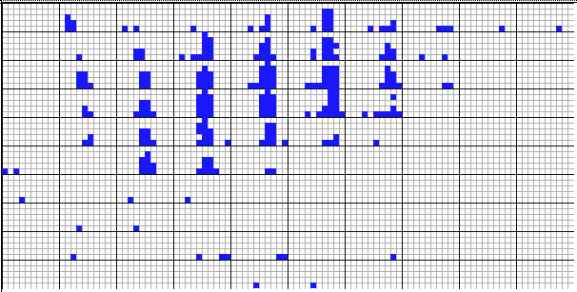
Dimensional Stacking
    Used by permission of M. Ward, Worcester Polytechnic Institute
Visualization of oil mining data with longitude and latitude mapped to the outer x-, y-axes and ore grade and depth mapped to the inner x-, y-axes

Slide 57
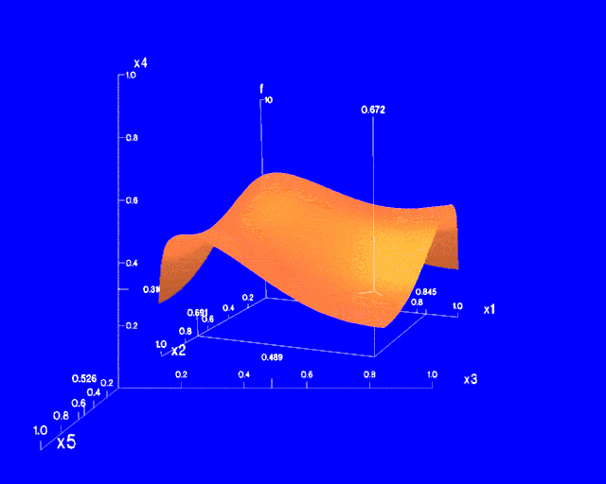
Worlds-within-Worlds
Assign the function and two most important parameters to innermost world
Fix all other parameters at constant values - draw other (1 or 2 or 3 dimensional worlds choosing these as the axes)
Software that uses this paradigm
  N–vision: Dynamic interaction through data glove and stereo displays, including rotation, scaling (inner) and translation (inner/outer)
  Auto Visual: Static interaction by means of queries

Slide 58
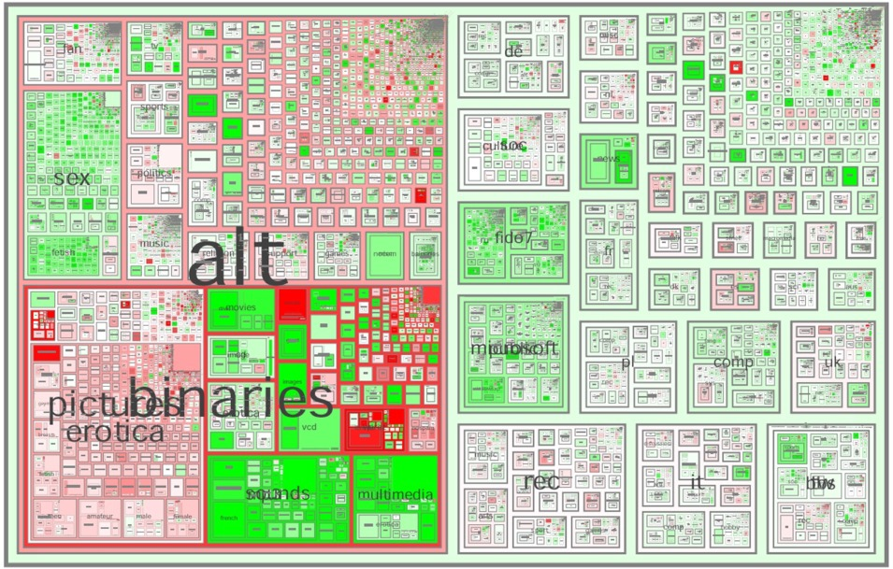
Tree-Map
Screen-filling method which uses a hierarchical partitioning of the screen into regions depending on the attribute values
The x- and y-dimension of the screen are partitioned alternately according to the attribute values (classes)
MSR Netscan Image
Ack.: http://www.cs.umd.edu/hcil/treemap-history/all102001.jpg

Slide 59
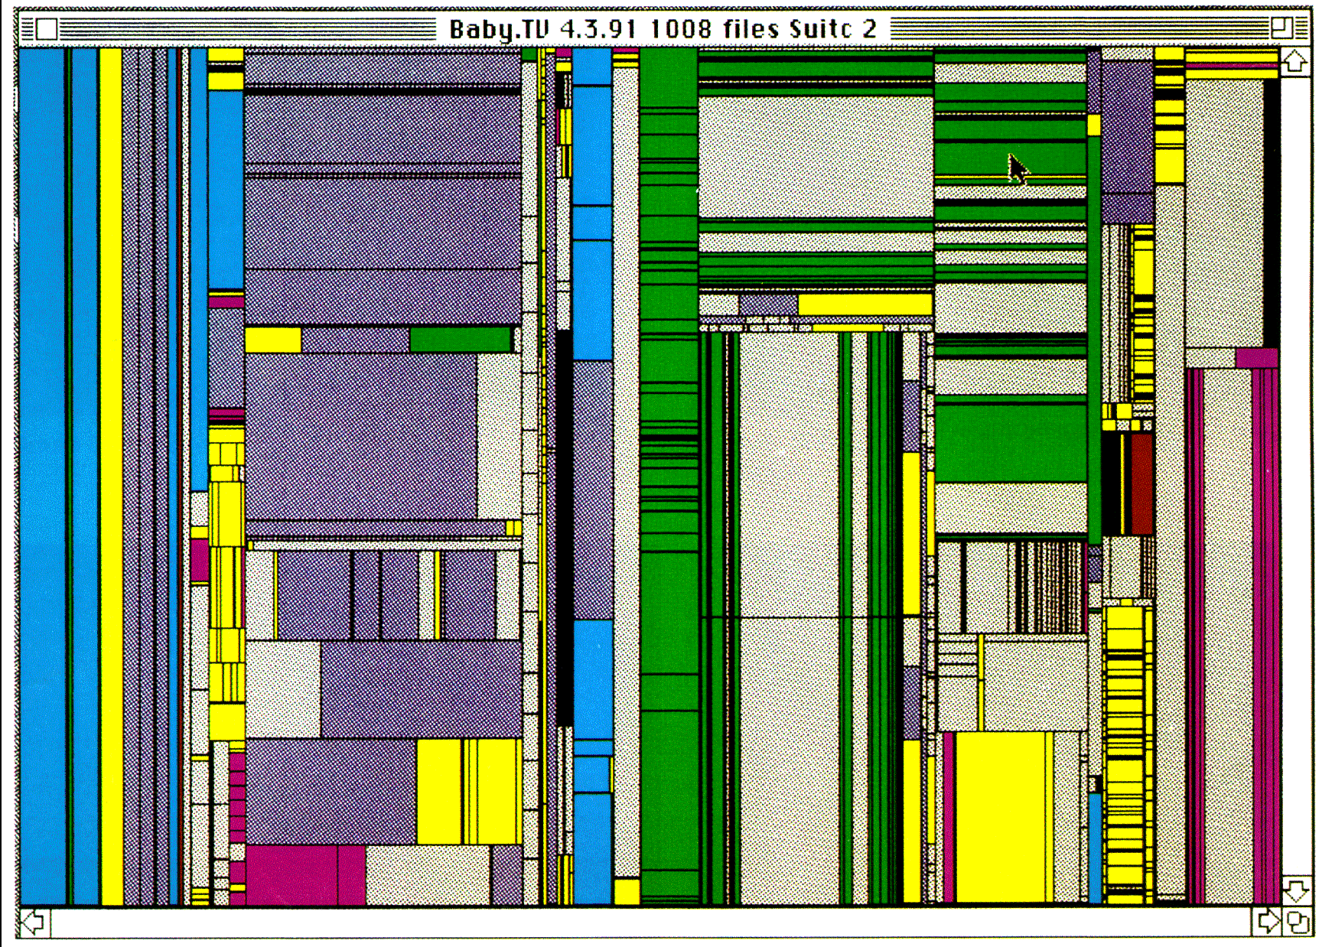
Tree-Map of a File System (Schneiderman)

Slide 60

InfoCube
A 3-D visualization technique where hierarchical information is displayed as nested semi-transparent cubes
The outermost cubes correspond to the top level data, while the subnodes or the lower level data are represented as smaller cubes inside the outermost cubes, and so on

Slide 61
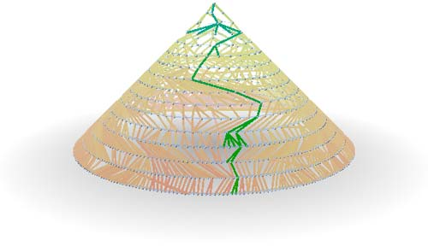
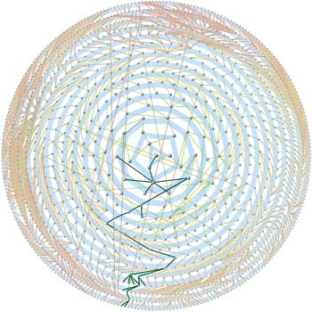
Three-D Cone Trees
3D cone tree visualization technique works well for up to a thousand nodes or so
First build a 2D circle tree that arranges its nodes in concentric circles centered on the root node
Cannot avoid overlaps when projected to 2D
G. Robertson, J. Mackinlay, S. Card. “Cone Trees: Animated 3D Visualizations of Hierarchical Information”, ACM SIGCHI'91
Graph from Nadeau Software Consulting website: Visualize a social network data set that models the way an infection spreads from one person to the next
Ack.: http://nadeausoftware.com/articles/visualization

Slide 62
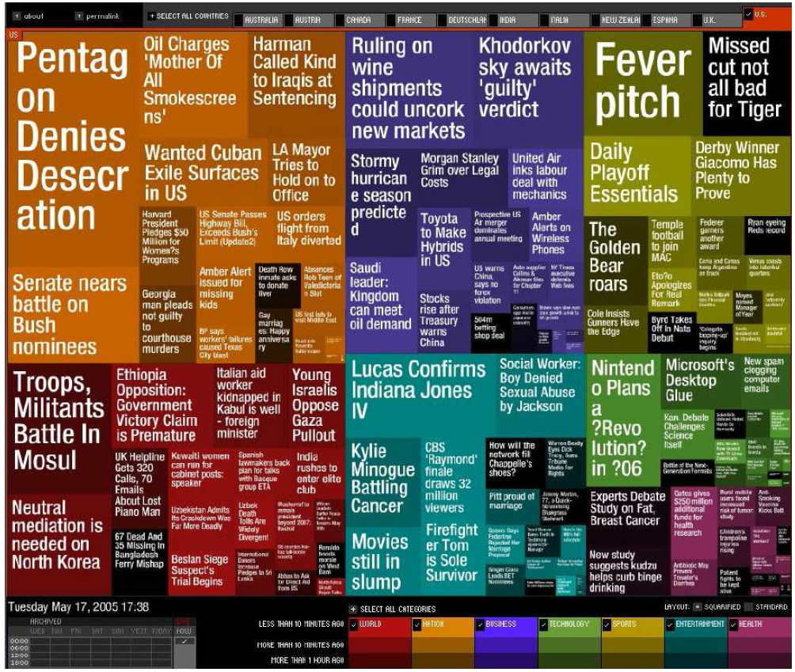
Visualizing Complex Data and Relations
Visualizing non-numerical data: text and social networks
Tag cloud: visualizing user-generated tags
  The importance of tag is represented by font size/color
Besides text data, there are also methods to visualize relationships, such as visualizing social networks
Newsmap: Google News Stories in 2005

Slide 63
Similarity and Dissimilarity
Similarity
  Numerical measure of how alike two data objects are
  Value is higher when objects are more alike
  Often falls in the range [0,1]
Dissimilarity (e.g., distance)
  Numerical measure of how different two data objects are
  Lower when objects are more alike
  Minimum dissimilarity is often 0
  Upper limit varies
Proximity refers to a similarity or dissimilarity

Slide 64
Data Matrix and Dissimilarity Matrix
Data matrix
  n data points with p dimensions
  Two-modes matrix
Dissimilarity matrix
  n data points, but registers only the distance
  A triangular matrix
  Single-mode matrix

Slide 65
Proximity Measure for Nominal Attributes
Can take 2 or more states, e.g., red, yellow, blue, green (generalization of a binary attribute)
Method 1: Simple matching
  m: # of matches, p: total # of variables
Method 2: Use a large number of binary attributes
  creating a new binary attribute for each of the M nominal states

Slide 66

Proximity Measure for Nominal Attributes
Object identifier | Test-1 (nominal)
1 | Code A
2 | Code B
3 | Code C
4 | Code A
Test-1 (nominal)
Dissimilarity matrix
set P=1
d(4,1)=(p-m)/p=(1-1)/1=0

Slide 67




Proximity Measure for Binary Attributes
A contingency table for binary data
Distance measure for asymmetric binary variables
Object j
Object i
Distance measure for symmetric binary variables
Jaccard coefficient (similarity measure for asymmetric binary variables)

Slide 68
Dissimilarity between Binary Variables
Example
  Gender is a symmetric attribute
  The remaining attributes are asymmetric binary
  Let the values Y and P be 1, and the value N be 0
Mary
 | 1 | 0
1 | 2 | 0
0 | 1 | 3
Jack

Slide 69
Standardizing Numeric Data
Z-score:
  X: raw score to be standardized, μ: mean of the population, σ: standard deviation
  the distance between the raw score and the population mean in units of the standard deviation
  negative when the raw score is below the mean, “+” when above
An alternative way: Calculate the mean absolute deviation (MAD)
  where
  standardized measure (z-score):
Using mean absolute deviation is more robust than using standard deviation
Notes:
mean absolute deviation: 平均絕對離差

Slide 70
Example:
Data Matrix and Dissimilarity Matrix
Data Matrix
Dissimilarity Matrix
(with Euclidean Distance)
Notes:
Euclidean Distance: 尤拉距離/ 歐基里德距離

Slide 71
Distance on Numeric Data: Minkowski Distance
Minkowski distance: A popular distance measure
  where i = (x_{i1}, x_{i2}, …, x_{ip}) and j = (x_{j1}, x_{j2}, …, x_{jp}) are two p-dimensional data objects, and h is the order (the distance so defined is also called L-h norm)
Properties
  d(i, j) > 0 if i ≠ j, and d(i, i) = 0 (Positive definiteness)
  d(i, j) = d(j, i) (Symmetry)
  d(i, j) ≤ d(i, k) + d(k, j) (Triangle Inequality)
A distance that satisfies these properties is a metric
Notes:
Minkowski distance (閔可夫斯基距離)

Slide 72
Special Cases of Minkowski Distance
h = 1: Manhattan (city block, L₁ norm) distance
  E.g., the Hamming distance: the number of bits that are different between two binary vectors
h = 2: (L₂ norm) Euclidean distance
h → ∞. “supremum” (L_{max} norm, L∞ norm) distance.
  This is the maximum difference between any component (attribute) of the vectors
Notes:
Norm (范數)

Slide 73
Example: Minkowski Distance
Dissimilarity Matrices
Manhattan (L₁)
Euclidean (L₂)
Supremum

Slide 74
Ordinal Variables
An ordinal variable can be discrete or continuous
Order is important, e.g., rank
Can be treated like interval-scaled
  replace x_{if} by their rank
  map the range of each variable onto [0, 1] by replacing i-th object in the f-th variable by
  compute the dissimilarity using methods for interval-scaled variables

Slide 75

Ordinal Variables- Example
Object identifier | Test-2 (ordinal) | Step 1 | Step 2 Normalized
1 | Excellent | 3 | 1
2 | Fair | 1 | 0
3 | Good | 2 | 0.5
4 | excellent | 3 | 1
Three states for test-2: Fair, Good, Excellent M_{f}=3
Step1: replace each value for test-2 by its rank
➔ 3, 1, 2, 3
Step2: normalize the ranking in [0,1]
1, 0, 0.5, 1
Step3: calculate the dissimilarity by using the Euclidean distance
d(2,1)=1.0, d(4,2)=1.0

Slide 76

Attributes of Mixed Type (2/2)
A database may contain all attribute types (e.g. nominal, symmetric binary, asymmetric binary, numeric, ordinal)
One may use a weighted formula to combine their effects
  f is binary or nominal:
    d_{ij}^{(f)} = 0 if x_{if} = x_{jf} , or d_{ij}^{(f)} = 1 otherwise
  f is numeric: use the normalized distance
$$d_{ij}^{(f)}=\frac{{|x}_{if}−x_{jf}|}{\max_{h}x_{hf}−\min_{h}x_{hf}}$$

Slide 77
Attributes of Mixed Type (2/2)
  f is ordinal
    Compute ranks r_{if} and
    Treat z_{if} as interval-scaled

Slide 78






Attributes of Mixed Type- Example
Object identifier | Test-1 (nominal) | Test-2 (ordinal) | Test-3 (numeric)
1 | Code A | Excellent | 45
2 | Code B | Fair | 22
3 | Code C | Good | 64
4 | Code A | Excellent | 28
Test-1 (nominal)
Dissimilarity matrix
Test-2 (ordinal)
Dissimilarity matrix
Test-3 (numeric)
Max=64, min=22
Dissimilarity matrix from three attributes of mixed types:

Slide 79

Cosine Similarity
A document can be represented by thousands of attributes, each recording the frequency of a particular word (such as keywords) or phrase in the document.
Other vector objects: gene features in micro-arrays, …
Applications: information retrieval, biologic taxonomy, gene feature mapping, ...
Cosine measure: If d₁ and d₂ are two vectors (e.g., term-frequency vectors), then
cos(d₁, d₂) = (d₁ • d₂) /||d₁|| ||d₂|| ,
  where • indicates vector dot product, ||d||: the length of vector d

Slide 80


Example: Cosine Similarity
Ex: Find the similarity between documents 1 and 2.
  d₁ = (5, 0, 3, 0, 2, 0, 0, 2, 0, 0)
  d₂ = (3, 0, 2, 0, 1, 1, 0, 1, 0, 1)
  d₁•d₂ = 5*3+0*0+3*2+0*0+2*1+0*1+0*1+2*1+0*0+0*1 = 25
  ||d₁||= (5*5+0*0+3*3+0*0+2*2+0*0+0*0+2*2+0*0+0*0)^{0.5}=(42)^{0.5} = 6.481
  ||d₂||= (3*3+0*0+2*2+0*0+1*1+1*1+0*0+1*1+0*0+1*1)^{0.5}=(17)^{0.5} = 4.12
  cos(d₁, d₂ ) = 0.94

Slide 81
Summary
Data attribute types: nominal, binary, ordinal, interval-scaled, ratio-scaled
Many types of data sets, e.g., numerical, text, graph, Web, image.
Gain insight into the data by:
  Basic statistical data description: central tendency, dispersion, graphical displays
  Data visualization: map data onto graphical primitives
  Measure data similarity
Above steps are the beginning of data preprocessing.
Many methods have been developed but still an active area of research.

