Slide 1
Chapter 08
Classification: Basic concepts
Dr. Chin-Hui Lai
Department of Information Management, CYCU
E-mail: chlai@cycu.edu.tw

Slide 2
Outline
Classification: Basic Concepts
Decision Tree Induction
  Attribute Selection in Decision Tree
  Model Overfitting
Bayes Classification Methods
Rule-Based Classification
Model Evaluation and Selection
Techniques to Improve Classification Accuracy: Ensemble Methods
Summary
2
Notes:
2

Slide 3
Supervised vs. Unsupervised Learning
Supervised learning (classification)
  Supervision: The training data (observations, measurements, etc.) are accompanied by labels indicating the class of the observations
  New data is classified based on the training set
Unsupervised learning (clustering)
  The class labels of training data is unknown
  Given a set of measurements, observations, etc. with the aim of establishing the existence of classes or clusters in the data

Slide 4
Prediction Problems: Classification vs. Numeric Prediction
Classification
  predicts categorical class labels (discrete or nominal)
  classifies data (constructs a model) based on the training set and the values (class labels) in a classifying attribute and uses it in classifying new data
Numeric Prediction
  models continuous-valued functions, i.e., predicts unknown or missing values
Typical applications
  Credit/loan approval:
  Medical diagnosis: if a tumor is cancerous or benign
  Fraud detection: if a transaction is fraudulent
  Web page categorization: which category it is

Slide 5
Classification: Definition
Given a collection of records (training set )
  Each record is by characterized by a tuple (x,y), where x is the attribute set and y is the class label
    x: attribute, predictor, independent variable, input
    y: class, response, dependent variable, output
Task:
  Learn a model that maps each attribute set x into one of the predefined class labels y

Slide 6
Examples of Classification Task
Task | Attribute set, x | Class label, y
Categorizing email messages | Features extracted from email message header and content | spam or non-spam
Identifying tumor cells | Features extracted from x-rays or MRI scans | malignant or benign cells
Cataloging galaxies | Features extracted from telescope images | Elliptical, spiral, or irregular-shaped galaxies

Slide 7
Classification Techniques
Base Classifiers
  Decision Tree based Methods
  Naïve Bayes and Bayesian Belief Networks
  Rule-based Methods
  Nearest-neighbor
  Support Vector Machines
  Neural Networks, Deep Neural Nets
Ensemble Classifiers
  Boosting, Bagging, Random Forests

Slide 8
General Approach for Building Classification Model

Slide 9
Classification—A Two-Step Process
Model construction: describing a set of predetermined classes
  Each tuple/sample is assumed to belong to a predefined class, as determined by the class label attribute
  The set of tuples used for model construction is training set
  The model is represented as classification rules, decision trees, or mathematical formulae
Model usage: for classifying future or unknown objects
  Estimate accuracy of the model
    The known label of test sample is compared with the classified result from the model
    Accuracy rate is the percentage of test set samples that are correctly classified by the model
    Test set is independent of training set (otherwise overfitting)
  If the accuracy is acceptable, use the model to classify new data
Note: If the test set is used to select models, it is called validation (test) set

Slide 10
Step 1: Model Construction
Classification
Algorithms
Training
Data
Classifier
(Model)
IF rank = ‘professor’
OR years > 6
THEN tenured = ‘yes’

Slide 11
Step2: Using the Model in Prediction
Classifier
Testing
Data
Unseen Data
(Jeff, Professor, 4)
Tenured?

Slide 12
Example of a Decision Tree
categorical
categorical
continuous
class
Splitting Attributes
Home Owner
Yes
No
NO
MarSt
Single, Divorced
Married
Income
NO
< 80K
> 80K
NO
YES
Training Data
Model: Decision Tree

Slide 13
Apply Model to Test Data
Start from the root of tree.
Test Data
Home Owner
Yes
No
NO
MarSt
Single, Divorced
Married
Income
NO
< 80K
> 80K
NO
YES

Slide 14
Apply Model to Test Data
Test Data
Home Owner
Yes
No
NO
MarSt
Single, Divorced
Married
Income
NO
< 80K
> 80K
NO
YES

Slide 15
Apply Model to Test Data
Test Data
Home Owner
Yes
No
NO
MarSt
Single, Divorced
Married
Income
NO
< 80K
> 80K
NO
YES

Slide 16
Apply Model to Test Data
Test Data
Home Owner
Yes
No
NO
MarSt
Single, Divorced
Married
Income
NO
< 80K
> 80K
NO
YES

Slide 17
Apply Model to Test Data
Test Data
Home Owner
Yes
No
NO
MarSt
Single, Divorced
Married
Income
NO
< 80K
> 80K
NO
YES

Slide 18
Apply Model to Test Data
Test Data
Home Owner
Yes
No
NO
MarSt
Single, Divorced
Married
Assign Defaulted to “No”
Income
NO
< 80K
> 80K
NO
YES

Slide 19
Another Example of Decision Tree
categorical
categorical
continuous
class
Single, Divorced
MarSt
Married
NO
Home Owner
Yes
No
NO
Income
< 80K
> 80K
NO
YES
There could be more than one tree that fits the same data!

Slide 20
Decision Tree Induction

Slide 21
Decision Tree Induction: An Example
Training data set: Buys_computer
The data set follows an example of Quinlan’s ID3 (Playing Tennis)
Resulting tree:
age?
<=30
overcast
>40
31..40
student?
yes
credit rating?
no
yes
excellent
fair
no
yes
no
yes

Slide 22
Algorithm for Decision Tree Induction
Basic algorithm (a greedy algorithm)
  Tree is constructed in a top-down recursive divide-and-conquer manner
  At start, all the training examples are at the root
  Attributes are categorical (if continuous-valued, they are discretized in advance)
  Examples are partitioned recursively based on selected attributes
  Test attributes are selected on the basis of a heuristic or statistical measure (e.g., information gain)

Slide 23
Design Issues of Decision Tree Induction
How should training records be split?
  Method for expressing test condition
    depending on attribute types
  Measure for evaluating the goodness of a test condition
How should the splitting procedure stop?
  All samples for a given node belong to the same class
  There are no remaining attributes for further partitioning – majority voting is employed for classifying the leaf
  There are no samples left

Slide 24
Methods for Expressing Test Conditions
Depends on attribute types
  Binary
  Nominal
  Ordinal
  Continuous

Slide 25
Test Condition for Nominal Attributes
Multi-way split:
  Use as many partitions as distinct values.
Binary split:
  Divides values into two subsets

Slide 26
Test Condition for Ordinal Attributes
Multi-way split:
  Use as many partitions as distinct values
Binary split:
  Divides values into two subsets
  Preserve order property among attribute values
This grouping violates order property

Slide 27
Test Condition for Continuous Attributes

Slide 28
Splitting Based on Continuous Attributes
Different ways of handling
  Discretization to form an ordinal categorical attribute
    Ranges can be found by equal interval bucketing, equal frequency bucketing (percentiles), or clustering.
    Static – discretize once at the beginning
    Dynamic – repeat at each node
  Binary Decision: (A < v) or (A ≥ v)
    consider all possible splits and finds the best cut
    can be more compute intensive

Slide 29
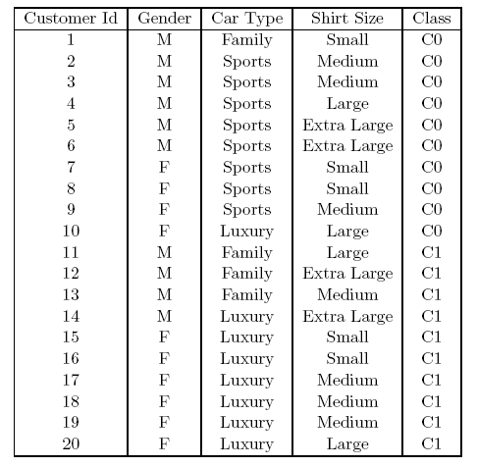
How to determine the Best Split
Before Splitting: 10 records of class 0,
10 records of class 1
Which test condition is the best?

Slide 30
How to determine the Best Split
Greedy approach:
  Nodes with purer class distribution are preferred
Need a measure of node impurity:
High degree of impurity
Low degree of impurity

Slide 31
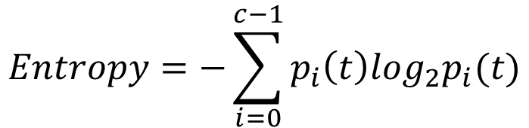
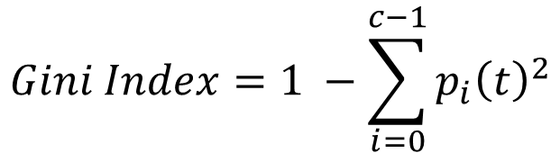
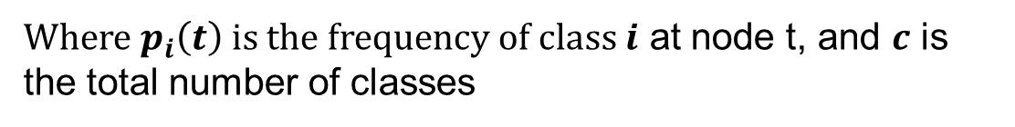
Measures of Node Impurity
Entropy
Gini Index
$$Entropy=−\sum_{i=0}^{c−1}{p_{i}\left(t\right)log_{2}p_{i}(t)}$$
$$Gini Index=1 −\sum_{i=0}^{c−1}{p_{i}{\left(t\right)}^{2}}$$
Where $p_{i}\left(t\right)$ is the frequency of class $i$ at node t, and $c$ is the total number of classes

Slide 32
Finding the Best Split
Compute impurity measure (P) before splitting
Compute impurity measure (M) after splitting
    Compute impurity measure of each child node
    M is the weighted impurity of child nodes
Choose the attribute test condition that produces the highest gain
Gain = P – M
or equivalently, lowest impurity measure after splitting (M)

Slide 33
Finding the Best Split
Before Splitting:
P
A?
B?
Yes
No
Yes
No
Node N1
Node N2
Node N3
Node N4
M11
M12
M21
M22
M1
M2
Gain = P – M1 vs P – M2

Slide 34
Attribute Selection in Decision Tree

Slide 35
Attribute Selection Measure
Decision Tree Algorithm: ID3
  Information Gain
Decision Tree Algorithm: C4.5
  Gian Ratio
Decision Tree Algorithm: CART
  Gini Index

Slide 36
Information Gain (ID3)
Select the attribute with the highest information gain
Let p_{i} be the probability that an arbitrary tuple in D belongs to class C_{i}, estimated by |C_{i, D}|/|D|
Expected information (Entropy) needed to classify a tuple in D:
Information needed (after using A to split D into v partitions) to classify D:
Information gained by branching on attribute A
Notes:
I : the expected information needed to classify a given sample
E (entropy) : expected information based on the partitioning into subsets by A

Slide 37
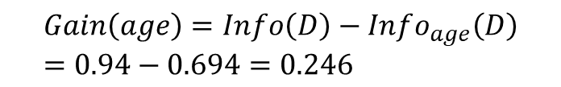
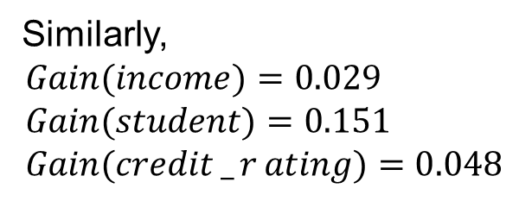
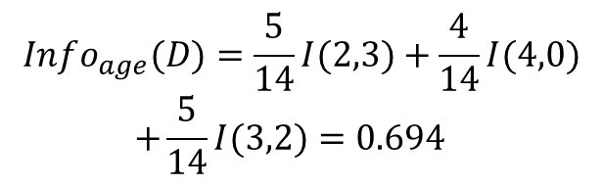

Information Gain
$$Info_{age}(D)=\frac{5}{14}I(2,3)+\frac{4}{14}I(4,0) \\ +\frac{5}{14}I(3,2)=0.694$$
$$\frac{5}{14}I(2,3)$$
means “age <=30” has 5 out of 14 samples, with 2 yes’es and 3 no’s. Hence
$$Gain\left(age\right)=Info\left(D\right)−Info_{age}\left(D\right)=0.94−0.694=0.246$$
Similarly,
$$Gain(income)=0.029 \\ Gain(student)=0.151 \\ Gain(credit_{r}ating)=0.048$$
Class P: buys_computer = “yes”
Class N: buys_computer = “no”

Slide 38
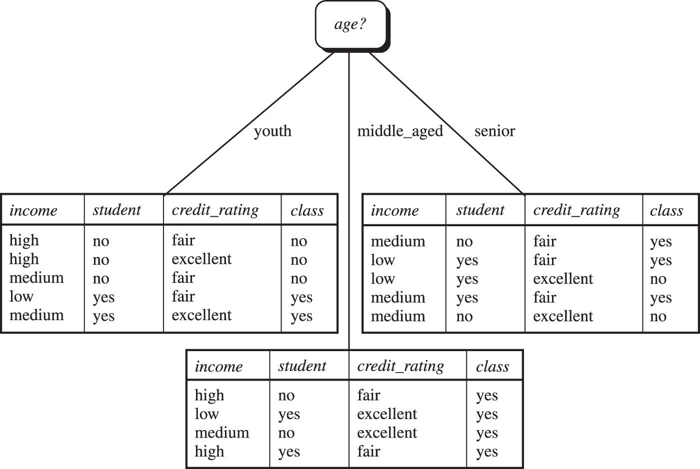
Information Gain
Figure 8.5 The attribute age has the highest information gain and therefore becomes the splitting attribute at the root node of the decision tree. Branches are grown for each outcome of age. The tuples are shown partitioned accordingly.

Slide 39
Computing Information-Gain for Continuous-Valued Attributes
Let attribute A be a continuous-valued attribute
Must determine the best split point for A
  Sort the value A in increasing order
  Typically, the midpoint between each pair of adjacent values is considered as a possible split point
    (a_{i}+a_{i+1})/2 is the midpoint between the values of a_{i} and a_{i+1}
  The point with the minimum expected information requirement for A is selected as the split-point for A
Split:
  D1 is the set of tuples in D satisfying A ≤ split-point, and D2 is the set of tuples in D satisfying A > split-point

Slide 40

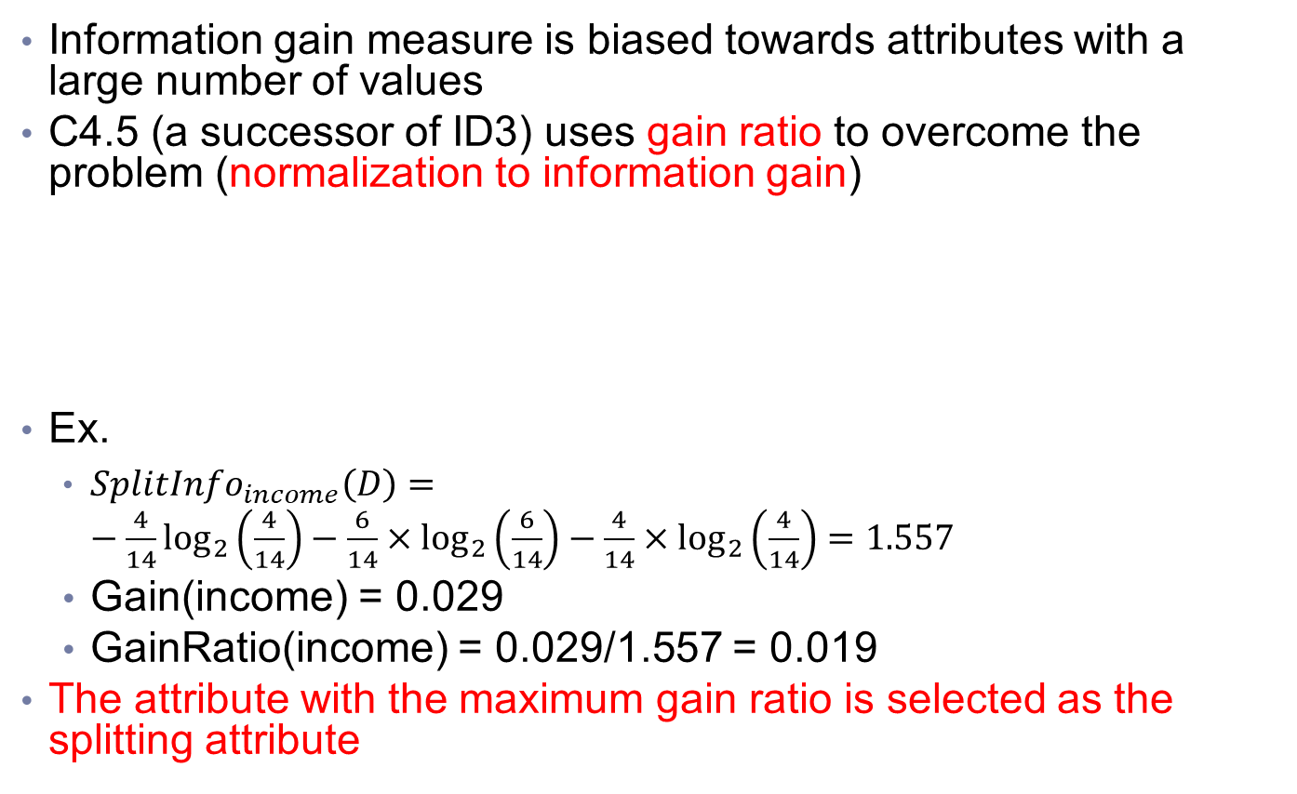
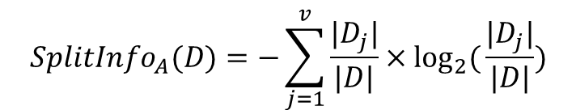
Gain Ratio (C4.5)
Information gain measure is biased towards attributes with a large number of values
C4.5 (a successor of ID3) uses gain ratio to overcome the problem (normalization to information gain)
Ex.
  ${SplitInfo}_{income}\left(D\right)=−\frac{4}{14}\log_{2}\left(\frac{4}{14}\right)−\frac{6}{14}×\log_{2}\left(\frac{6}{14}\right)−\frac{4}{14}×\log_{2}\left(\frac{4}{14}\right)=1.557$
  Gain(income) = 0.029
  GainRatio(income) = 0.029/1.557 = 0.019
The attribute with the maximum gain ratio is selected as the splitting attribute
$$SplitInfo_{A}(D)=−\sum_{j=1}^{v}{\frac{|D_{j}|}{|D|}}×\log_{2}{(}\frac{|D_{j}|}{|D|})$$

Slide 41


Gini Index (CART)
If a data set D contains examples from n classes, gini index, Gini(D) is defined as
where p_{j} is the relative frequency of class j in D
If a data set D is split on A into two subsets D₁ and D₂, the gini index gini_{A}(D) is defined as
Reduction in Impurity:
The attribute provides the smallest Gini_{split}(D) (or the largest reduction in impurity) is chosen to split the node (need to enumerate all the possible splitting points for each attribute)

Slide 42

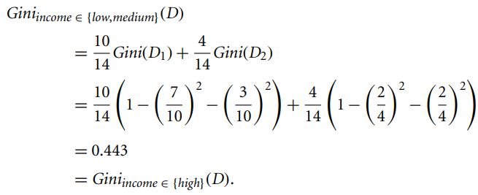
Computation of Gini Index
Data set D has 9 tuples in buys_computer = “yes” and 5 in “no”
Suppose the attribute income partitions D into 10 in D₁: {low, medium} and 4 in D₂:{high}
Gini_{{low,high}} is 0.458
Gini_{{medium,high}} is 0.450
Split on the {low,medium} (and {high}) since it has the lowest Gini index

Slide 43
Computation of Gini Index
All attributes are assumed continuous-valued
May need other tools, e.g., clustering, to get the possible split values
Can be modified for categorical attributes

Slide 44
Comparing Attribute Selection Measures
The three measures, in general, return good results but
  Information gain:
    biased towards multivalued attributes
  Gain ratio:
    tends to prefer unbalanced splits in which one partition is much smaller than the others
  Gini index:
    biased to multivalued attributes
    has difficulty when # of classes is large
    tends to favor tests that result in equal-sized partitions and purity in both partitions

Slide 45
Other Attribute Selection Measures
CHAID: a popular decision tree algorithm, measure based on χ² test for independence
C-SEP: performs better than info. gain and gini index in certain cases
G-statistic: has a close approximation to χ² distribution
MDL (Minimal Description Length) principle (i.e., the simplest solution is preferred):
  The best tree as the one that requires the fewest # of bits to both (1) encode the tree, and (2) encode the exceptions to the tree
Multivariate splits (partition based on multiple variable combinations)
  CART: finds multivariate splits based on a linear comb. of attrs.
Which attribute selection measure is the best?
  Most give good results, none is significantly superior than others

Slide 46
Model Overfitting

Slide 47
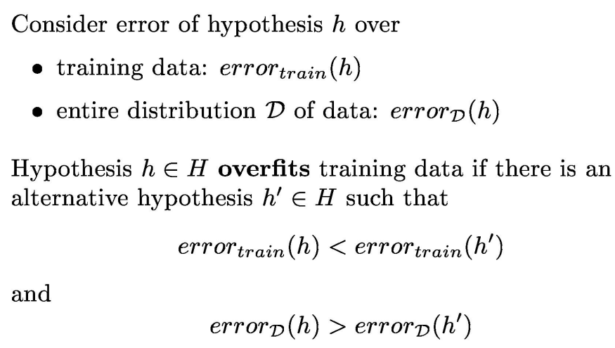
Overfitting in decision trees
Overfitting: An induced tree may overfit the training data
  Too many branches, some may reflect anomalies due to noise or outliers
  Poor accuracy for unseen samples

Slide 48
Classification Errors
Training errors: Errors committed on the training set
Test errors: Errors committed on the test set
Generalization errors: Expected error of a model over random selection of records from same distribution

Slide 49
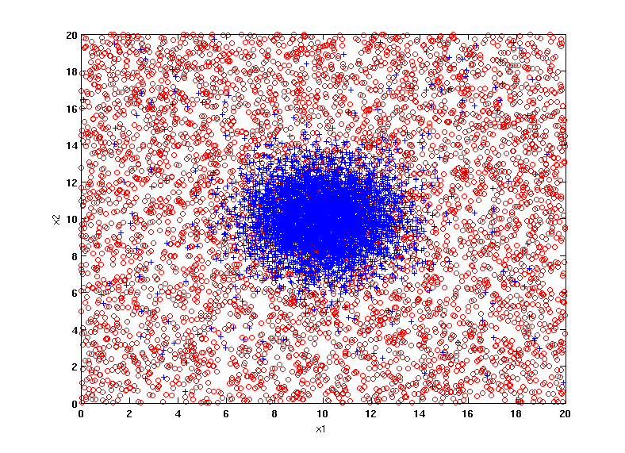
Example Data Set
Two class problem:
+ : 5400 instances
5000 instances generated from a Gaussian centered at (10,10)
400 noisy instances added
o : 5400 instances
Generated from a uniform distribution
10 % of the data used for training and 90% of the data used for testing

Slide 50
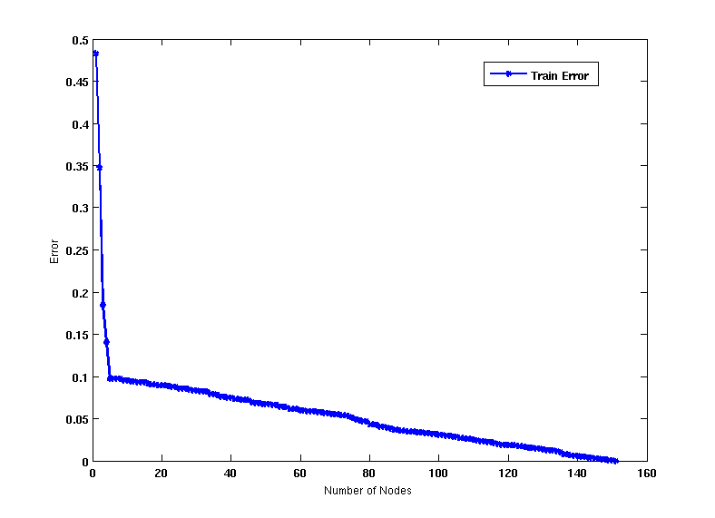
Increasing number of nodes in Decision Trees

Slide 51
Decision Tree with 4 nodes
Decision Tree
Decision boundaries on Training data

Slide 52
Decision Tree with 50 nodes
Decision Tree
Decision Tree
Decision boundaries on Training data

Slide 53
Which tree is better?
Decision Tree with 4 nodes
Which tree is better ?
Decision Tree with 50 nodes

Slide 54
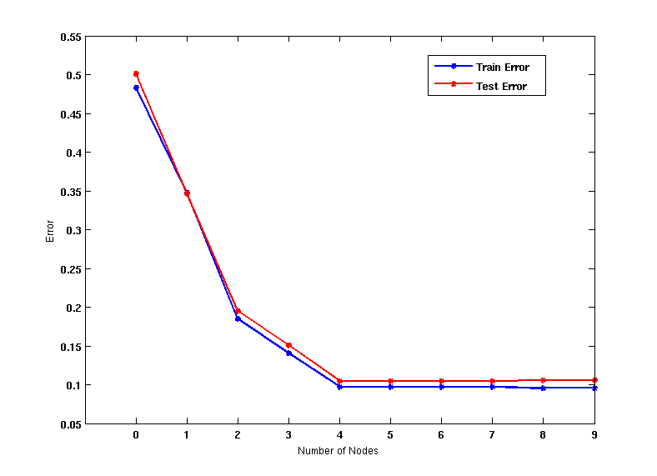
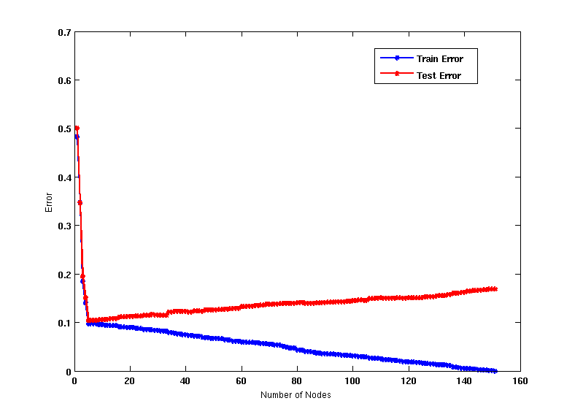
Model Underfitting and Overfitting
As the model becomes more and more complex, test errors can start increasing even though training error may be decreasing
Underfitting: when model is too simple, both training and test errors are large
Overfitting: when model is too complex, training error is small but test error is large

Slide 55
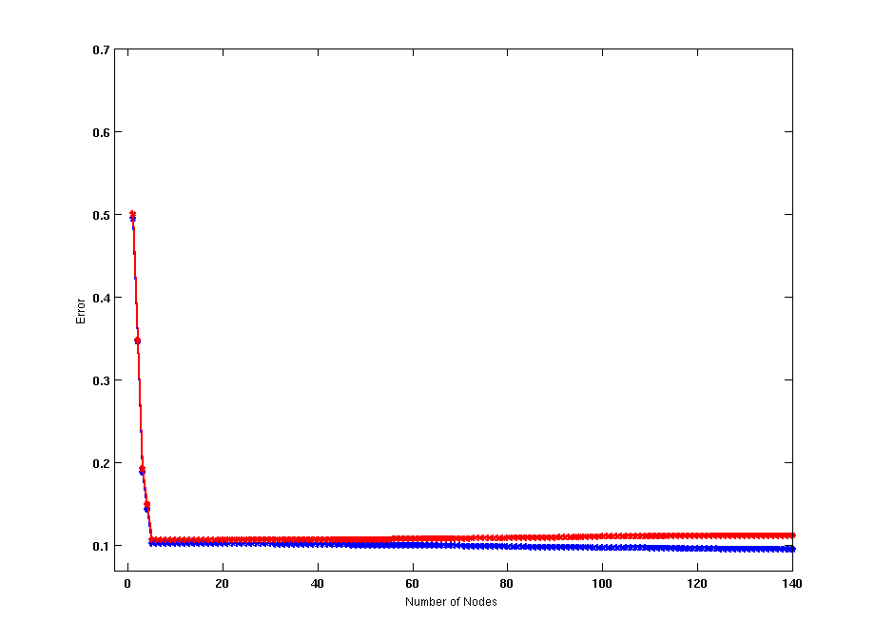
Model Overfitting – Impact of Training Data Size
Decision Tree with 50 nodes
Decision Tree with 50 nodes
Using twice the number of data instances
Increasing the size of training data reduces the difference between training and testing errors at a given size of model

Slide 56
Reasons for Model Overfitting
Not enough training data
High model complexity
  Too many un-necessary branches in the tree

Slide 57
Tree pruning
Overfitting results in different kind of anomalies that are the results of outliers and noise.
Two approaches to avoid overfitting
  Prepruning: Halt tree construction early
    do not split a node if this would result in the goodness measure falling below a threshold
    Difficult to choose an appropriate threshold
  Postpruning: Remove branches from a “fully grown” tree
    get a sequence of progressively pruned trees
    Use a set of data different from the training data to decide which is the “best pruned tree”

Slide 58
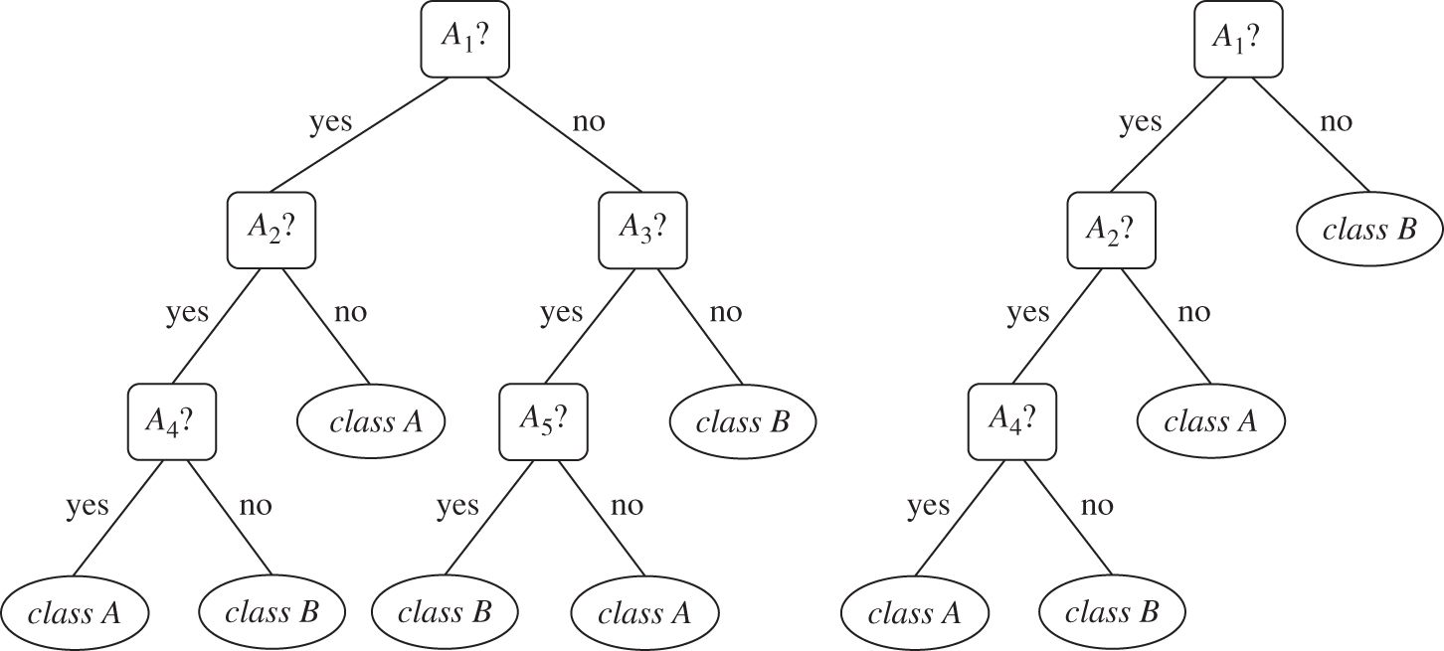
An example of tree pruning
CART
Cost complexity pruning algorithm
Postpruning approach
Considers the cost complexity of a tree to be a function of the number of leaves in the tree and the error rate of the tree
C4.5
Pessimistic pruning
Uses error rate for subtree pruning

Slide 59
Enhancements to Basic Decision Tree Induction
Allow for continuous-valued attributes
  Dynamically define new discrete-valued attributes that partition the continuous attribute value into a discrete set of intervals
Handle missing attribute values
  Assign the most common value of the attribute
  Assign probability to each of the possible values
Attribute construction
  Create new attributes based on existing ones that are sparsely represented
  This reduces fragmentation, repetition, and replication

Slide 60
Classification in Large Databases
Classification—a classical problem extensively studied by statisticians and machine learning researchers
Scalability: Classifying data sets with millions of examples and hundreds of attributes with reasonable speed
Why is decision tree induction popular?
  relatively faster learning speed (than other classification methods)
  convertible to simple and easy to understand classification rules
  can use SQL queries for accessing databases
  comparable classification accuracy with other methods
RainForest (VLDB’98 — Gehrke, Ramakrishnan & Ganti)
  Builds an AVC-list (attribute, value, class label)

Slide 61
Scalability Framework for RainForest
Separates the scalability aspects from the criteria that determine the quality of the tree
Builds an AVC-list: AVC (Attribute, Value, Class_label)
AVC-set (of an attribute X )
  Projection of training dataset onto the attribute X and class label where counts of individual class label are aggregated
AVC-group (of a node n )
  Set of AVC-sets of all predictor attributes at the node n

Slide 62
Rainforest: Training Set and Its AVC Sets
Training Examples
AVC-set on Age
AVC-set on income
Age | Buy_Computer
 | yes | no
<=30 | 2 | 3
31..40 | 4 | 0
>40 | 3 | 2
income | Buy_Computer
 | yes | no
high | 2 | 2
medium | 4 | 2
low | 3 | 1
AVC-set on
credit_rating
AVC-set on Student
student | Buy_Computer
 | yes | no
yes | 6 | 1
no | 3 | 4
Credit rating | Buy_Computer
 | yes | no
fair | 6 | 2
excellent | 3 | 3

Slide 63
BOAT (Bootstrapped Optimistic Algorithm for Tree Construction)
Use a statistical technique called bootstrapping to create several smaller samples (subsets), each fits in memory
Each subset is used to create a tree, resulting in several trees
These trees are examined and used to construct a new tree T’
  It turns out that T’ is very close to the tree that would be generated using the whole data set together
Adv: requires only two scans of DB, an incremental alg.
63
Notes:
63

Slide 64
Bayes Classification Methods

Slide 65
Bayesian Classification: Why?
A statistical classifier: performs probabilistic prediction, i.e., predicts class membership probabilities
Foundation: Based on Bayes’ Theorem.
Performance: A simple Bayesian classifier, naïve Bayesian classifier, has comparable performance with decision tree and selected neural network classifiers
Incremental: Each training example can incrementally increase/decrease the probability that a hypothesis is correct — prior knowledge can be combined with observed data
Standard: Even when Bayesian methods are computationally intractable, they can provide a standard of optimal decision making against which other methods can be measured
Notes:
Reference:
https://www.machinelearningplus.com/predictive-modeling/how-naive-bayes-algorithm-works-with-example-and-full-code/
https://www.saedsayad.com/naive_bayesian.htm
https://www.javatpoint.com/machine-learning-naive-bayes-classifier

Slide 66
Bayes’ Theorem: Basics
Total probability Theorem:
Bayes’ Theorem:
  Let X be a data sample (“evidence”): class label is unknown
  Let H be a hypothesis that X belongs to class C
  Classification is to determine P(H|X), (i.e., posteriori probability): the probability that the hypothesis holds given the observed data sample X
  P(H) (prior probability): the initial probability
    E.g., X will buy computer, regardless of age, income, …
  P(X): probability that sample data is observed
  P(X|H) (likelihood): the probability of observing the sample X, given that the hypothesis holds
    E.g., Given that X will buy computer, the prob. that X is 31..40, medium income

Slide 67
Prediction Based on Bayes’ Theorem
Given training data X, posteriori probability of a hypothesis H, P(H|X), follows the Bayes’ theorem
Informally, this can be viewed as
  posteriori = likelihood x prior/evidence
Predicts X belongs to C_{i} iff the probability P(C_{i}|X) is the highest among all the P(C_{k}|X) for all the k classes
Practical difficulty: It requires initial knowledge of many probabilities, involving significant computational cost
Unknown
Known
P(Outcome | Evidence)
(To be predicted for test data)
P(Evidence | Outcome)
(Known from training data)

Slide 68
Classification Is to Derive the Maximum Posteriori
Let D be a training set of tuples and their associated class labels, and each tuple is represented by an n-D attribute vector X = (x₁, x₂, …, x_{n})
Suppose there are m classes C₁, C₂, …, C_{m}.
Classification is to derive the maximum posteriori, i.e., the maximal P(C_{i}|X)
This can be derived from Bayes’ theorem
Since P(X) is constant for all classes, only
  needs to be maximized

Slide 69
Naïve Bayes Classifier
A simplified assumption: attributes are conditionally independent (i.e., no dependence relation between attributes):
This greatly reduces the computation cost: Only counts the class distribution
If A_{k} is categorical, P(x_{k}|C_{i}) is the # of tuples in C_{i} having value x_{k} for A_{k} divided by |C_{i, D}| (# of tuples of C_{i} in D)
If A_{k} is continous-valued, P(x_{k}|C_{i}) is usually computed based on Gaussian distribution with a mean μ and standard deviation σ
  and P(x_{k}|C_{i}) is

Slide 70
Naïve Bayes Classifier: Training Dataset
Class:
C1:buys_computer = ‘yes’
C2:buys_computer = ‘no’
Data to be classified:
X = (age <=30,
Income = medium,
Student = yes
Credit_rating = Fair)

Slide 71
Naïve Bayes Classifier: An Example
P(C_{i}): P(buys_computer = “yes”) = 9/14 = 0.643
P(buys_computer = “no”) = 5/14= 0.357
Compute P(X|C_{i}) for each class
  P(age = “<=30” | buys_computer = “yes”) = 2/9 = 0.222
  P(age = “<= 30” | buys_computer = “no”) = 3/5 = 0.6
  P(income = “medium” | buys_computer = “yes”) = 4/9 = 0.444
  P(income = “medium” | buys_computer = “no”) = 2/5 = 0.4
  P(student = “yes” | buys_computer = “yes) = 6/9 = 0.667
  P(student = “yes” | buys_computer = “no”) = 1/5 = 0.2
  P(credit_rating = “fair” | buys_computer = “yes”) = 6/9 = 0.667
  P(credit_rating = “fair” | buys_computer = “no”) = 2/5 = 0.4
X = (age <= 30 , income = medium, student = yes, credit_rating = fair)
P(X|C_{i}) : P(X|buys_computer = “yes”) = 0.222 x 0.444 x 0.667 x 0.667 = 0.044
P(X|buys_computer = “no”) = 0.6 x 0.4 x 0.2 x 0.4 = 0.019
P(X|C_{i})*P(C_{i}) : P(X|buys_computer = “yes”) * P(buys_computer = “yes”) = 0.028
P(X|buys_computer = “no”) * P(buys_computer = “no”) = 0.007
Therefore, X belongs to class (“buys_computer = yes”)

Slide 72
Avoiding the Zero-Probability Problem
Naïve Bayesian prediction requires each conditional prob. be non-zero. Otherwise, the predicted prob. will be zero
Ex. Suppose a dataset with 1000 tuples, income=low (0), income= medium (990), and income = high (10)
Use Laplacian correction (or Laplacian estimator)
  Adding 1 to each case
    Prob(income = low) = 1/1003 = 0.0001
    Prob(income = medium) = 991/1003 = 0.988
    Prob(income = high) = 11/1003 = 0.011
  The “corrected” prob. estimates are close to their “uncorrected” counterparts

Slide 73
Naïve Bayes Classifier: Comments
Advantages
  Easy to implement
  Good results obtained in most of the cases
Disadvantages
  Assumption: class conditional independence, therefore loss of accuracy
  Practically, dependencies exist among variables
    E.g., hospitals: patients: Profile: age, family history, etc.
      Symptoms: fever, cough etc., Disease: lung cancer, diabetes, etc.
    Dependencies among these cannot be modeled by Naïve Bayes Classifier
How to deal with these dependencies? Bayesian Belief Networks (Chapter 9)

Slide 74
Rule-based Classification

Slide 75
Using IF-THEN Rules for Classification
Represent the knowledge in the form of IF-THEN rules
  R: IF age = youth AND student = yes THEN buys_computer = yes
  Rule antecedent/precondition vs. rule consequent
Assessment of a rule: coverage and accuracy
  n_{covers} = # of tuples covered by R
  n_{correct} = # of tuples correctly classified by R
  coverage(R) = n_{covers} /|D| /* D: training data set */
  accuracy(R) = n_{correct} / n_{covers}
Example: Consider rule R which covers 2 of 14 tuples. It can correctly classify both tuples.
  Coverage(R)=2/14=14.28%
  Accuracy(R)=2/2=100%

Slide 76
Using IF-THEN Rules for Classification
Rule R1: (age = youth) ^ (student = yes) => (buys_computer = yes)
A given tuple X = (age = youth, income=medium, student = yes, credit_rating = fair).
Q: Is rule R1 satisfied X?
If more than one rule are triggered, need conflict resolution
  Size ordering: assign the highest priority to the triggering rules that has the “toughest” requirement (i.e., with the most attribute tests)
  Class-based ordering: decreasing order of prevalence or misclassification cost per class
  Rule-based ordering (decision list): rules are organized into one long priority list, according to some measure of rule quality or by experts
Notes:
Prevalence: 普及、盛行

Slide 77
Rule Extraction from a Decision Tree
Rules are easier to understand than large trees
One rule is created for each path from the root to a leaf
Each attribute-value pair along a path forms a conjunction: the leaf holds the class prediction
Rules are mutually exclusive and exhaustive
age?
<=30
31..40
>40
student?
credit rating?
yes
no
yes
excellent
fair
no
yes
no
yes

Slide 78
Rule Extraction from a Decision Tree
Example: Rule extraction from our buys_computer decision-tree
  IF age = young AND student = no THEN buys_computer = no
  IF age = young AND student = yes THEN buys_computer = yes
  IF age = mid-age THEN buys_computer = yes
  IF age = old AND credit_rating = excellent THEN buys_computer = no
  IF age = old AND credit_rating = fair THEN buys_computer = yes
age?
<=30
>40
31..40
student?
credit rating?
yes
no
yes
excellent
fair
no
yes
no
yes

Slide 79
Rule Induction: Sequential Covering Method
Sequential covering algorithm: Extracts rules directly from training data
Typical sequential covering algorithms: FOIL, AQ, CN2, RIPPER
Rules are learned sequentially, each for a given class C_{i} will cover many tuples of C_{i} but none (or few) of the tuples of other classes
Steps:
  Rules are learned one at a time
  Each time a rule is learned, the tuples covered by the rules are removed
  Repeat the process on the remaining tuples until termination condition, e.g., when no more training examples or when the quality of a rule returned is below a user-specified threshold
Comp. w. decision-tree induction: learning a set of rules simultaneously
Notes:
Reference: http://123android.blogspot.com/2011/11/111103-data-mining.html

Slide 80
Sequential Covering Algorithm
while (enough target tuples left)
  generate a rule
  remove positive target tuples satisfying this rule
Examples covered
by Rule 2
Examples covered
by Rule 1
Examples covered
by Rule 3
Positive examples

Slide 81
Rule Generation
To generate a rule
  while(true)
  find the best predicate p
  if foil-gain(p) > threshold then add p to current rule
  else break
A3=1
A3=1&&A1=2
A3=1&&A1=2
&&A8=5
Positive examples
Negative examples

Slide 82
How to Learn-One-Rule?
Start with the most general rule possible: condition = empty
Adding new attributes by adopting a greedy depth-first strategy
  Picks the one that most improves the rule quality
Rule-Quality measures: consider both coverage and accuracy
  Foil-gain (in FOIL & RIPPER): assesses info_gain by extending condition
    favors rules that have high accuracy and cover many positive tuples
Rule pruning based on an independent set of test tuples
    Pos/neg are # of positive/negative tuples covered by R.
    If FOIL_Prune is higher for the pruned version of R, prune R

Slide 83
Model Evaluation and Selection

Slide 84
Model Evaluation and Selection
Evaluation metrics: How can we measure accuracy? Other metrics to consider?
Use validation test set of class-labeled tuples instead of training set when assessing accuracy
Methods for estimating a classifier’s accuracy:
  Holdout method, random subsampling
  Cross-validation
  Bootstrap
Comparing classifiers:
  Confidence intervals
  Cost-benefit analysis and ROC Curves
84

Slide 85
Classifier Evaluation Metrics: Confusion Matrix
Confusion Matrix:
Actual class\Predicted class | C₁ | ¬ C₁
C₁ | True Positives (TP) | False Negatives (FN)
¬ C₁ | False Positives (FP) | True Negatives (TN)
Example of Confusion Matrix:
Actual class\Predicted class | buy_computer = yes | buy_computer = no | Total
buy_computer = yes | 6954 | 46 | 7000
buy_computer = no | 412 | 2588 | 3000
Total | 7366 | 2634 | 10000
Given m classes, an entry, CM_{i,j} in a confusion matrix indicates # of tuples in class i that were labeled by the classifier as class j
May have extra rows/columns to provide totals
85

Slide 86
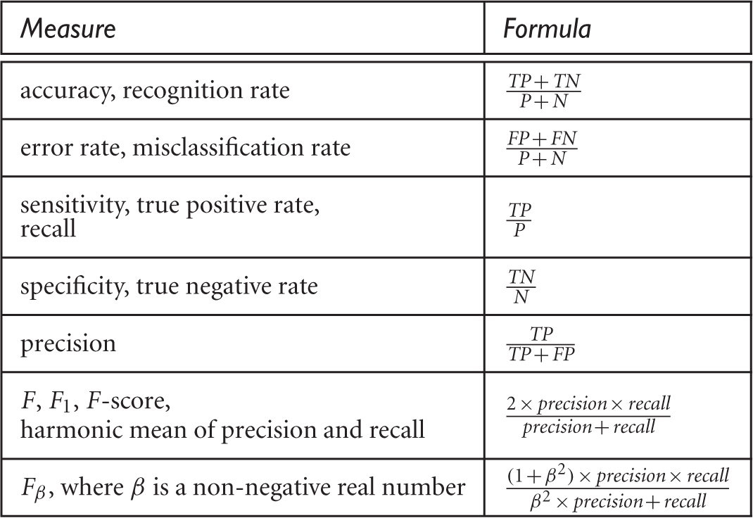
Evaluation Measures
Figure 8.13 Evaluation measures. Note that some measures are known by more than one name. TP,TN,FP,P, N refer to the number of true positive, true negative, false positive, positive, and negative samples, respectively (see text).

Slide 87
Classifier Evaluation Metrics: Accuracy, Error Rate, Sensitivity and Specificity
Class Imbalance Problem:
  One class may be rare, e.g. fraud, or HIV-positive
  Significant majority of the negative class and minority of the positive class
  Sensitivity: True Positive recognition rate
    Sensitivity = TP/P
  Specificity: True Negative recognition rate
    Specificity = TN/N
A\P | C | ¬C
C | TP | FN | P
¬C | FP | TN | N
 | P’ | N’ | All
Classifier Accuracy (recognition rate)
  percentage of test set tuples that are correctly classified
  Accuracy = (TP + TN)/All
Error rate = 1 – accuracy
Error rate = (FP + FN)/All
87

Slide 88
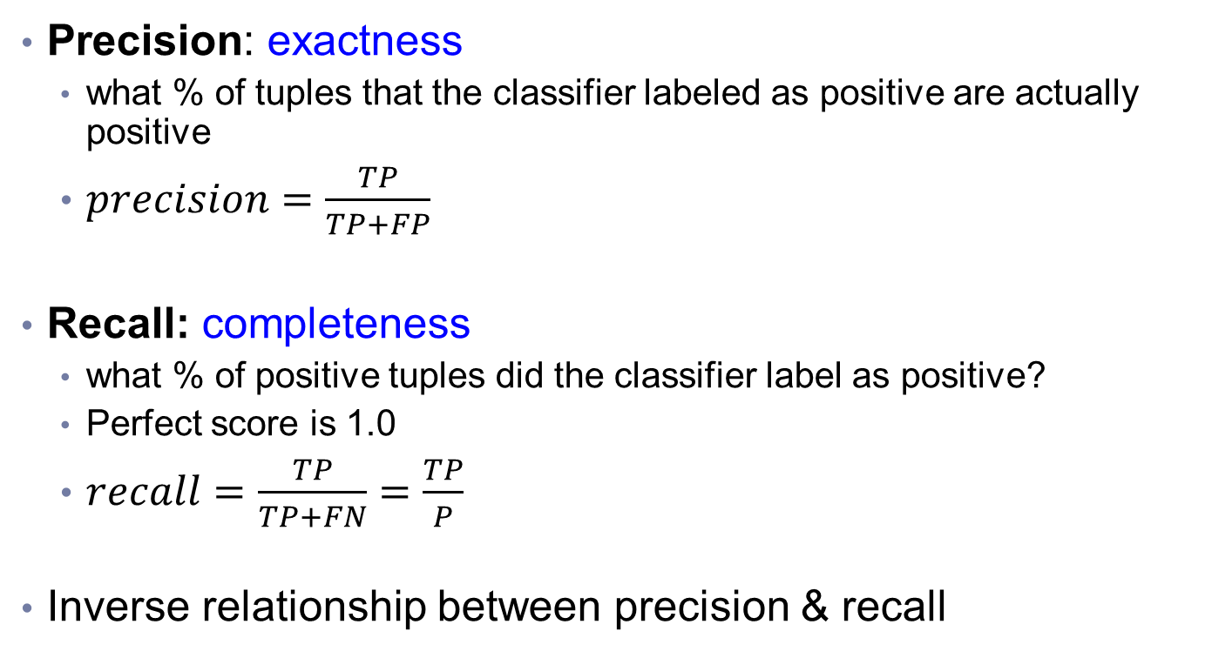
Classifier Evaluation Metrics:
Precision and Recall, and F-measures
Precision: exactness
  what % of tuples that the classifier labeled as positive are actually positive
  $precision=\frac{TP}{TP+FP}$
Recall: completeness
  what % of positive tuples did the classifier label as positive?
  Perfect score is 1.0
  $recall=\frac{TP}{TP+FN}=\frac{TP}{P}$
Inverse relationship between precision & recall

Slide 89
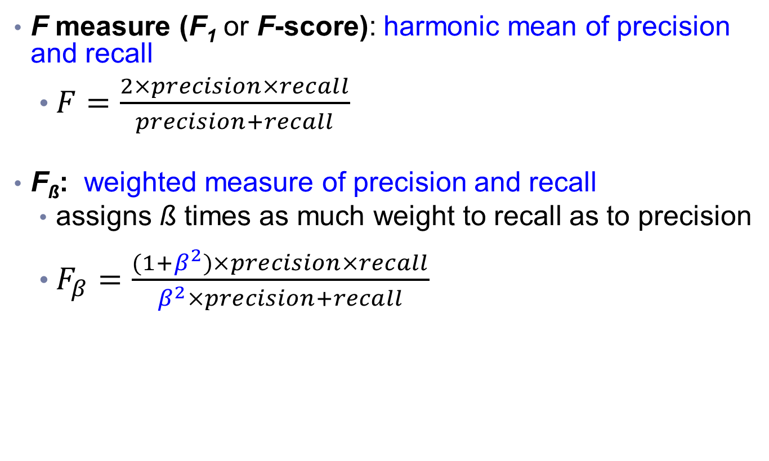
Classifier Evaluation Metrics:
Precision and Recall, and F-measures
F measure (F₁ or F-score): harmonic mean of precision and recall
  $F=\frac{2×precision×recall}{precision+recall}$
F_{ß}: weighted measure of precision and recall
  assigns ß times as much weight to recall as to precision
  $F_{β}=\frac{(1+β^{2})×precision×recall}{β^{2}×precision+recall}$

Slide 90
Classifier Evaluation Metrics: Example
Actual Class\Predicted class | cancer = yes | cancer = no | Total | Recognition(%)
cancer = yes | 90 | 210 | 300 | 30.00 (sensitivity)
cancer = no | 140 | 9560 | 9700 | 98.56 (specificity)
Total | 230 | 9770 | 10000 | 96.50 (accuracy)
  Precision = 90/230 = 39.13% Recall = 90/300 = 30.00%
90

Slide 91
Classifier Evaluation Metrics: An Exercise
Actual class\Predicted class | buy_computer = yes | buy_computer = no | Total
buy_computer = yes | 6954 | 46 | 7000
buy_computer = no | 412 | 2588 | 3000
Total | 7366 | 2634 | 10000
Please calculate the following evaluation metrics:
Precision
Recall
Accuracy
Sensitivity
Specificity

Slide 92
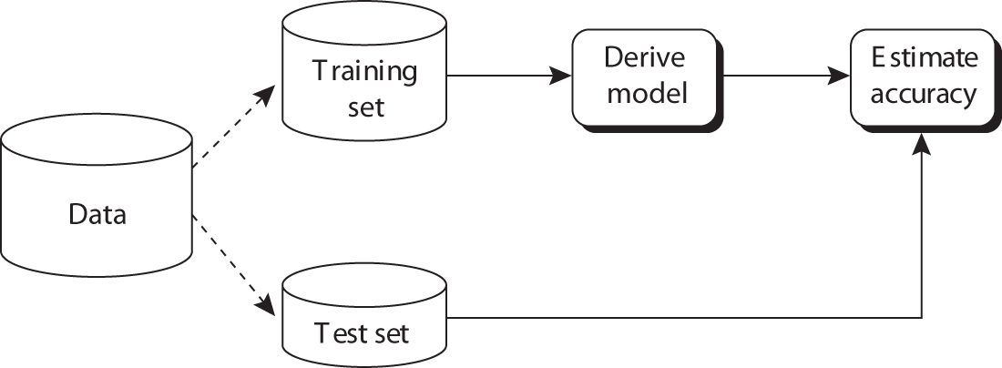
Evaluating Classifier Accuracy
Holdout method
  Given data is randomly partitioned into two independent sets
    Training set (e.g., 2/3) for model construction
    Test set (e.g., 1/3) for accuracy estimation
  Random sampling: a variation of holdout
    Repeat holdout k times, accuracy = avg. of the accuracies obtained
train
test
Figure 8.17 Estimating accuracy with the holdout method.
92

Slide 93
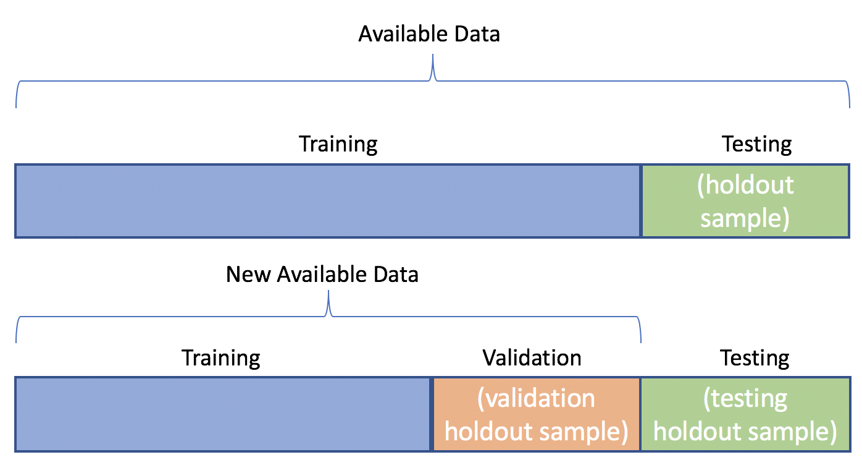
Holdout Method
For tuning parameters
https://datascience.stackexchange.com/questions/61467/clarification-on-train-test-and-val-and-how-to-use-implement-it

Slide 94
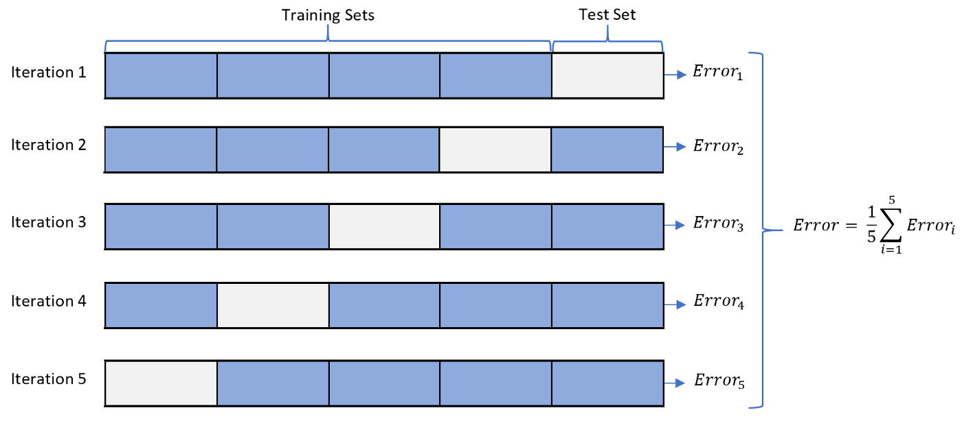
Evaluating Classifier Accuracy
Cross-validation (k-fold, where k = 10 is most popular)
  Randomly partition the data into k mutually exclusive subsets, each approximately equal size
  At i-th iteration, use D_{i} as test set and others as training set
  Report average accuracy and standard deviation of the accuracy
5-fold cross-validation

Slide 95
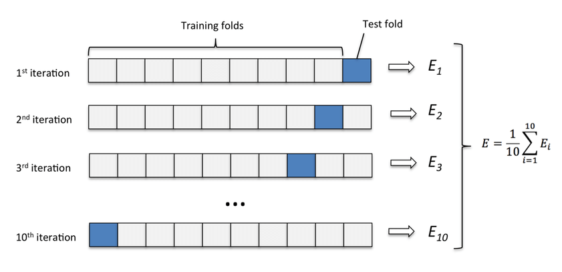
Example of Cross-validation (1/2)

Slide 96
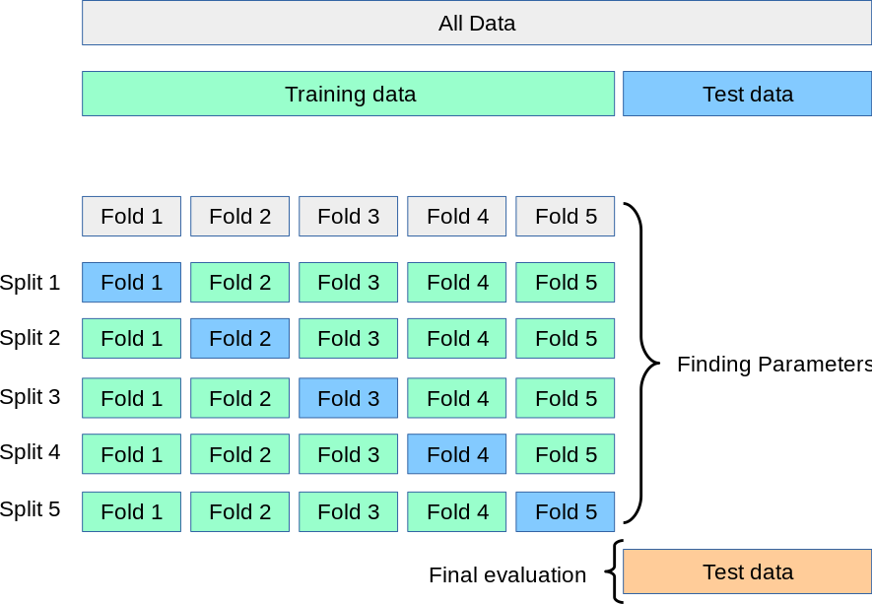
Example of Cross-validation (2/2)
Validation set
https://scikit-learn.org/stable/modules/cross_validation.html

Slide 97
Evaluating Classifier Accuracy
  Leave-one-out: a special case of k-fold cross-validation where k = # of tuples, for small sized data
    Only one sample is “left out” at a time for the test set
  *Stratified cross-validation*: folds are stratified so that class dist. in each fold is approx. the same as that in the initial data

Slide 98

Evaluating Classifier Accuracy: Bootstrap
Bootstrap
  Works well with small data sets
  Samples the given training tuples uniformly with replacement
    i.e., each time a tuple is selected, it is equally likely to be selected again and re-added to the training set
Several bootstrap methods, and a common one is .632 boostrap
  A data set with d tuples is sampled d times, with replacement, resulting in a training set of d samples. The data tuples that did not make it into the training set end up forming the test set. About 63.2% of the original data end up in the bootstrap, and the remaining 36.8% form the test set (since (1 – 1/d)^{d} ≈ e⁻¹ = 0.368)
  Repeat the sampling procedure k times, overall accuracy of the model:

Slide 99
Evaluation: Significant Tests

Slide 100
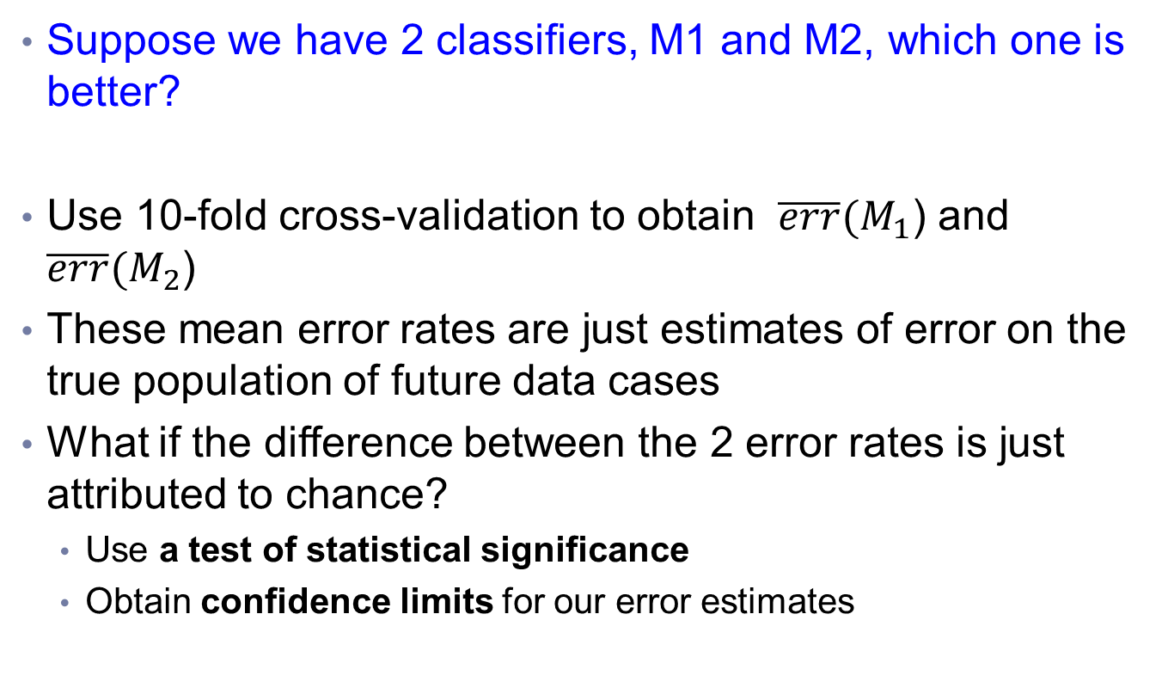
Estimating Confidence Intervals:
Classifier Models M1 vs. M2
Suppose we have 2 classifiers, M1 and M2, which one is better?
Use 10-fold cross-validation to obtain $\overline{err}(M_{1}$) and $\overline{err}(M_{2}$)
These mean error rates are just estimates of error on the true population of future data cases
What if the difference between the 2 error rates is just attributed to chance?
  Use a test of statistical significance
  Obtain confidence limits for our error estimates
Notes:
Confidence limits: 信賴界限

Slide 101
Estimating Confidence Intervals:
Null Hypothesis
Perform 10-fold cross-validation
Assume samples follow a t distribution with k–1 degrees of freedom (here, k=10)
Use t-test (or Student’s t-test)
Null Hypothesis: M₁ & M₂ are the same
If we can reject null hypothesis, then
  we conclude that the difference between M₁ & M₂ is statistically significant
  Chose model with lower error rate

Slide 102
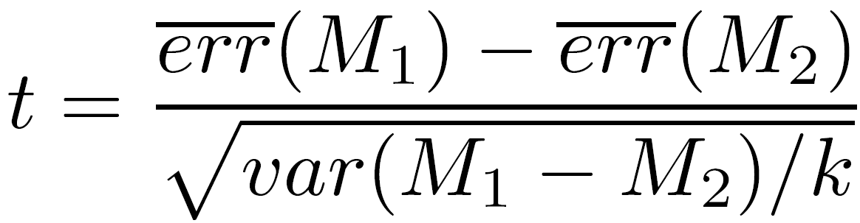
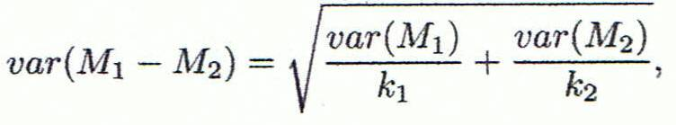
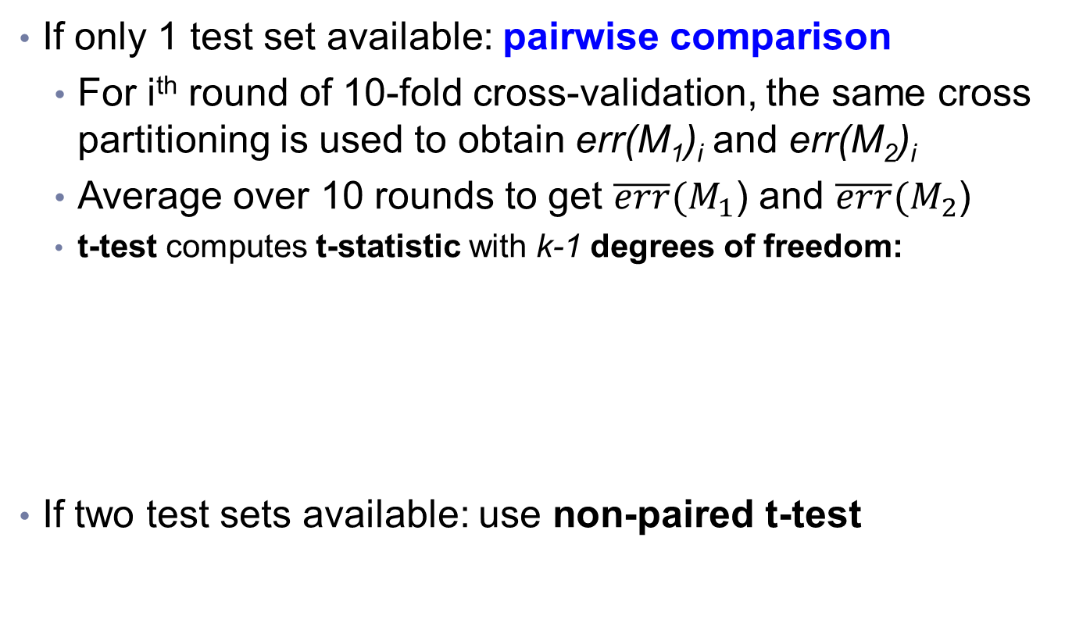
Estimating Confidence Intervals: t-test
If only 1 test set available: pairwise comparison
  For i^{th} round of 10-fold cross-validation, the same cross partitioning is used to obtain err(M₁)_{i} and err(M₂)_{i}
  Average over 10 rounds to get $\overline{err}(M_{1}$) and $\overline{err}(M_{2}$)
  t-test computes t-statistic with k-1 degrees of freedom:
If two test sets available: use non-paired t-test
where
where
where k₁ & k₂ are # of cross-validation samples used for M₁ & M₂, resp.

Slide 103
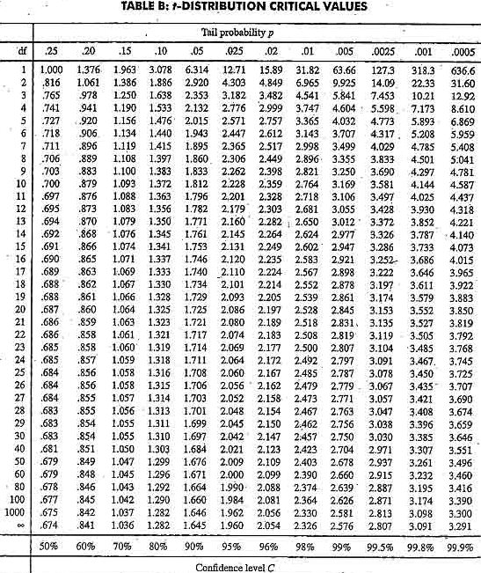
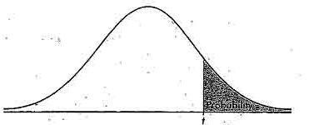
Estimating Confidence Intervals:
Table for t-distribution
Symmetric
Significance level, e.g., sig = 0.05 or 5% means M₁ & M₂ are significantly different for 95% of population
Confidence limit, z = sig/2

Slide 104
Estimating Confidence Intervals:
Statistical Significance
Are M₁ & M₂ significantly different?
  Compute t. Select significance level (e.g. sig = 5%)
  Consult table for t-distribution: Find t value corresponding to k-1 degrees of freedom (here, 9)
  t-distribution is symmetric: typically upper % points of distribution shown → look up value for confidence limit z=sig/2 (here, 0.025)
  If t > z or t < -z, then t value lies in rejection region:
    Reject null hypothesis that mean error rates of M₁ & M₂ are same
    Conclude: statistically significant difference between M₁ & M₂
  Otherwise, conclude that any difference is chance

Slide 105
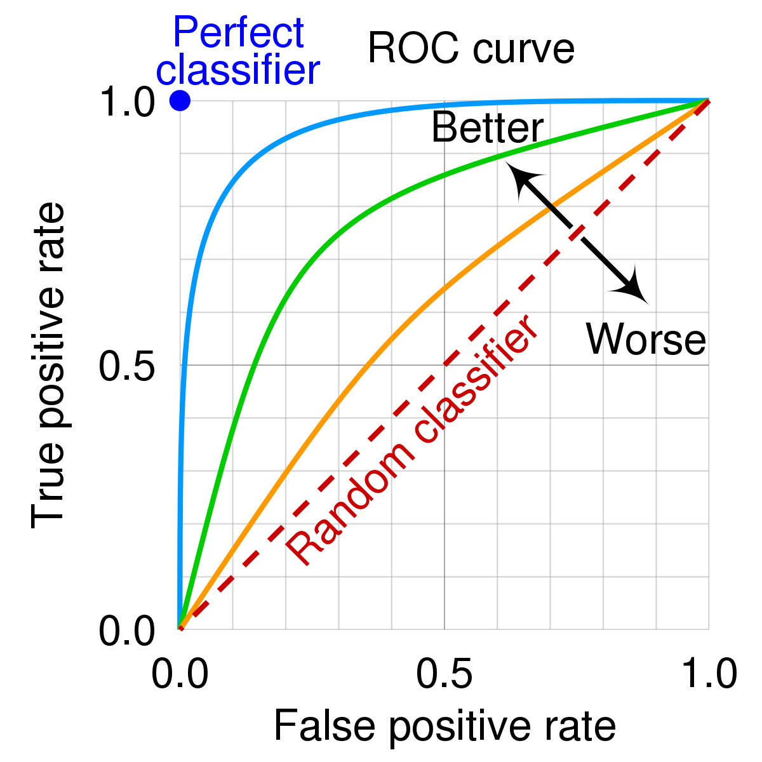
Model Selection: ROC Curves
ROC (Receiver Operating Characteristics) curves: for visual comparison of classification models
Originated from signal detection theory
Shows the trade-off between the true positive rate and the false positive rate
Vertical axis represents the true positive rate
Horizontal axis rep. the false positive rate
The plot also shows a diagonal line
A model with perfect accuracy will have an area of 1.0

Slide 106
Model Selection: ROC Curves
The area under the ROC curve is a measure of the accuracy of the model
Rank the test tuples in decreasing order: the one that is most likely to belong to the positive class appears at the top of the list
The closer to the diagonal line (i.e., the closer the area is to 0.5), the less accurate is the model

Slide 107
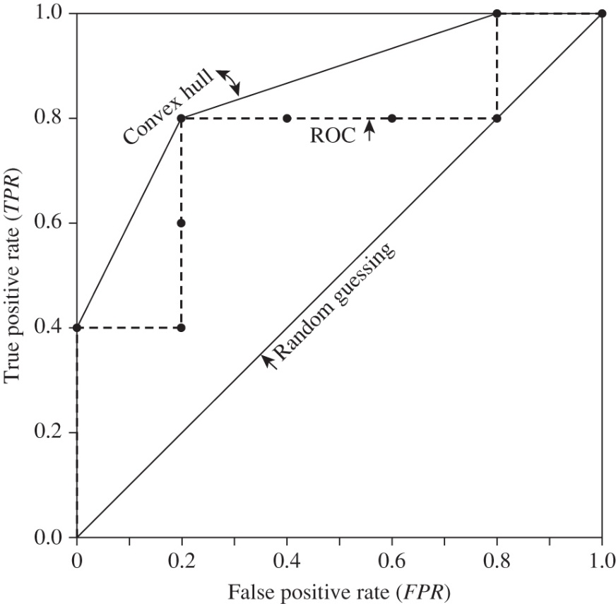
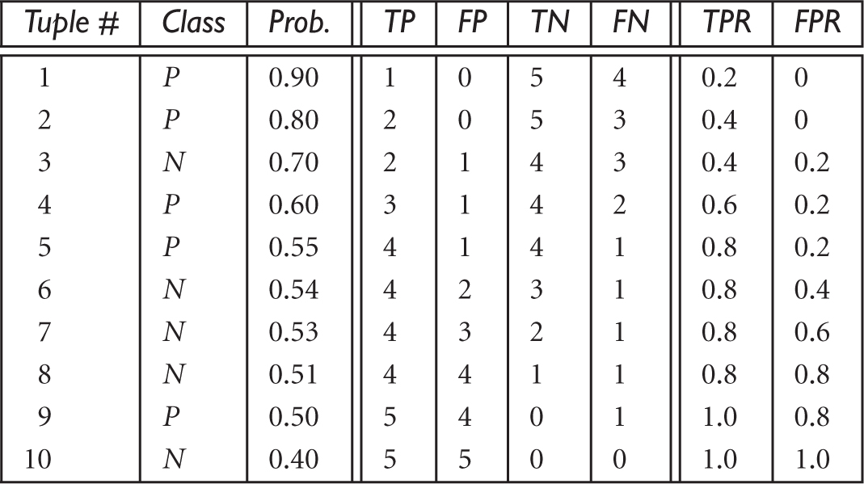
Plotting an ROC curve
TPR= TP/(TP+FN) = TP/P
FPR= FP/(FP+TN) = FP/N
Figure 8.18 Tuples sorted by decreasing score, where the score is the value returned by a probabilistic classifier.

Slide 108
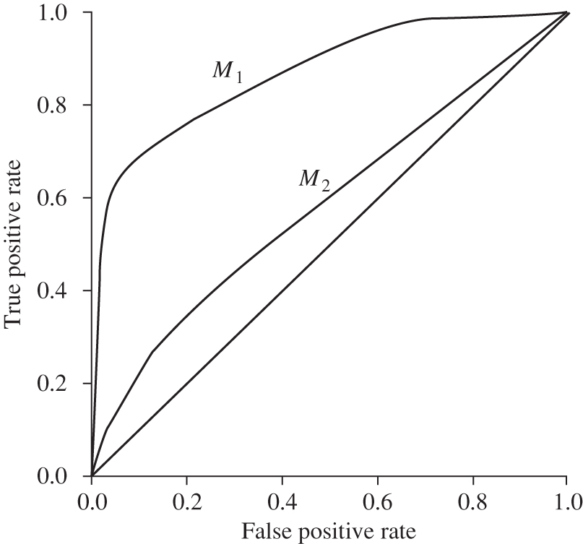
Model Selection: ROC Curves
Figure 8.20 ROC curves of two classification models, M₁ and M₂. The diagonal shows where, for every true positive, we are equally likely to encounter a false positive. The closer an ROC curve is to the diagonal line, the less accurate the model is. Thus, M₁ is more accurate here.

Slide 109
Issues Affecting Model Selection
Accuracy
  classifier accuracy: predicting class label
Speed
  time to construct the model (training time)
  time to use the model (classification/prediction time)
Robustness: handling noise and missing values
Scalability: efficiency in disk-resident databases
Interpretability
  understanding and insight provided by the model
Other measures, e.g., goodness of rules, such as decision tree size or compactness of classification rules
Notes:
109

Slide 110
Techniques to Improve Classification Accuracy: Ensemble Methods

Slide 111
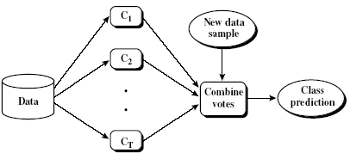
Ensemble Methods: Increasing the Accuracy
Ensemble methods
  Use a combination of models to increase accuracy
  Combine a series of k learned models, M₁, M₂, …, M_{k}, with the aim of creating an improved model M*
Popular ensemble methods
  Bagging: averaging the prediction over a collection of classifiers
  Boosting: weighted vote with a collection of classifiers
  Ensemble: combining a set of heterogeneous classifiers
111

Slide 112
Bagging: Boostrap Aggregation
Analogy: Diagnosis based on multiple doctors’ majority vote
Training
  Given a set D of d tuples, at each iteration i, a training set D_{i} of d tuples is sampled with replacement from D (i.e., bootstrap)
  A classifier model M_{i} is learned for each training set D_{i}
Classification: classify an unknown sample X
  Each classifier M_{i} returns its class prediction
  The bagged classifier M* counts the votes and assigns the class with the most votes to X
Prediction: can be applied to the prediction of continuous values by taking the average value of each prediction for a given test tuple
Accuracy
  Often significantly better than a single classifier derived from D
  For noise data: not considerably worse, more robust
  Proved improved accuracy in prediction
112

Slide 113
Boosting
Analogy: Consult several doctors, based on a combination of weighted diagnoses—weight assigned based on the previous diagnosis accuracy
How boosting works?
  Weights are assigned to each training tuple
  A series of k classifiers is iteratively learned
  After a classifier M_{i} is learned, the weights are updated to allow the subsequent classifier, M_{i+1}, to pay more attention to the training tuples that were misclassified by M_{i}
  The final M* combines the votes of each individual classifier, where the weight of each classifier's vote is a function of its accuracy
Boosting algorithm can be extended for numeric prediction
Comparing with bagging: Boosting tends to have greater accuracy, but it also risks overfitting the model to misclassified data
113

Slide 114
Adaboost (Freund and Schapire, 1997)
Given a set of d class-labeled tuples, (X₁, y₁), …, (X_{d}, y_{d})
Initially, all the weights of tuples are set the same (1/d)
Generate k classifiers in k rounds. At round i,
  Tuples from D are sampled (with replacement) to form a training set D_{i} of the same size
  Each tuple’s chance of being selected is based on its weight
  A classification model M_{i} is derived from D_{i}
  Its error rate is calculated using D_{i} as a test set
  If a tuple is misclassified, its weight is increased, o.w. it is decreased
Error rate: err(X_{j}) is the misclassification error of tuple X_{j}. Classifier M_{i} error rate is the sum of the weights of the misclassified tuples:
The weight of classifier M_{i}’s vote is

Slide 115
Random Forest (Breiman 2001)
Random Forest:
  Each classifier in the ensemble is a decision tree classifier and is generated using a random selection of attributes at each node to determine the split
  During classification, each tree votes and the most popular class is returned
Two Methods to construct Random Forest:
  Forest-RI (random input selection): Randomly select, at each node, F attributes as candidates for the split at the node. The CART methodology is used to grow the trees to maximum size
  Forest-RC (random linear combinations): Creates new attributes (or features) that are a linear combination of the existing attributes (reduces the correlation between individual classifiers)
Comparable in accuracy to Adaboost, but more robust to errors and outliers
Insensitive to the number of attributes selected for consideration at each split, and faster than bagging or boosting
115

Slide 116
Classification of Class-Imbalanced Data Sets
Class-imbalance problem: Rare positive example but numerous negative ones, e.g., medical diagnosis, fraud, oil-spill, fault, etc.
Traditional methods assume a balanced distribution of classes and equal error costs: not suitable for class-imbalanced data
Typical methods for imbalance data in 2-class classification:
  Oversampling: re-sampling of data from positive class
  Under-sampling: randomly eliminate tuples from negative class
  Threshold-moving: moves the decision threshold, t, so that the rare class tuples are easier to classify, and hence, less chance of costly false negative errors
  Ensemble techniques: Ensemble multiple classifiers introduced above
Still difficult for class imbalance problem on multiclass tasks
116

Slide 117
Summary (I)
Classification is a form of data analysis that extracts models describing important data classes.
Effective and scalable methods have been developed for decision tree induction, Naive Bayesian classification, rule-based classification, and many other classification methods.
Evaluation metrics include: accuracy, sensitivity, specificity, precision, recall, F measure, and F_{ß} measure.
Stratified k-fold cross-validation is recommended for accuracy estimation. Bagging and boosting can be used to increase overall accuracy by learning and combining a series of individual models.

Slide 118
Summary (II)
Significance tests and ROC curves are useful for model selection.
There have been numerous comparisons of the different classification methods; the matter remains a research topic
No single method has been found to be superior over all others for all data sets
Issues such as accuracy, training time, robustness, scalability, and interpretability must be considered and can involve trade-offs, further complicating the quest for an overall superior method

Slide 119
Issues: Evaluating Classification Methods
Accuracy
  classifier accuracy: predicting class label
  predictor accuracy: guessing value of predicted attributes
Speed
  time to construct the model (training time)
  time to use the model (classification/prediction time)
Robustness: handling noise and missing values
Scalability: efficiency in disk-resident databases
Interpretability
  understanding and insight provided by the model
Other measures, e.g., goodness of rules, such as decision tree size or compactness of classification rules
119
Notes:
119

Slide 120
Predictor Error Measures
Measure predictor accuracy: measure how far off the predicted value is from the actual known value
Loss function: measures the error betw. y_{i} and the predicted value y_{i}’
  Absolute error: | y_{i} – y_{i}’|
  Squared error: (y_{i} – y_{i}’)²
Test error (generalization error): the average loss over the test set
  Mean absolute error: Mean squared error:
  Relative absolute error: Relative squared error:
  The mean squared-error exaggerates the presence of outliers
  Popularly use (square) root mean-square error, similarly, root relative squared error
120
Notes:
120

