Slide 1
Qualitative Research 2
質性研究/定性研究
13
  Department of Information Management
  CYCU
  CK Farn
mailto: ckfarn@gmail.com
  2024.01

Slide 2
Choosing a Qualitative Method
Project’s purpose
Researcher characteristics
Factors
Schedule
Types of participants
Budget
Topics
Notes:
The researcher chooses a qualitative methodology based on the project’s purpose, its schedule including the speed with which insights are needed; its budget, the issue(s) or topic(s) being studied; the types of participants needed; and the researcher’s skill, personality, and preferences.

Slide 3
NonProbability Sampling
Purposive
Sampling
Snowball
Sampling
Convenience
Sampling
Notes:
Sample sizes for qualitative research vary by technique but are generally small. A study might include just two or three focus groups or a few dozen individual depth interviews.
Qualitative research involves non-probability sampling, where little attempt is made to generate a representative sample. There are several common types.
Purposive sampling means that the researchers choose participants arbitrarily for their unique characteristics or their experiences, attitudes, or perceptions.
Snowball sampling means that participants refer researchers to others who have characteristics, experiences, or attitudes similar to or different from their own.
Convenience sampling means that researchers select any readily available individuals as participants.

Slide 4
Qualitative Sampling
General sampling rule:
You should keep conducting interviews until no new insights are gained.
Notes:
The general sampling guideline for qualitative research is to keep sampling as long as your breadth and depth of knowledge of the issue under study is expanding, and stop when you gain no new knowledge or insights. In other words, a qualitative researcher will stop sampling when he or she has reached data redundancy.

Slide 5
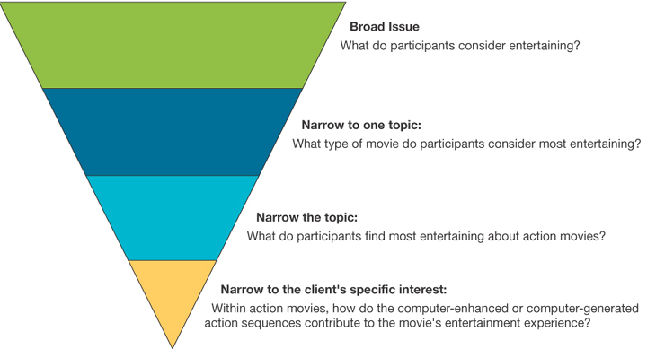
The Interview Question Hierarchy
Notes:
Exhibit 7-6
Interviewing requires a trained interviewer (often called a moderator for group interviews).
The interviewer must be able to make participants feel comfortable and probe for details without upsetting the participants.
The actual interviewer is usually responsible for generating the interview or discussion guide, the list of topics to be discussed, or the questions to be asked, and in what order. In building this guide, many interviewers employ a hierarchical questioning structure. This structure is shown in Exhibit 7-6.
Broader questions start the interview, designed to put participants at ease and give them a sense that they have a lot to contribute, followed by increasingly more specific questions to draw out detail.

Slide 6
Interviewer Responsibilities
Recommends topics and questions
Controls interview
Plans location and facilities
Proposes criteria for drawing sample
Writes screener
Recruits participants
Develops pretasking activities
Prepares research tools
Supervises transcription
Helps analyze data
Draws insights
Writes report
Notes:
The interviewer is generally responsible for many tasks related to the interview. Several of these tasks are listed in the slide.

Slide 7
Elements of a Recruitment Screener: interview guide
Heading
Screening requirements
Identity information
Introduction
Security questions
Demographic questions
Behavior questions
Lifestyle questions
Attitudinal and knowledge questions
Articulation and creative questions
Offer/ Termination
Notes:
One of the tasks listed in the last slide was that of writing the recruitment screener.
The recruitment screener is a semistructured or structured interview guide designed to assure the interviewer that the prospect will be a good participant for the planned qualitative research.
Exhibit 7-7 provides the various elements necessary for a comprehensive recruitment screener.
Each question is designed to reassure the researcher that the person who has the necessary information and experiences, as well as the social and language skills to relate the desired information, is invited to participate.

Slide 8

Interview Formats
Unstructured
Semi-structured
Structured
Notes:
In an unstructured interview, there are no specific questions or order of topics to be discussed. Each interview is customized to each participant.
In a semistructured interview, there are a few standard questions but the individual is allowed to deviate based on his or her answers and thought processes. The interviewer’s role is to probe.
In a structured interview, the interview guide is detailed and specifies question order, and the way questions are to be asked. These interviews permit more direct comparability of responses and maintain interviewer neutrality.
Most qualitative research relies on the unstructured or semistructured interview format. The next slide highlights the differences between unstructured or semistructured and structured interviews.

Slide 9
Requirements for
Unstructured Interviews
Developed dialog
Distinctions
Probe for
answers
Interviewer
creativity
Interviewer skill
Notes:
Unstructured or semi-structured interviews rely on developing a dialog between interviewer and participant. Without this dialog and comfort between the two people, the interview will not result in valuable data. Because the researcher is seeking information that the participant may not be willing to share or may not even recognize consciously, the researcher must be creative. Further, interviewer skill is necessary to extract more and a greater variety of data. Finally, interviewer experience and skill generally result in greater clarity and more elaborate answers.

Slide 10
The Interview Mode
Individual
Group
Notes:
The interview is the primary data collection technique for gathering data in qualitative methodologies. Interviews may vary based on the number of people involved during the interview, the level of structure, the proximity of the interviewer to the participant, and the number of interviews conducted during the research. An interview can be conducted in groups or individually.
Exhibit 7-5 compares the individual and the group interview as a research methodology. Both are important in qualitative research.

Slide 11
IDI vs Group
Individual Interview | Group Interview
Research Objective Explore life of individual in depth Create case histories: repeated interviews over time Test a survey | Orient the researcher to a field of inquiry and the language of the field Explore a range of attitudes, opinions, and behaviors Observe a process of consensus and disagreement
Topic Concerns Detailed individual experiences, choices, biographies Sensitive issues that might provoke anxiety | Issues of public interest or common concern Issues where little is known or of a hypothetical nature
Participants Time-pressed participants or those difficult to recruit (e.g., elite or high-status participants) Participants with sufficient language skills (e.g., those older than seven) Participants whose distinctions would inhibit participation | Participants whose backgrounds are similar or not so dissimilar as to generate conflict or discomfort Participants who can articulate their ideas Participants who offer a range of positions on issues

Slide 12
Individual In-depth Interview
Dialog
Advantages
  In-depth and detailed research data is obtained, with better quality than other methods
  Assistance in interpreting information is available
  Better control: Language can be adjusted depending on the informant
  High cost: time and money
Possible to interrupt an interview to reduce cost

Slide 13
Successful personal interview
Informants possess data need in the research
Informants understand their role
Enough motivation for the informants
Design filtering questions
  To decide whether to continue the interview
Role of interviewer
  Explain
  Coach
  encourage

Slide 14
Interview technique 1
Increase interviewee’s willingness to cooperate
  Belief that the process will be enjoyable and satisfying
  Feeling that the answer to the questions is important and worthwhile
  Achieve some psychological satisfaction
Start: Break the ice
In case the interviewee is busy, or is not available…
  Next schedule
Build a good relationship
  pleasant
  trust

Slide 15
Interview technique 2
Gathering information – probing
  Indicate understanding and interest
  Indicate expectation, short pause
  Repeat the question
  Repeat the interviewee’s answer – reconfirm
  Use neutral questions, or comments
  Clarifying questions – follow-up questions
Transcript of the interview
  Notes, audio and video recordings
  Obtain the consent of the parties first
Select and train interviewers
  If this is a large-scale study with multiple interviewers

Slide 16
Tools: Questionnaires
Yes, there are questionnaires for interviews as well
  Structured questionnaires
  Unstructured checklists
Stage 1
  Develop a questionnaire design strategy
Stage 2
  Constructing the Problem and Measurement Methodology
Stage 3
  Drafting and revising the questionnaire

Slide 17
Use of language/text for the questionnaire
Present questions in common terms
Ensure the terms used in the questionnaire do not have multiple meanings
  Avoid equivocal, or confusing terms
Question should not imply unproven or distorted assumptions
Avoid biased wording in the question
Personalized appropriately
  Different groups of interviewee may require different terminology
If there are multiple choice, the options must cover all possibilities

Slide 18
Start and screen the interviewees
Provide the interviewee an incentive to cooperate
Disclosure of research units, commissioning units, and research objectives
Disclose the general direction of the questions in the interview
Inform the time required
May contain filtering items
  Screening unwanted interviewees
Establish the rapport (a friendly, harmonious relationship)

Slide 19
Termination of interviews
Problem to consider:
When the interviewee did not answer the filtering questions satisfactorily, whether or how should the interview be terminated?
When an interviewee decides to stop an interview, how do they stop?

Slide 20
Acquisition and collation of information
Transcript of the interview
  Notes - Manuscript Collation
  Audio tapes - transcribed into transcripts
Analysis of the text
  Template comparison: Find a special pattern
  Content analysis
  Theme (sentence) analysis
Interpretation
  Gaining insight

Slide 21

Group Interviews
Dyads
Triads
Mini-Groups 2-6
Small Groups 6-10
(Focus Group)
Supergroups
Notes:
Group interviews involve a single interviewer with more than one research participant. They vary widely in size.
Mini-groups involve 2-6 people. Small groups usually include 6-10 people and are generally the most used. Supergroups include up to 20 people.
The focus group is a type of small group (6-10.Dyads are frequently used when the special nature of the relationship is needed to stimulate frank discussion on a sensitive topic.
Group interaction is desirable but time constraints still limit extracting detail from each participant. It is also difficult to recruit, arrange, and coordinate group discussions.

Slide 22
Determining the Number of Groups
Scope
Number of distinct segments
Desired number of ideas
Desired level of detail
Level of distinction
Homogeneity
Notes:
The skilled researcher helps the sponsor determine an appropriate number of group interviews to conduct. This slide lists the considerations affecting the number of group interviews. The following guidelines apply.
The broader the issue(s), the more groups needed.
The larger the number of distinct market segments of interest, the more groups needed.
The larger the number of desired new ideas, the more groups needed.
The greater the level of detail desired, the more groups needed.
The greater the influence of ethnic and geographic differences, the more groups needed.
The less homogeneity, the more groups needed.
The general rule is that one should keep conducting focus groups until no new insights are gained.

Slide 23
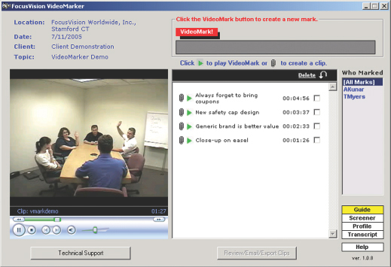
Group Interview Modes
Face-to-Face
Telephone
Online
Videoconference
Notes:
The focus group is a panel of people (usually 6-10 people), led by a trained moderator, who meet for 90 minutes to 2 hours. The facilitator uses group dynamics principles to focus or guide the group in an exchange of ideas, feelings, and experiences.
The term focus group was first coined by R.K. Merton in his 1956 book, The Focused Interview.
Focus groups can be conducted using various modes.
Telephone focus groups are effective when it is difficult to recruit the desired participants, when target group members are rare, when issues are sensitive, and when one needs national representation with a few groups. Telephone focus groups are usually shorter than traditional groups and less expensive. They should not be used when participants need to handle a product that cannot be sent ahead to them, when the session must be long, or when the participants are children.
Online focus groups are very effective with teens and young adults. Access and speed are strengths of this mode, but it is more difficult to gain insight from group dynamics.
Videoconferencing is likely to grow as a focus group mode because it saves time and money while creating less barrier between moderator and participants than the telephone.
All methods provide for transcriptions of the full interview. These are analyzed using content analysis.

Slide 24
Observational studies
Part of qualitative research
Can be done in conjunction with other mean
  Such as: interviews, questionnaires, secondary materials, etc.
Mostly the exploratory phase of research

Slide 25
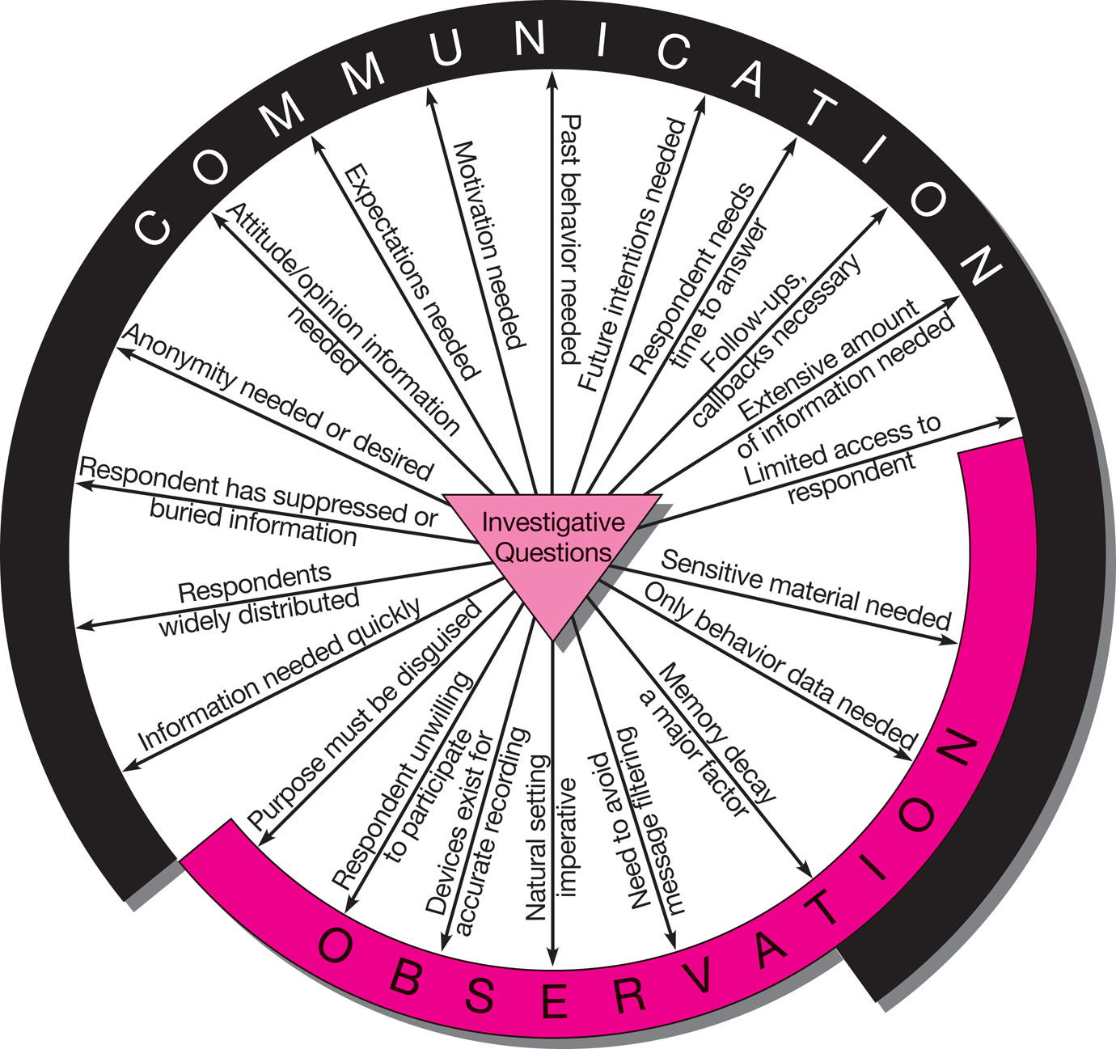
Selecting the Data Collection Method

Slide 26
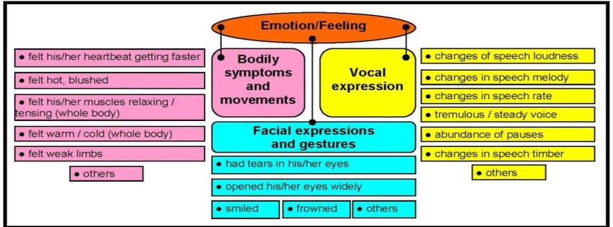
Extra-linguistic analysis

Slide 27
Merits of observations
Sometimes it is the only way to go
Collect information in real time when an incident occurs
Grasp information that may have been missed
  Such as: Sherlock Holmes 福爾摩斯偵探
Information can be gathered in the natural context in which the entire event occurred

Slide 28
Limitation of observations
The situation is subject to the interference of observation
The unpredictability of events
Slow and expensive
Can only grasp the actions on the table and the intelligence on the surface
Subjective judgment and record-keeping
It is not possible to study events that have already passed

Slide 29
Criteria for qualified observers
Able to concentrate in many distraction situations
Can remember a lot of details of the events they have experienced
Able to observe situations without attracting attention
The ability to extract the most insight from the observed data – the ability to abstract it

Slide 30
Conducting observational studies
Types of observational studies
  Simple or systematic observations
  Structure of the Observational study
    Completely unstructured – natural context
    Unstructured - Laboratory
    Structural – natural context
    Fully Structured – Laboratory
Specification of content
  Targets for observation
Training of observers
  Observer-to-observer consistency
Data Collection (Who; What; When; How)

Slide 31
Systematic Observation
Standardized procedures
Structured
Trained observers
Systematic
Encoding observation information
Recording schedules
Notes:
Systematic studies employ standardized procedures, trained observers, schedules for recording, and other devices for the observer that reflect the scientific procedures of other primary data methods.

Slide 32
Research Design
Who?
Where?
Task Details
What?
(event or time)
How?
When?
Notes:
The data collection plan specifies the details of the task.
Who? The plan must specify what qualifies a person to participate as a subject of the observation. It must also assign responsibilities on the research side.
What? The characteristics of the observation must be set as sampling elements and units of analysis. This is achieved when event-time dimension and “act” terms are defined. In event sampling, the researcher selects certain elements, behavioral acts, or conditions to record that answer the investigative questions. In time sampling, the researcher must choose among a time-point sample, continuous real-time measurement, or a time-interval sample. For a time-point sample, recording occurs at fixed points for a specified length. Time-interval sampling records every behavior in real time but counts the behavior only once during the interval. What constitutes an “act” depends on the study. For instance, acts could include a single expressed thought, a physical movement, a facial expression, or a motor skill.
When? When specifies whether the time of the study is important, and if so, what time period will be used.
How? Will the data be observed directly? How will various situations be handled? How will data be recorded?
Where does the act take place?

Slide 33
Content of Observation
Factual | Inferential
Introduction/identification of salesperson and customer. | Credibility of salesperson. Qualified status of customer.
Time and day of week. | Convenience for the customer. Welcoming attitude of the customer
Product presented. | Customer interest in product.
Selling points presented per product. | Customer acceptance of selling points of product.
Number of customer objections raised per product. | Customer concerns about features and benefits.
Salesperson’s rebuttal of objection. | Effectiveness of salesperson’s rebuttal attempts.
Salesperson’s attempt to restore controls. | Effectiveness of salesperson’s control attempt. Consequences for customer who prefers interaction.
Length of interview. | Customer’s/salesperson’s degree of enthusiasm for the interview.
Environmental factors interfering with the interview. | Level of distraction for the customer.
Customer purchase decision. | General evaluation of sale presentation skill.
Notes:
Exhibit 8-6

Slide 34

Data Collection
Watching
Listening
Touching
Smelling
Reading
Notes:
Besides collecting data visually, observation involves listening, reading, smelling, and touching.
Refer back to Exhibit 8-2, which describes the conditions under which observation is appropriate.

Slide 35

Using Observation
Systematic planning
Properly controlled
Consistently dependable
Accurate account of events
Notes:
Simple observation is unstructured and not standardized.
Systematic observation is structured and uses standardized procedures to observe participants or objects.
Observation may be the primary methodology used to answer a research question when it is systematically planned and executed, uses proper controls, and provides a consistently dependable (reliable) and accurate and authoritative (valid) account of what happened.

Slide 36
Observational studies
Non-behavioral observations
  Record analysis
  Physical condition Analysis
  Physical process analysis
Observation of behavior
  Non-verbal analysis (observation of body-movement, motor expressions and even glances)
  Linguistic analysis (information conveyed number of “ahhs” or “uh-huhs”)
  Extra-linguistic analysis (Observation of vocal, temporal, interaction and verbal stylistic patterns of a subject)
  Spatial analysis

Slide 37
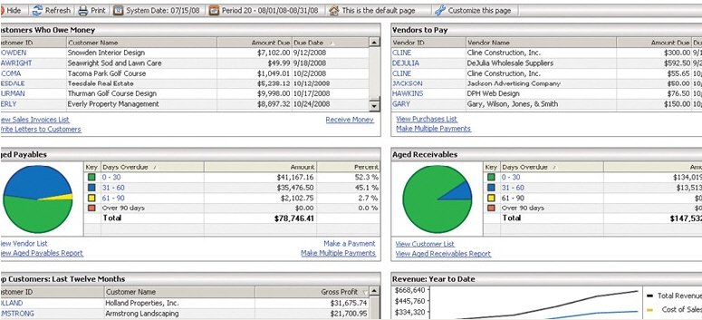
Nonbehavioral Observation
Record
Analysis
Physical Condition
Analysis
Physical Process
Analysis
Notes:
Record analysis…think data mining…is a common nonbehavioral observation. What you are looking at is an accounting software report relating to late payments of customers, but such observation could as easily be looking at a defect report from operations, a record of sick days in human resources, a promotions sales-lift report, or many others that firms—large and small—generate on a regular basis.
Physical condition analysis might relate to a safety audit or an analysis of inventory conditions or an analysis of food preparation areas in a restaurant. Building inspectors do physical condition analyses when they allow a builder to progress to the next phase of construction following an inspection of plumbing, wiring, etc.
Process analysis started with time-motion studies in manufacturers, but today relates to any organization that tracks time related to activity or process steps and stages. Some examples include: banks (ATMs resulted from such a process analysis), merchandise retailers (e-commerce sites are constantly evaluating abandon carts), restaurants, medical practices, and architects use such nonbehavioral evaluations.

Slide 38

Behavioral Observation
“We noticed people scraping the toppings off our pizza crusts. We thought at first there was something wrong, but they said, ‘We love it, we just don’t eat the crust anymore.”
  Tom Santor, Donatos Pizza
Notes:
Donatos Pizza discovered something about consumer preferences from simple observation of human behavior.

Slide 39
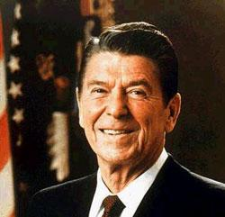
Extralinguistic Observation
Vocal
Temporal
Interaction
Verbal Stylistic
Notes:
Linguistic observation is the observation of human verbal behavior during conversation, presentation, or interaction. Extralinguistic observation, the focus of this slide, is the recording of vocal, temporal, interaction, and verbal stylistic behaviors of human participants. Vocal behaviors include pitch, loudness, and timbre.
Temporal behaviors include the rate of speaking, duration of utterance, and rhythm.
Interaction includes the tendencies to interrupt, dominate, or inhibit.
Verbal stylistic behaviors include vocabulary and pronunciation peculiarities, dialect, and characteristic expressions.
Ronald Reagan was lauded for his command of extralinguistic behavior.

Slide 40
Non-intrusive measurements
Measurements
  Indirect measurements
  Historical data search
  Observe and classify
Traces of physical phenomena
  Abrasion, consumption, weathering
  Accumulation (e.g. junkology)

Slide 41
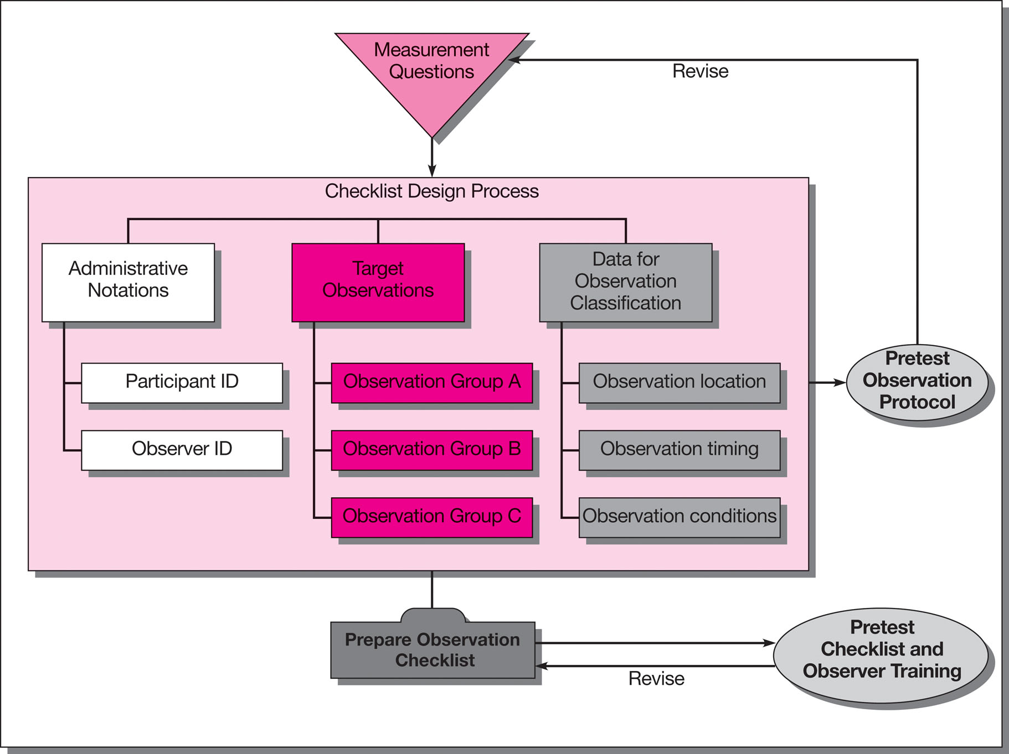
Flowchart for Checklist Design
Notes:
Exhibit 8-5

Slide 42
Relationship between the observer and the objects
Direct or indirect observation
  Indirect example: a psychologist outside the one-way mirror
Whether the identity of the observer is known to the observer
  Concealment or disclosure
The role of the observer
  Participant or purely observant
Outsider observer
Participant Observation
Field observers
Insiders observer

Slide 43
Recording
Memory
  Go back every night and organize it into notes
Notes, shorthand
Audio and video recordings
  With prior consent

Slide 44
Errors Introduced by Observers
Halo Effect
Observer Drift
Notes:
Inexperience can be an advantage if there is a risk that experienced observers may have preset convictions about the topic or if prior observations will influence what is perceived in a current observation. This is called the halo effect.
Observers can also introduce error when fatigued, which can result in observer drift. Observer drift is error caused by decay in consistency and accuracy on recorded observations over time, affecting categorization.

Slide 45
Evaluation of
Behavioral Observation
Strengths
Securing information that is otherwise unavailable
Avoiding participant filtering/ forgetting
Securing environmental context
Optimizing naturalness
Reducing obtrusiveness
Weaknesses
Enduring long periods
Incurring higher expenses
Having lower reliability of inferences
Quantifying data
Keeping large records
Being limited on knowledge of cognitive processes
Notes:
This slide lists the strengths and limitations of observation as a data collection method. Observation is the only method available for gathering certain types of information. Another advantage is that it can capture the whole event as it occurs in its natural environment. Observation participants seem to accept an observational intrusion better than they respond to the intrusion of survey takers. Further, some observation studies are concealed
A key limitation of observation is that it records what, where, who, and how, but cannot record why people behave as they do. Observation is slow and expensive. Observation may be factual or inferential. It is most reliable when it is based on fact. Exhibit 9-4, shown on the next slide, shows how we can separate the factual and inferential component of a salesperson’s presentation.

Slide 46
Combining Qualitative Methodologies
Case Study
Action Research
Notes:
Qualitative methods can be combined to glean more and better information.
The case study, also called a case history, combines individual or group interviews with record analysis and observation.
Researchers extract information from company brochures, annual reports, sales receipts, and newspaper and magazine articles along with direct observation, and combine it with interview data from participants.
Interview participants are invited to tell the story of their experience, with those chosen representing different levels within the same organization or different perspectives of the same situation.
The objective is to obtain multiple perspectives of a single organization, situation, event, or process at a point in time or over a period of time.
The research problem is usually a “how and why” problem.
Case study methodology, or the case analysis or case write-up, can be used to understand business processes.
Action research is designed to address complex, practical problems about which little is known. It involves brainstorming, followed by sequential trial-and-error attempts until desired results are achieved.

Slide 47
Triangulation:
Merging Qualitative and Quantitative
Conduct studies
simultaneously
Ongoing qualitative
with multiple waves
of quantitative
Perform series:
Qualitative,
Quantitative,
Qualitative
Quantitative
precedes
Qualitative
Notes:
Triangulation is the combining of several qualitative methods or combining qualitative with quantitative methods.
This slide identifies the four strategies for combining methods.
This is a good place to show the DVD case on the development of the Lexus SC 430. A significant part of the research used in the development of this sports car used qualitative research and the video describes Qual-Quant clinics.

