Slide 1
Measurement Scales, Questionnaires and Instruments
量表設計
10
  Department of Information Management
  CYCU
  CK Farn
mailto: ckfarn@gmail.com
  2023.11 Updated

Slide 2
Measurements are Relative
“Any measurement must take into account the position of the observer. There is no such thing as measurement absolute, there is only measurement relative.”
Jeanette Winterson
journalist and author
Notes:
2
This note relates to the effort it takes to develop a good measurement scale, and that the emphasis is always on helping the manager make a better decision—actionable data.

Slide 3
Target of Measurement
Observable, direct measurement, ask
Factual
  How many times did you travel overseas
  How many times did you failed a course
  Did you pray every week
  What is the revenue of your company
Implicit
  What do you belief
  What do you think
  Who will you vote for
  What do you feel
  What is your intention
Can only be collect through questions and answer, questionnaire design
Avoid asking socially correct questions

Slide 4

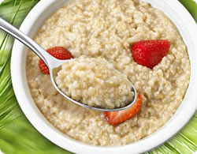
Nature of Attitudes
Cognitive
I think oatmeal is healthier
than corn flakes for breakfast.
Affective
I hate corn flakes.
Behavioral
I intend to eat more oatmeal
for breakfast.
Notes:
An attitude is a learned, stable predisposition to respond to oneself, other persons, objects, or issues in a consistently favorable or unfavorable way.
Attitudes can be expressed or based cognitively, affectively, and behaviorally. A example for each is provided in the slide.
Business researchers treat attitudes as hypothetical constructs because of
their complexity and
the fact that they are inferred from the measurement data, not actually observed.

Slide 5
Improving Predictability
Specific
Multiple measures
Strong
Factors
Reference groups
Direct
Basis
Notes:
Several factors have an effect on the applicability of attitudinal research for business.
Specific attitudes are better predictors of behavior than general ones.
Strong attitudes are better predictors of behavior than weak attitudes composed of little intensity or topic interest.
Direct experiences with the attitude object produce behavior more reliably.
Cognitive-based attitudes influence behaviors better than affective-based attitudes.
Affective-based attitudes are often better predictors of consumption behaviors.
Using multiple measurements of attitude or several behavioral assessments across time and environments improve prediction.
The influence of reference groups and the individual’s inclination to conform to these influences improves the attitude-behavior linkage.

Slide 6
Selecting a Measurement Scale
Research objectives
Response types
Data properties
Number of
dimensions
Balanced or
unbalanced
Forced or unforced
choices
Number of
scale points
Rater errors
Notes:
Attitude scaling is the process of assessing an attitudinal disposition using a number that represents a person’s score on an attitudinal continuum ranging from an extremely favorable disposition to an extremely unfavorable one.
Scaling is the procedure for the assignment of numbers to a property of objects in order to impart some of the characteristics of numbers to the properties in question.
Selecting and constructing a measurement scale requires the consideration of several factors that influence the reliability, validity, and practicality of the scale. These factors are listed in the slide.
Researchers face two types of scaling objectives: 1) to measure characteristics of the participants who participate in the study, and 2) to use participants as judges of the objects or indicants presented to them.
Measurement scales fall into one of four general response types: rating, ranking, categorization, and sorting. These are discussed further on the following slide.
Decisions about the choice of measurement scales are often made with regard to the data properties generated by each scale: nominal, ordinal, interval, and ratio.
Measurement scales are either
unidimensional or multidimensional,
balanced or unbalanced,
forced or unforced.
These characteristics are discussed further as is the issue of number of scale points and rater errors.

Slide 7
Response Types
Rating scale
Ranking scale
Categorization
Sorting
Notes:
A rating scale is used when participants score an object or indicant without making a direct comparison to another object or attitude. For example, they may be asked to evaluate the styling of a new car on a 7-point rating scale.
Ranking scale constrain the study participant to making comparisons and determining order among two or more properties or objects. Participants may be asked to choose which one of a pair of cars has more attractive styling. A choice scale requires that participants choose one alternative over another. They could also be asked to rank-order the importance of comfort, ergonomics, performance, and price for the target vehicle.
Categorization asks participants to put themselves or property indicants in groups or categories.
Sorting requires that participants sort card into piles using criteria established by the researcher. The cards might contain photos or images or verbal statements of product features such as various descriptors of the car’s performance.

Slide 8

Number of Dimensions
Unidimensional
Multi-dimensional
Reflective
Formative
Notes:
With a unidimensional scale, one seeks to measure only one attribute of the participant or object. One measure of an actor’s star power is his or her ability to “carry” a movie. It is a single dimension.
A multidimensional scale recognizes that an object might be better described with several dimensions. The actor’s star power variable might be better expressed by three distinct dimensions - ticket sales for the last three movies, speed of attracting financial resources, and column-inch/amount of TV coverage of the last three movies.

Slide 9
Multidimensional Scale
Reflective
  Each item reflects on the property of the construct
  Example: Happy
Formative
  The construct is “formed” by a weighted total of the items
  Example: Social support

Slide 10
Balanced or Unbalanced
How good an actress is Angelina Jolie?
Very bad
Bad
Neither good nor bad
Good
Very good
Poor
Fair
Good
Very good
Excellent
Notes:
A balanced rating scale has an equal number of categories above and below the midpoint.
Scales can be balanced with or without a midpoint option.
An unbalanced rating scale has an unequal number of favorable and unfavorable response choices.

Slide 11
Forced or Unforced Choices
How good an actress is Angelina Jolie?
Very bad
Bad
Neither good nor bad
Good
Very good
Very bad
Bad
Neither good nor bad
Good
Very good
No opinion
Don’t know
Notes:
An unforced-choice rating scale provides participants with an opportunity to express no opinion when they are unable to make a choice among the alternatives offered.
A forced-choice scale requires that participants select one of the offered alternatives.

Slide 12

Number of Scale Points
How good an actress is Angelina Jolie?
Very bad
Bad
Neither good nor bad
Good
Very good
Very bad
Somewhat bad
A little bad
Neither good nor bad
A little good
Somewhat good
Very good
Notes:
What is the ideal number of points for a rating scale?
A scale should be appropriate for its purpose. For a scale to be useful, it should match the stimulus presented and extract information proportionate to the complexity of the attitude object, concept, or construct.
E.g., A product that requires little effort or thought to purchase can be measured with a simple scale (perhaps a 3 point scale). When the product is complex, a scale with 5 to 11 points should be considered.
As the number of scale points increases, the reliability of the measure increases.
In some studies, scales with 11 points may produce more valid results than 3, 5, or 7 point scales.
Some constructs require greater measurement sensitivity and the opportunity to extract more variance, which additional scale points provide.
A larger number of scale points are needed to produce accuracy when using single-dimension versus multiple dimension scales.

Slide 13
Rater Errors
Adjust strength of
descriptive adjectives
Space intermediate
descriptive phrases
farther apart
Provide smaller
differences
in meaning between
steps near the
ends of the scale
Use more scale points
Error of
central tendency
Error of leniency
Notes:
Some raters are reluctant to give extreme judgments and this fact accounts for the error of central tendency.
Participants may also be “easy raters” or “hard raters” making what is called error of leniency.
Suggestions for addressing these tendencies are provided in the slide.

Slide 14
Rater Errors
Primacy Effect
Recency Effect
Reverse order of
alternatives periodically
Notes:
A primacy effect is one that occurs when respondents tend to choose the answer that they saw first.
When respondents choose the answer seen most recently, the recency effect has occurred.
These problems can be avoided by randomizing the order in which responses are presented.

Slide 15
Dealing with Halo Effects
Rate one trait
at a time
Reveal one trait
per page
Reverse anchors
periodically
Halo Effects
光暈效果
Notes:
The halo effect is the systematic bias that the rater introduces by carrying over a generalized impression of the subject from one rating to another.
For instance, a teacher may expect that a student who did well on the first exam to do well on the second.
Ways of counteracting the halo effect are listed in the slide.

Slide 16

Simple Category Scale
I plan to purchase an iPhone in the next 12 months.
    Yes
    No
Notes:
This scale is also called a dichotomous scale.
It offers two mutually exclusive response choices.
In the example shown in the slide, the response choices are yes and no, but they could be other response choices too such as agree and disagree.

Slide 17

Multiple-Choice,
Single-Response Scale
What newspaper do you read most often for financial news?
    East City Gazette
    West City Tribune
    Regional newspaper
    National newspaper
    Other (specify:_____________)
Notes:
When there are multiple options for the rater but only one answer is sought, the multiple-choice, single-response scale is appropriate.
The other response may be omitted when exhaustiveness of categories is not critical or there is no possibility for an other response.
This scale produces nominal data.

Slide 18

Multiple-Choice,
Multiple-Response Scale
What sources did you use when designing your new
home? Please check all that apply.
    Online planning services
    Magazines
    Independent contractor/builder
    Designer
    Architect
    Other (specify:_____________)
Notes:
This scale is a variation of the last and is called a checklist.
It allows the rater to select one or several alternatives.
The cumulative feature of this scale can be beneficial when a complete picture of the participant’s choice is desired, but it may also present a problem for reporting when research sponsors expect the responses to sum to 100 percent.
This scale generates nominal data.

Slide 19

Likert Scale: agree/disagree
The Internet is superior to traditional libraries for
comprehensive searches.
    Strongly disagree
    Disagree
    Neither agree nor disagree
    Agree
    Strongly agree
Notes:
The Likert scale was developed by Rensis Likert and is the most frequently used variation of the summated rating scale.
Summated rating scales consist of statements that express either a favorable or unfavorable attitude toward the object of interest.
The participant is asked to agree or disagree with each statement.
Each response is given a numerical score to reflect its degree of attitudinal favorableness and the scores may be summed to measure the participant’s overall attitude.
Likert-like scales may use 7 or 9 scale points.
They are quick and easy to construct.
The scale produces interval data.
Originally, creating a Likert scale involved a procedure known as item analysis.
Item analysis assesses each item based on how well it discriminates between those people whose total score is high and those whose total score is low.
It involves calculating the mean scores for each scale item among the low scorers and the high scorers.
The mean scores for the high-score and low-score groups are then tested for statistical significance by computing t values.
After finding the t values for each statement, the statements are rank-ordered, and those statements with the highest t values are selected.
Researchers have found that a larger number of items for each attitude object improves the reliability of the scale.

Slide 20

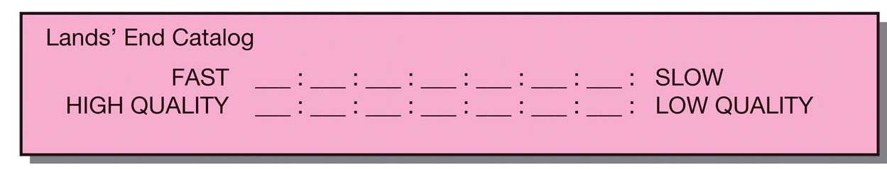
Semantic Differential 語意分析
Notes:
From Exhibit 12-3
The semantic differential scale measures the psychological meanings of an attitude object using bipolar adjectives.
Researchers use this scale for studies of brand and institutional image, employee morale, safety, financial soundness, trust, etc.
The method consists of a set of bipolar rating scales, usually with 7 points, by which one or more participants rate one or more concepts on each scale item.
The scale is based on the proposition that an object can have several dimensions of connotative meaning. The meanings are located in multidimensional property space, called semantic space.
The semantic differential scale is efficient and easy for securing attitudes from a large sample. Attitudes may be measured in both direction and intensity. The total set of responses provides a comprehensive picture of the meaning of an object and a measure of the person doing the rating. It is standardized and produces interval data.
Exhibit 12-7 provides basic instructions for constructing an SD scale.

Slide 21
Adapting SD Scales
Convenience of Reaching the Store from Your Location
Nearby | ___: ___: ___: ___: ___: ___: ___: | Distant
Short time required to reach store | ___: ___: ___: ___: ___: ___: ___: | Long time required to reach store
Difficult drive | ___: ___: ___: ___: ___: ___: ___: | Easy Drive
Difficult to find parking place | ___: ___: ___: ___: ___: ___: ___: | Easy to find parking place
Convenient to other stores I shop | ___: ___: ___: ___: ___: ___: ___: | Inconvenient to other stores I shop
Products offered
Wide selection of different kinds of products | ___: ___: ___: ___: ___: ___: ___: | Limited selection of different kinds of products
Fully stocked | ___: ___: ___: ___: ___: ___: ___: | Understocked
Undependable products | ___: ___: ___: ___: ___: ___: ___: | Dependable products
High quality | ___: ___: ___: ___: ___: ___: ___: | Low quality
Numerous brands | ___: ___: ___: ___: ___: ___: ___: | Few brands
Unknown brands | ___: ___: ___: ___: ___: ___: ___: | Well-known brands

Slide 22
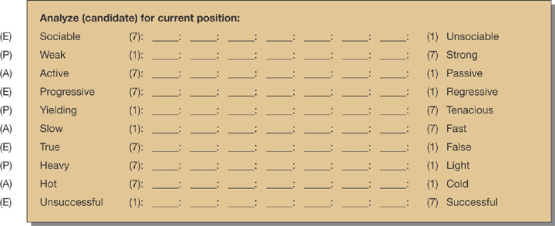
SD Scale for Analyzing Actor Candidates
Notes:
In Exhibit 12-8, we see a scale used by a consulting firm to help a movie production company evaluate actors for the leading role of a risky film venture. The selection of concepts is driven by the characteristics they believe the actor must possess to produce box office financial targets. To analyze the results, the set of values for each component (evaluation, potency, and activity) is averaged.

Slide 23
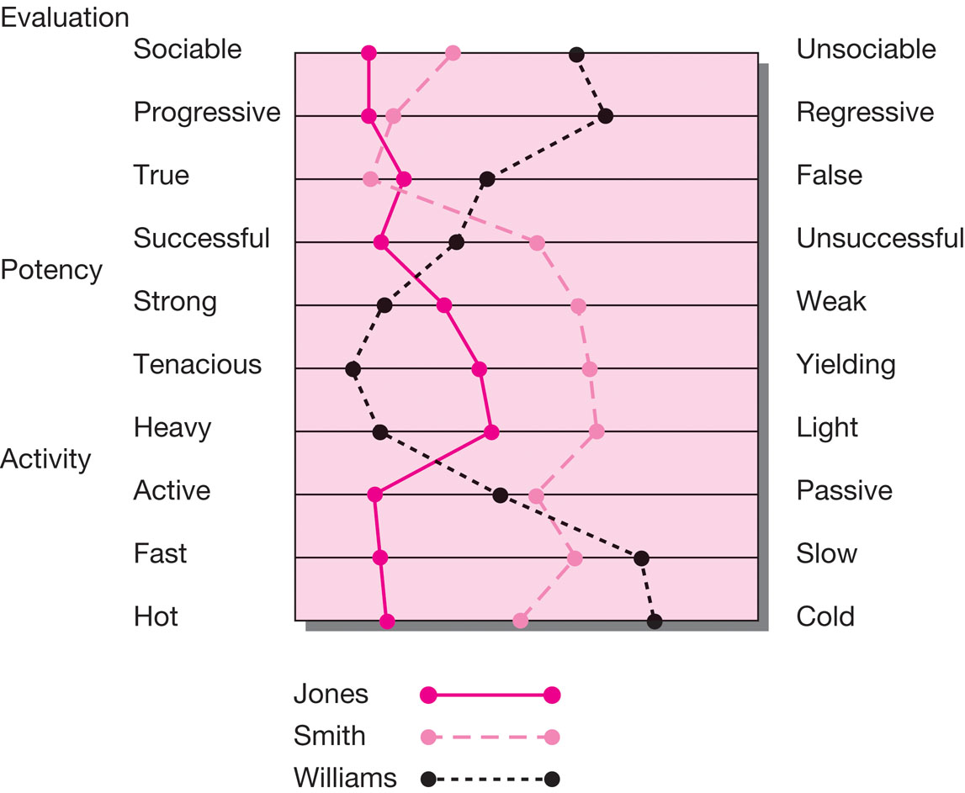
Graphic of SD Analysis
Notes:
In Exhibit 12-9, the data are plotted on a snake diagram. Here the adjective pairs are reordered so evaluation, potency, and activity descriptors are grouped together, with the ideal factor reflected by the left side of the scale. Profiles of the three actor candidates may be compared to each other and to the ideal.

Slide 24

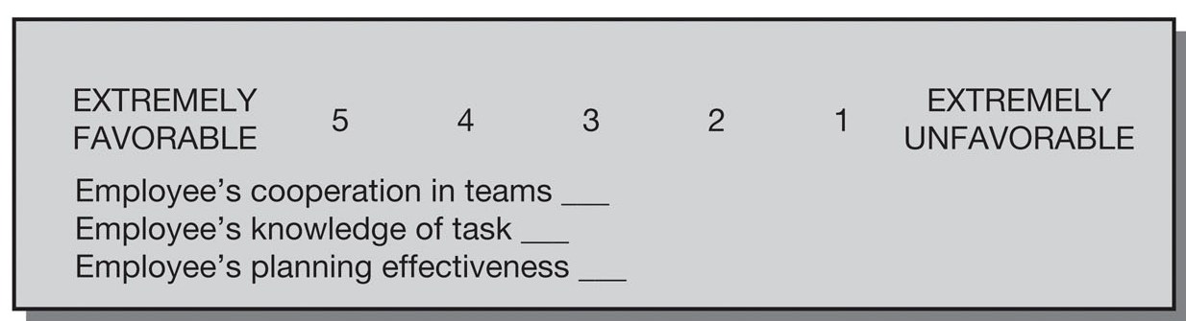
Numerical Scale
Notes:
From Exhibit 12-3
Numerical scales have equal intervals that separate their numeric scale points. The verbal anchors serve as the labels for the extreme points.
Numerical scales are often 5-point scales but may have 7 or 10 points.
The participants write a number from the scale next to each item.
It produces either ordinal or interval data.

Slide 25

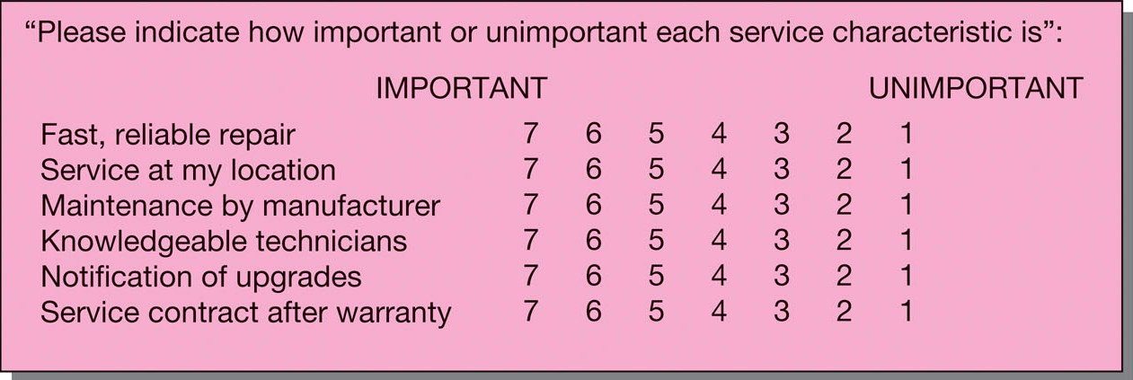
Multiple Rating List Scales
Notes:
From Exhibit 12-3:
A multiple rating scale is similar to the numerical scale but differs in two ways:
it accepts a circled response from the rater, and
the layout facilitates visualization of the results.
The advantage is that a mental map of the participant’s evaluations is evident to both the rater and the researcher.
This scale produces interval data.

Slide 26

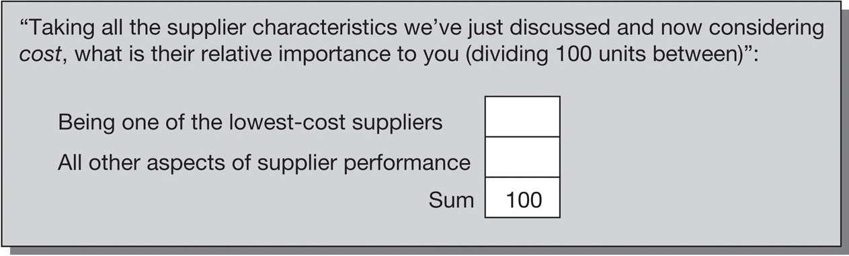
Constant-Sum Scales
Notes:
From Exhibit 12-3:
The constant-sum scale helps researchers to discover proportions.
The participant allocates points to more than one attribute or property indicant, such that they total a constant sum, usually 100 or 10.
Participant precision and patience suffer when too many stimuli are proportioned and summed.
A participant’s ability to add may also be taxed.
Its advantage is its compatibility with percent and the fact that alternatives that are perceived to be equal can be so scored.
This scale produces interval data.

Slide 27
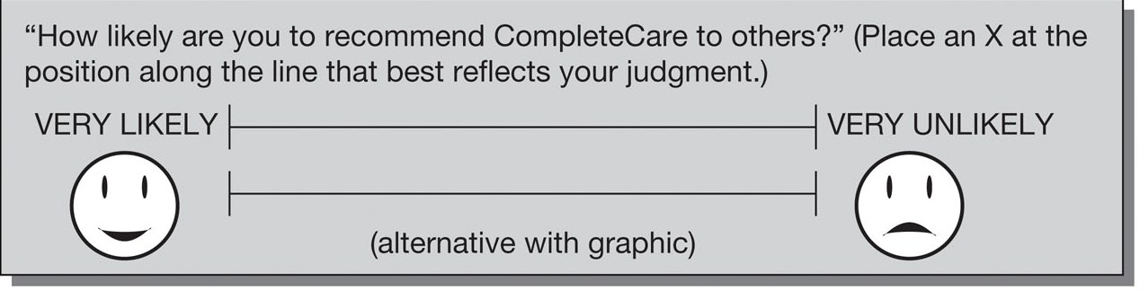
Graphic Rating Scales
Notes:
From Exhibit 12-3:
The graphic rating scale was originally created to enable researchers to discern fine differences.
Theoretically, an infinite number of ratings is possible if participants are sophisticated enough to differentiate and record them.
They are instructed to mark their response at any point along a continuum.
Usually, the score is a measure of length from either endpoint.
The results are treated as interval data.
The difficulty is in coding and analysis.
Graphic rating scales use pictures, icons, or other visuals to communicate with the rater and represent a variety of data types.
Graphic scales are often used with children.

Slide 28

Ranking Scales
Paired-comparison scale
Forced ranking scale
Comparative scale
Notes:
From Exhibit 12-3:
In ranking scales, the participant directly compares two or more objects and makes choices among them.
The participant may be asked to select one as the best or most preferred.

Slide 29
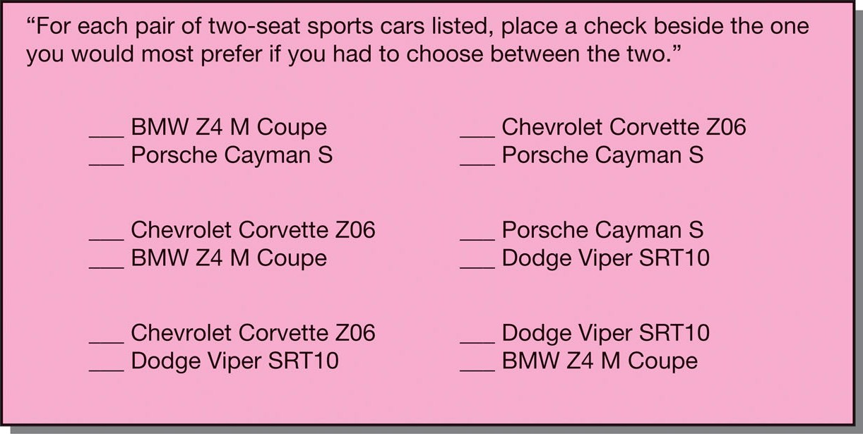
Paired-Comparison Scale
Notes:
From Exhibit 12-10:
Using the paired-comparison scale, the participant can express attitudes unambiguously by choosing between two objects.
The number of judgments required in a paired comparison is [(n)(n-1)/2], where n is the number of stimuli or objects to be judged.
Paired comparisons run the risk that participants will tire to the point that they give ill-considered answers or refuse to continue.
Paired comparisons provide ordinal data.

Slide 30

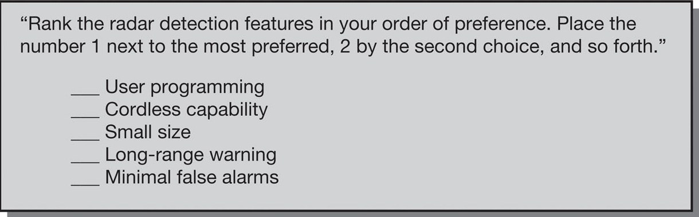
Forced Ranking Scale
Notes:
From Exhibit 12-10:
The forced ranking scale lists attributes that are ranked relative to each other.
This method is faster than paired comparisons and is usually easier and more motivating to the participant.
With five item, it takes ten paired comparisons to complete the task, but the simple forced ranking of five is easier.
A drawback of this scale is the limited number of stimuli (usually no more than 7) that can be handed by the participant.
This scale produces ordinal data.

Slide 31

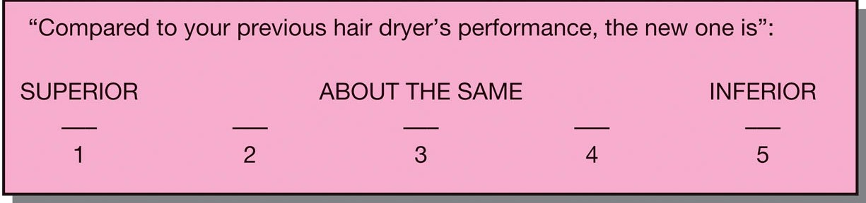
Comparative Scale
Notes:
From Exhibit 12-10:
When using a comparative scale, the participant compares an object against a standard.
The comparative scale is ideal for such comparisons if the participants are familiar with the standard.
Some researchers treat the data produced by comparative scales as interval data since the scoring reflects an interval between the standard and what is being compared, but the text recommends treating the data as ordinal unless the linearity of the variables in question can be supported.

Slide 32
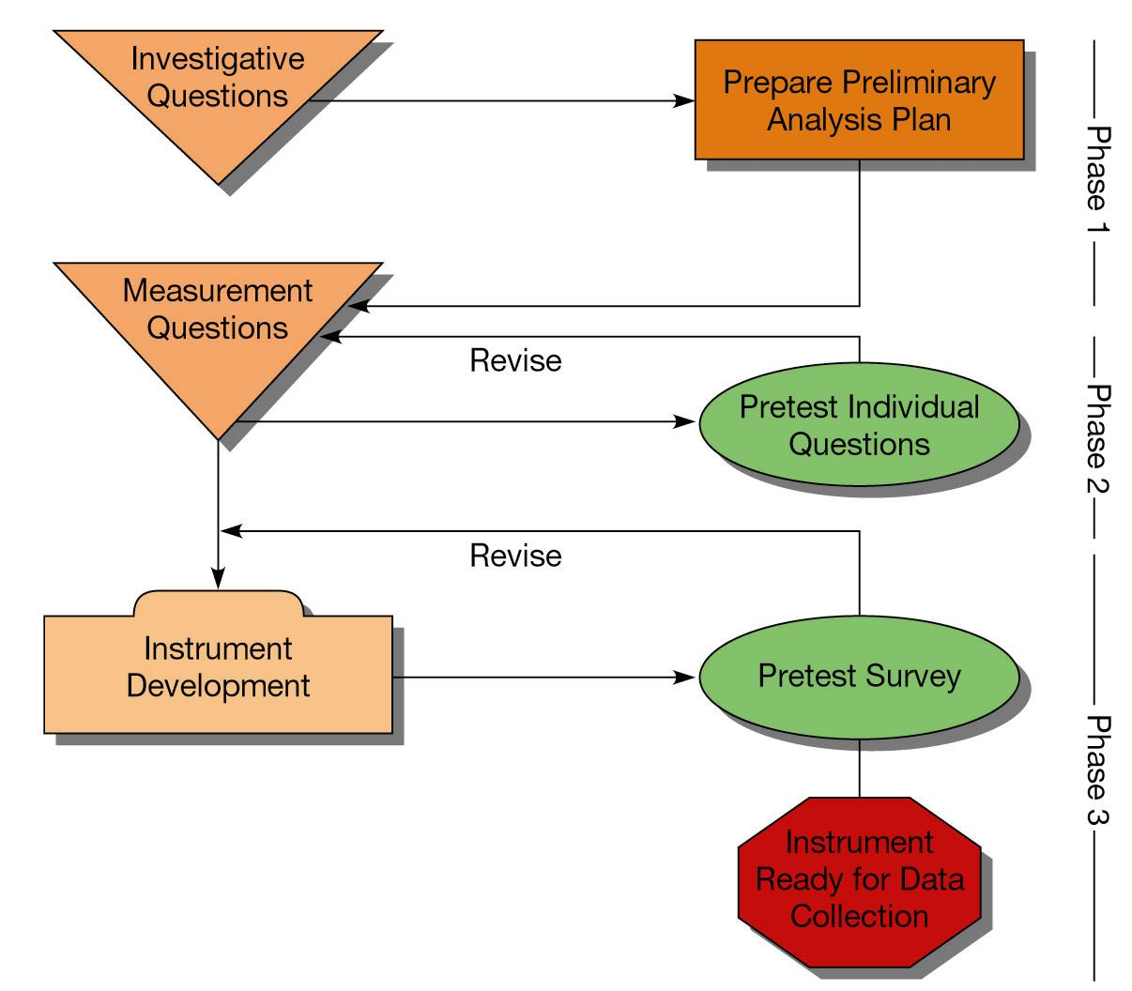
Overall Flowchart for Instrument Design
Instrument
Ready for Data
Collection
Notes:
Exhibit 13-1 is a suggested flowchart for instrument design. The procedures followed in developing an instrument vary from study to study, but the flowchart suggests three phases. Each phase is discussed in this chapter.

Slide 33
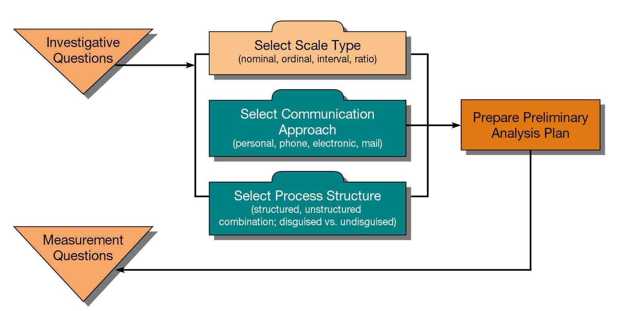
Flowchart for Instrument Design
Phase 1
Notes:
Exhibit 13-2: By this stage in a research project, the process of moving from the general management dilemma to specific measurement question has traveled through the first three question levels:
Management question –the dilemma, stated in question form, that the manager needs resolved;
Research question(s) – the fact-based translation of the question the researcher must answer to contribute to the solution of the management questions;
Investigative questions – specific questions the researcher must answer to provide sufficient detail and coverage of the research question. Within this level, there may be several questions as the researcher moves from the general to the specific;
Measurement questions – questions participants must answer if the researcher is to gather the needed information and resolve the management question.
Once the researcher understands the connection between the investigative questions and the potential measurement questions, a strategy for the survey is the next logical step.

Slide 34
Strategic Concerns in Instrument Design
What type of scale is needed?
What communication approach will be used?
Should the questions be structured?
Should the questioning be disguised?

Slide 35

Technology Affects
Questionnaire Development
Write questionnaires more quickly
Create visually driven instruments
Eliminate manual data entry
Save time in data analysis
WebSurveyor used to write an instrument.

Slide 36
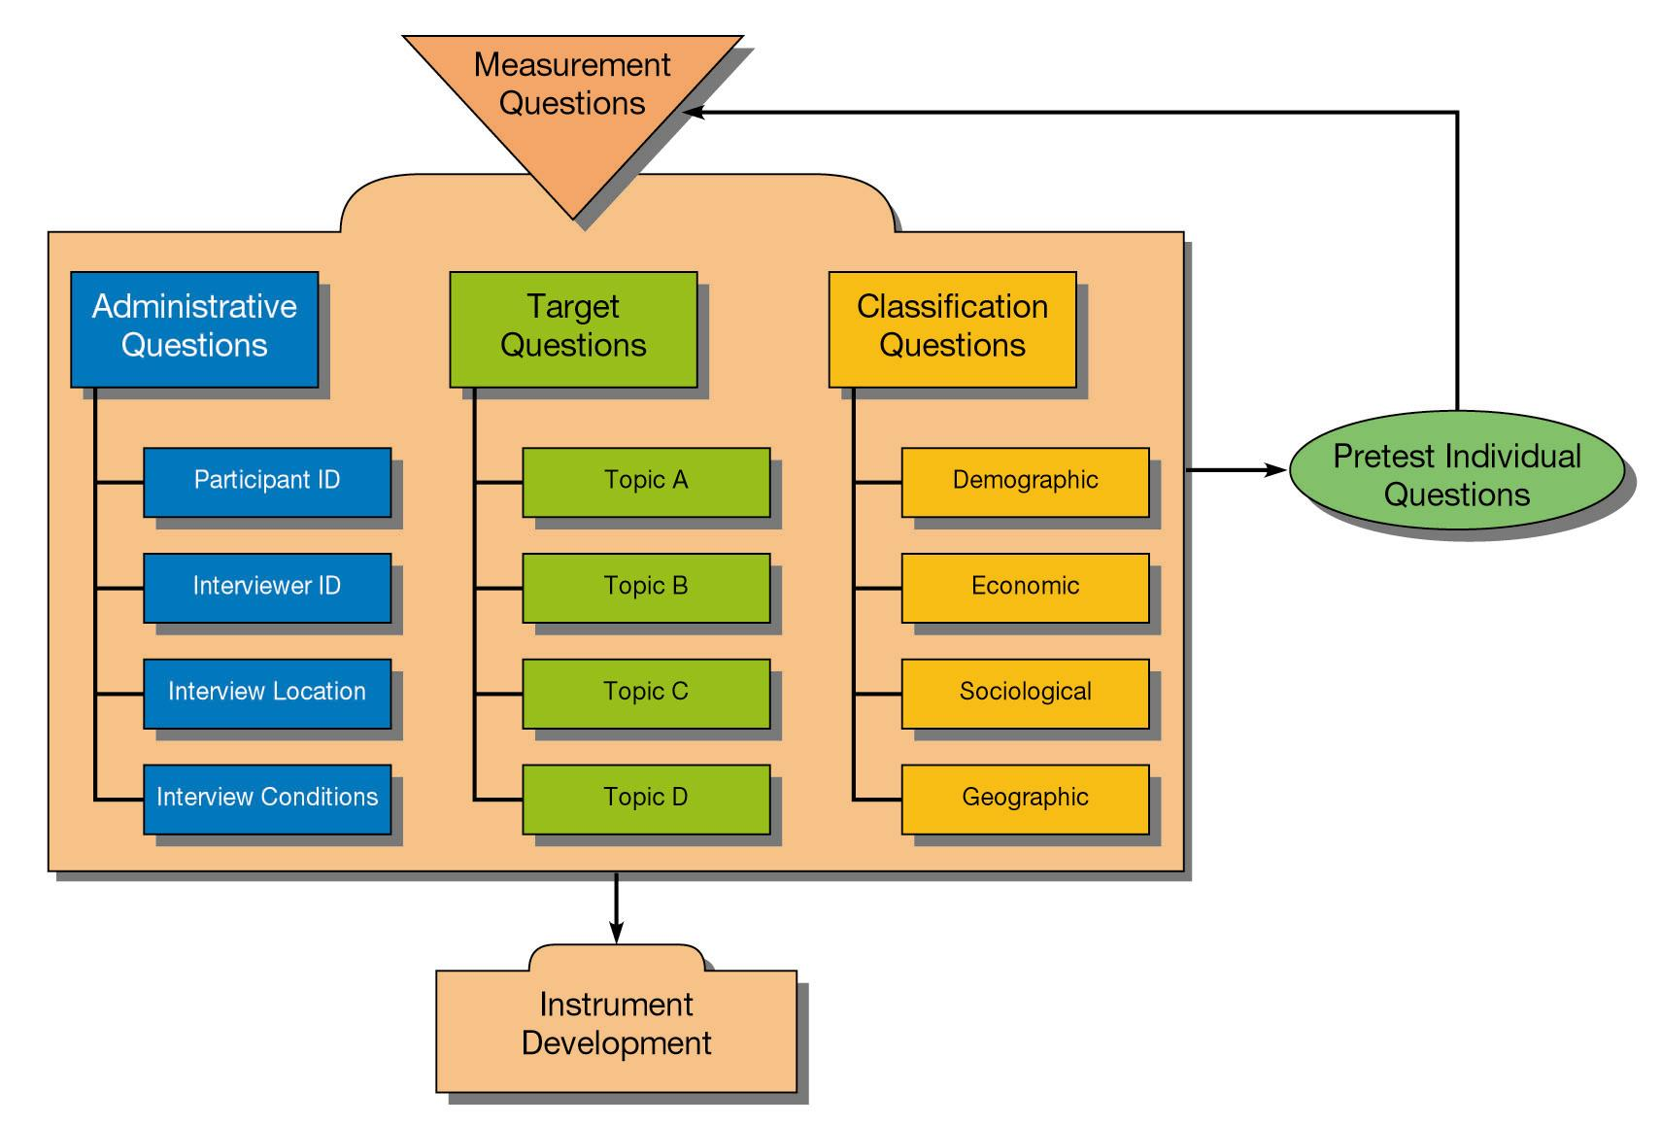
Flowchart for Instrument Design
Phase 2
Notes:
In Phase 2 (Exhibit 13-4), you generate specific measurement questions considering subject content, the wording of each question, and each response strategy.
The order, type, and wording of the measurement questions, the introduction, the instructions, the transitions, and the closure in a quality communication instrument should accomplish the following:
Encourage each participant to provide accurate responses,
Encourage each participant to provide an adequate amount of information,
Discourage each participant from refusing to answer specific questions,
Discourage each participant from early discontinuation of participation, and
Leave the participant with a positive attitude about survey participation.

Slide 37

Question Categories and Structure
Administrative
Classification
Target
Notes:
Questionnaires can range from those that have a great deal of structure to those that are unstructured. They contain three categories of measurement questions.
Administrative questions identify the participant, interviewer, interviewer location, and conditions. These questions are rarely asked of the participant but are necessary for studying patterns within the data and identify possible error sources.
Classification questions usually cover sociological-demographic variables that allow participants’ answers to be grouped so that patterns are revealed and can be studied. These questions usually appear at the end of a survey.
Target questions address the investigative questions of a specific study. These are grouped by topic in the survey. Target questions may be structured or unstructured.

Slide 38
Question Content
Should this question be asked?
知道你問題的目的（不要是因為其他人都問）
Is the question of proper scope and coverage?
Can the participant adequately
answer this question as asked?
Will the participant willingly
answer this question as asked?
Notes:
These are the seven activities the researcher must accomplish to make an experiment a success.
In the first step, the researcher is challenged to
select variables that are the best operational definitions of the original concepts,
determine how many variables to test, and 3) select or design appropriate measures for the chosen variables. The selection of measures for testing requires a thorough review of the available literature and instruments.
In an experiment, participants experience a manipulation of the independent variable, called the experimental treatment. The treatment levels are the arbitrary or natural groups the researcher makes within the independent variable. A control group can provide a base level for comparison. A control group is a group of participants that is measured but not exposed the independent variable being studied.
Environmental control means holding the physical environment of the experiment constant. When participants do not know if they are receiving the experimental treatment, they are said to be blind. When neither the participant nor the researcher knows, the experiment is said to be double-blind.
The design is then selected. Several designs are discussed on the next several slides.
The participants selected for the experiment should be representative of the population to which the researcher wishes to generalize the study’s results. Random assignment is required to make the groups as comparable as possible.

Slide 39
Question Wording
Shared
vocabulary
Adequate
alternatives
Single
meaning
Criteria
Personalized
Misleading
assumptions
Biased
Notes:
Survey questions should be revised until they satisfy these criteria:
Is the question stated in terms of a shared vocabulary?
Does the question contain vocabulary with a single meaning?
Does the question contain unsupported or misleading assumptions?
Does the question contain biased wording?
Is the question correctly personalized?
Are adequate alternatives presented within the question?

Slide 40
Response Strategy
Objectives
of the study
Participant’s
motivation to
share
Participant’s level of information
Factors
Ease and clarity with which participant communicates
Degree to which participants have thought through topic
Notes:
In choosing response options in questions, researchers must consider these factors.

Slide 41

Free-Response Strategy
What factors influenced your enrollment in Metro U?
____________________________________________
____________________________________________
Notes:
Free-response questions, also known as open-ended questions, ask the participant a question and either the interviewer pauses for the answer or the participant records his or her ideas in his or her own words in the space provided on a questionnaire. Survey researchers try to reduce the number of these questions as they are difficult to interpret and are costly to analyze.

Slide 42

Dichotomous Response Strategy
Did you attend the “A Day at College” program at Metro U?
  Yes
  No
Notes:
Dichotomous questions are measurement questions that offer two mutually exclusive and exhaustive alternatives.

Slide 43

Multiple Choice Response Strategy
Which one of the following factors was most influential
in your decision to attend Metro U?
  Good academic standing
  Specific program of study desired
  Enjoyable campus life
  Many friends from home
  High quality of faculty
Notes:
Multiple-choice questions are appropriate when there are more than two alternatives or where we seek gradations of preference, interest, or agreement.
A problem can occur with this question type when one or more responses have not been anticipated. A second problem occurs when the list of choices is not exhaustive. Participants may also feel that they have multiple answers while the question allows for only one response; in this case, the response choices are not mutually exclusive. The order in which choices are given can also cause bias. Order bias with non-numeric response categories often leads the participant to choose the first alternative (primacy effect) or the last alternative (recency effect) over the middle ones.
Primacy effects dominate in visual surveys while recency effects dominate oral surveys.
Multiple choice questions usually generate nominal data.

Slide 44

Checklist Response Strategy
Which of the following factors influenced
your decision to enroll in Metro U? (Check all that apply.)
    Tuition cost
    Specific program of study desired
    Parents’ preferences
    Opinion of brother or sister
    Many friends from home attend
    High quality of faculty
Notes:
The checklist question is a question that poses numerous alternatives and encourages multiple unordered responses. Checklists are efficient and provided nominal data.

Slide 45
Rating Response Strategy
 | Strongly influential | Somewhat influential | Not at all influential
Good academic reputation | ❑ | ❑ | ❑
Enjoyable campus life | ❑ | ❑ | ❑
Many friends | ❑ | ❑ | ❑
High quality faculty | ❑ | ❑ | ❑
Semester calendar | ❑ | ❑ | ❑

Slide 46

Ranking
Please rank-order your top three factors from the following list based on their influence in encouraging you to apply to Metro U. Use 1 to indicate the most encouraging factor, 2 the next most encouraging factor, etc.
_____ Opportunity to play collegiate sports
_____ Closeness to home
_____ Enjoyable campus life
_____ Good academic reputation
_____ High quality of faculty
Notes:
When relative order of the alternatives is important, the ranking question is ideal. The ranking question is a measurement question that asks the participant to compare and order two or more objects or properties using a numeric scale.
It is always best to have participants rank only those elements with which they are familiar. For this reason, ranking questions might follow a checklist question which identifies the objects of familiarity. Avoid asking participants to rank more than seven items. Ranking generates ordinal data.

Slide 47
Summary of Scale Types
Type | Restrictions | Scale Items | Scale points | Data Type
Rating Scales
Simple Category Scale | Needs mutually exclusive choices | One or more | 2 | Nominal
Multiple Choice Single-Response Scale | Needs mutually exclusive choices; may use exhaustive list or ‘other’ | many | 2 | Nominal
Multiple Choice Multiple-Response Scale (checklist) | Needs mutually exclusive choices; needs exhaustive list or ‘other’ | many | 2 | Nominal
Likert Scale | Needs definitive positive or negative statements with which to agree/disagree | One or more | 5 | Ordinal
Likert-type Scale | Needs definitive positive or negative statements with which to agree/disagree | One or more | 7 or 9 | Ordinal
Notes:
Exhibit 13-7 summarizes some important considerations in choosing between the various response strategies.
While all of the response strategies are available for use in Web questionnaires, there are slightly different layout options for response in Web surveys.

Slide 48
Summary of Scale Types
Type | Restrictions | Scale Items | Scale points | Data Type
Semantic Differential Scale | Needs words that are opposites to anchor the graphic space. | One or more | 7 | Ordinal
Numerical Scale | Needs concepts with standardized or defined meanings; needs numbers anchor the end-points or points along the scale; score is a measurement of graphical space from one anchor. | One or many | 3-10 | Ordinal or Interval
Multiple Rating List Scale | Needs words that are opposites to anchor the end-points on the verbal scale | Up to 10 | 5-7 | Ordinal
Fixed Sum Scale | Participant needs ability to calculate total to some fixed number, often 100. | Two or more | none | Interval or Ratio
Stapel Scale | Needs verbal labels that are operationally defined or standard. | One or more | 10 | Ordinal or Interval
Graphic Rating Scale | Needs visual images that can be interpreted as positive or negative anchors; score is a measurement of graphical space from one anchor. | One or more | none | Ordinal (Interval, or Ratio)
Notes:
Exhibit 13-7 summarizes some important considerations in choosing between the various response strategies.
While all of the response strategies are available for use in Web questionnaires, there are slightly different layout options for response in Web surveys.

Slide 49
Summary of Scale Types
Type | Restrictions | Scale Items | Scale points | Data Type
Ranking Scales
Paired Comparison Scale | Number is controlled by participant’s stamina and interest. | Up to 10 | 2 | Ordinal
Forced Ranking Scale | Needs mutually exclusive choices. | Up to 10 | many | Ordinal or Interval
Comparative Scale | Can use verbal or graphical scale. | Up to 10 |  | Ordinal
Notes:
Exhibit 13-7 summarizes some important considerations in choosing between the various response strategies.
While all of the response strategies are available for use in Web questionnaires, there are slightly different layout options for response in Web surveys.
Exhibit 13-6, starting on the next slide, illustrates these layout options.

Slide 50
Sources of Questions
Handbook of Marketing Scales
The Gallup Poll Cumulative Index
Measures of Personality and Social-Psychological Attitudes
Measures of Political Attitudes
Index to International Public Opinion
Sourcebook of Harris National Surveys
Marketing Scales Handbook
American Social Attitudes Data Sourcebook
Notes:
Exhibit 13-8 provides sources of questions from books and web sites. This slide highlights many of the books listed in the Exhibit.

Slide 51
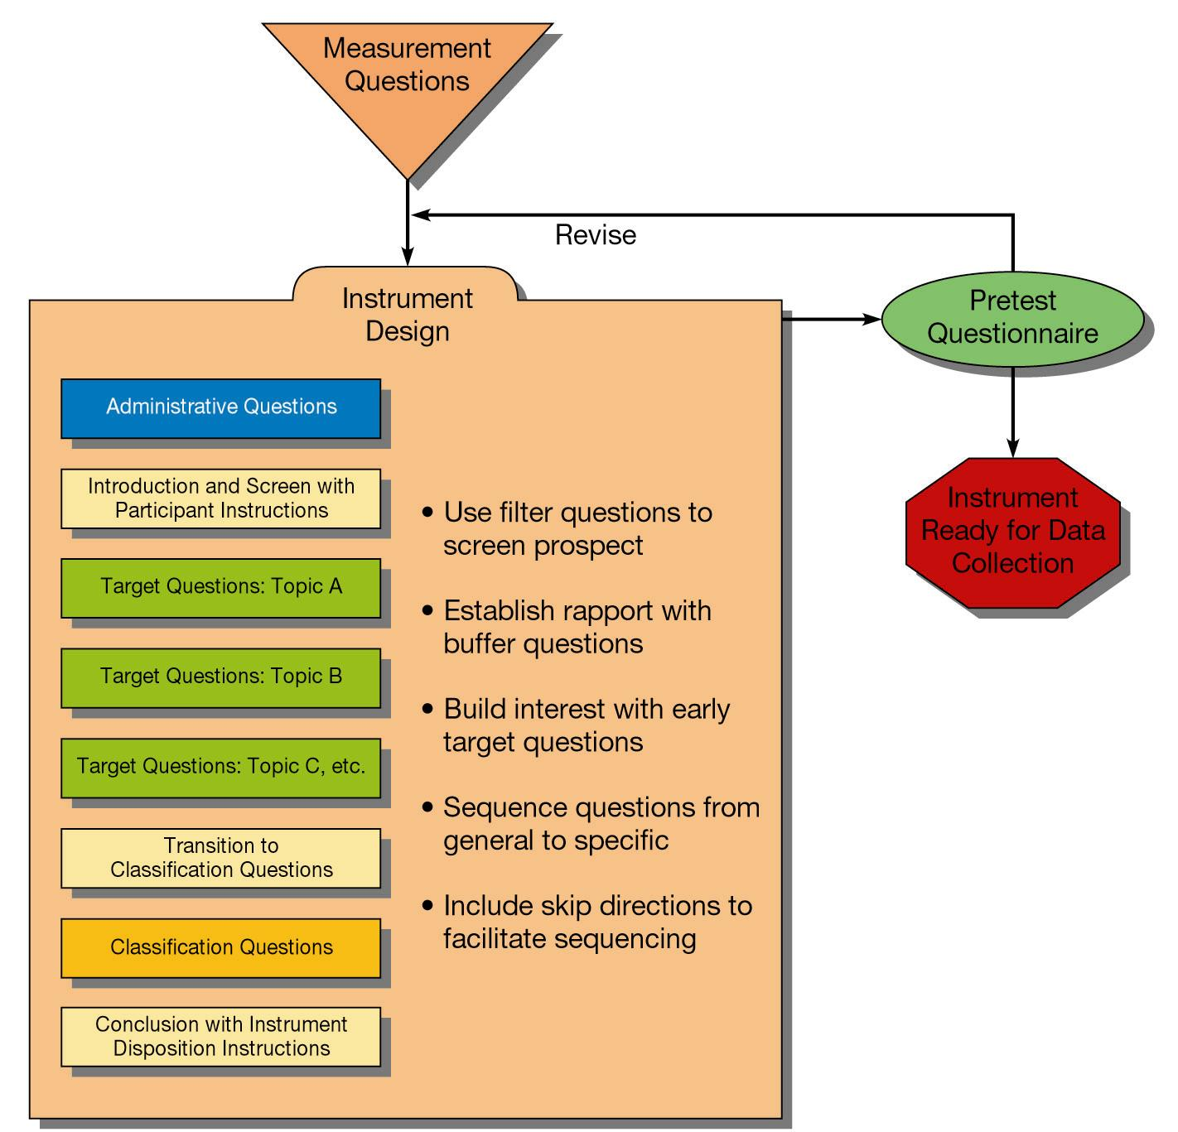
Flowchart for Instrument Design: Phase 3
Instrument
Ready for Data
Collection
Notes:
As depicted in Exhibit 13-9, instrument design is a multistep process.
Develop the participant-screening process along with the introduction. A screen question is a question to qualify the participant’s knowledge about the target questions of interest or experience necessary to participate.
Arrange the measurement question sequence:
Identify groups of target questions by topic
Establish a logical sequence for the question groups and questions within groups
Develop transitions between these question groups.
Prepare and insert instructions including termination instructions, skip directions, and probes.
Create and insert a conclusion, including a survey disposition statement.
Pretest specific questions and the instrument as a whole.

Slide 52
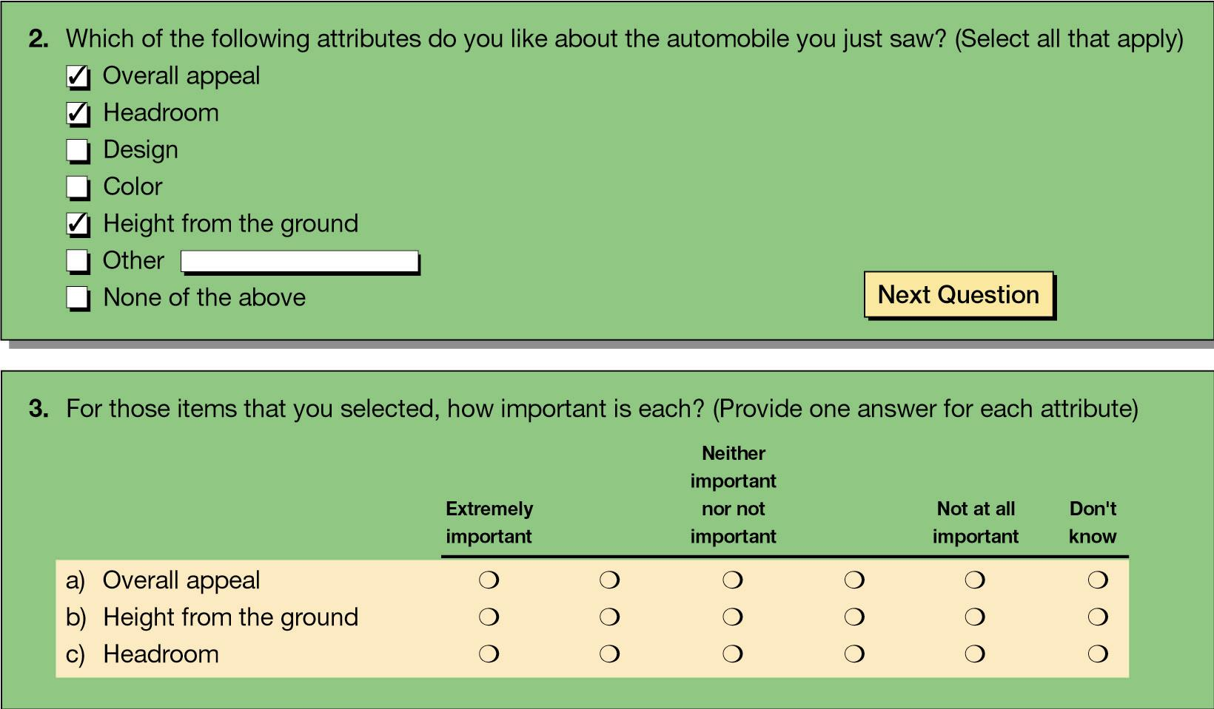
Branching Question
Notes:
Sometimes the content of one question assumes other questions have been asked and answered. This is a branched question. In web surveys, branching allows for respondents to avoid “skip patterns”. Based on their answers, respondents are branched to the appropriate section of the survey.
Web surveys also allow for piping. Piping takes the answer from one question and uses the answer in a later question. For instance, if in one question, a respondent named Diet Coke as his or her favorite beverage, a later question might ask “Which is your favorite characteristic of Diet Coke?”

Slide 53
Overcoming Instrument Problems
Build rapport
Redesign question process
Explore alternatives
Use other methods
Pretest
Notes:
There is no substitution for a thorough understanding of question wording, question content, and question sequencing issues. However, the researcher can do several things to help improve survey results. These are listed in the slide.
Most information can be secured by direct undisguised questioning if rapport has been developed. The assurance of confidentiality can also increase participant motivation.
You can redesign the questioning process to improve the quality of answers by modifying the administrative process and the response strategy.
When drafting the original question, try developing positive, negative, and neutral versions of each type of question. Minimize nonresponses to particular questions by recognizing the sensitivity of certain topics.
The final step toward improving survey results is pretesting, the assessment of questions and instruments before the start of a study. Pretesting can allow one to 1) discover ways to increase participant interest, 2) increase the likelihood that participants will remain engaged, 3) discover question content, wording, and sequencing problems, 4) discover target question groups where researcher training is needed, and 5) explore ways improve the overall quality of survey data.
Urge your students to review Appendix 13a, especially Exhibit 13a-5, Restructuring Questions, for some insight into overcoming problems.

