Slide 1




Paper Review
Structural drivers of upstream supply chain complexity and the frequency of supply chain disruptions
Teacher:
Professor Cheng-Wen Lee
Student:
MAKAIREH DAMPHA(11004610)

Slide 2
Presentation Outline
6th
5th
4th
3rd
2nd
1st
Introduction
Background on reverse logistics
Conceptual framework and hypotheses
Methods
Analysis and Results
Discussion & Conclusion

Slide 3
Introduction
“If you are in supply chain management today, the complexity is a cancer you have to fight
Complexity in the inter-connected flows of materials, funds, and information between firms have not only been blamed for decreasing supply chain efficiency, but also identified as a key precursor of supply chain disruptions
(Sodhi etal.,2012) scholars advised firms to tackle the risk of supply chain disruptions as aggressively as they do financial risks and to reassess their supply chain designs from a risk perspective
However, relatively little is known about the link between the structural characteristics of supply chains and the risk of disruptions.

Slide 4
Introduction
The purpose of this study is to advance our understanding of the relationship between supply chain characteristics and the frequency of supply chain disruptions.
The author hypothesize and tests a proposed theoretical model that links structural drivers of upstream supply chain complexity with the number of supply chain disruptions experienced by buying firms over a 12-month period.
Further, to understand the linkage between supply chain structure and disruptions.
Author review on supply chain complexity, which will be the basis for the subsequent development of hypotheses

Slide 5
Background
Supply chain disruptions
Many risks that firms face, the risk of supply chain disruptions arises from the vulnerabilities of the inter-connected flows of materials, information, and funds in inter- firm networks
In these works, a supply chain disruption is typically viewed as a discrete event that causes the losses for the affected firms.
Supply chain disruption as an unintended and unexpected triggering event in the upstream supply chain.
The inbound logistics network, (sourcing) environment, and a consequential situation that present a serious threat to the normal course of business operations of the focal firm.

Slide 6
Background
Supply chain complexity
Complexity is an important theme in the supply chain literature2 in which there is a ageneral consensus that supply chains have become increasingly complex over the last decades and that this complexity is not a desirable feature.
Within this literature, there are two sub-streams that take a unique perspective on complexity in supply chains.
Choi etal.,2001; Pathak etal.,2007). One stream investigates supply chains as complex adaptive systems that have the capability to learn and adapt to changes in their environments
A second stream examines supply chains as complex social networks and uses methods from social network analysis to understand how relational ties are formed and how these ties affect social capital, resource access, convergence, and contagion in supply chains

Slide 7
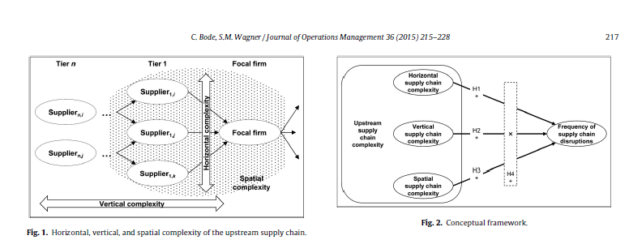

Slide 8
Conceptual framework and hypotheses
The first mechanism is related to the emergence of disruptive events in complex systems
(Perrow, 1984). A system that comprises a larger number of elements can be expected to produce more disruptions than a smaller system
This can be easily demonstrated using Bernoulli random variables.
Let's assume that for every element j (j = 1,..., n) in a system, there is an independent probability pj of producing a disruption within a certain finite time horizon.
For convenience, corresponding Bernoulli disruption indicators 1Dj are defined so that P[1Dj = 1] = pj.
The expected value of disruptions (which the focal firm will have faced at the end of the time horizon) is equal to E(D) = Σj=1 to n 1Dj, which clearly increases with the number of elements.

Slide 9
Conceptual framework and hypotheses
The second mechanism is related to the managerial ability to detect and prevent disruptive events shortly before or very soon after their occurrence.
If these accident precursors are detected and correctly interpreted, disruptions can be averted or at least their impact contained by resorting to quick preventive interventions.
For example, receiving two months’ advance notice of a supplier becoming financially distressed would enable a buying firm to adapt its sourcing arrangements or to financially support the distressed supplier in order to preserve the supply chain.

Slide 10
Horizontal supply chain complexity
(Daft, 2006). In organizational theory, horizontal complexity is associated with the specialization of skills and knowledge in an organization
First, because no supplier is perfectly reliable, the frequency of disruptions will likely increase with the number of direct suppliers
The severity of supply chain disruptions is affected by the chosen sourcing strategy,
(single, dual, or multi-sourcing).
The intensive use of dual/multi-sourcing arrangements can increase the horizontal complexity and frequency of disruptions, but it can also mitigate the severity of the experienced disruptions.

Slide 11
Horizontal supply chain complexity: Conti
Second, larger supply bases are also associated with more coordination and administrative tasks which may impair a buying firm’s ability to proactively identify disruptions
The more direct suppliers a focal firm has, the greater the number of interfaces that need to be managed, monitored, and coordinated
Wally and Baum, 1994. Task complexity has been reported to reduce the quality of decisions and slow down the pace of decision-making
Hypothesis 1. There is a positive relationship between horizontal supply chain complexity and the frequency of supply chain disruptions.

Slide 12
Vertical supply chain complexity
(Jablin, 1987; TolbertandHall,2009).
Organizations with more hierarchical levels exhibit greater complexity than organizations with fewer.
In a supply chain context, this type of complexity corresponds to the number of tiers which has been argued to drive supply chain complexity.
First, vertical supply chain complexity is related to the potential for chain reactions (i.e.,cascading disruptions from upstream supply chain tiers)(Choi etal.,2001).
Thus, the greater the vertical complexity, the more likely a firm is to experience disruptions as a result of problems that occurred upstream the supply chain (events that spread throughout the supply chain).

Slide 13
Vertical supply chain complexity: Cont..
Second, uncertainty in the upstream supply chain increases with vertical supply chain complexity
Many focal firms have only limited transparency and knowledge “regarding what lies beyond the top-tier supplier (e.g., who the second- and third- tier suppliers are).” Upper supply chain tiers are often not actively managed and emerge over time.
(Beamon, 1999;Milgate,2000). Choi and Hong(2002,p.490)
This makes it hard to detect and identify early warning signals.
Hypothesis 2. There is a positive relationship between vertical supply chain complexity and the frequency of supply chain disruptions

Slide 14
Spatial supply chain complexity
Spatial complexity is the geographical spread of an organization and/or a supply base
High levels of spatial complexity in the upstream supply chain are typically associated with global sourcing
First, a geographically dispersed supply chain implies a physically elongated flow of goods with longer paths and longer and more variable lead times which creates more possibilities for disturbance
Second, and as in the case of horizontal complexity, information- processing needs and monitoring costs increase with geographic distance from the suppliers.
Hypothesis 3. There is a positive relationship between spatial supply chain complexity and the frequency of supply chain disruptions

Slide 15
Interaction of supply chain complexity dimensions
The upshot of the preceding analysis is that horizontal, vertical, and spatial complexity are likely associated with increased uncertainty and with poorer transparency and visibility, leading to an increasing frequency of supply chain disruptions
Simultaneous high levels of horizontal, spatial, and vertical complexity create additional potential for unfamiliar cause-effect sequences caused by non-linear interactions, dependencies (e.g., supplier default dependencies)
These arguments suggest that the effects produced by the three supply chain complexity dimensions amplify each other’s effects.
Hypothesis 4. The total effect of horizontal, vertical, and spatial supply chain complexity on the frequency of supply chain disruptions is greater than the sum of the effects of each individual complexity dimension.

Slide 16
Method
Data and procedure
The empirical context for this study is the manufacturing sector and our unit of analysis is a buying firm that experienced at least one disruption in its upstream supply chain during a period of 12 months.
Primary data were collected in 2007 by means of a self-administered Internet-based survey of 3945 firms in Germany, Austria, and Switzerland.

Slide 17
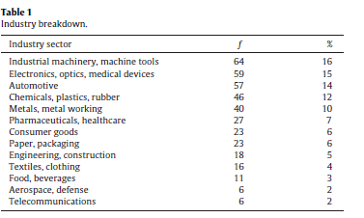
Data and procedure
The total annual revenues of the respondents’ firms in 2006 ranged from US $1 million to US$14.5billion(M= US-$491.98million, SD = 1474.32 million)
Number of employees ranged from fewer than 100 to 40000(M= 1388.63, SD = 3803.15). Most of the respondents were senior managers in purchasing who had been in their current positions for an average of 6.9 years (SD = 5.90) and with their firms for 11.57years(SD = 9.30).
Work experience consisted of purchasing, logistics ,or supply chain management for an average of 14.37 years (SD = 8.42).

Slide 18
Data and procedure: Conti…
Dependent variable
Supply chain disruptions (D),the author asked the respondents for the number of supply chain disruptions experienced for the12months from January1 through December31,2006.
The distribution of this variable was highly positively skewed with a mean of 13.89 (SD = 55.19),and a minimum of 1and a maximum of1000.
Independent variables
Horizontal supply chain complexity (HC) was measured as the number of direct suppliers of the focal firm.
Vertical supply chain complexity (VC), we used the analogy of a typical automotive supplychain and asked the respondents: “

Slide 19
Data and procedure: Conti…
Spatial supply chain complexity (SC) we followed Stock etal. (2000) and Lorentz etal.(2011) and asked how each firm’s purchasing volume (in monetary units) is spread over five geographic regions:
Home countries ( Austria, Germany, Switzerland), other European countries, North America(US, Canada, and Mexico), Asia/Pacific region, and the rest of the world (e.g., Latin America)
Control variables
Firm size (FS), measured as the number of employees in the focal firm.
Firm age (FA), measured as the difference between the founding year and the year of the data collection.
Competitive intensity (CI), the extent to which respondents perceive the competitive climate
Finally, they controlled for industry by using 12 industry dummies (cf. Table 1), accounting for the effects of the13 industry sectors within their sample.

Slide 20
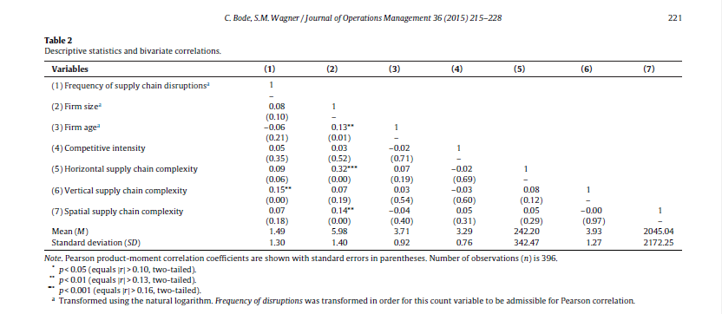

Slide 21
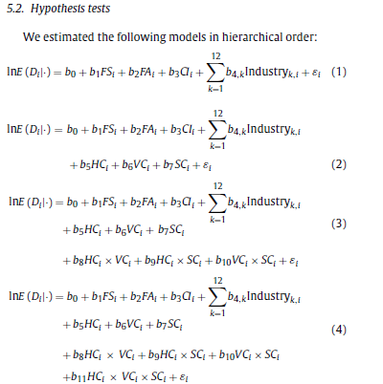
Analysis and results: Conti…
Control variables were entered as a block in Model 1,
followed by the main effect variables in Model 2,
The two-way (pair-wise) interaction terms in Model 3, and
The three-way interaction term in Model 4 (simultaneous within blocks, stepwise across).

Slide 22
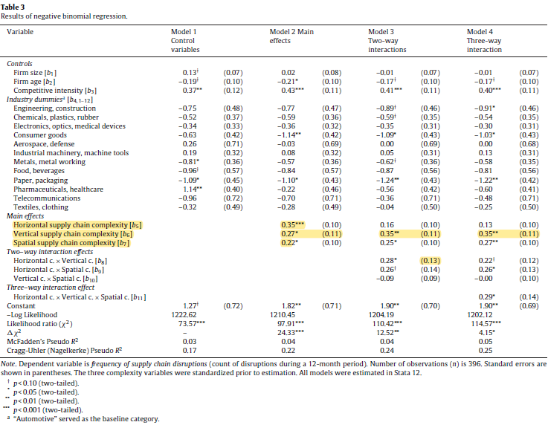
Analysis and results: Conti…

Slide 23
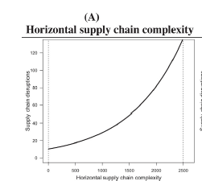
Analysis and results: Conti…
Hypothesis 1 suggests that the frequency of supply chain disruptions increases with horizontal complexity. The results for Model 1 support this hypothesis (standardized regression coefficient B5 = 0.35, p < 0.001).
As shown in Table 4, the average marginal effect (for the unstandardized variable)is 0.013 suggesting that a firm would experience 1.3 more disruptions per year (on average), if its supply base increased by 100 suppliers.
When plotting this effect(Fig. 3A), we find that the relationship between horizontal complexity and the number of supply chain disruptions is not constant over the observed variable range.

Slide 24
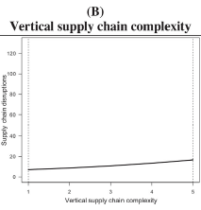
Analysis and results: Conti…
Hypothesis 2 suggests that vertical supply chain complexity increases the number of supply chain disruptions.
This is supported by the results which suggest that the number of upstream supply chain tiers has a positive effect on the frequency of supply chain disruptions (B6 = 0.27, p = 0.013)
Table 4, every additional upstream tier increases the frequency of disruptions by on average 2.69.
Fig. 3B depicts the relationship which seems to be almost linear over the observed range.

Slide 25
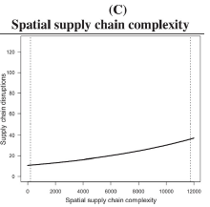
Analysis and results: Conti…
Finally, the results lend empirical support for the third direct effect hypothesis which pertains to spatial supply chain complexity. The corresponding regression coefficient is significant and in the expected direction(B7 = 0.22, p = 0.023),thus corroborating Hypothesis 3. Similar to Hypothesis 1, the corresponding plot
(Fig. 3C) indicates that the rate of change in disruption frequency varies along the observed variable range.

Slide 26
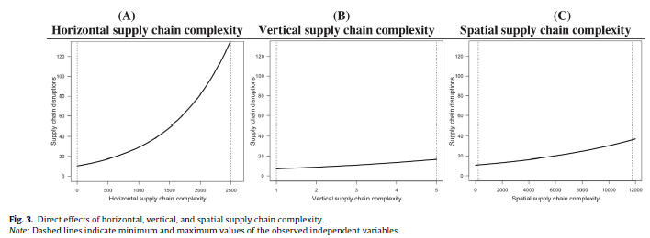
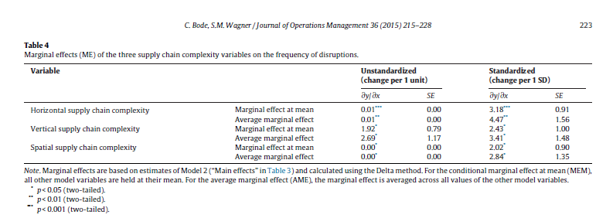

Slide 27
Analysis and results: Conti…
Beyond these direct effects, the predictive power of the interaction effects is tested in Model3 and Model 4. Hypothesis 4 suggests complementarities(or synergies)among the three complexity variables
The results indicate a significant positive interaction effect between horizontal and vertical supply chain complexity(B8 = 0.28, p = 0.032).
interaction between horizontal and spatial supply chain complexity is positive (B9 = 0.26),but slightly above the 5% level of confidence (p = 0.053). For the effect between vertical and spatial supply chain complexity, we found a negative(B10 = –0.09),but substantially insignificant effect (p = 0.317).
Model 4 introduces the important three-way interaction term formed by the three complexity dimensions. The results indicate a positive and significant coefficient for this interaction term (B11 = 0.29, p < 0.036).
In sum, these results support the synergy posited in Hypothesis 4

Slide 28
Discussion
This study contributes to a better understanding of the multi- dimensional nature of upstream supply chain complexity and its consequences for the frequency of supply chain disruptions
In essence, the proposed model posits positive direct relationships among horizontal, vertical, and spatial supply chain complexity and the frequency of supply chain disruptions.
In addition, the model suggests that the three drivers or dimensions of complexity act synergistically which further amplifies the frequency of supply chain disruptions
The results provided support for our predictions and have several important scholarly and managerial implications

Slide 29
Limitations and future research directions
This study’s findings need to be considered in light of its limitations. A few obvious limitations pertain to data collection procedure:
(1)The low response rate,
(2)The concentration on manufacturing firms,
(3)Our reliance on single informants,
(4)the estimated models are based on the simplified assumption that the surveyed firms’ supply chain structures remain relatively stable during the considered time period, and
(5)Except for the control variables firm size and firm age, we were unable to draw on objective data for the main variables in our model.
A replication of this study across other industries and based on multiple informants would augment the generalizability of the results.

Slide 30



Thank you !

