Slide 1
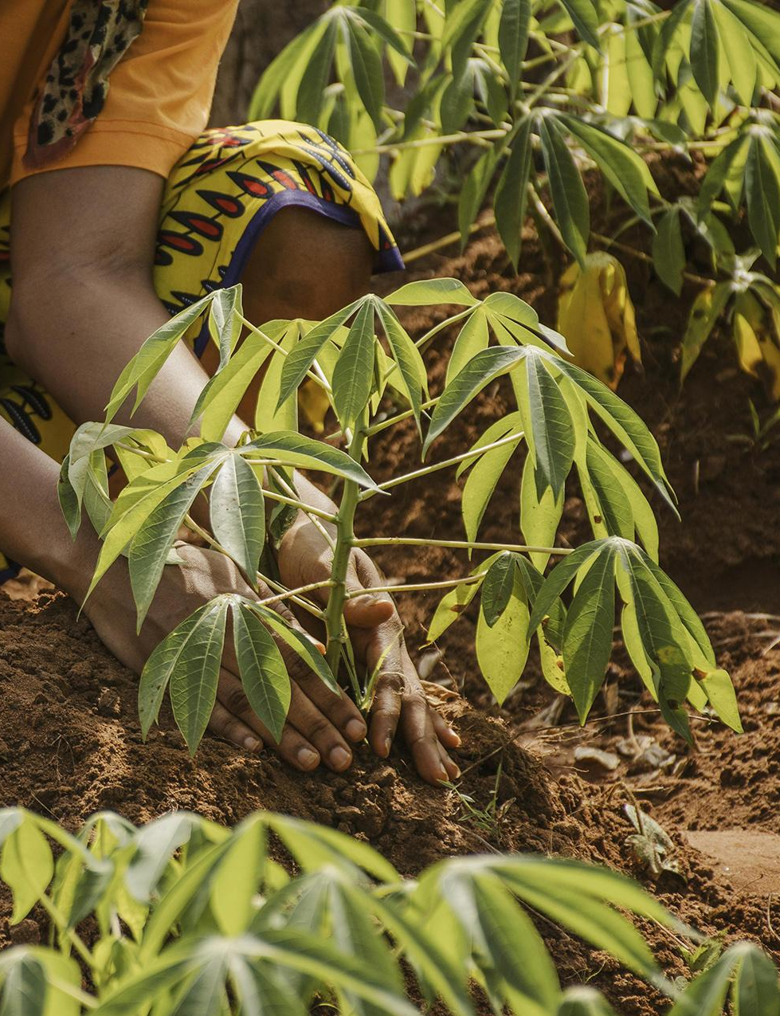
Agribusiness
Investment Opportunities

Slide 2
Agendas
PURPOSE
01
04
REGIONAL OUTLOOK
MARKET OPPORTUNITIES
07
02
OVERVIEW, THE GAMBIA
05
AGRIBUSINESS IN THE GAMBIA
08
GLOBAL PERSPECTIVE
03
MARKET ADVANTAGES
06
AGRI-PRODUCTION IN GAMBIA
09
GLOBAL SUPPLY POTENTIAL

Slide 3
PURPOSE
Agribusiness Opportunities
  The purpose of this presentation is to inform and attract potential investors about the lucrative opportunities in the agribusiness sector in The Gambia
Partnership and Collaboration
  Request your guidance and assistance in establishing connections with possible investors in this industry.

Slide 4
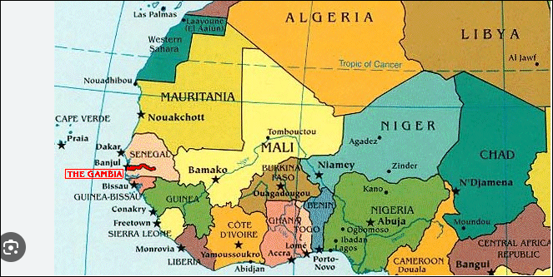
2. OVERVIEW, The Gambia
The Gambia is a small country (2.7 million people) located in West Africa with a total Area Around 11,295 square kilometers (4,361 square miles).
Topography Landscape:
Predominantly flat with some low hills.
Elevation: Mostly low-lying 53 meters (174 feet) above sea level.
Climate Type:
Tropical climate
Distinct Dry Season (November to May)
Rainy season (June to October)
Economic Geography:
70% employed Agriculture sector
(e.g) peanuts, rice, millet, and horticultural crops. Mostly on subsistence scale.
Strategic Location: Direct Market Access to Worldwide markets

Slide 5
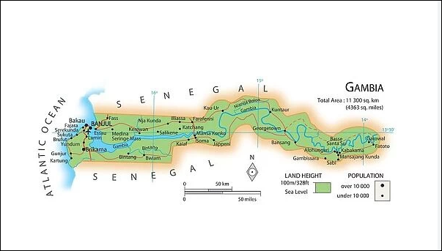
3. MARKET ADVANTAGES
Topography
Water Bodies
Climate
Vegetation
Labor Availability
Diverse Agricultural Opportunities
Growing Demand
Easy to acquire arable land
Low Labor Costs
68% are between the ages 15-35 years
GIEPA administers various investment incentives as well as an all-inclusive Sustainable Investor Certificate (SIC) of incentives to foster business success particularly in selected priority sectors

Slide 6
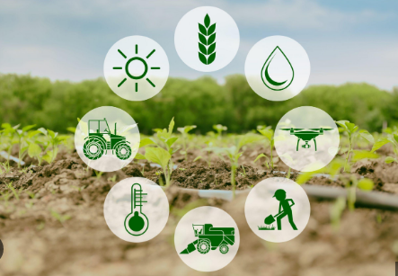
4. MARKET OPPORTUNITIES
Rice Production
  Staple Food ( sub-region)
  Import Substitution
Livestock and Poultry
  Meat production ( growing demand)
  Diary Production ( fresh milk and others)
Horticulture
  Fruits and Vegetables ( for local and export)
  Export Opportunities
Agro-Processing
  Value-Addition: Processing facilities ( fruits, vegetables, grains and others.
  Food Preservation: reduce after harvest losses

Slide 7
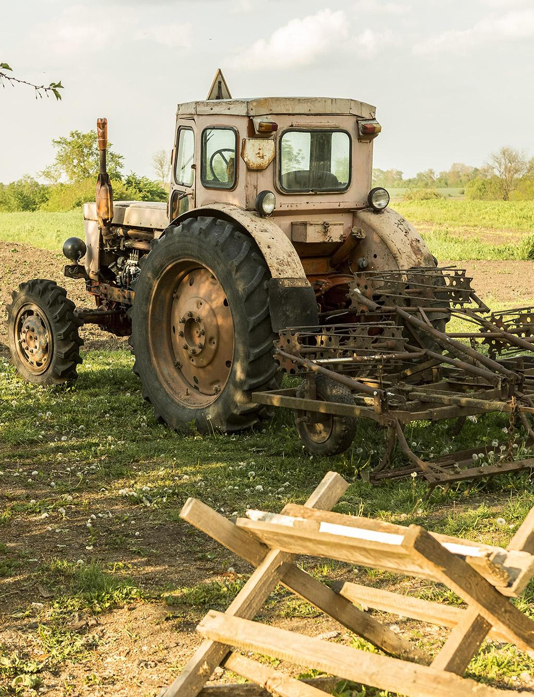
Agriculture in Gambia is largely based on traditional methods of farming where there are equipment, they will either be too old or largely dysfunctional

Slide 8

5. AGRIBUSINESS IN GAMBIA
1. Primary Production: Focusing on crop cultivation, livestock rearing, and fisheries, with opportunities for introducing advanced farming techniques and technologies to enhance productivity.
Crop Production- cash crops, cereals, horticulture, roots and tuber crops
Livestock, poultry and animal husbandry , aquaculture etc.
2. Processing: Adding value through processing agricultural products, improving shelf life, and creating new marketable products.
Agro-processing of Crops, Livestock and Dairy Processing, Fish Processing

Slide 9

Gambian agriculture has been characterized by subsistence production of food crops, comprising cereals (early millet, late millet, maize, sorghum, rice), semi-intensive cash crop production (groundnut, cotton, sesame, and horticulture
The Ministry of Trade announced that the Gambia aims to reduce the amount of ‘’American Rice’’ import in the tune of $50 million yearly

Slide 10
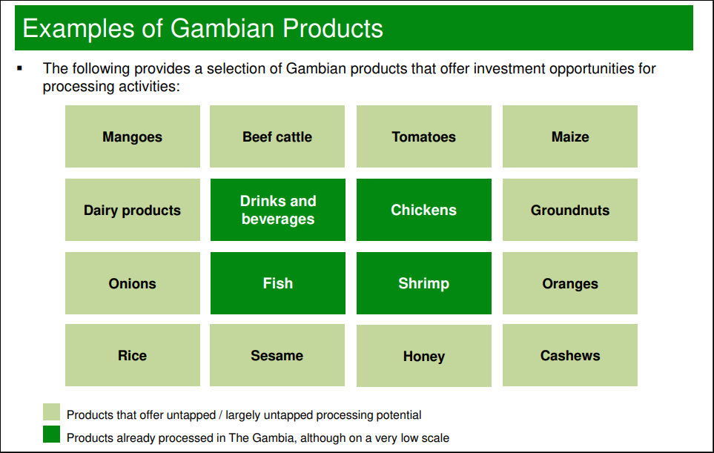
6. Agri-production in The Gambia
1
2
3
4
The Gambia’s few agri-processing facilities are currently found in the Western Region
Other parts of The Gambia can also offer suitable processing locations, given agricultural
Is a cold place
This is the ringed planet

Slide 11

7. REGIONAL OUTLOOK
Agriculture is expected to be a $1tn opportunity by 2030 in Africa (FAO, 2020)
The Sub-Saharan Africa1 (SSA) region accounts for more than 950 million people, approximately 13% of the global population
The important role of the agricultural sector in contributing to food security is reflected in its prioritization in the development agenda of every country in the subregion
Technological Advancements
Market Access and Integration
Export Market Diversification
Sustainable Supply Chains

Slide 12
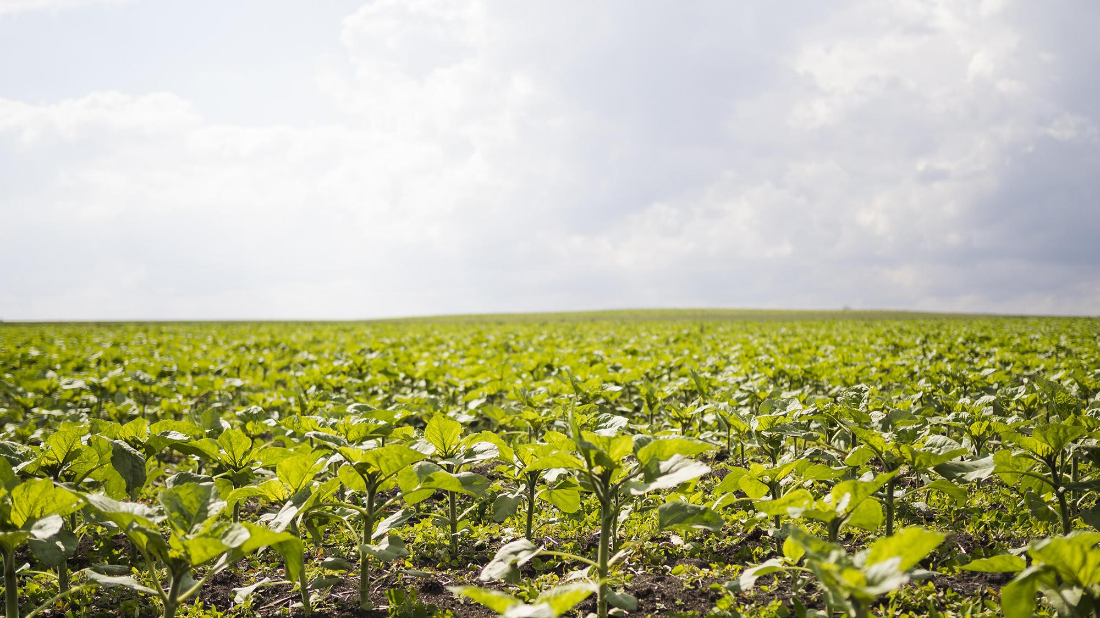
8. GLOBAL PERSPECTIVE
Population growth, economic development, dietary shifts, technological advancements, and sustainability concerns drive the rising global demand for food and agricultural products. Addressing this demand requires a multifaceted approach, including increasing agricultural productivity, enhancing food supply chains, and adopting sustainable practices. By embracing these strategies, the global community can work towards ensuring food security and meeting the nutritional needs of a growing population.

Slide 13

Technological advancements in Agribusiness
The integration of advanced technologies in agribusiness significantly enhances both productivity and sustainability. It can enhance the following:
Optimal Resource Use
Improved Crop Management
Labor Efficiency
Higher Crop Quality
Year-Round Production

Slide 14
9. Global supply potential
Nearly all Gambian products can be exported at
preferential duty rates and quota free to:
ECOWAS markets under the ECOWAS Trade
Liberalization Scheme (ETLS)
EU market under the Everything But Arms (EBA)
Initiative offered by the European Union
US market under the African Growth and
Opportunity Act (AGOA)
India, Brazil and South Korea under preferential
duty rates for products from Least-Developed
Countries (LDCs)

Slide 15
Our aim is not limited to Agribusiness
Renewable energy and green technology
Manufacturing
Distribution

Slide 16
Thanks!
Questions, suggestions and contributions

