Slide 1
Survey Research
8
  Department of Information Management
  CYCU
  CK Farn
mailto: ckfarn@gmail.com
  2023.11

Slide 2
Dilemma for Surveys
“The ubiquity of cell phones and the rapid and continuing development of the Internet have completely altered the way we talk to each other, the way marketers talk to customers, the way customers shop and the way the media research their audiences.”
Alain Tessier, founder,
Mediamark Research, Inc.

Slide 3
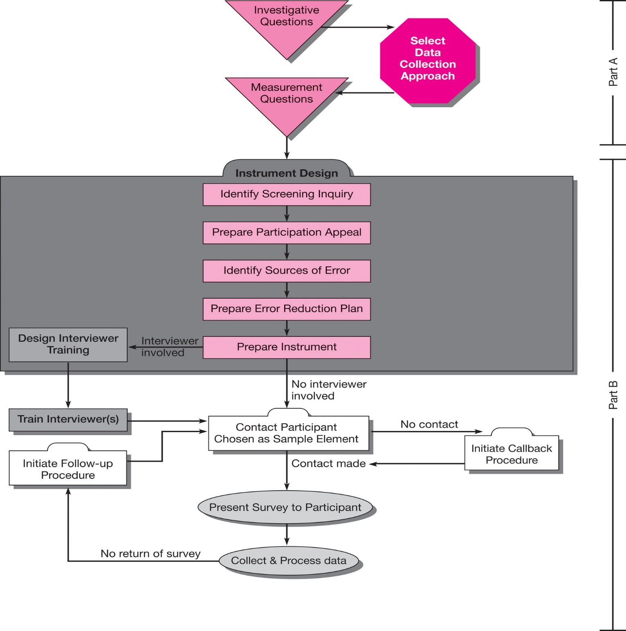
Data Collection Approaches in Surveys
Notes:
Exhibit 9-1 depicts the use of questionnaires and interviewers in the survey research process.

Slide 4
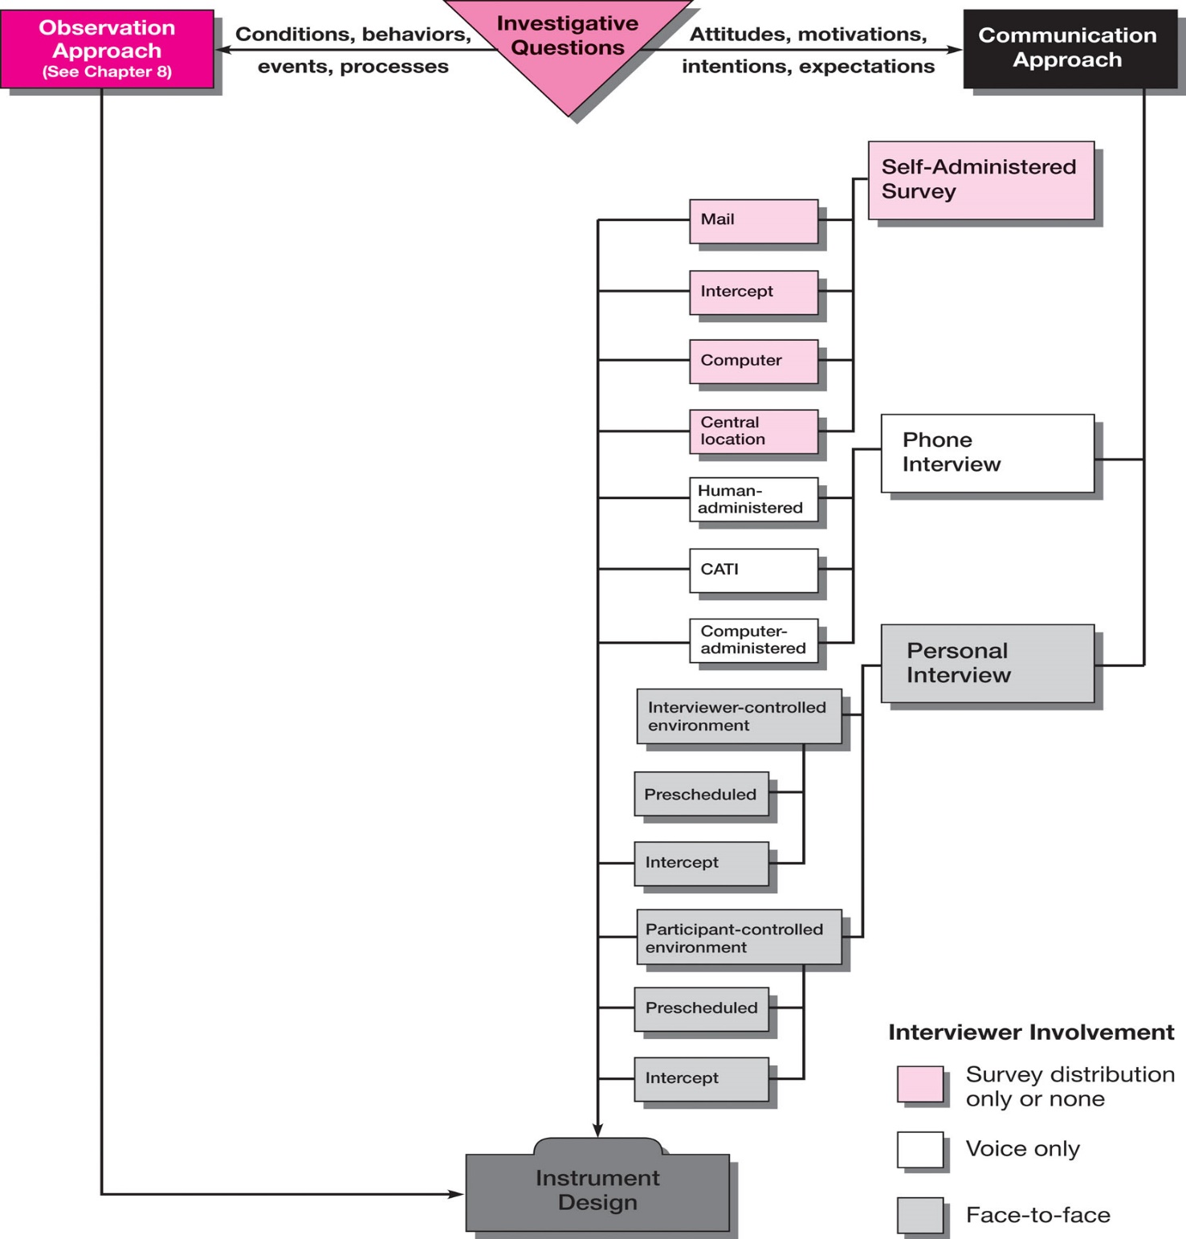
Selecting a Communication
Data Collection Approach
Notes:
Exhibit 9-2 illustrates the possible data collection modes that can be used for the communication approach.

Slide 5
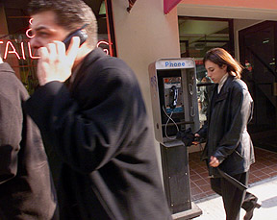
Communication Approach
Strengths
Versatility
Efficiency
Geographic coverage
Weaknesses
Error
Inaccessible populations
Notes:
The communication approach involves surveying or interviewing people and recording their responses for analysis. A survey is a measurement process used to collect information during a highly structured interview - sometimes with a human interviewer and other times without.
The great strength of the survey as a primary data collection approach is its versatility. Abstract information of all types can be gathered. A few well-chosen questions can yield information that otherwise would take more time and effort. A survey that uses the telephone, mail, a computer, e-mail, or the Internet as the medium of communication can expand geographic coverage at a fraction of the cost and time required by observation.
The bad news for communication research is all communication research has some error.

Slide 6
Sources of Error
Error
Sources
Measurement
Questions
Participant
Interviewer
Notes:
Exhibit 9-3: There are three major sources of error in communication research: measurement questions and survey instruments, interviewers, and participants.
Researchers/Interviewers cannot help a business decision maker answer a research question if they
1) select or craft inappropriate questions,
2) ask them in inappropriate order, or
3) use inappropriate transitions and instructions to elicit information.
Interviewer error is error that results from interviewer influence of the participant. It can be caused by several actions such as
failure to secure full participant cooperation,
failure to record answers accurately and completely,
failure to consistently execute interview procedures,
failure to establish appropriate interview environment,
falsification of answers,
inappropriate influencing behavior, and
physical presence bias.
Participants cause error in two ways: whether they respond (willingness) and how they respond.
Three factors influence participant participation:
The participant must believe that the experience will be pleasant and satisfying.
The participant must believe that answering the survey is worthwhile.
The participant must dismiss any mental reservations about participation.

Slide 7
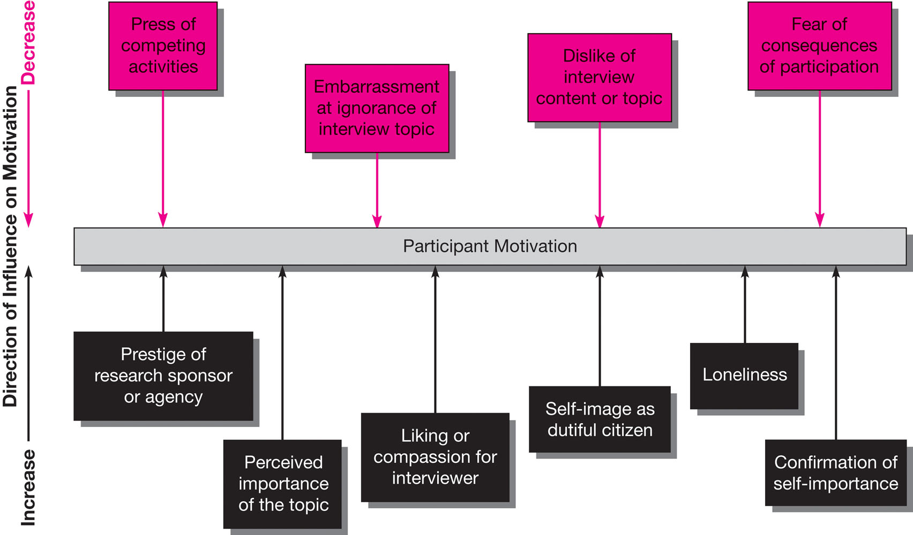
Participant Motivation
Notes:
As depicted in Exhibit 9-4, the quality and quantity of information secured depends heavily on the ability and willingness of participants to cooperate.
By failing to respond or refusing to respond, participants create a nonrepresentative sample for the study overall or for a particular item or question in the study.
Nonresponse error occurs when the participants differ in some systematic way from the responses of nonparticipants.
This occurs when the researcher cannot locate the person to be studied or is unsuccessful in encouraging that person to participate.
Response error occurs when the participant fails to give a correct or complete answer.
Participants may also cause error by responding in such a way as to unconsciously or consciously misrepresent their actual behavior, attitudes, preferences, motivations, or intentions.
This is called response bias.
When they respond in a socially acceptable way, social desirability bias could occur.

Slide 8
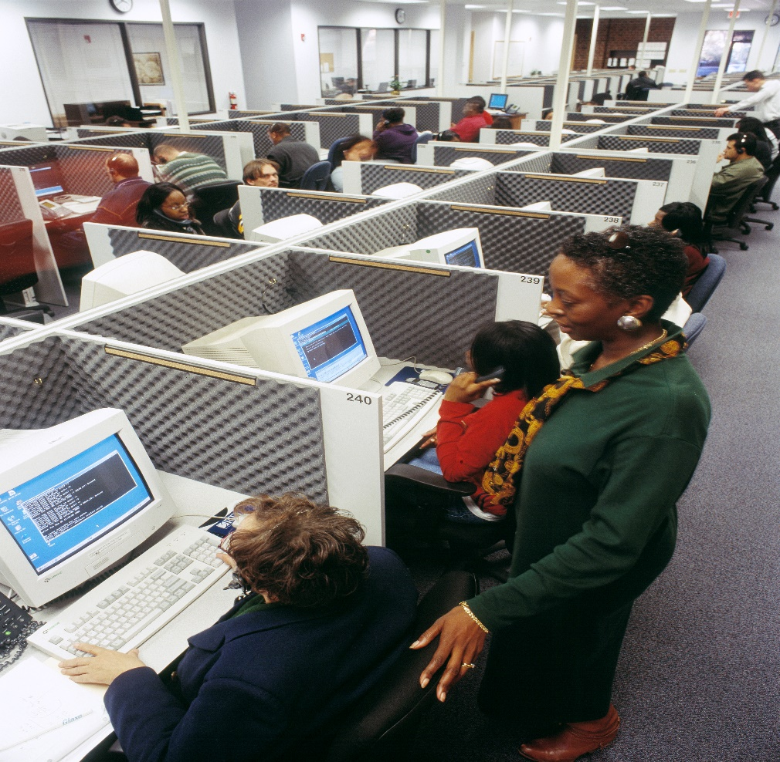
Response Terms
Noncontact rate
Refusal rate
Incidence rate
Notes:
This slide introduces terms relevant to contacts and response rates.
The noncontact rate is a ratio of potential but unreached contacts to all potential contacts. A contact may be unreachable due to no answer, busy signal, answering machine or voice mail, and disconnects).
The refusal rate refers to the ratio of contacted participants who decline the interview to all potential contacts.
The incidence rate refers to the ratio of contacted people who actually qualify for the survey to all contacts.

Slide 9
Communication Approaches
Self-
Administered
Survey
Telephone
Survey
Survey via
Personal
Interview
Notes:
Once the sponsor or researcher has determined that surveying is the appropriate data collection approach, various means may be used to secure information from individuals. These are discussed on the next several slides.

Slide 10
Self-Administered Surveys
Mail
Intercept
Drop-off
Modes
Disk-by-Mail
Fax
CASI
Notes:
This slide illustrates the various methods for distributing self-administered surveys. CASI stands for computer-assisted self interviews and includes e-mail surveys, Web-based surveys, and intranet surveys.

Slide 11
Self-Administered Surveys
Costs
Topic Coverage
Sample Accessibility
Systematic
Anonymity
Time Constraints
Notes:
Systematic studies employ standardized procedures, trained observers, schedules for recording, and other devices for the observer that reflect the scientific procedures of other primary data methods.

Slide 12
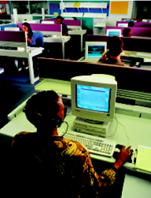
Designing Questionnaires Using the TDM
Easy to read
Offer clear directions
Include personalization
Notify in advance
Encourage response
Notes:
The TDM method refers to Don Dillman’s Total Design Method. He proposes that surveys be based upon social exchange theory. One suggestion that flows from social exchange theory is that the burden to participants should be minimized. Questionnaire design can minimize respondent burden by designing questionnaires that have the characteristics named in the slide.

Slide 13
Options for Web-based Surveys
Fee-Based
Service
Surveying
Software
Notes:
The web-based questionnaire, a survey both delivered and collected via the Internet, has the power of computer-assisted telephone interview systems, but without the expense of network administrators, specialized software, or additional hardware. Most products for web survey creation are browser-driven with design features that allow custom survey creation and modification.
There are two primary opts for creating web surveys. With fee-based services, the researcher is guided through questionnaire design and then the supplier’s staff generates the questionnaire HTML code, hosts the survey at their server, and provides data consolidation and reports. Surveymonkey.com and Perseus are examples of fee-based services.
Researchers can also buy Off-the-shelf software programs that allow easy programming and deployment. These software programs generally require that the researcher have a server to support data collection efforts. Examples include Inquisite, Snap, and some programs available from Perseus.

Slide 14
Advantages of Surveying Software
Questionnaire design in word processing environment
Question and scale libraries
Automated publishing to the Web
Real-time viewing of incoming data
Rapid transmission of results
Flexible analysis and reporting mechanisms
Notes:
This slide lists many of the advantages of using software for building web surveys.

Slide 15
The Web as a Survey Research Venue
Advantages
Cost savings
Short turnaround
Use of visual stimuli
Access to participants
Perception of anonymity
Access to data and experiences otherwise unavailable
Disadvantages
Recruitment
Coverage
Difficulty developing probability samples
Technical skill
System compatibility issues
Possible self-selection bias
Notes:
Exhibit 9-6 The Web is increasingly used as a data collection mode.
The speed and cost savings make the Web very desirable, but there are disadvantages. Recruitment can be challenging because of the lack of lists of those who use the Internet. Further, not everyone has Internet access. Thus, it is still not appropriate for general population studies. This becomes less of an issue as more people gain access. Currently, more than 60% of the US population have access.

Slide 16
Advantages of Self-Administered Study
Access inaccessible participants
Incentives for higher response rates
Lowest-cost
Geographic coverage
Minimal staff needed
Perceived anonymity
Reflection time
Question complexity
Rapid data collection
Visuals possible
Multiple sampling possible
Notes:
Exhibit 9-5 presents a comparison of communication approaches. The advantages and disadvantages for each mode are presented on the next several slides.

Slide 17
Disadvantages of
Self-Administered Study
Low response rates in some modes
No interviewer intervention
Cannot be too long
Cannot be too complex
Requires accurate list
Skewed responses by extremists
Participant anxiety possible
Directions necessary
Need for low-distraction environment
Security
Notes:
Drawn from Exhibit 9-5.

Slide 18
Improving Response Rates
Advance notification
Reminders
Return directions and devices
Monetary incentives
Deadlines
Promise of anonymity
Appeal for participation
Notes:
More than 200 articles have been published on methods for improving response rates to surveys. This slide lists several practical suggestions. Deadlines do not increase response rates overall but do encourage respondents to respond sooner. The promise of anonymity also does not increase response rates but is important to those who do respond. All the other suggestions do result in increases in response rates.

Slide 19
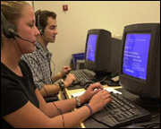
Telephone Survey
Traditional
CATI systems
Computer-
administered
Notes:
Given the high level of telephone service penetration in the United States and the European Union, access to participants through low-cost efficient means has made telephone interviewing an attractive data collection mode for business researchers.
Telephone surveys can be conducted from call centers or from interviewers’ homes. Telephone interviewing can be combined with immediate entry of the responses into a data file by means of terminals, personal computers, or voice data entry. Computer-assisted telephone interviewing (CATI) is used in research organizations throughout the world. A CATI facility consists of acoustically isolated interviewing carrels organized around supervisory stations. The telephone interviewer has a personal computer that is networked to the phone system and central data processing unit. A software program prompts the interviewer with introductory statements, qualifying questions, and precoded questionnaire items. CATI works with a telephone number management system to select numbers, dial the sample, and enter responses.
Another means of securing immediate response data is the computer-administered telephone survey. Unlike CATI, there is no human interviewer. A computer calls the number, conducts the interview, places data into a file for later tabulation, and terminates the contact. The questions are voice-synthesized. Several modes exist including touch-tone data entry, voice recognition, and automatic speech recognition.

Slide 20
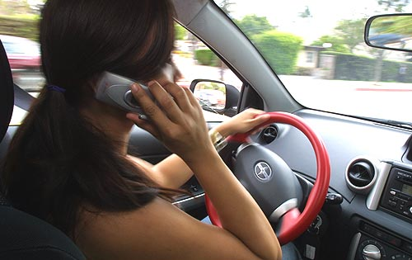
Advantages of the Telephone Survey
Lower costs than personal interview
Wide geographic coverage
Fewer interviewers
Reduced interviewer bias
Fast completion time
Random Dialing
CATI

Slide 21
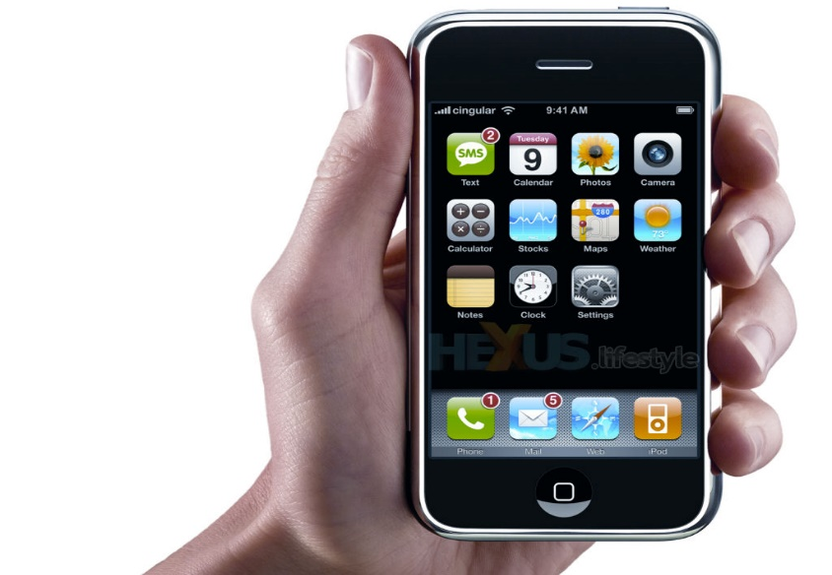
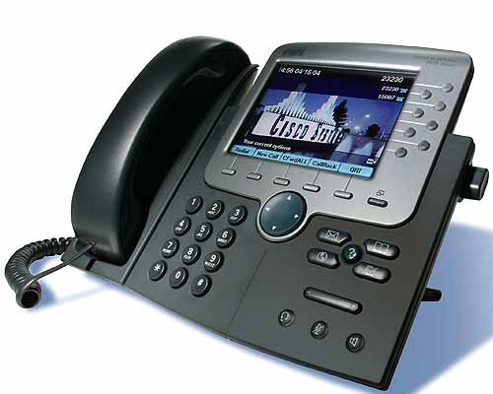
Disadvantages of the Telephone Survey
iPhone
Lower response rate
Early termination
Higher costs if geographically dispersed sample
Limited Interview length
Inaccessible populations
Limited complexity of scales
Voice-over IP
Notes:
While data collection using the telephone has many advantages, there are also disadvantages. This slide lists many of the disadvantages.
Approximately 94% of all US households have access to telephone service.
However, households with incomes below the poverty line remain underrepresented with phone access below 75%.
Also, more households are using filtering devices like caller ID, and Tele-Zapper.
is designed to reduce some of the bias caused by participant availability issues.
Random dialing also limits the problem with inaccurate numbers.
Under ten minutes is generally thought of as the ideal length for telephone interviews, but interviews of 20 minutes is not uncommon.
The telephone limits the complexity of the survey and the use of complex scales or measurement techniques that is possible with personal interviewing.
Participants find it easy to terminate a phone interview. Telemarketing practices may be one reason for this.
The environment in which one answers a phone survey varies given that many people use cellular phones, wireless phones, and office phones. Data quality and refusal rates could be affected these distracting circumstances.

Slide 22
Survey via Personal Interview
CAPI
Intercept
Notes:
Computer-assisted personal interviewing (CAPI) is a personal interview with computer-sequenced questions capable of employing visualization techniques. However, such surveys can be costly.
An exception is the intercept interview which targets participants in centralized locations such as retail malls. Intercept interviews reduce costs associated with the need for several interviewers, training, and travel. The cost effectiveness is offset when representative sampling is crucial to the study’s outcome.

Slide 23
Personal Interview Survey
Advantages
Good cooperation rates
Interviewer can probe and explain
Visual aids possible
Illiterate participants can be reached
Interviewer can prescreen
CAPI possible
Disadvantages
High costs
Need for highly trained interviewers
Time consuming
Labor-intensive
Some unwilling to invite strangers into homes
Interviewer bias possible
Notes:
Derived from Exhibit 9-5.

Slide 24
https://citeseerx.ist.psu.edu/document?repid=rep1&type=pdf&doi=65fea9e761f2e389f6916fe1f0063919f4625ddf

Slide 25
Assignment #6B
You have a choice between this assignment and the assignment for experiment research in class note #7
Read the paper on citizenship behavior: https://citeseerx.ist.psu.edu/document?repid=rep1&type=pdf&doi=65fea9e761f2e389f6916fe1f0063919f4625ddf
Describe its survey research design: how did the authors conduct the survey
What are the weaknesses of the design? What can be done to improve? Discuss from the perspectives of validities
Why do you think the authors did not do these?
Prepare a short ppt document, no more that SIX pages
File name: HW6B_SID_Name.ppt
Upload your ppt file to https://mega.linkin.tw/index.php/s/f2Z5zf2Br9rWgmS

