Slide 1
Experimentation:
Lab Experiments and Field Experiments
7
  Department of Information Management
  CYCU
  CK Farn
mailto: ckfarn@gmail.com
  2023.11 Updated

Slide 2
Empirical Research Design
Lab Experiment
Experiment
Quasi Experiment
Manipulation of x
Field Experiment
Simulated Experiment
Pre- Experiment
Empirical
Research
…
Document analysis
Content analysis
Measuring of x
Ex post Facto
Survey
Case study
Ethnography
Observation
Participant observation
Artifact analysis
…

Slide 3
Trade-offs among validities
Academic research
  Internal > Construct > Statistical Conclusion > External
Practical research, applied research
  Internal > External > Construct (of the Y) > Statistical Conclusion > Construct (of the X)
The researchers should make conscious trade-offs among different types of validities
  For example, should I use students as informants (low cost, high feasibility, high internal validity, low external validity); or use real employees (high cost, low feasibility, low internal validity, high external validity)

Slide 4
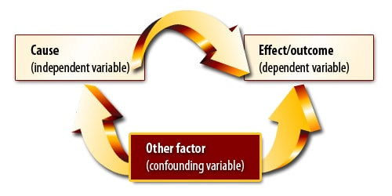
Causal Relationship
Cause leads to effects (outcome)
  Manipulate the cause
With extraneous/confounding factors
  Control the extraneous factors

Slide 5
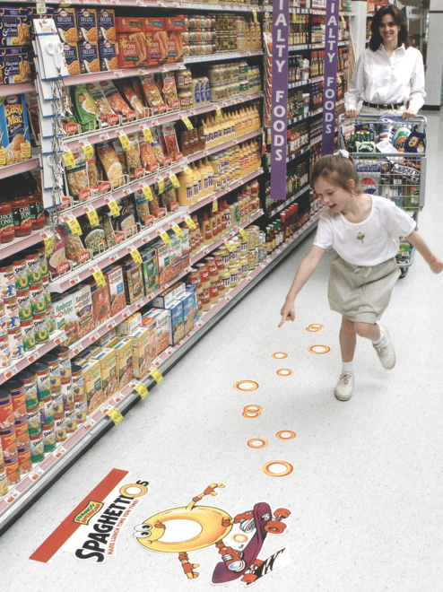
Causal Evidence
Agreement between
Xs and Ys
Time order of occurrence
Extraneous variables
did not influence Ys
Notes:
An experiment is a study involving intervention by the researcher beyond that required for measurement. The usual intervention is to manipulate some variable in a setting and observe how it affects the participants or subjects being studied. There is at least one independent variable (IV) and one dependent variable (DV) in a causal relationship.
There are three types of evidence necessary to support causality. First, there must be an agreement between independent and dependent variables. The presence or absence of one is associated with the presence or absence of the other. Second, beyond the correlation of independent and dependent variables, we consider the time order of the occurrence of the variables. The effect on the dependent variable should not precede the manipulation of the independent variable. The effect and manipulation may occur simultaneously or the manipulation may occur before the effect. The third source of support comes when researchers are confident that other extraneous variables did not influence the dependent variable. To ensure that these other variables are not the source of influence, researchers control their ability to confound the planned comparison.

Slide 6
Experiments can be conducted in…
Laboratories (Lab or true experiments)
  Strong control over many factors
  In science lab, we control temperature, humidity, atmospheric pressure, lightning, ….
  Lab experiments
Real-world settings (Quasi or field experiments)
  Extraneous cannot be well controlled
  Field experiments, Quasi experiments
Computer simulation

Slide 7
Controls in experiments
Experimental group
  Manipulations are administered
  e.g. newly developed vaccine (疫苗) injected
Control group
  A group for making comparisons
  All other conditions are the came: controlled
  e.g. fake vaccine (placebo 安慰劑) injected
Other controls
  Ensure that no other confounding factors contaminating the experiment

Slide 8
Laboratory Experiments
Conducted in a well “controlled” laboratory setting
  The lab setting is different from the “real world”
  Eliminate, as much as possible, extraneous factors and potential threats to validity
  Sacrifices external validity, while maximizing internal validity
Manipulating the independent variable, then measuring the dependent variable
  Strong causal relationship: internal validity.
  Manipulating X, thus ethical considerations need to be taken into account
  Controlling possible extraneous factors
  Measuring the dependent variable and other variables

Slide 9
Advantages of Lab Experiments
Determined “causal” relationship
Eliminating contamination from extraneous variables
Convenience and low costs
Can easily be replicated and repeated
Can makes use of natural phenomena

Slide 10
Disadvantages of Lab Experiments
Artificial lab setting
  In a lab, samples are not making real decisions
Certain samples may introduce bias
  Students instead to business managers
Costs may be higher
  Certain costs in simulating the real settings
More effective for contemporary issues
  Usage of smart phones
Ethical concerns in manipulation
  Treating patients with placebo (安慰劑)

Slide 11
Conducting an Experiment
Specify treatment variables (X)
Specify treatment levels
Control environment
Choose experimental design
Select and assign participants
Pilot-test, revise, and test
Collect data
Analyze data
Notes:
11
These are the seven activities the researcher must accomplish to make an experiment a success.
In the first step, the researcher is challenged to 1) select variables that are the best operational definitions of the original concepts, 2) determine how many variables to test, and 3) select or design appropriate measures for the chosen variables. The selection of measures for testing requires a thorough review of the available literature and instruments.
In an experiment, participants experience a manipulation of the independent variable, called the experimental treatment. The treatment levels are the arbitrary or natural groups the researcher makes within the independent variable. A control group can provide a base level for comparison. A control group is a group of participants that is measured but not exposed the independent variable being studied.
Environmental control means holding the physical environment of the experiment constant. When participants do not know if they are receiving the experimental treatment, they are said to be blind. When neither the participant nor the researcher knows, the experiment is said to be double-blind.
The design is then selected. Several designs are discussed on the next several slides.
The participants selected for the experiment should be representative of the population to which the researcher wishes to generalize the study’s results. Random assignment is required to make the groups as comparable as possible.

Slide 12
Lab and Field Experiments
Lab
Field
Artificial settings - unreal
Natural settings
Few confounding factors
Uncontrolled extraneous factors
Tight controls
Loose control
Low cost
High cost
Duration short
Duration long
Samples are aware
Sample may not aware

Slide 13
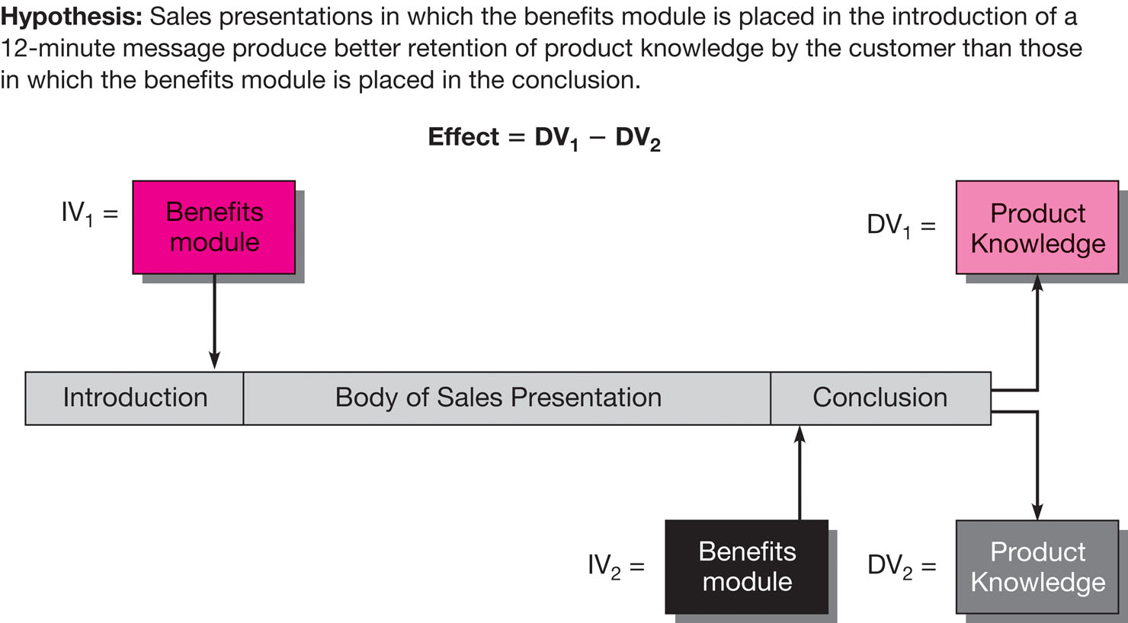
Experiment: Placement of Benefits Module
Notes:
Exhibit 10-2 illustrates an experimental design.

Slide 14
Measurement Options
Observation
Physiological
measures
Paper-and-pencil tests
Options
Scaling techniques
Self-administered instruments
Notes:
Researchers have several measurement and instrument options with experiments.

Slide 15
Validity in Experimentation
Internal
External
Notes:
Internal validity exists when the conclusions drawn about a demonstrated experimental relationship truly implies cause.
External validity exists when an observed causal relationship can be generalized across persons, settings, and times.

Slide 16
Threats to Internal Validity
Maturation
History
Experimental
mortality
Threats
Testing
Statistical
regression
Instrumentation
Selection
Notes:
These seven threats to internal validity can largely be addressed through random assignment.
History: During the time that an experiment is taking place, some events may occur that confuse the relationship being studied.
Maturation: Changes may also occur within the participant that are a function of the passage of time and are not specific to any particular event. A participant may become hungry, bored, or tired and these conditions can affect response results.
Testing: The process of taking a test can affect the scores of a second test.
Instrumentation: This threat to internal validity results from changes between observation in either the measuring instrument or the observer.
Selection: An important threat to internal validity is the selection of participants for experimental and control groups. The groups should be equivalent in every respect.
Statistical regression: This factor operates especially when groups have been selected by their extreme scores.
Experimental mortality: This occurs when the composition of the study groups changes during the test.

Slide 17
Threats to External Validity
Representativeness of samples
  Students as samples
  But, in cases of “on-line learning” it may be OK
Notes:
External validity is concerned with the interaction of the experimental treatment with other factors and the resulting impact on the ability to generalize to (and across) times, settings, or persons. Three major threats to external validity are presented in the slide.
Reactivity of testing on X: The reactive effect refers to sensitizing participants via a pretest so that they respond to the experimental stimulus (X) in a different way.
For instance, people who participate in a web survey like the one from Kohl’s shown in the slide may then be sensitized to store displays and organization.
Interaction of selection and X: The process by which test participants are selected for an experiment may be a threat to external validity. The population from which one selects participants may not be the same as the population to which one wishes to generalize the results.
Other reactive factors:
The experimental settings themselves may have a biasing effect on a participant’s response to X.
An artificial setting can produce results that are not representative of larger populations.
If participants know they are participating in an experiment, there may be a tendency to role-play in a way that distorts the effects of X.
Another reactive effect is the possible interaction between X and participant characteristics.

Slide 18
Additional Threats to Internal Validity
Diffusion of treatment
Compensatory equalization
Compensatory rivalry
Resentful disadvantaged
Local history
Notes:
Five additional threats to internal validity are independent of whether or not one randomizes.
Diffusion or imitation of treatment: If people in the experimental and control groups talk, then those in the control group may learn of the treatment, eliminating the difference between the groups.
Compensatory equalization: Where the experimental treatment is much more desirable, there may be an administrative reluctance to deprive the control group members. Actions to compensate the control group may confound the experiment.
Compensatory rivalry: This may occur when members of the control group know they are in the control group. This may generate competitive pressures, causing the control group members to try harder.
Resentful demoralization of the disadvantaged: When the treatment is desirable and the experiment is conspicuous, control group members may become resentful that they are deprived and lower their cooperation and output.
Local history: The regular history effect already mentioned impacts both experimental and control groups alike. When one assigns all experimental persons to one group session and all control group people to another, there is a chance for some peculiar event to confound results.

Slide 19
Experimental Research Designs
Pre-experiments
True experiments
Field experiments
Notes:
Experimental designs vary widely in their power to control contamination of the relationship between the independent and dependent variables. Experiments can be categorized as pre-experiments, true experiments, and field experiments based on the characteristic of control.
Various designs in each category are presented on the following slides.

Slide 20
Selecting and Assigning Participants
Random
assignment
Matching
Notes:
Random assignment uses a randomized sample frame for assigning participants to experimental and control groups.
Matching is an equalizing process for assigning participants to experimental and control groups. Matching employs a nonprobability quota sampling approach. The object of matching is to have each experimental and control participant matched on every characteristic used in the research.
Quota matrix is a means of visualizing the matching process. If matching does not alleviate assignment problems, a combination of matching, randomization, and increasing the sample size may be useful.
Examples of each are provided on the following slides.

Slide 21
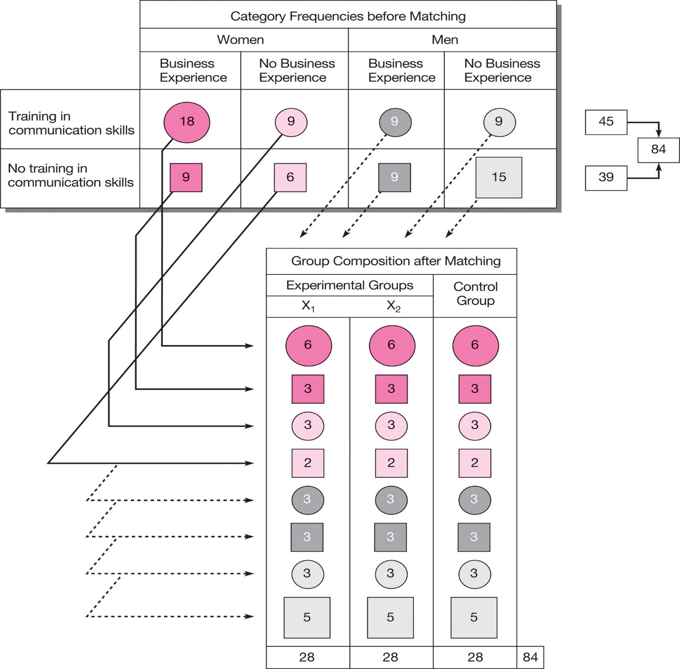
Matched assignment:
Quota Matrix Example
Notes:
Exhibit 10-3 presents an example of a quota matrix. One-third of the participants from each cell of the matrix would be assigned to each of the tree groups.

Slide 22
實驗設計的一些慣用符號
X: manipulation 操弄
O: observation 觀察
R: random assignment 隨機分派
M: matched pair assignment 配對分派

Slide 23

假實驗 Pre-experimentation
(One-Shot) After-Only Case Study
X O
No control group!
Pre-experiment
Notes:
X refers to the treatment or manipulation of the independent variable (more than one X refers to a different level of treatment). O refers to the observation or measurement of the dependent variable.
An example is a media campaign about a product’s features without a prior measurement of consumer knowledge. Results would reveal only how much target consumers know after the media campaign, but there is no way to judge the effectiveness of the campaign. The lack of a pretest and control group makes this design inadequate for establishing causality.
Dryel was test-marketed prior to full commercialization. Its placement in a market followed by observations of sales is another example of this design.

Slide 24
One Group Pretest-Posttest Design
O₁ X O₂
No control group!
Pre-experiment
Notes:
This design meets the threats to internal validity better than the one-shot case study, but it is still a weak design.
For example, a researcher examining the effect of a commercial on brand liking would begin by taking a pre-test to determine current levels of brand liking among the participants. The commercial would be shown. Then a post-test would measure brand liking after the commercial. A comparison between the post-test and the pre-test shows the change in liking.
However, any changes in liking are not necessarily due to the commercial. The act of giving a pre-test could have influenced liking (testing effect).

Slide 25
Static Group Comparison
X O₁
O₂
Pre-experiment
Notes:
This design provides for two groups, one of which receives the experimental stimulus while the other serves as a control.
For example, imagine that a new type of cheeseburger is being introduced, and an ad is run in one-fourth of the 210 designated market areas (DMAs) in the United States. After the ad airs, those who remember seeing it would be in the experimental group (X). Those who have no recall of the ad would be in the control group. The intent of each group to purchase the cheeseburger would be measured.
The main weakness of this design is that there is no way to be certain that the two groups are equivalent or that the individuals are representative.

Slide 26

真實驗 True Experimentation
Posttest-Only Control Group Design
Experimental group
R X O₁
R O₂
Control group
True experiment
Notes:
In this design, the pretest measurements are omitted. Pretests are well established in classical research design but are not really necessary when it is possible to randomize.
The experimental effect is measured by the difference between O1 and O2.
Internal validity threats from history, maturation, selection, and statistical regression are controlled adequately by the random assignment. Different mortality rates could cause a problem.
Buick dealerships wish to determine the effectiveness of a special “test-drive” incentive. Buick dealerships nationwide are randomly assigned to either the control group or the experimental group. Those in the experimental group use a promotion to encourage test drives. The control group does not use any such promotions. The number of test drives throughout are measured and compared to determine if the promotion resulted in significantly more test drives.

Slide 27

Pretest-Posttest Control Group Design
R O₁ X O₂
R O₃ O₄
  Effect= (O₂- O₁) vs (O₄ - O₃)
  Deal well with the major internal validity problems
Maturity threats
True experiment
Notes:
True experimental designs use randomly assigned groups to ensure equivalence.
In this design, groups are randomly assigned and there is a control group for comparison.
The effect of the experimental variable is E = (O₂-O₁) – (O₄-O₃).
This design deals with many of the threats to internal validity, but local history, maturation, and communication among groups can still lead to problems.
External validity is threatened because there is a chance for a reactive effect from testing.
For example, this meat counter may wish to test the effectiveness of adding a display of recipes for use with different cuts of meat. Participants are randomly assigned to either the control group or the experimental group. Those in the control group are not exposed to the display of recipes. Sales are measured for the control group at the start of the study and again the following week. Sales associated with the experimental group are also measured at the start of the study and again after exposure to the recipe display.

Slide 28
Pretest-Posttest Control Group Design 2
Completely Randomized Design
E.g., 3 treatment levels
  R O₁ X₂ O₃
  R O₃ X₃ O₄
  R O₅ X₅ O₆

Slide 29
Pretest-Posttest Control Group Design 3
Matched pair Design
E.g., 3 treatment levels
  M O₁ X₂ O₃
  M O₃ X₃ O₄
  M O₅ X₅ O₆

Slide 30
Pretest-Posttest Control Group Design 4
Randomized Block Design
Blocking Factor
Manioulation Factor
High
Medium
Low
Condition 1
R
X1
X1
X1
Condition 2
R
X2
X2
X2
Condition 3
R
X3
X3
X3

Slide 31
Pretest-Posttest Control Group Design 5
Latin Square Design
Customer Income
Store Size
High
Medium
Low
Large
X3
X1
X2
Medium
X2
X3
X1
Small
X1
X2
X3
This is a design seldom used, difficult to conduct statistical analysis

Slide 32
Pretest-Posttest Control Group Design 6
Factorial Design
Covariance Analysis
Price Spread
Unit price information?
7 Cents
12 Cents
17 Cents
Yes
X1Y1
X1Y2
X1Y3
No
X2Y1
X2Y2
X2Y3

Slide 33
Field Experiments:
Quasi- or Semi-Experiments
Non Equivalent Control Group Design
Separate Sample Pretest-Posttest Design
Group Time Series Design

Slide 34

Nonequivalent Control Group Design
O₁ X O₂
O₃ O₄
No random assignment to groups
Problem with selection
Uncontrollable contamination
Field experiment
Notes:
This is a strong and widely used quasi-experimental design. It differs from the pretest and posttest control group design because the test and control groups are not randomly assigned.
There are two varieties: intact equivalent design and self-selected experimental group design.
In the intact equivalent design, the membership of the experimental and control groups is naturally assembled. The self-selected experimental group design is weaker because volunteers are recruited to form the experimental group, while non-volunteer participants are used for control.
A comparison of the pretest results for each group is one indicator of the degree of equivalence between test and control groups.
For example, children from two different classes in school may be asked to test a toy. Participants are pre-tested on their interest in the toy. The experimental group spends time playing with the toy while the control group is not exposed to the toy. A post-test then measures interest in the toy.

Slide 35

Separate Sample Pretest-Posttest Design
O₁ (X)
X O₂
Field experiment
Notes:
This design is most applicable when we cannot know when and to whom to introduce the treatment but we can decide when and whom to measure.
The parenthesized treatment (X) is irrelevant to the purpose of the study but is shown to suggest that the experimenter cannot control exposure to the treatment. This is not a strong design because several threats to internal validity are not handled adequately. History can confound the results. There is no way to restrict the application of the treatment.
For example, an new advertising campaign for a prescription drug is introduced on television. Awareness of the brand name is measured prior to the campaign introduction. After the campaign ends, awareness is measured again.

Slide 36

Group Time Series Design
O₁ O₂ O₃ X O₄ O₅ O₆
O₇ O₈ O₉ O₁₀ O₁₁ O₁₂
Field experiment
Notes:
A time series design introduces repeated observations before and after treatment and allows participants to act as their own controls. The single treatment group design has before-after measurements as the only controls. There is also a multiple design with two or more comparison groups as well as the repeated measurements in each treatment group.
This format is especially useful where regularly kept records are a natural part of the environment and are unlikely to be reactive. The time series approach is also good way to study unplanned events in an ex post facto manner.
The internal validity problem for this design is history. To reduce this risk, we keep a record of possible extraneous factors and attempt to adjust the result to reflect their influence.,
For example, if the federal government were to begin price controls, we could still study the effects of this action on gasoline prices later if we had regularly collected records for the period before and after the advent of price control.

Slide 37
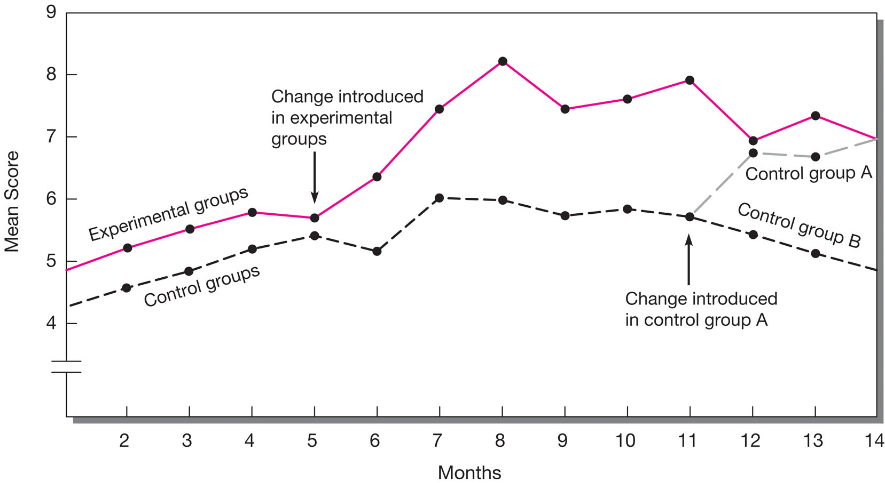
Job Enrichment Quasi-experiment

Slide 38
Main effects and moderating effects
Main effect
The influence of a single independent variable on a dependent variable.
Interaction effect
The influence on a dependent variable by combinations of two or more independent variables.
主效果
調節效果

Slide 39
2 x 2 Factorial Design
Ad A Ad B
Men
Women
65
65
55
75
>
Main Effects
of Gender
85
45
70 60
>
Main Effects of Ad

Slide 40
Interaction: Moderating effects
100
90
80
70
60
50
40
30
20
10
Women
Believability
Men
Ad A Ad B

Slide 41
Strongest design: Lab Experiment
Extraneous factors can be mostly excluded
  In general, high internal validity
  Strong conclusion in causal relationship
Criticism
  Samples are unrelated to the real world
  Weak in external validity
In cases of systems development
  Conduct experiments with simulation

Slide 42
Assignment #6A
You have a choice between this assignment and the assignment for survey research in class note #8
Read the paper: https://onlinelibrary.wiley.com/doi/pdf/10.1002/mar.20120
Classify its experimental design
What are the major design considerations to exclude the threads of validity
Discuss on its internal and external validities
Prepare a short ppt document, no more that SIX pages
File name: HW6A_SID_Name.ppt
Upload your ppt file to https://mega.linkin.tw/index.php/s/f2Z5zf2Br9rWgmS

