Slide 1
Is your research valid?
-- Validity in Social Science Research
  Department of Information Management
  CYCU
  CK Farn
mailto: ckfarn@gmail.com
  2023.09

Slide 2
Explaining the dependent variable Y
Variable
  A characteristics that can take on different values
  The independent variable, x, is the cause
  The dependent variable, y, is the effect
Dependent variable
  The focus in a research
  We want to explain why it changes
  Because of changes in some manipulated or non manipulated independent variable?
  Can we measure it?
Different academic disciplines have different mainstream Y’s
x
y

Slide 3
Validity in Social Science Research
Conceptual Level
Alternate
effects
X
External Validity
Y
Construct
Validity
Construct
Validity
Operationalization
Operationalization
Internal Validity
x
y
Causal relationship
Manipulation,
Observation
Association
Measurement
Statistical Conclusion Validity
error
error
Operational Level
Cook & Campbell (1979) Quasi-Experimentation, Houghton Miffin, Boston

Slide 4
Construct and variable
Variable
  A manifest and measurable characteristics that can take on different values, such as height, age, temperature, or test scores
Construct 構念
  An abstraction that researchers use to represent a phenomenon that’s not directly observable
  Examples: self-esteem, motivation, job satisfaction, personal traints, and physical fitness
A “research construct” differs from a “research variable” in that it is not directly measurable
  Construct: X, Y at conceptual level (body size)
  Variable: x, y at the operational level (height, weight, size of shoe…)

Slide 5
Proposition and Hypothesis
Proposition 命題
  Conceptual level, law/theory
  e.g. hardworking kids performs better
Hypothesis 假說
  Not assumption（很多人誤翻為「假設」）
  Operational level, derived from conceptual level
  e.g. kids spent more time studying performs better in final exams

Slide 6
Statistical Conclusion Validity
統計結論效度
Can we make statistical conclusion?
Q: Are the dependent variable (y) and the independent variables (x) associated? co-varies?
  The research design should be sensitive enough to support the association among the variables
  If it is sensitive enough, are there evidence to support the co-variation among y and x’s
  If there are support, what is the statistical power

Slide 7
A review of basic concepts in statistics
Population 母體
  The whole set of target
  Real “parameters” like Mean (μ)
Sample 樣本
  A selected group of subjects from the population
  Estimated “parameters” like Average (x bar)
Concepts
  There are some characteristics in the population that we want to know, but cannot achieve
  We make use of the characteristics of the samples to estimate the true population parameters
  Are the estimates correct? What is the chance of a correct estimate?

Slide 8
Issues on Statistical Conclusion Validity
Statistical power
  Analytical methods, sample size, sampling methods
Statistical significance
Sample size: an important factor affecting “power”
  In the cases where the population is much higher
  Minimum sample size: n
  n = Z²p(1-p)/e²
  α: level of significance
  Z: the normal Z-score at a specific level of α (when α =.05, Z=1.96)
  e: allowable error
  p: probability of an event (0.5 being the conservative value)

Slide 9
Statistical errors
Type I and type II errors
  A type I error (false-positive 偽陽) occurs if an investigator rejects a null hypothesis that is actually true in the population
  A type II error (false-negative 偽陰) occurs if the investigator fails to reject a null hypothesis that is actually false in the population

Slide 10
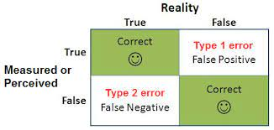
Statistical errors ₂
₃

Slide 11
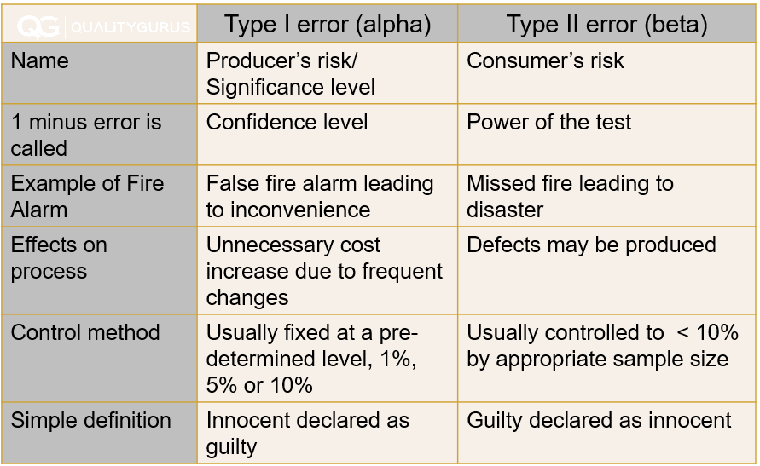
Statistical errors ₃

Slide 12
Concept of Confirmatory Study
驗證型研究
Rule of Refutation in Empirical research
  Statistical inferencing can only be used to refute an aspect of theory
  Cannot be used to confirm a theory
Process
  Establish theory or proposition at the logical level
  Establish research hypothesis at the operational level
  Set up alternative null hypothesis
  Refute the null hypothesis through statistical inferencing, accept the research hypothesis

Slide 13
Threats to Statistical Conclusion Validity
Lack of statistical power
  Sample size, confidence level
Violate basic assumptions of statistics
  Population distribution, homogeneity （同質性）, independence among the x’s
Fishing with the research dataset

Slide 14
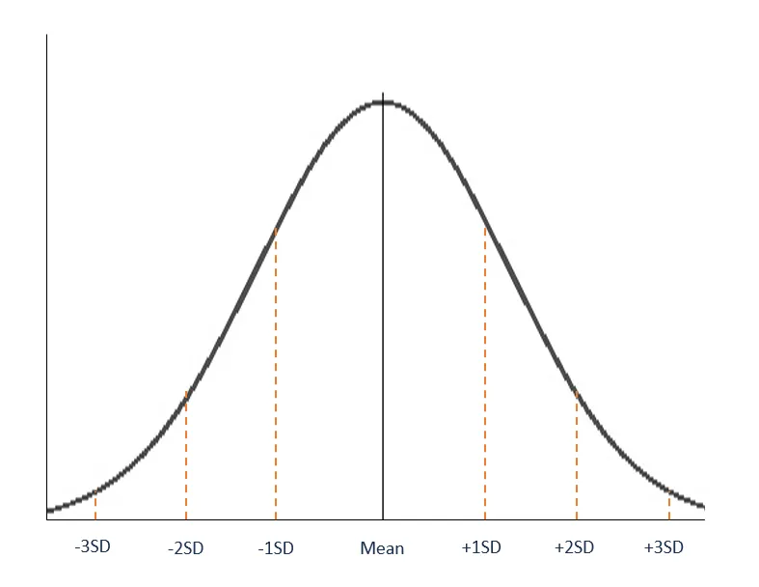
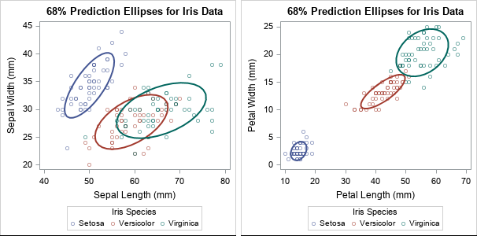
Assumptions of statistics
Homogeneity
Normal distribution

Slide 15
Threats to Statistical Conclusion Validity ₂
Reliability of measurements
Reliability of manipulation
Random biases in research settings
  Internal and external uncontrollable factors
  Extraneous factors related to internal validity
Systematic biases from informants

Slide 16
Internal Validity 內部效度
Q: If A and B co-varies, what are the possible causal relationships?
A
A->B
A??B
Alternate
Causal explanation
B
B->A
A->C->B
C
A
+
A
+
A
-
B
B
Extraneous
influences
+
B
-
-
C
-
C
+
C
+
Eliminate possible alternative causal relationships

Slide 17
Threats to Internal Validity
Historical events
  The effects of events between pretest and post test
Maturity
  The subjects may “mature” during the research
Changes in measurement tools
  Inconsistent operationalization
Regression effects
  The subject that gets a lowest score will improve

Slide 18
Threats to Internal Validity 2
Selection, self –selection
  In the case of grouping, selection will introduce bias
Mortality, attrition of subjects
  Especially in longitudinal research
Interactions among the previous factors
Confusing causal explanation

Slide 19
Construct Validity 構念效度
Operationalization:
  Mapping from the conceptual level to the operational level
  manipulation and measurement
Ensure that the operationalization of constructs is sound
  The independent variable does reflect the related constructs
  The independent variable does not change with the related but different variable
  The dependent variable should reflect the related constructs
  The dependent variable should not be affected by the irrelevant variable
  Different measures for the same constructs should converge
  The measurement results for related but different constructs should diverge

Slide 20
Threats to Construct Validity
Confusions before operationalization
  Definition, operational definition, real-world meaning
Mono-operations bias
  Multi-level operations
  For example, the concept of HOT and COLD
    What are the meanings of 0, 4 and 36.5 Celcius?
Mono-method bias
  Can we measure the weight of an individual to determine whether one is a BIG GUY?
  Need to use multiple measures
Speculations on the research proposition by informants

Slide 21
Threats to Construct Validity2
Informant apprehension to the measurement process
Specific expectation by the informants on the results
Confusions on the constructs, and its levels
Interactions among the operations, manipulations and measurements

Slide 22
Measurement Model 測量模型
Some constructs are manipulated, some are measured
Different types of construct validity
  Face validity 表面效度
    Each and every measure
  Content Validity 內容效度
    The entire set of measures
  Criterion Validity 效標效度
    Relationships with the real-world
    empirical validity, concurrent validity, predictive validity
  Convergent/divergent Validity 收歛／發散效度
    Relationships among items
  …
Construct
Manifest variables,
Measurement items

Slide 23
Reliability 信度
The stability and robustness of a measurement tool
Internal consistency among the measurement items
Internal consistency among the raters
  Rating gymnastic competitions in Olympic games

Slide 24
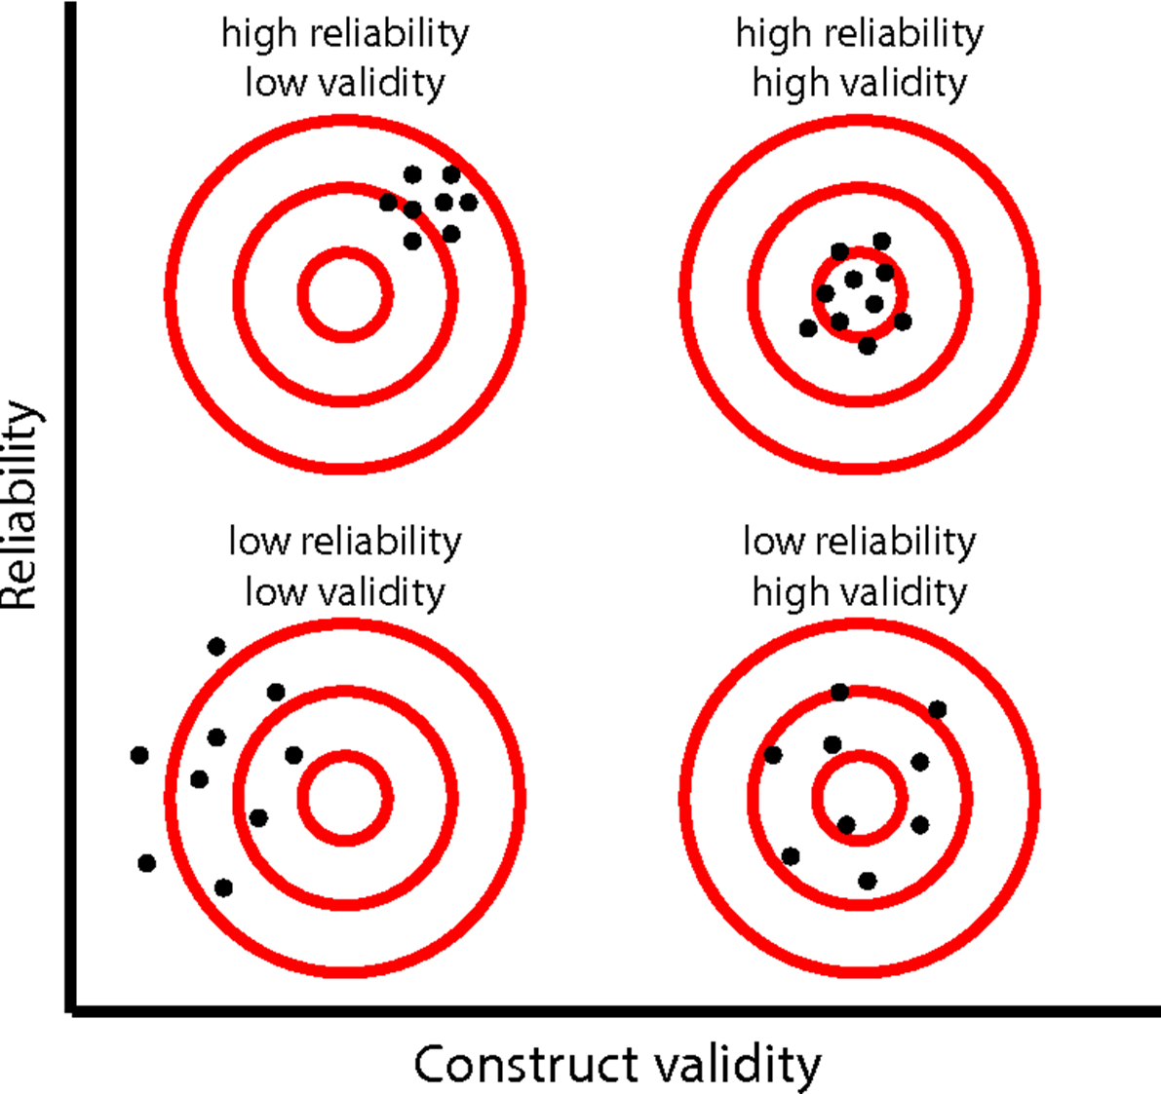
Construct validity and reliability

Slide 25
External Validity 外部效度
Q: Can the research results be applied to the entire population?
Which “population?”
  Target population
  The set of sample as formally defined
  The population mapped to the achieved samples
Generalizability
  Can the research results be extended to cover other population?

Slide 26
External Validity
Planned sample
Target population
Achieved sample
Formally defined
Achieved population

Slide 27
Threats to External Validity
The effects of research setting
  Research within an organization
    Can you actually conduct a fully random sampling?
  Research in a classroom
    Students are different from decision makers
Interactions between manipulation and selection
  Self selection may exclude certain samples
  Testing of new drugs, the volunteers may have higher will to live
Interactions between research settings and manipulation
Interactions between historical events and manipulation
  Especially in longitudinal studies
  Mortality, attrition, …

Slide 28
Improve external validity through better sampling
Comprehensive (Full scale) random sampling
  Good representativeness, high statistical power
  Expensive
  Not possible if conduction lab experiments
Stratified random sampling
  Achieving heterogeneity
  Include every sub-class
Selection of typical cases
  Week in power

Slide 29
Improve external validity through repetitive research
Different types of repetition
  Concurrent repetition, continuous repetition
  Same researcher, different researchers
  Real repletion, assumed repetition (large scale research)
Good repetitions in research
  Multiple small scale research
  Multiple settings
  Multiple researchers

Slide 30
Trade-offs among validities
Academic research
  Internal > Construct > Statistical Conclusion > External
Practical research, applied research
  Internal > External > Construct (of the Y) > Statistical Conclusion > Construct (of the X)
The researchers should make conscious trade-offs among different types of validities
  For example, should I use students as informants (low cost, high feasibility, high internal validity, low external validity); or use real employees (high cost, low feasibility, low internal validity, high external validity)

