Slide 1
The Field of MIS Research
1
Department of Information Management
CYCU
CK Farn
mailto: ckfarn@gmail.com
http://www.mgt.ncu.edu.tw/~ckfarn
2023.09

Slide 2
Instructor
Prof. CK Farn
Retired Distinguished Professor from National Central University
B.S.E., Mech. Engineering, National Taiwan University
M.Sc., Management Sciences, UMIST, Manchester, UK
Ph.D., Management (MIS), UCLA, USA
Email: ckfarn@gmail.com
Google “ckfarn”

Slide 3
Preparations
Web pages
http://www.mgt.ncu.edu.tw/~ckfarn/2023Fall.html
Class time
Thu. 18:00-21:50
Break once
Discussions on make up class (Dec 7)
Roll call
Self introduction
English name
Nameplate
Assignments
All assignments and papers are individual

Slide 4
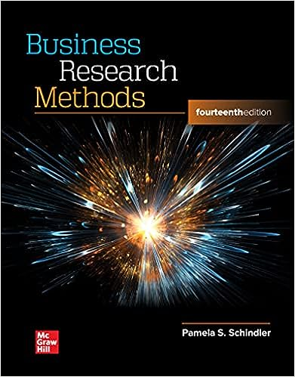
Teaching materials
No Text book
In case you want to grasp something
Schindler, P. (2022) Business Research Methods, 14th Edition, McGraw Hill.
A text book that is adopted by many universities in the U.S.
Used to be authored by Cooper, D. before 12th ed.
Powerpoint slides by instructor
On my web page, feel free to download

Slide 5
The Discipline: Management Information Systems
“The Study of the effective design, delivery and usage of information systems in organizations.” Keen (1980)
Cumulative tradition
Stacking of knowledge over the years
Keen, P.G.W., “MIS research: reference disciplines and a cumulative tradition,” ICIS 1980 Proceedings, https://aisel.aisnet.org/icis1980/9/

Slide 6
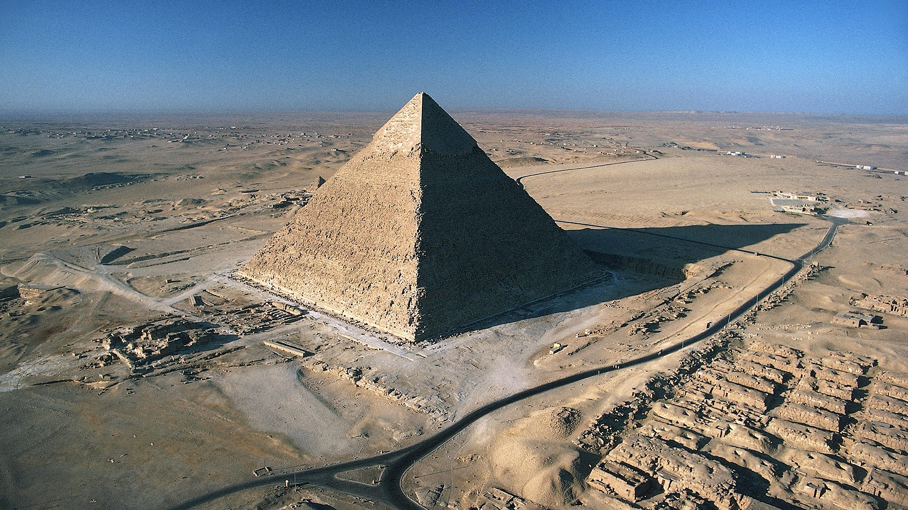
Pyramid

Slide 7
Foundation of MIS: Reference Disciplines
Management Information Systems
Mathematics
Cognitive
Theory
Mathematics
Programming
Computer
Science
Decision
Sciences
Operations
Research
…
…
Algorithms
Data Analysis
Organization
Functional Management
General Management
…
Sociology
Psychology

Slide 8
A Hybrid Discipline Founded on Practical Applications
Rooted in solving “Real World” problems
What is the Relevance of your work
Multiple paradigm, borrowed from different reference disciplines
Balance between theoretical elegance and real-world relevance

Slide 9
Objectives of Scientific Research
Describing and Exploring phenomena
What happened?
Discover Laws
Explaining phenomena
Why did it happened?
Build Theories
Predicting phenomena
What will happen?
Based on Laws
Manipulating phenomena
How to change it?
Apply Laws and Theories
When looking into these, we often have to understand who did what to whom, where and when

Slide 10
Law and Theory
Law
A set of observations on the association among the phenomena, does no imply causality
Newton’s Law of motion
Theory
A set of explanations (why) on causal relationships
Copernicus’ heliocentric theory 哥白尼提出的地動說
Proposition, Scientific Hypothesis
An intermediate step towards proving a theory
Not “null hypothesis,” which is a statistical concept

Slide 11
Elegance and Relevance
Calculus
Theoretically elegant
Leave it to the mathematicians
Building an accounting information system
Real-world relevant
Leave it to the software professionals
Balance
How to strike a balance?

Slide 12
Research Paradigm
MIS Research
Social Science
Research
Engineering Research
Pioneering
Empirical
Research
Theoretical
Research
Incremental
Improvement
Qualitative
Research
Variance
(Quantitative)
Research

Slide 13
Decide on a research issue
A direction, a problem, and issue is more important than a “topic”
What is a researchable issue?
In Social Sciences, we try to provide an answer to some interesting phenomena
What is the reasons certain “variables” changes
What are the factors affecting the changes
The ultimate goal is to manipulate, or to control the phenomena

Slide 14
What is a Researchable Issue?
What are the issues in our field?
“The study of the effective design, delivery and usage of information systems in organizations.”
--The MIS field as defined by Keen(1980)
What is your dependent variable?
Three Questions to Answer:
Why is it important (practically)?
Why is it interesting (academically)?
How do you contribute?

Slide 15
Tools for conduction research
Google
Google scholar
You can download most full paper on campus
Generative AI
ChatGPT (if you are a paid customer, it will provide VIP service)
Bard
Chat PDF
…

Slide 16
Assignment #1: use of tools
Pick a topic you like, which is specific and focused enough
Pick a paper that you are interested in, and evaluate the paper with the help of the AI tools
Prepare an essay with reasonable length (not exceed 5 pages)
The essay should include the following, providing as much information as possible, to fully demonstrate your hard work
The process you went through in the preparation, what and how are the tools used, etc.
A comprehensive evaluation of the selected paper
Share your experience during the process. If you can, suggest an efficient way to accomplish the task
File name: HW1_SID_Name.pdf
Upload your pdf file to https://mega.linkin.tw/index.php/s/SxoKaqrZLRG9A7C

