Slide 1
WEKA Tutorial- Classification
Dr. Chin-Hui Lai
Department of Information Management, CYCU
Email: chlai@cycu.edu.tw

Slide 2
Classification: Decision Trees
Weka supports all major classification and regression methods
Decision Trees, Rule learners, Nearest Neighbor, Naïve Bayes, Neural Networks, etc.
We will go over a DT example is some detail
Build a decision tree to classify Iris data set
Examine the results
Visualize the decision tree
Visualize the errors
Let’s start fresh without the discretization
Undo last step or close window and reload “Iris”

Slide 3
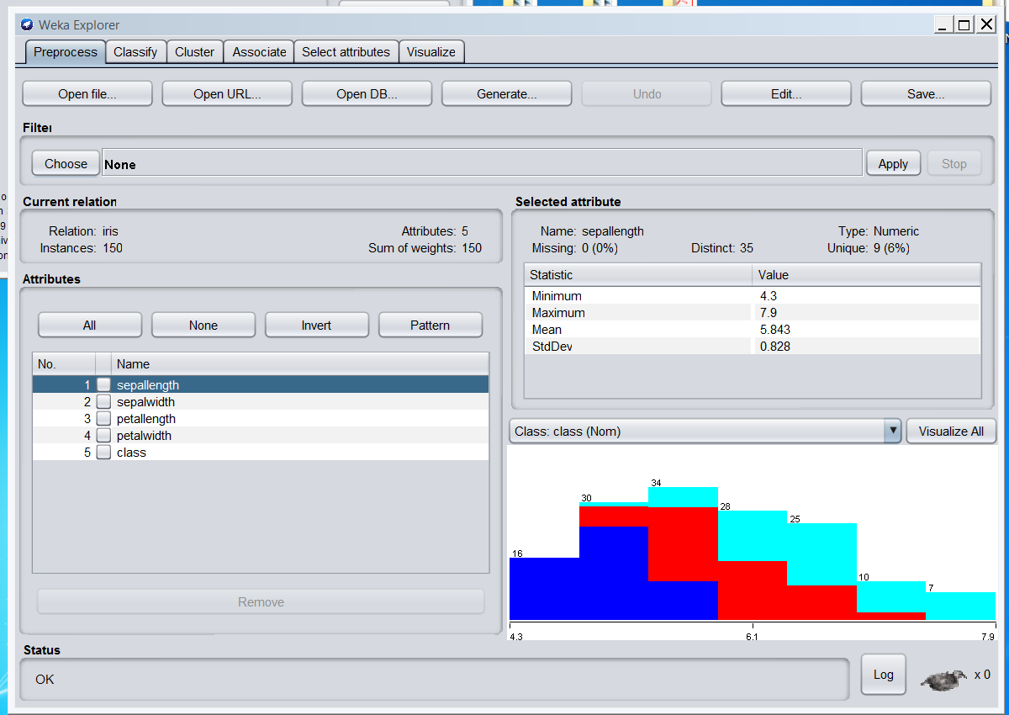

Slide 4
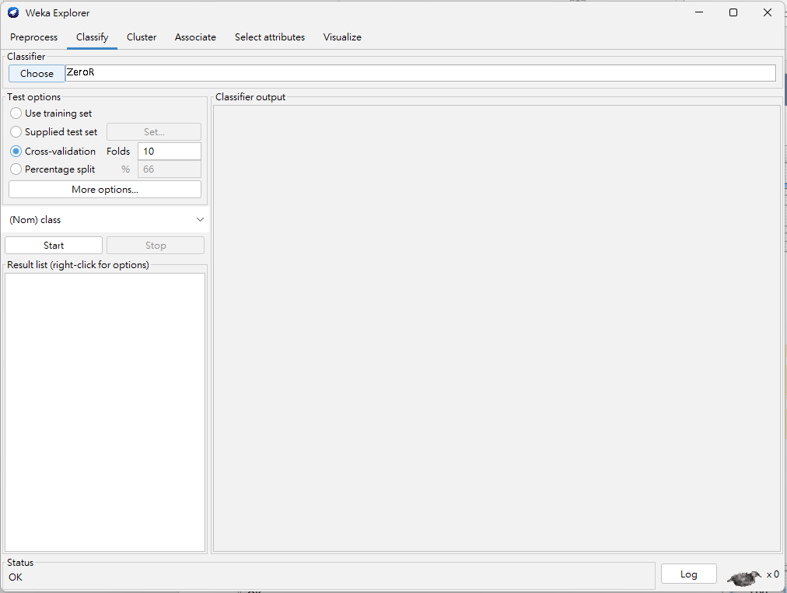

Slide 5
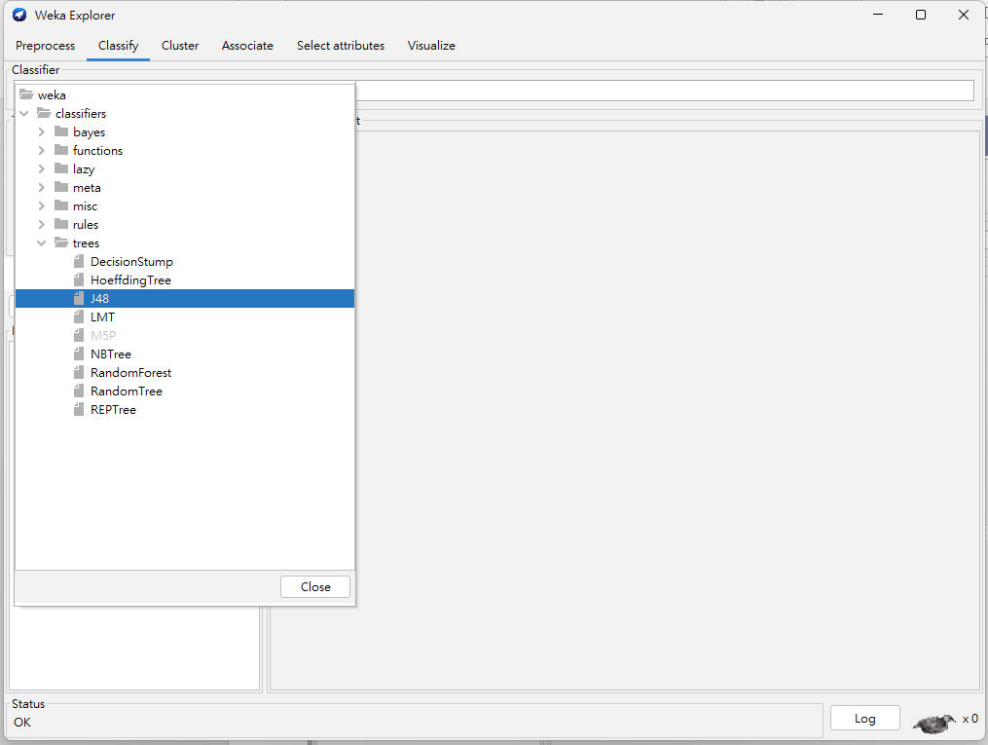
Lots of choices, organized under several categories. We will use J48 that can be found under “Trees”.
Note that the version of Weka we are using has a somewhat different organization

Slide 6
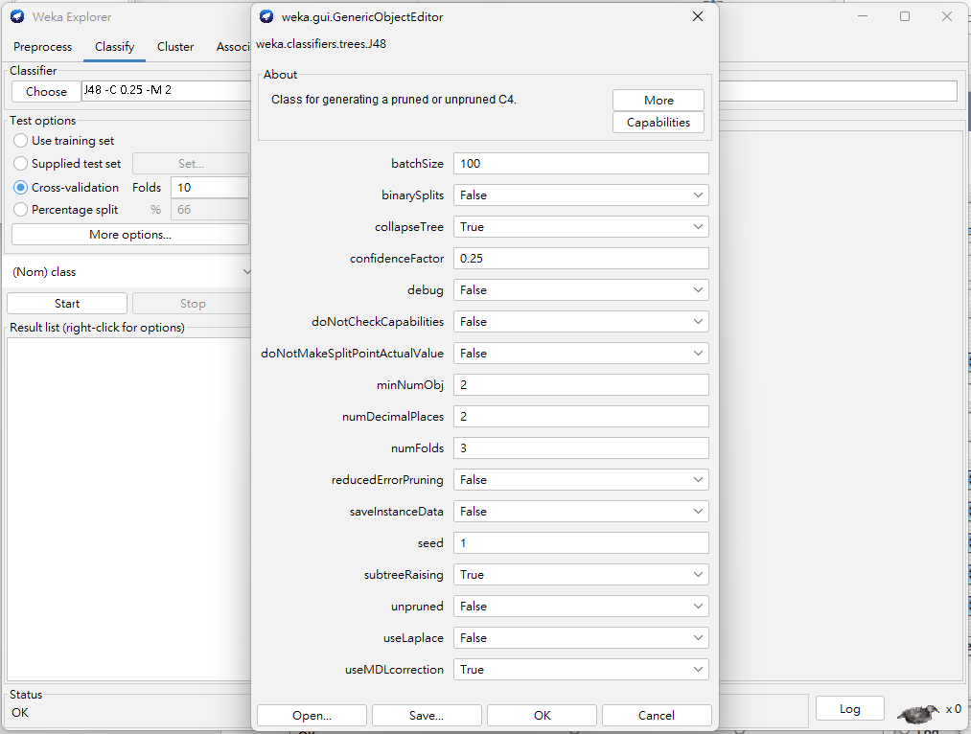
Accept defaults. Just click OK.

Slide 7
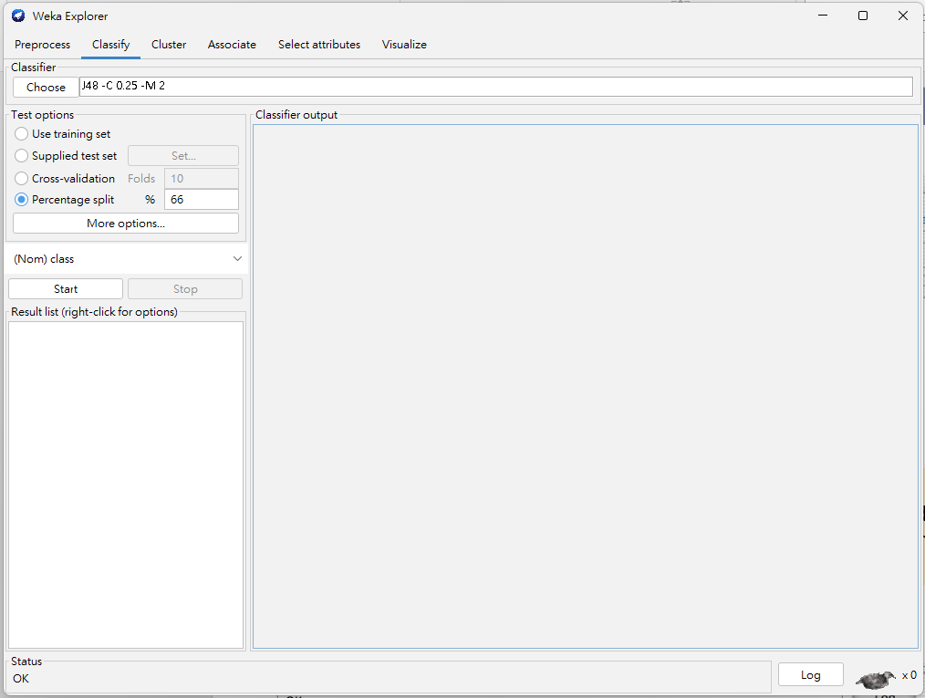
Build and evaluate model using a percentage split instead of 10-fold cross validation. The 66% is for the training set so 34% is for testing.

Slide 8
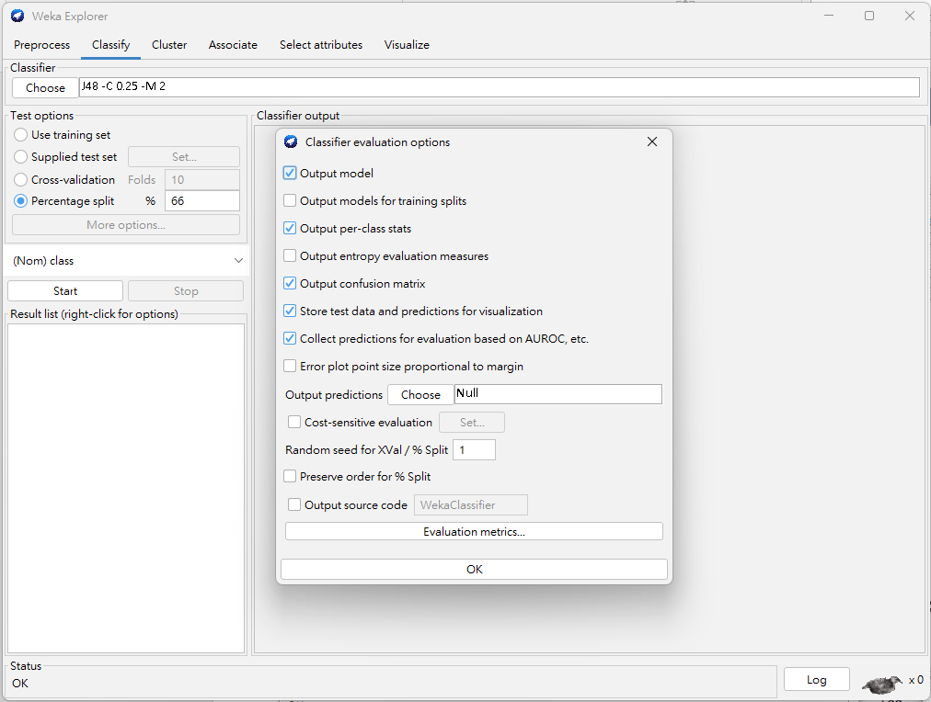
Click on “More Options” to open this window
Just click OK

Slide 9
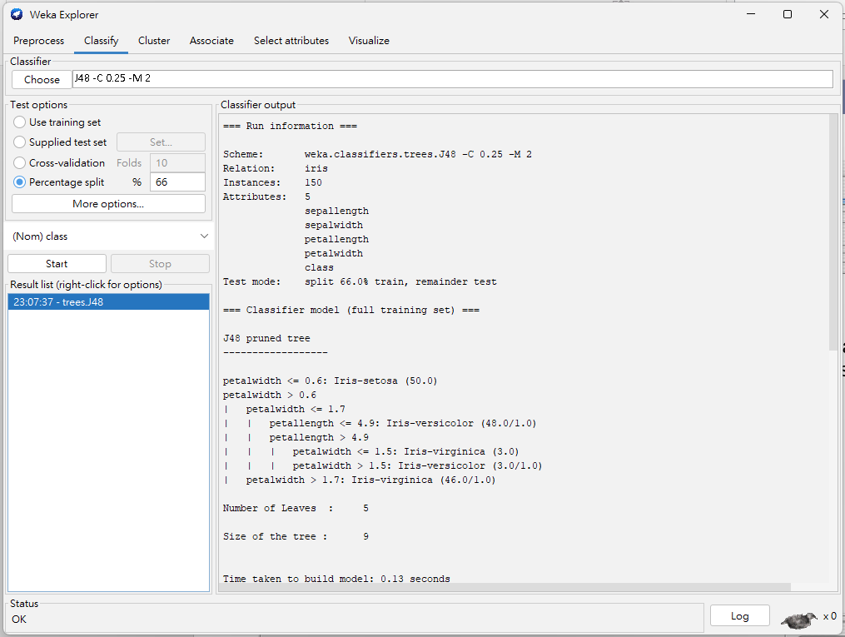
Note: Do not worry if your results are slightly different
Records command line with options
Textual tree representation
Click Start

Slide 10
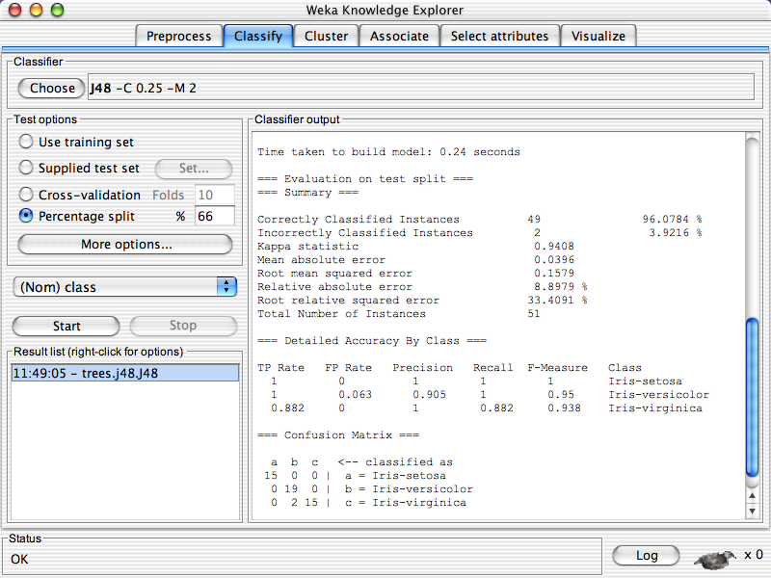
Scroll down to see more output

Slide 11
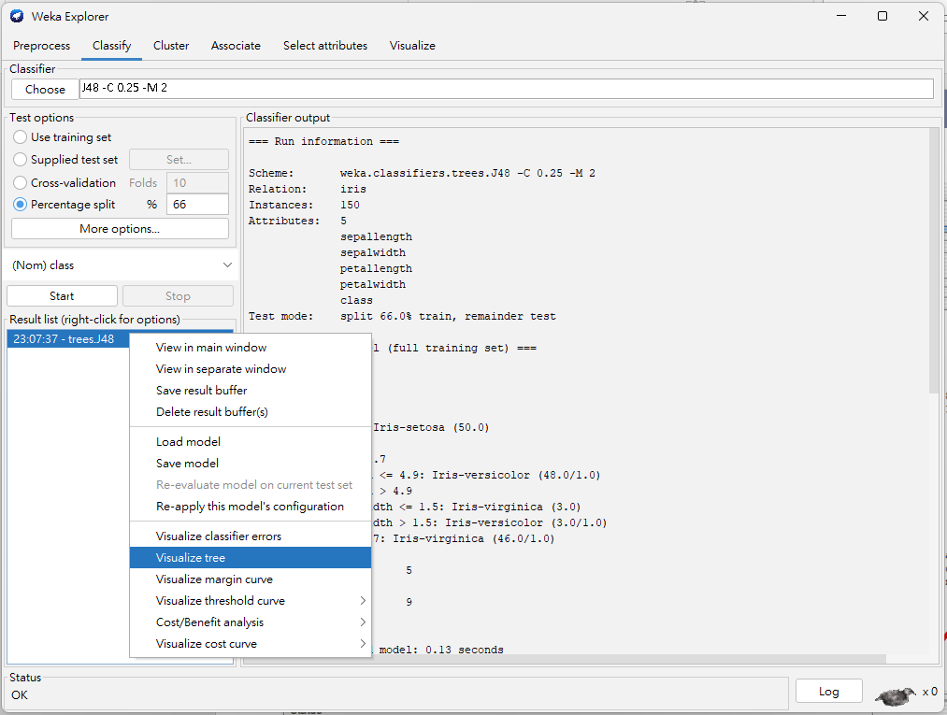
Right click on model
Window pops up then select visualize tree

Slide 12
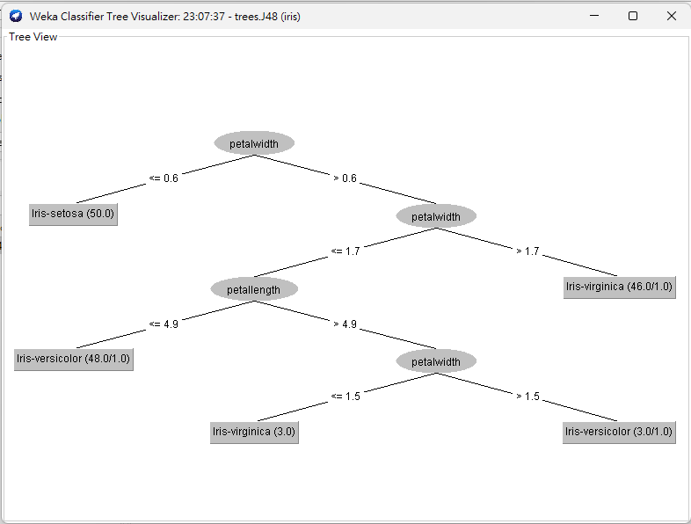

Slide 13
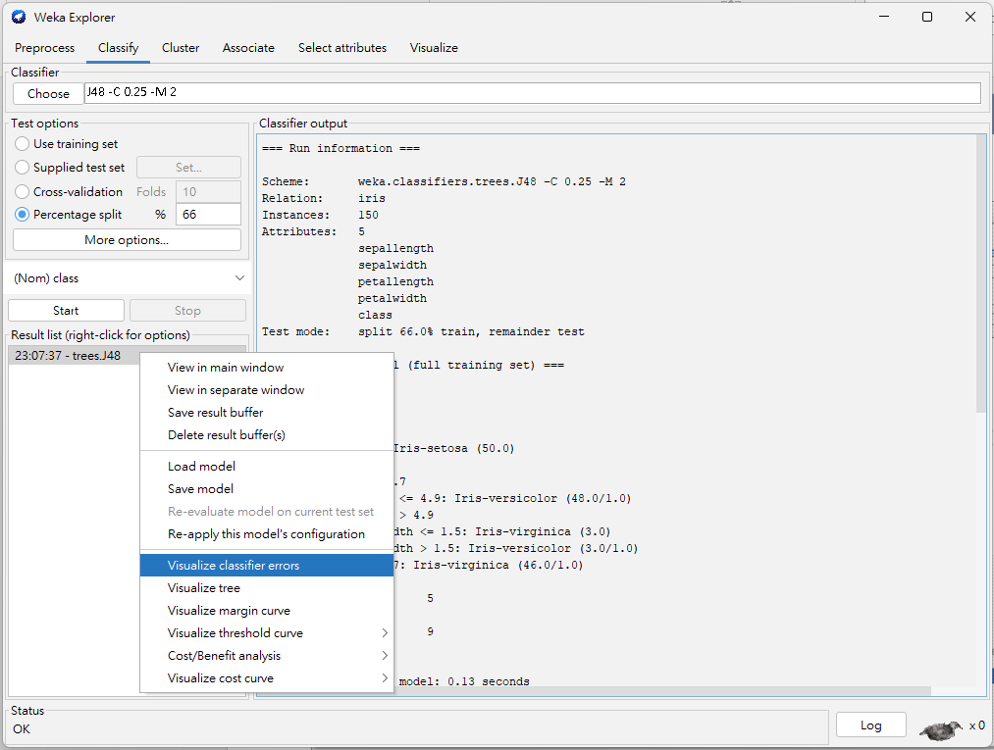
Right click then select visualize classifier errors

Slide 14
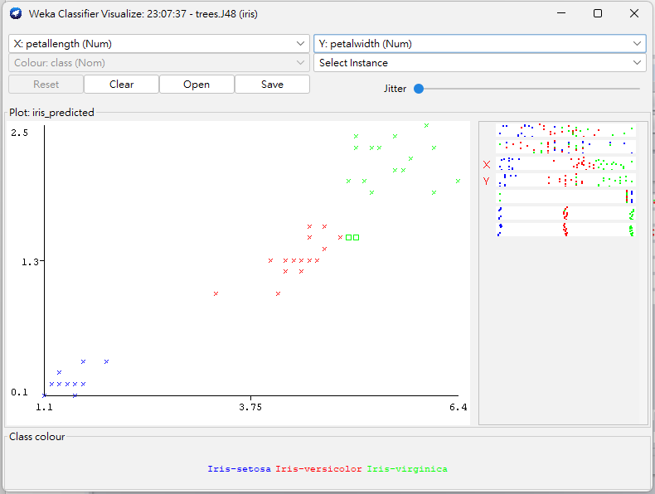
Set X to petallength and Y to petalwidth
If points to close modify jitter
Here are the two errors
Virginica classified as Versicolor Not surprisingly near the decision boundary

Slide 15
Review: Decision Trees
Covered an example in detail
You should be able to build a decision tree classifier and understand the results
You should be able to find the necessary documentation to understand and set the various parameters

