Slide 1
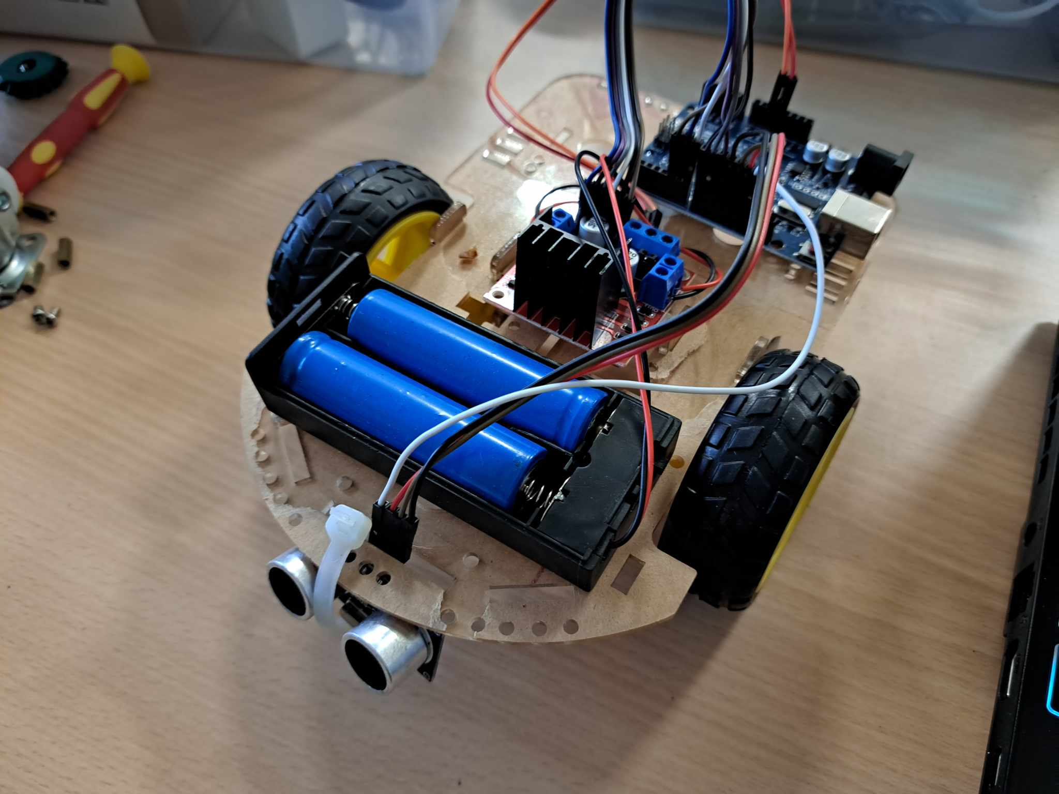
超聲波避障自走車
第8次社課

Slide 2
材料清點
Arduino*1
超聲波感測器*1
車體*1
18650電池*2
18650電池盒*1
L298N*1
直流馬達*2
輪子*2
支架*4
萬象輪*1
銅柱*4
螺絲*8+4
螺帽*4
束線帶*1
杜邦公母線*14
杜邦公公線*2

Slide 3
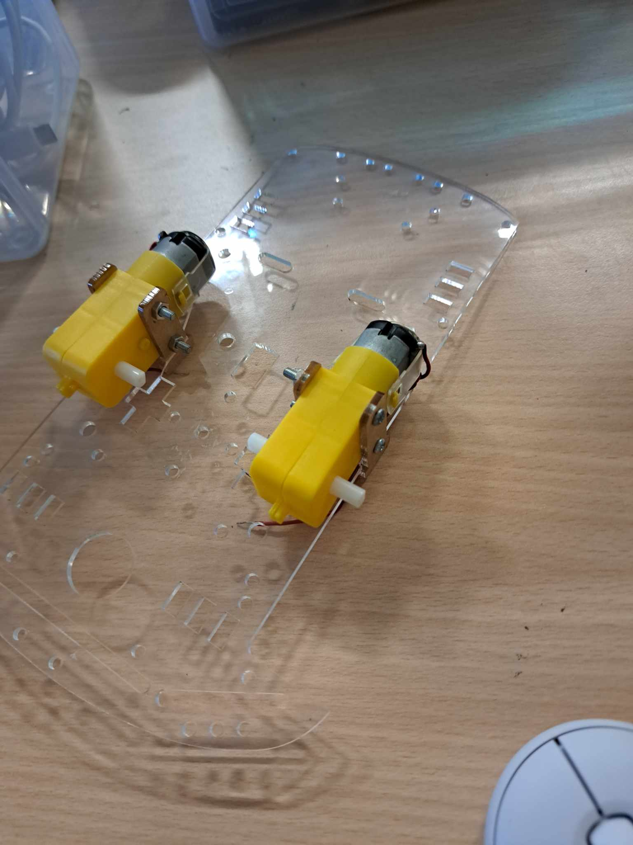
車體組裝

Slide 4
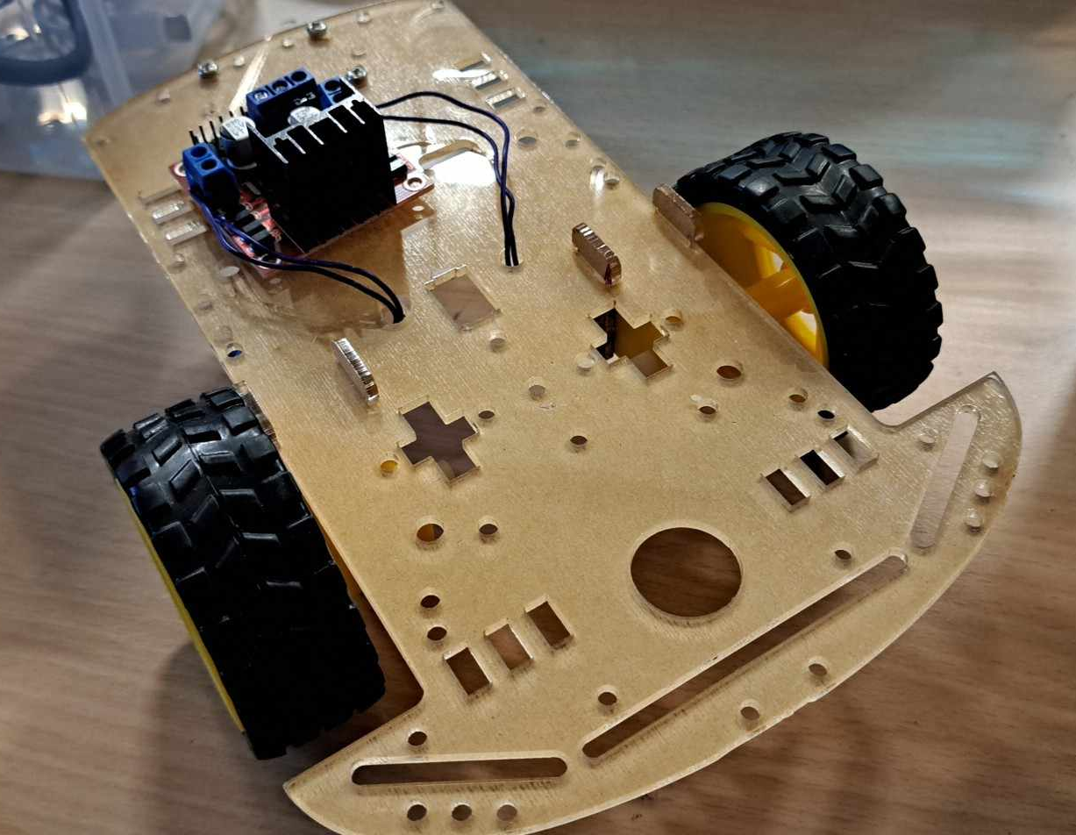

Slide 6
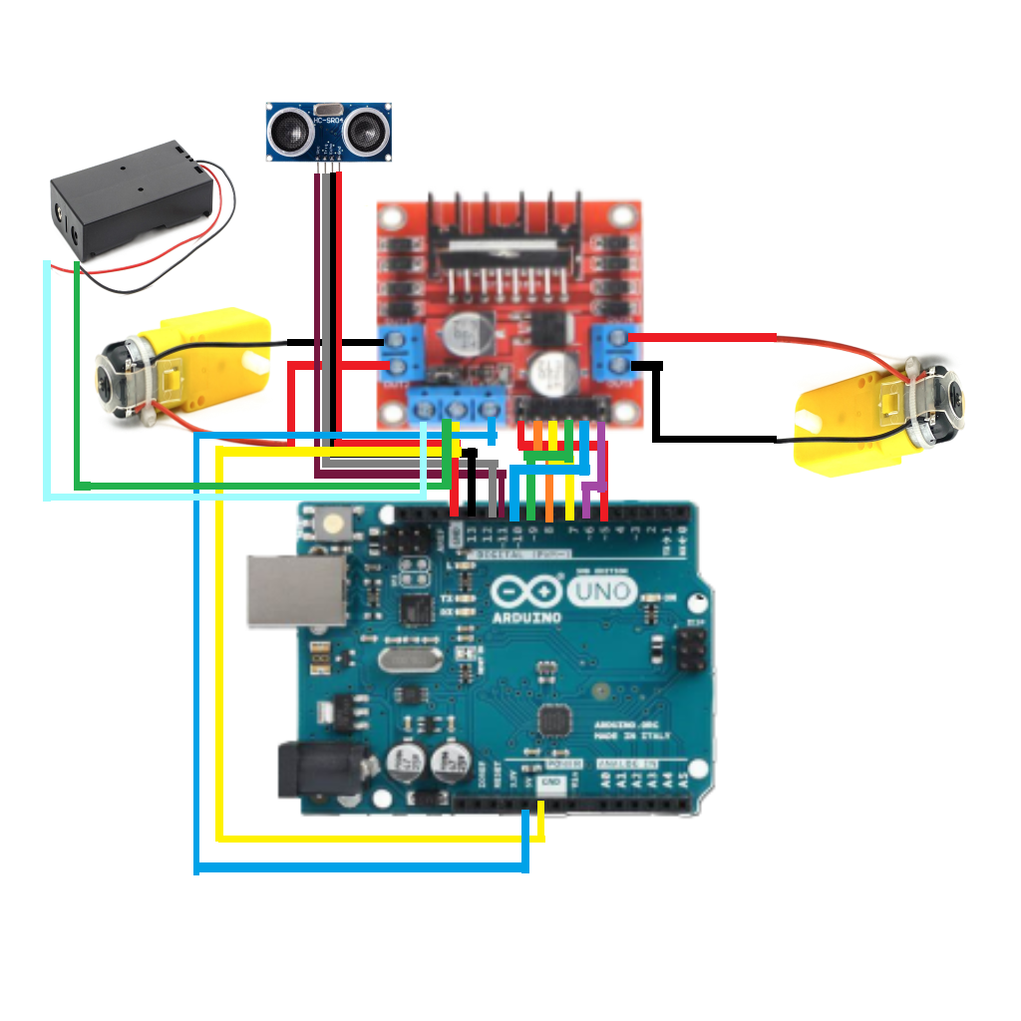
接線圖

Slide 7
//避障車
const int Vcc = 11;
const int trigPin = 12;
const int echoPin = 13;
// 馬達控制設定
#define ENA 5 // 左馬達速度控制 (PWM)
#define IN1 6 // 左馬達控制
#define IN2 7 // 左馬達控制
#define ENB 10 // 右馬達速度控制 (PWM)
#define IN3 8 // 右馬達控制
#define IN4 9 // 右馬達控制
void setup() {
// 初始化馬達控制腳位
pinMode(ENA, OUTPUT);
pinMode(IN1, OUTPUT);
pinMode(IN2, OUTPUT);
pinMode(ENB, OUTPUT);
pinMode(IN3, OUTPUT);
pinMode(IN4, OUTPUT);
pinMode(Vcc, OUTPUT);
pinMode(trigPin, OUTPUT);
pinMode(echoPin, INPUT);
Serial.begin(9600); // Initialize serial communication
}

Slide 8
// 根據距離控制馬達運動
if (distance > 20) {
// 前進
digitalWrite(IN1, HIGH);
digitalWrite(IN2, LOW);
analogWrite(ENA, 200); // Adjust the PWM value as needed
digitalWrite(IN3, HIGH);
digitalWrite(IN4, LOW);
analogWrite(ENB, 200); // Adjust the PWM value as needed
} else {
// 停止
digitalWrite(IN1, LOW);
digitalWrite(IN2, LOW);
analogWrite(ENA, 0);
digitalWrite(IN3, LOW);
digitalWrite(IN4, LOW);
analogWrite(ENB, 0);
delay(400);
// 後退0.5秒
digitalWrite(IN1, LOW);
digitalWrite(IN2, HIGH);
analogWrite(ENA, 200); // Adjust the PWM value as needed
digitalWrite(IN3, LOW);
digitalWrite(IN4, HIGH);
analogWrite(ENB, 200);
delay(500);
void loop() {
digitalWrite(Vcc, HIGH);
// 測量距離
long duration, distance;
digitalWrite(trigPin, LOW);
delayMicroseconds(2);
digitalWrite(trigPin, HIGH);
delayMicroseconds(10);
digitalWrite(trigPin, LOW);
duration = pulseIn(echoPin, HIGH);
distance = (duration / 2) / 29.1;
delay(25);
// 顯示距離
Serial.print("Distance: ");
Serial.print(distance);
Serial.println(" cm");

Slide 9
// Randomly choose left or right
if (random(2) == 0) {
// 向左轉隨機時長
digitalWrite(IN1, LOW);
digitalWrite(IN2, HIGH);
analogWrite(ENA, 200); // Adjust the PWM value as needed
digitalWrite(IN3, HIGH);
digitalWrite(IN4, LOW);
analogWrite(ENB, 200); // Adjust the PWM value as needed
delay(random(200, 501)); // Random duration between 200 and 500 milliseconds
} else {
// 向右轉隨機時長
digitalWrite(IN1, HIGH);
digitalWrite(IN2, LOW);
analogWrite(ENA, 200); // Adjust the PWM value as needed
digitalWrite(IN3, LOW);
digitalWrite(IN4, HIGH);
analogWrite(ENB, 200); // Adjust the PWM value as needed
delay(random(200, 501)); // Random duration between 200 and 500 milliseconds
}
}
}

